Slide 1
AT A GLANCE
LPU Placement
Intelligence
96.08%
hold-out accuracy
8
Student readiness prediction, skill-gap diagnosis and a prescriptive improvement roadmap
algorithms benchmarked
4,048
TEAM — 3 MEMBERS
Team Member 1
Data & ML modelling
student records · 7 datasets
Name · Roll No.
Team Member 2
Backend & deployment
11/11
Name · Roll No.
Team Member 3
Frontend & explainability
required components covered
Name · Roll No.
School of Computer Science & Engineering · Lovely Professional University
Notes:
Open with the one-line pitch: students find out too late that they are not placement-ready. We built a deployed machine-learning system that scores readiness, explains why, and prescribes what to fix. Mention the three-member split once, then move on.

Slide 2
AGENDA
The 11 mandatory components, mapped to this deck
01
Problem Definition
slide 03
07
Ensemble Learning & Optimization
slide 11
02
Dataset & Data Acquisition
slide 04
08
Explainable AI (XAI)
slide 12
03
Exploratory Data Analysis
slide 05
09
ML Pipeline & Reproducibility
slide 13
04
Preprocessing & Feature Engineering
slide 06
10
Deployment
slides 14–15
05
Model Development & Baselines
slide 07
11
GitHub Repository & Docs
slide 16
06
Model Evaluation & Accuracy
slides 08–10
Plus: live demo, tech stack, team split, limitations and future scope.
Notes:
State that every component the brief asks for is present, and point out that evaluation gets three slides because accuracy is the part most likely to be questioned.

Slide 3
COMPONENT 1 OF 11
1 / 11
Problem Definition
Real-world problem
Target users & stakeholders
ML objective
Placement preparation is reactive. Students discover their gaps only after a rejection, and advice is generic rather than profile-specific.
Students preparing for campus drives, training & placement cells, faculty mentors, and recruiters screening readiness.
Binary classification of placement readiness from nine measurable competency signals, with an explainable probability used as a ranking score.
Input variables (9)
Expected output
Success criteria
CGPA · coding · technical · aptitude · communication · projects · internships · certifications · active backlogs.
Readiness score 0–100 with a category (Ready / Nearly Ready / Needs Focus), skill-gap matrix and priority-ranked action plan.
≥ 90% accuracy and F1 on held-out data, beats both baselines, every prediction explained, and the whole flow usable in a browser.
Scope discipline: the model predicts readiness from self-reported competency inputs — it does not promise a job offer, and the interface says so.
Notes:
Anchor on the decision the system supports: where should a student spend the next 30 days? Emphasise that the output is advisory and the app carries that disclaimer visibly.

Slide 4
COMPONENT 2 OF 11
2 / 11
Dataset & Data Acquisition
# | Dataset file | Rows | Source | Role in the project
1 | students.csv | 253 | Curated / synthetic — LPU schema | Primary training set
2 | college_placement_engineering.csv | 2,966 | Kaggle — Engineering Placements | External benchmark
3 | campus_recruitment_kaggle.csv | 215 | Kaggle — Campus Recruitment | Secondary analysis
4 | job_placement_features.csv | 215 | Kaggle — Job Placement | Secondary analysis
5 | engineering_skills_placement.csv | 99 | Kaggle — Engineering Skills | Secondary analysis
6 | placement_package_salary.csv | 200 | CampusX — salary benchmark | Regression study
7 | placement_iq_academic.csv | 100 | CampusX — IQ + CGPA | Classification study
 | Total | 4,048 | 7 files · PII-free | Documented in dataset/README.md
PRIMARY DATASET
students.csv
253 rows · 9 features · 1 binary target (placement_ready) · 0 missing values
CLASS BALANCE
Not ready 130 · Ready 123
51% / 49% — near-balanced
WHY THIS SET
Every feature is actionable: a student can raise coding score or clear backlogs. Demographics are deliberately excluded.
▪ Acquisition: public Kaggle / CampusX files for benchmarking; the primary schema mirrors LPU competency dimensions.
▪ Audit: dataset/data_audit.py produces reports/data-audit/ — 3 blocking findings were found and documented, not hidden.
Notes:
Be explicit that only students.csv trains the live model, and that the six external files are benchmarks. The audit found duplicates and missing salary values; we recorded them and restricted use rather than merging everything.

Slide 5
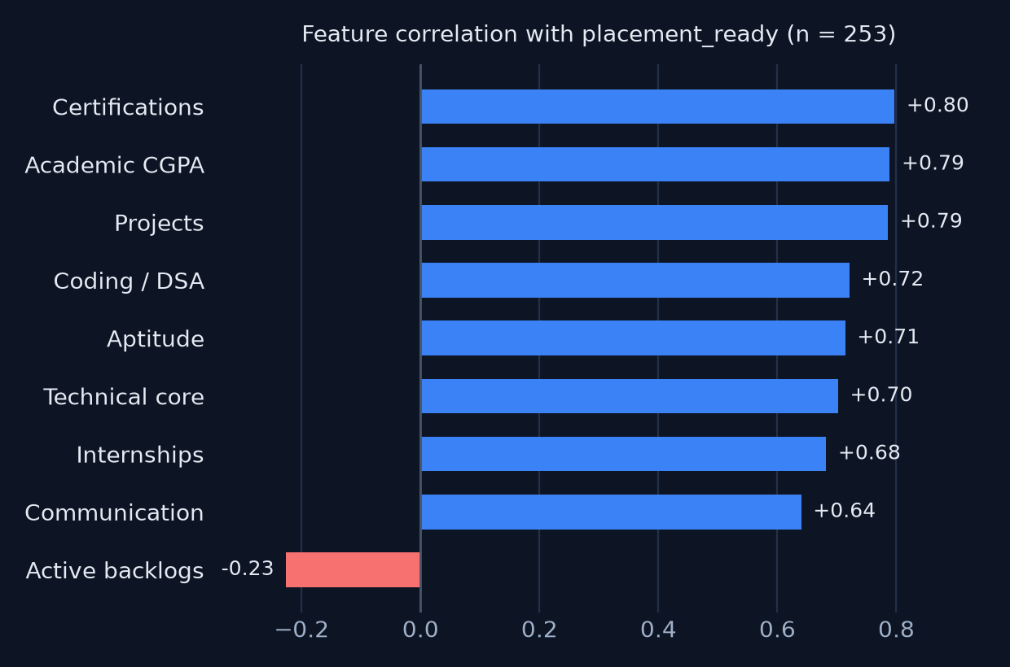
COMPONENT 3 OF 11
3 / 11
Exploratory Data Analysis
253
rows
0
missing values
2
exact duplicates
9
features
▪ Distributions: CGPA 5.1–9.0 (mean 7.32), scores 32–97, so the data spans weak and strong profiles.
▪ Class balance: 130 vs 123 — mild imbalance, handled with stratified splitting and balanced accuracy.
▪ Correlation: certifications, CGPA and projects lead; backlogs is the only negative signal.
▪ Outliers: no impossible values; extreme profiles kept because they are real edge cases.
▪ Data-quality flags: 2 duplicate rows in the primary set, 1,829 in the Kaggle engineering file, 67 missing salaries.
Notes:
Say the audit is the reason the EDA slide starts with data quality. The duplicate in the primary set is removed before evaluation; the external dataset is not merged, so its duplicates cannot leak into training.

Slide 6
COMPONENT 4 OF 11
4 / 11
Preprocessing & Feature Engineering
01
Schema & boundary validation
02
Deduplicate & clean
Type, range and required-field checks (CGPA 0–10, scores 0–100, non-negative counts) at the API edge, so bad input never reaches the model.
Explicit exact-duplicate removal — 253 → 251 rows — plus missing-value checks. Duplicates are dropped by decision, not silently.
03
Stratified split & folds
04
Feature engineering
80/20 stratified hold-out and 3 × 5 repeated stratified CV, seed 42, preserving the class ratio in every fold.
Research pipeline adds coding_technical_mean and experience_count. The live model keeps the original nine features for explainability.
05
Scaling & encoding
06
Imbalance & calibration
Not required: tree ensembles are scale-invariant, and all nine inputs are numeric. This is a deliberate choice, not an omission.
Stratified folds + balanced accuracy for selection; sigmoid calibration turns raw scores into usable probabilities.
Notes:
If asked why no scaler: gradient boosting splits on thresholds, so monotone scaling cannot change the split. Say the engineered features exist in the research XGBoost experiment and are not silently mixed into the live model.

Slide 7
COMPONENT 5 OF 11
5 / 11
Model Development & Baselines
BASELINES FIRST
Logistic Regression
K-Nearest Neighbors
Majority class
51.4% accuracy
Rule-based thresholds
76.9% accuracy
linear reference model
instance-based similarity
Support Vector Machine
Naive Bayes
RBF kernel, margin-based
probabilistic baseline
Any model that cannot beat 77% is not learning anything useful.
Decision Tree
Random Forest
depth-limited, interpretable
bagged trees, 250 estimators
Then eight algorithms were trained under identical data, split and seed, so the comparison is fair.
AdaBoost
Gradient Boosting
boosted stumps, 100 estimators
sequential residual fitting
10 models × 5 metrics = 50 scores
Justification: tabular data, 251 rows, mixed monotone thresholds → tree ensembles are the correct family. Deep learning would overfit and cost explainability.
Notes:
Spend a moment on the baselines: 51% majority and 77% rule-based. That frames the 96% number honestly. The eight models cover linear, instance, margin, probabilistic and ensemble families.

Slide 8
COMPONENT 6 OF 11
6 / 11
Model Evaluation — Repeated Cross-Validation
Model | Accuracy | Balanced acc. | Precision | Recall | F1 | ROC-AUC
Majority baseline | 51.4% ± 0.8 | 50.0% | 0.0% | 0.0% | 0.0% | 0.500
Rule-based baseline | 76.9% ± 5.4 | 76.3% | 100.0% | 52.6% | 68.3% | 0.763
SVM (RBF) | 88.0% ± 3.4 | 88.0% | 89.6% | 85.8% | 87.4% | 0.955
K-Nearest Neighbors | 90.0% ± 3.6 | 90.0% | 91.4% | 88.0% | 89.5% | 0.960
Naive Bayes | 92.8% ± 2.8 | 93.0% | 87.8% | 99.2% | 93.1% | 0.991
Random Forest | 93.9% ± 2.3 | 93.9% | 92.3% | 95.6% | 93.8% | 0.991
Logistic Regression | 94.0% ± 2.6 | 94.0% | 94.8% | 92.9% | 93.8% | 0.988
Gradient Boosting — deployed | 94.7% ± 3.0 | 94.7% | 94.6% | 94.5% | 94.5% | 0.985
Decision Tree | 95.0% ± 3.2 | 94.9% | 95.2% | 94.5% | 94.7% | 0.949
AdaBoost — CV winner | 95.9% ± 2.2 | 95.9% | 95.8% | 95.9% | 95.8% | 0.995
251 rows · 3 × 5 repeated stratified CV · mean ± std · seed 42 · duplicates removed
Winner is chosen on balanced accuracy and F1 — not accuracy alone. The two best models are ensembles and sit within 1.2 points of each other.
Notes:
Walk down the model column, not every cell. The story is: baselines, then a steady climb, then a plateau around 94–96%. AdaBoost edges the CV table; Gradient Boosting is within one standard deviation, so both are defensible.

Slide 9
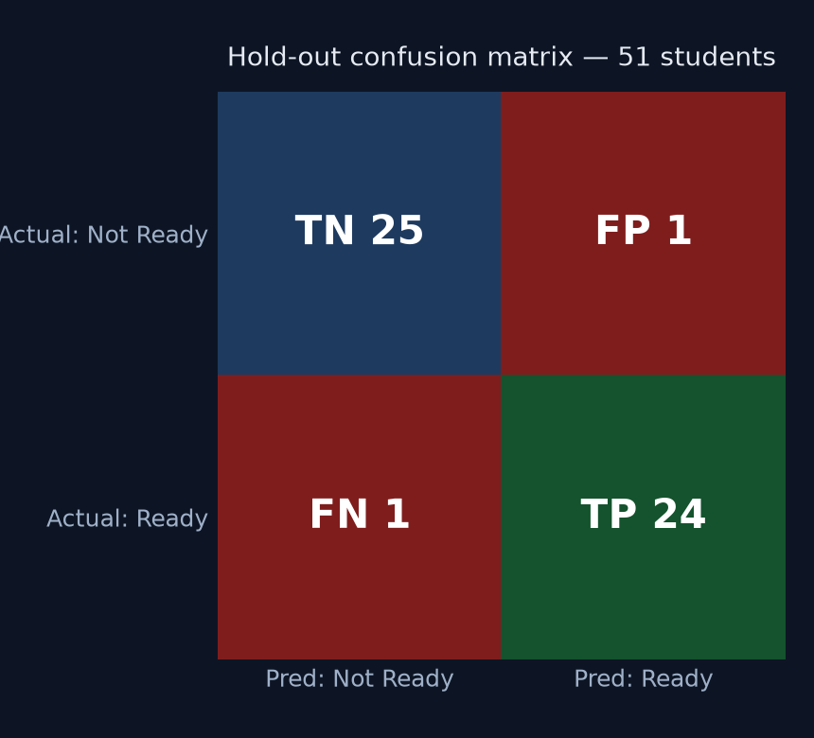
COMPONENT 6 OF 11
6 / 11
Accuracy Deep-Dive — Deployed Model
96.08%
96.00%
0.9754
2
Accuracy
F1-score
ROC-AUC
Errors
49 / 51 correct
precision = recall
strong separation
1 false positive, 1 false negative
▪ How the score is produced: predict_proba → readiness probability → 0–100 score, then Ready (≥75), Nearly Ready (50–74), Needs Focus (<50).
▪ Accuracy in plain terms: 49 of 51 unseen students were classified correctly; both errors are one student each.
▪ Why both errors matter: a false positive creates false confidence, a false negative wastes preparation time.
▪ Honest caveat: 96.08% is one stratified 80/20 split. The repeated CV number for the same model is 94.7% ± 3.0% — that range, not the single split, is the realistic estimate.
▪ Baseline lift: +44.7 points over majority class and +19.2 points over the rule-based benchmark.
Notes:
This is the slide to slow down on. 96.08% is 49 of 51; say the counts out loud. Then immediately volunteer the CV range so the panel does not have to ask. Explaining accuracy via the confusion matrix is stronger than quoting a single percentage.

Slide 10
COMPONENT 6 OF 11
6 / 11
Error Analysis, Calibration & Limitations
PROBABILITY QUALITY — SIGMOID CALIBRATION
LIMITATIONS WE STATE OPENLY
Output | Brier | Log loss | ROC-AUC
Raw GB probability | 0.0531 | 0.8161 | 0.9853
Calibrated | 0.0460 | 0.1999 | 0.9828
▪ Prototype label: placement_ready is not a verified institutional outcome, so 96% is prototype accuracy, not a promise of placement.
▪ Same-source split: the hold-out comes from the same dataset, so this is internal validation only.
▪ Not yet audited: subgroup fairness across branches and regions is still open.
Log loss drops 75% → the 0–100 score behaves like a probability, not just a rank.
WHAT THE ERRORS LOOK LIKE
– Borderline profiles: students sitting exactly on a threshold are the hardest cases.
– CGPA dominates, so a low-CGPA student with strong projects is under-credited.
– Internships have almost no variance here, so their real effect cannot be learned.
REPRODUCE THESE NUMBERS
– python backend/compare_models.py → the CV table on slide 08.
– python backend/calibrate_model.py → the calibration row above.
– Artifacts and reports are regenerated, with the dataset SHA-256 recorded.
Notes:
Volunteering limitations earns marks. Say clearly: the number is reproducible, the label is not yet institutionally verified. Calibration is the technical highlight here — log loss from 0.82 to 0.20.

Slide 11
COMPONENT 7 OF 11
7 / 11
Ensemble Learning & Hyperparameter Optimization
BAGGING — RANDOM FOREST
BOOSTING — GRADIENT BOOSTING / ADABOOST
250 trees grown independently on bootstrap samples, then averaged.
Strength: stable, resists variance.
Limit: parallel trees never target the residual errors.
Trees are added sequentially; each one fits the previous ensemble's errors.
Strength: sharper boundaries, best accuracy + F1.
Risk: overfits small data — controlled with shallow depth.
GRID SEARCH — XGBOOST RESEARCH TRACK
SELECTION RULES THAT KEPT US HONEST
– Grid: learning_rate {0.05, 0.1} × max_depth {2, 3} × n_estimators {80, 160}
– Protocol: 3-fold stratified CV inside the training split only; selection on balanced accuracy.
– Best: lr 0.05, depth 2, 160 trees → CV 0.940, hold-out 88.2% (45/51) vs 51.0% baseline.
– Winner chosen on a five-metric average, with balanced accuracy for tuning.
– Tuning never sees the hold-out split.
– Research XGBoost stays offline — it does not silently replace the deployed artifact.
Bagging reduces variance, boosting reduces bias — with 251 rows and hard eligibility thresholds, bias reduction won.
Notes:
Explain the bagging vs boosting difference in one sentence each, then the grid search protocol. The key governance point: tuning was done inside the training split, so the hold-out stays untouched.

Slide 12
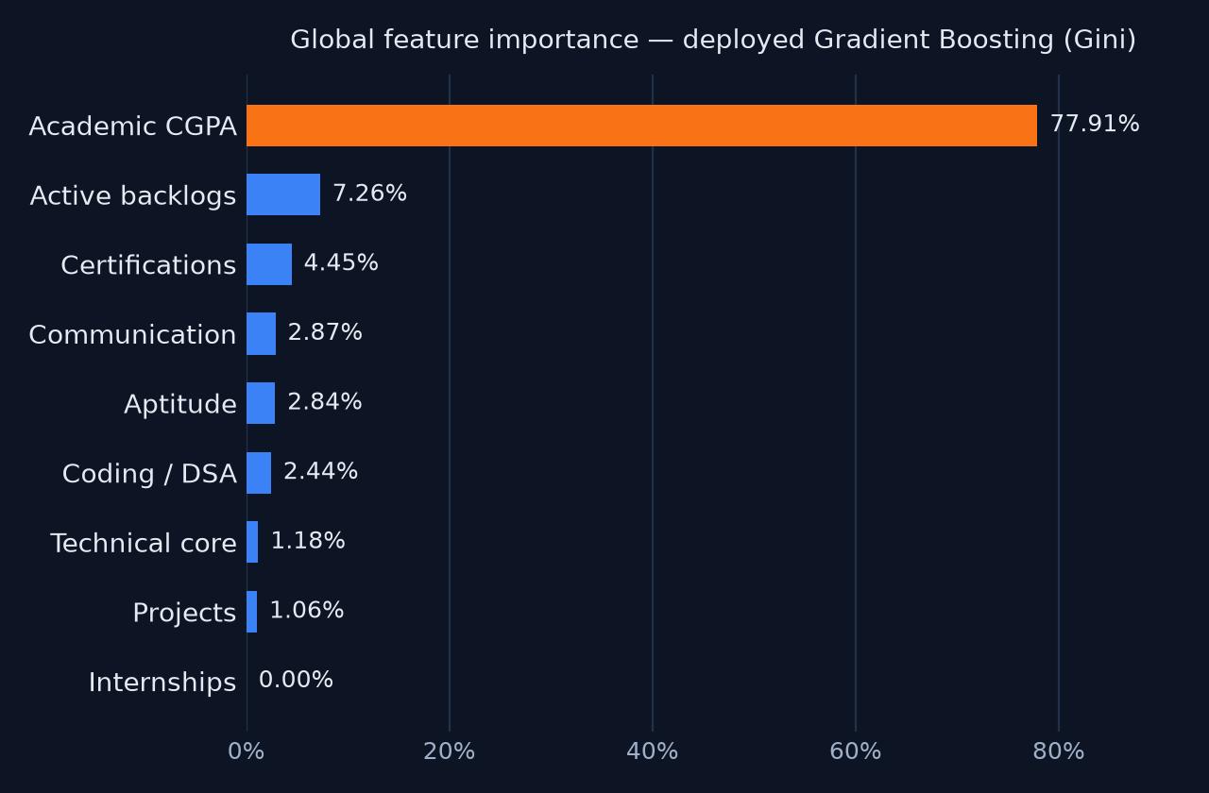
COMPONENT 8 OF 11
8 / 11
Explainable AI — Why the Model Says That
Global explanation
Gini importances show CGPA dominates (77.91%), backlogs next (7.26%). The panel sees the same chart in the app.
Local explanation
One-feature sensitivity and counterfactual scenarios: “if coding rises to 75, readiness moves from X to Y”.
SHAP on demand
TreeExplainer runs on request and is labelled in raw log-odds; it is unavailable for unsupported models instead of being faked.
CGPA dominance is not just a modelling artefact — it reflects how campus shortlisting actually gates students.
Notes:
If asked about SHAP values in log-odds: we do not relabel them as probabilities. The counterfactual view is the most useful part for students because it says what to change.

Slide 13
COMPONENT 9 OF 11
9 / 11
Reproducible ML Pipeline
1
2
3
4
5
Validate
Preprocess
Train & evaluate
Register artifact
Serve
data_audit.py + data_pipeline.py
schema, ranges, duplicates
dedupe → stratified splits
missing checks, engineered features
compare_models.py
3 × 5 CV + hold-out metrics
model_registry.py
version + metrics + metadata
Flask API → joblib model
predict + explain + skill gaps
Reproducibility
Versioned artifacts
Retraining on demand
Fixed seed 42, pinned requirements, dataset SHA-256 recorded, and every evaluation writes its own report JSON + Markdown.
1.0.0-gb-winner is the live model; 2.0.0-calibrated-gb is the calibrated candidate. Research models are never auto-promoted.
train_model.py, compare_models.py, tune_xgboost.py and auto_select_and_retrain.py rebuild and re-evaluate the pipeline end to end.
One command rebuilds evidence: reports/model-evaluation/, reports/data-audit/ and reports/teacher-brief-xgboost/ are generated, not hand-written.
Notes:
Frame the pipeline as a chain of recorded decisions. Mention that the model artifact carries its own metrics and metadata, so serving and evaluation cannot drift apart silently.

Slide 14
COMPONENT 10 OF 11
10 / 11
Deployment — Web App + REST API
React 18 SPA
Nginx
Gunicorn + Flask
Gradient Boosting
Vite · Recharts · Lucide
Dashboard, history, mentor views
Static build + SPA fallback
/api reverse proxy
2 workers × 4 threads
REST API, auth, CSRF
placement_model.joblib
predict_proba + explanations
▪ Run it: docker compose -f docker-compose.production.yml up --build → UI on :8080, API reached via the Nginx /api proxy.
▪ API surface: /api/predict, /api/history, /api/cohort-analytics, /api/auth/*, health & readiness probes.
▪ Security: session auth with server-enforced roles, CSRF token on state changes, cohort scoping.
▪ Alternate entry point: backend/asgi.py mounts the same app under FastAPI/uvicorn — no logic fork.
DEPLOYMENT STATUS
Containerized stack runs end to end and is health-check gated.
Hosted URL, TLS, institutional SSO and a managed database are the remaining production steps — documented in docs/DEPLOYMENT_BASELINE.md rather than claimed.
The prototype never presents its score as an official placement decision.
SAMPLE REQUEST — POST /api/v1/predict
{"cgpa": 8.5, "coding_score": 80, "technical_score": 75, "aptitude_score": 72,
"communication_score": 85, "projects": 4, "internships": 1, "certifications": 3,
"backlogs": 0} → {readiness_score, category, top_factors, skill_gaps}
Notes:
Deployment is mandatory, so lead with the runnable stack, not the caveats. Then be precise: local/container deployment is verified; a public institutional URL is the next step. FastAPI exists as a wrapper, not a second codebase.

Slide 15
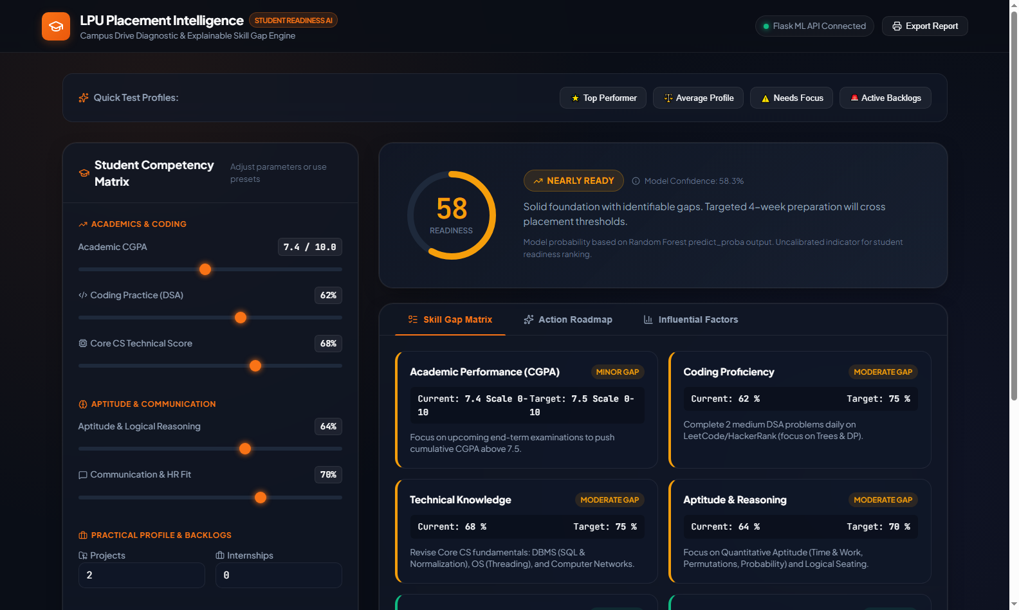
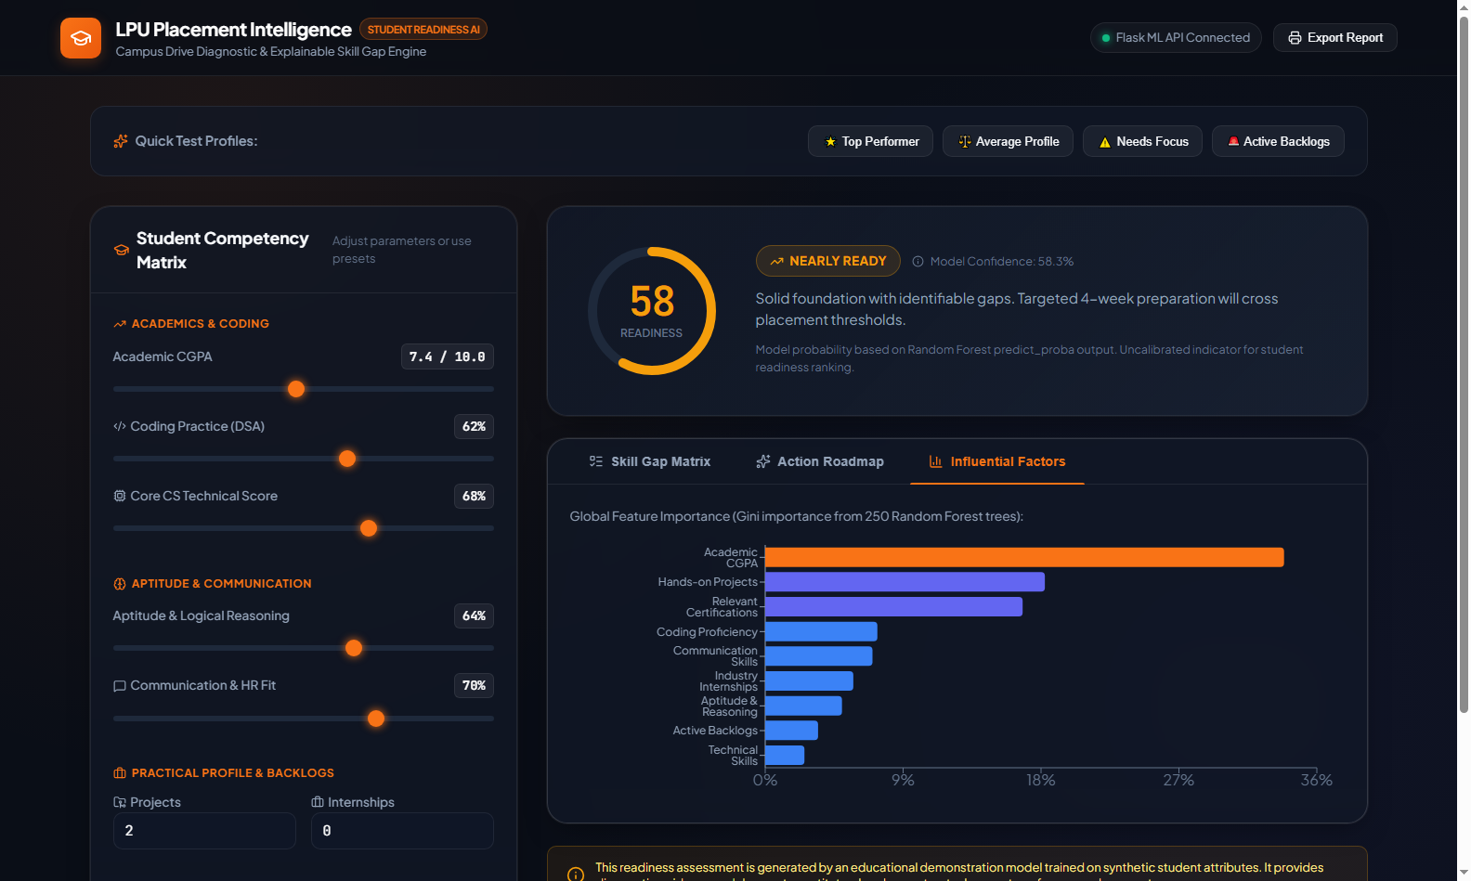
COMPONENT 10 OF 11
10 / 11
Live Demo — What the User Actually Sees
Readiness gauge + competency matrix
Skill-gap matrix
Influential factors
Score, confidence band and nine sliders sync live
Every gap vs benchmark, colour-coded by severity
Model importance surfaced inside the product
INTERACTION LOOP
Adjust profile
→
Live prediction
→
See the gap
→
Get 30–60 day plan
→
Export report
Presets (Top Performer / Average / Needs Focus / Active Backlogs) make the demo fast and repeatable in front of a panel.
Notes:
Demo order: top-performer preset, then needs-focus, then open the gap matrix and the roadmap. Keep it under 90 seconds. Point out that the importance chart in the UI is the same model evidence from the XAI slide.

Slide 16
COMPONENT 11 OF 11
11 / 11
GitHub Repository & Documentation
REPOSITORY LAYOUT
✓
Source code
✓
Dataset info
LPU-Placement-Intelligence/
├── backend/ Flask API · ML · auth · tests
│ ├── app.py · model.py · data_pipeline.py
│ ├── compare_models.py · tune_xgboost.py
│ └── placement_model.joblib (+ calibrated)
├── frontend/ React 18 + Vite dashboard
│ └── src/ · tests · Playwright e2e
├── dataset/ 7 CSV files + audit scripts
├── docs/ 27 design / ops / governance docs
├── reports/ CV, calibration, XAI evidence
├── screenshots/ demo figures used in this deck
├── docker-compose.yml + production stack
├── requirements-dev.txt · pyproject.toml
└── README.md setup · API · model card
backend + frontend + scripts
dataset/README.md with sources, sizes, limits
✓
ML pipeline
✓
Model artifacts
validation → training → evaluation → registry
versioned .joblib + retraining scripts
✓
Requirements
✓
README + deployment
requirements-dev.txt, research extras, npm lockfile
setup, API reference, Docker instructions
✓
Screenshots / demo
✓
Documentation
five figures + demo guide
architecture, XAI, auth, governance, release criteria
CI: .github/workflows/frontend-ci.yml (lint, format, unit tests, bundle budget) · 50 test files across backend and frontend
Notes:
If the panel checks the repository, the layout tree is the map. Point out that documentation is not one README — there are 27 docs covering auth, deployment, XAI and release criteria.

Slide 17
TECH STACK
What It Is Built With, and Why
Layer | Technology | Why this choice
Language | Python 3.10+ · JavaScript (ESM) | One ML ecosystem, one UI ecosystem
ML / data | scikit-learn · NumPy · pandas | Tabular ensembles, reproducible CV, mature tooling
Explainability | SHAP · feature importance · counterfactuals | Local and global reasons for every score
Backend | Flask REST API · Gunicorn | Small surface, easy auth/CSRF control, worker-safe
Optional ASGI | FastAPI / uvicorn wrapper | Same app served through an async entry point
Frontend | React 18 · Vite · Recharts · Lucide | Fast dev loop, charting, accessible components
Data stores | SQLite (prototype) · Supabase (migration path) | Local demo today, managed Postgres later
Packaging | Docker · Docker Compose · Nginx | Identical local and container behaviour
Quality | pytest · Vitest · Playwright · ESLint · Ruff | Model, API, UI and end-to-end coverage
Dependency discipline: runtime, research and migration requirements are separate files, so a demo install never drags in SHAP, XGBoost tuning or Supabase migration tooling.
Notes:
Do not read the table. Name the spine: scikit-learn for the model, Flask for serving, React for the interface, Docker for delivery, SHAP for trust.

Slide 18
TEAM
Three Members, End-to-End Ownership
Team Member 1
Team Member 2
Team Member 3
Name · Roll No.
Name · Roll No.
Name · Roll No.
DATA & ML
BACKEND & DEPLOYMENT
FRONTEND & XAI
– Dataset audit and EDA
– Preprocessing and baselines
– 8-model benchmark + tuning
– Calibration and evaluation reports
– Owner: reports/model-evaluation/
– Flask REST API and validation
– Auth, roles and CSRF
– Model registry and artifacts
– Docker, Gunicorn, Nginx, CI
– Owner: deployment + API docs
– React dashboard and presets
– Skill-gap and roadmap views
– SHAP / factor panels
– Docs, screenshots, demo script
– Owner: UI evidence + demo
Placeholder names and roll numbers — replace before submission.
Shared ownership: weekly review of reports, README and demo script.
Notes:
Keep this to 20 seconds unless asked. Edit the three placeholder name blocks and the role split to match the actual contributions.

Slide 19
WRAP-UP
Outcome, Honest Gaps, Next Steps
What we delivered
What is still prototype
What comes next
A deployed, explainable readiness platform: 8-model benchmark, 96.08% hold-out accuracy, calibrated probabilities, skill-gap diagnosis, action roadmap, auth and Docker stack.
The label and provenance are unverified, validation is same-source, no subgroup fairness audit, and hosting/TLS/institutional SSO remain before real student use.
Verified LPU outcome data, external validation and calibration checks, resume/GitHub parsing, company-specific cutoffs, and a hosted pilot with the placement cell.
TAKEAWAY
A model is only useful when a student can act on it. The contribution here is the complete loop — prediction, explanation, prescription and a deployable service — with the limits stated as clearly as the accuracy.
Notes:
Close on the loop, not the percentage. One sentence on limitations, one on next steps, then invite questions.

Slide 20
THANK YOU
Questions & discussion
LPU Placement Intelligence — student readiness prediction, skill-gap diagnosis and a prescriptive roadmap.
Reproducible evaluation
Explainable predictions
Deployable service
Team Member 1 · Team Member 2 · Team Member 3
Notes:
Stop here. Let the panel ask. Likely questions: why Gradient Boosting, why not deep learning, how do you know 96% is real, what happens with a new dataset.

