Slide 1
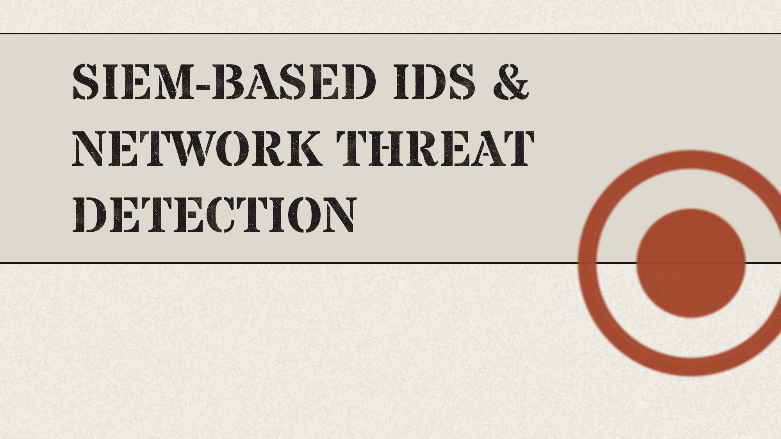
with Packet-Level Analysis
Gnanadeep Chittineni
Student ID: 25267604
Supervisor: Michael Johnson

Slide 2
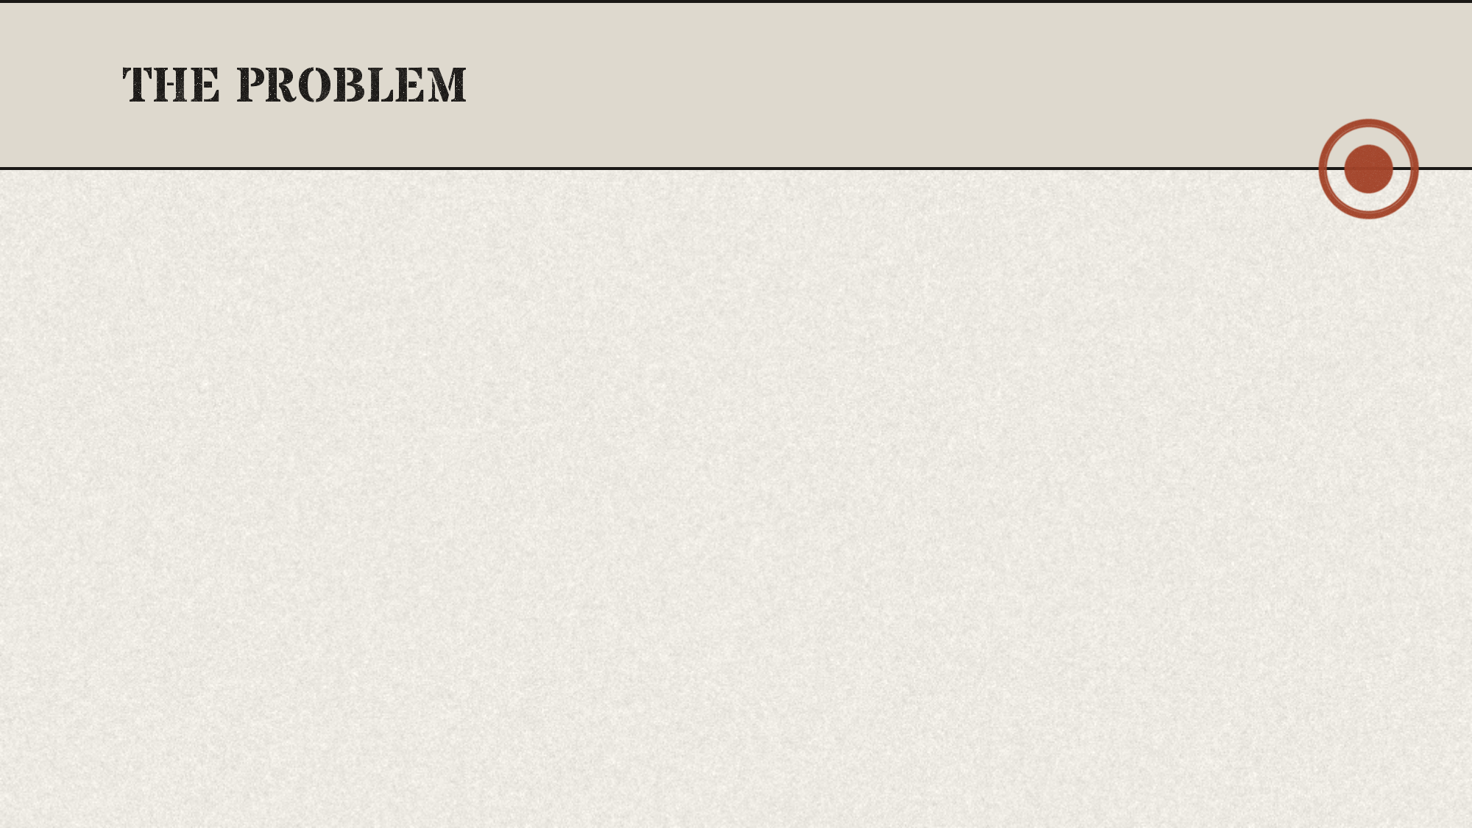

Modern networks expand faster than defenses
Firewalls react only to known threats
Small businesses face constant targeted attacks
Alerts across tools rarely get connected
Single tools miss critical attack context
Open source tools rarely integrate well

Slide 3

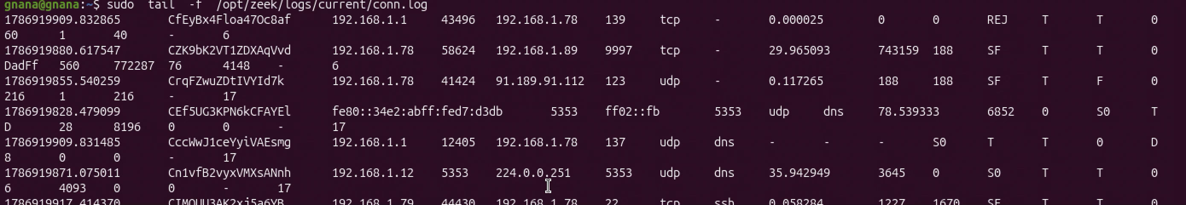
Zeek logs connections instead of alerts
IOT datasets proved large scale logging
Correlation solves fragmented single source alerts
Suricata added multithreading

Slide 4

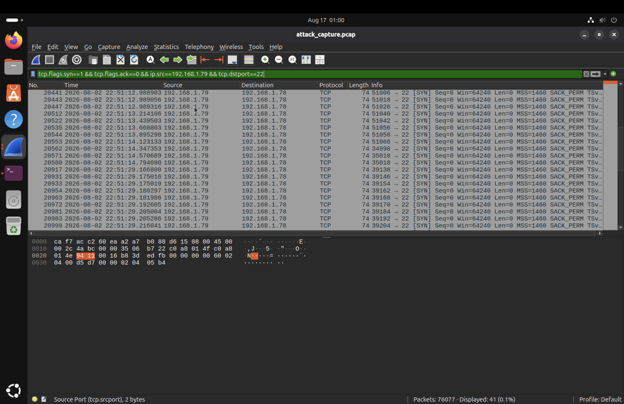
Detect intrusions across multiple network layers
Correlate alerts from independent security tools
Verify alerts using packet level analysis
Build the system entirely with open source tools

Slide 5
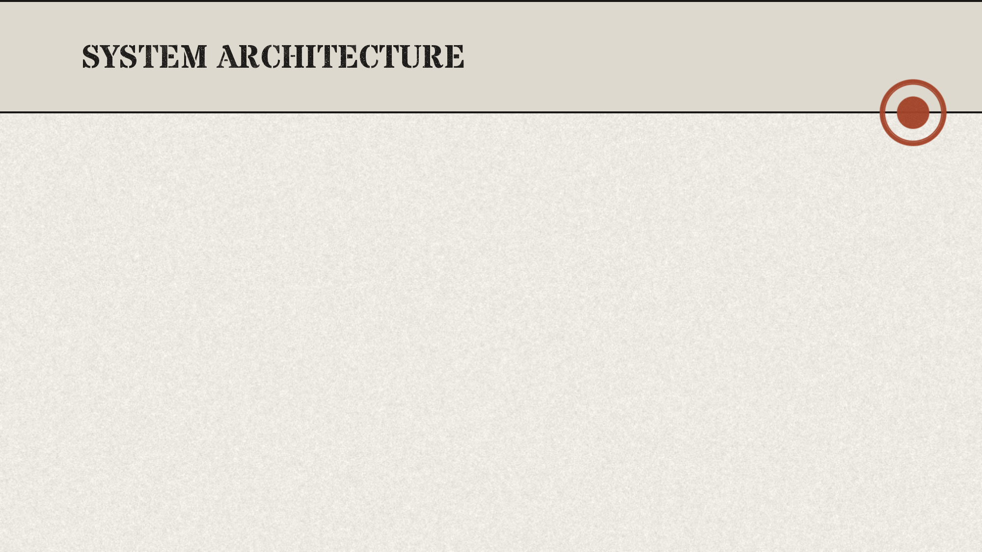
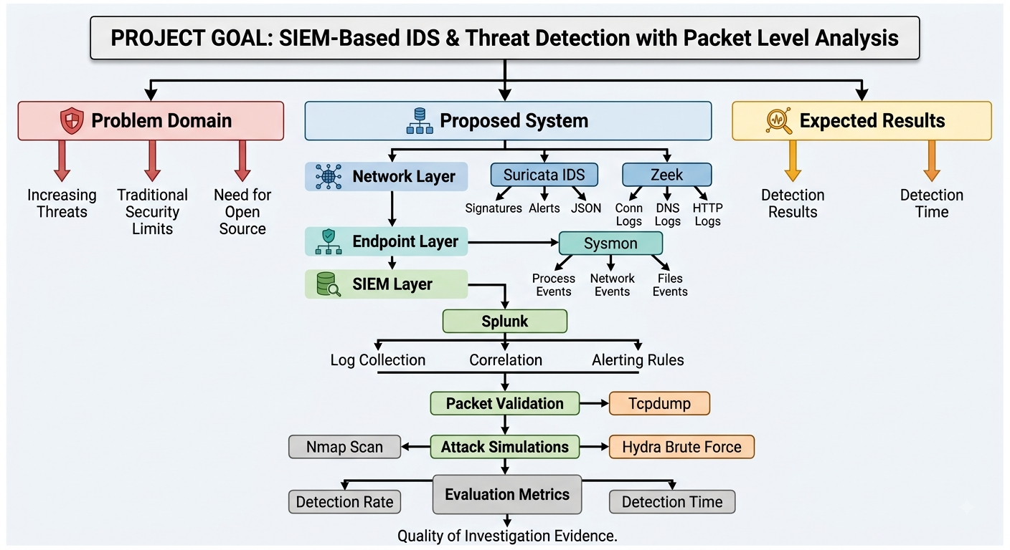
Used Tools: Suricata
Zeek
Sysmon
Splunk
Tcpdump
Wireshark

Slide 6

Suricata runs Emerging Threats rule sets
Zeek generates connection, DNS, HTTP logs
Sysmon captures process and network events
Splunk rules flag port scan attempts
Tcpdump captures packets for later verification

Slide 7

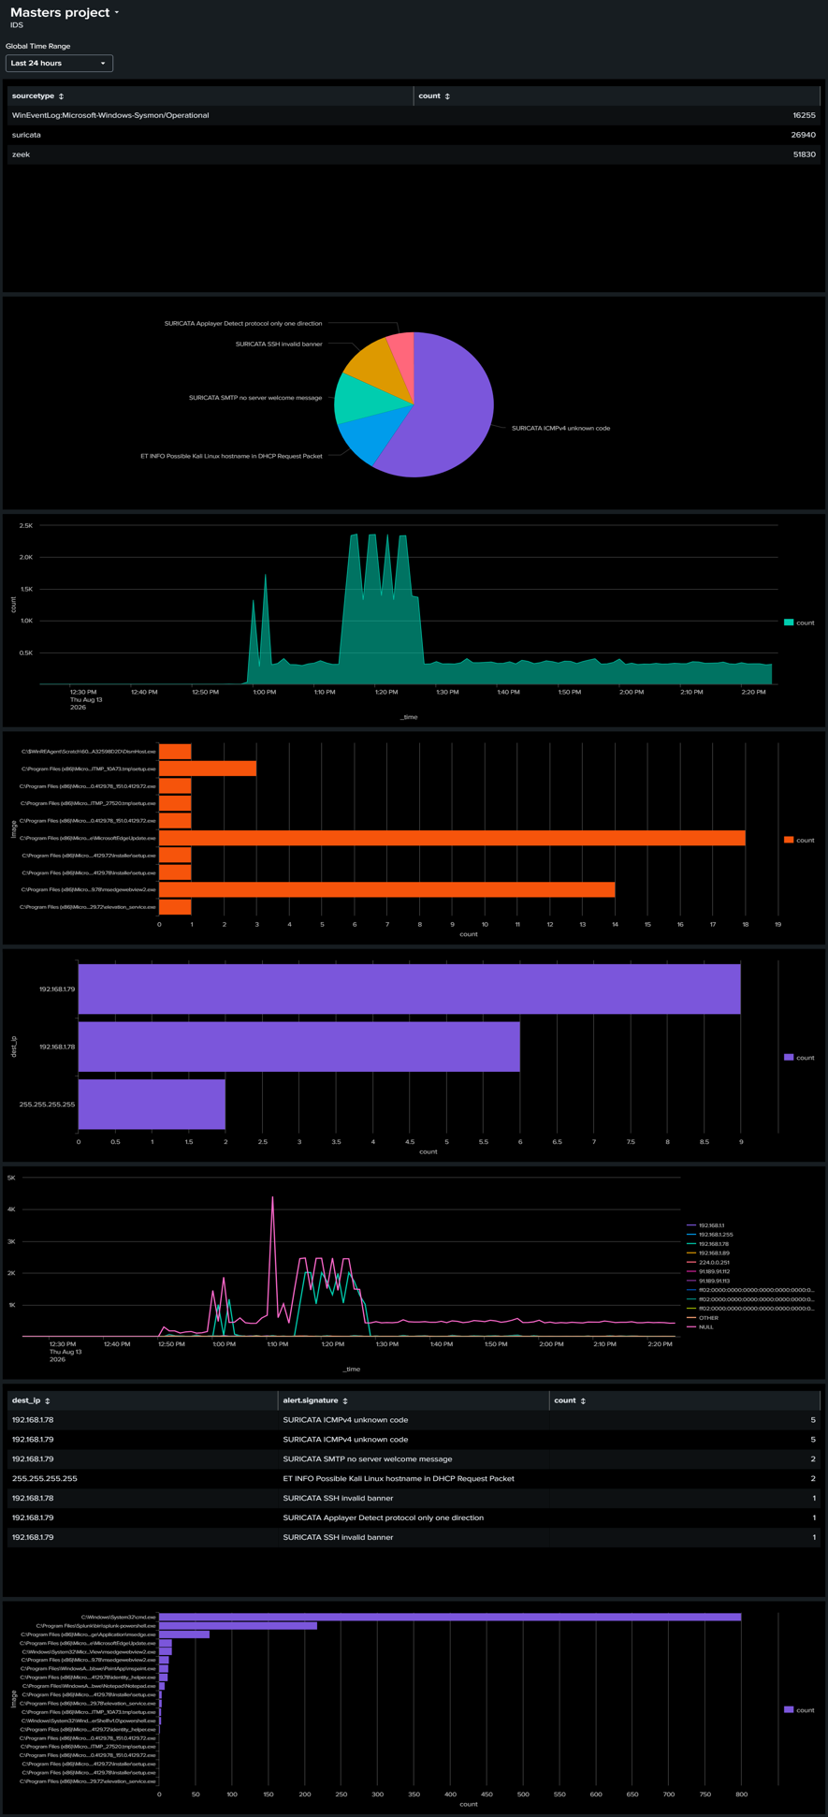
Detection rate exceeded ninety percent overall
False positives stayed below ten percent
Alerts fired within sixty seconds average
Packet captures confirmed most flagged alerts
Splunk dashboards visualized alerts across sources
Correlated alerts proved more reliable overall

Slide 8

Testing limited to one simulated lab network
High traffic volume can overwhelm log storage
Inconsistent signature detection
High False positive rate

Slide 9

Monitoring must respect user privacy rights
Captured traffic can expose sensitive personal data
Testing occurred only on owned lab systems
Real deployments require clear organizational consent
Logs and captures need controlled secure storage
Detection tools must never enable offensive misuse

Slide 10
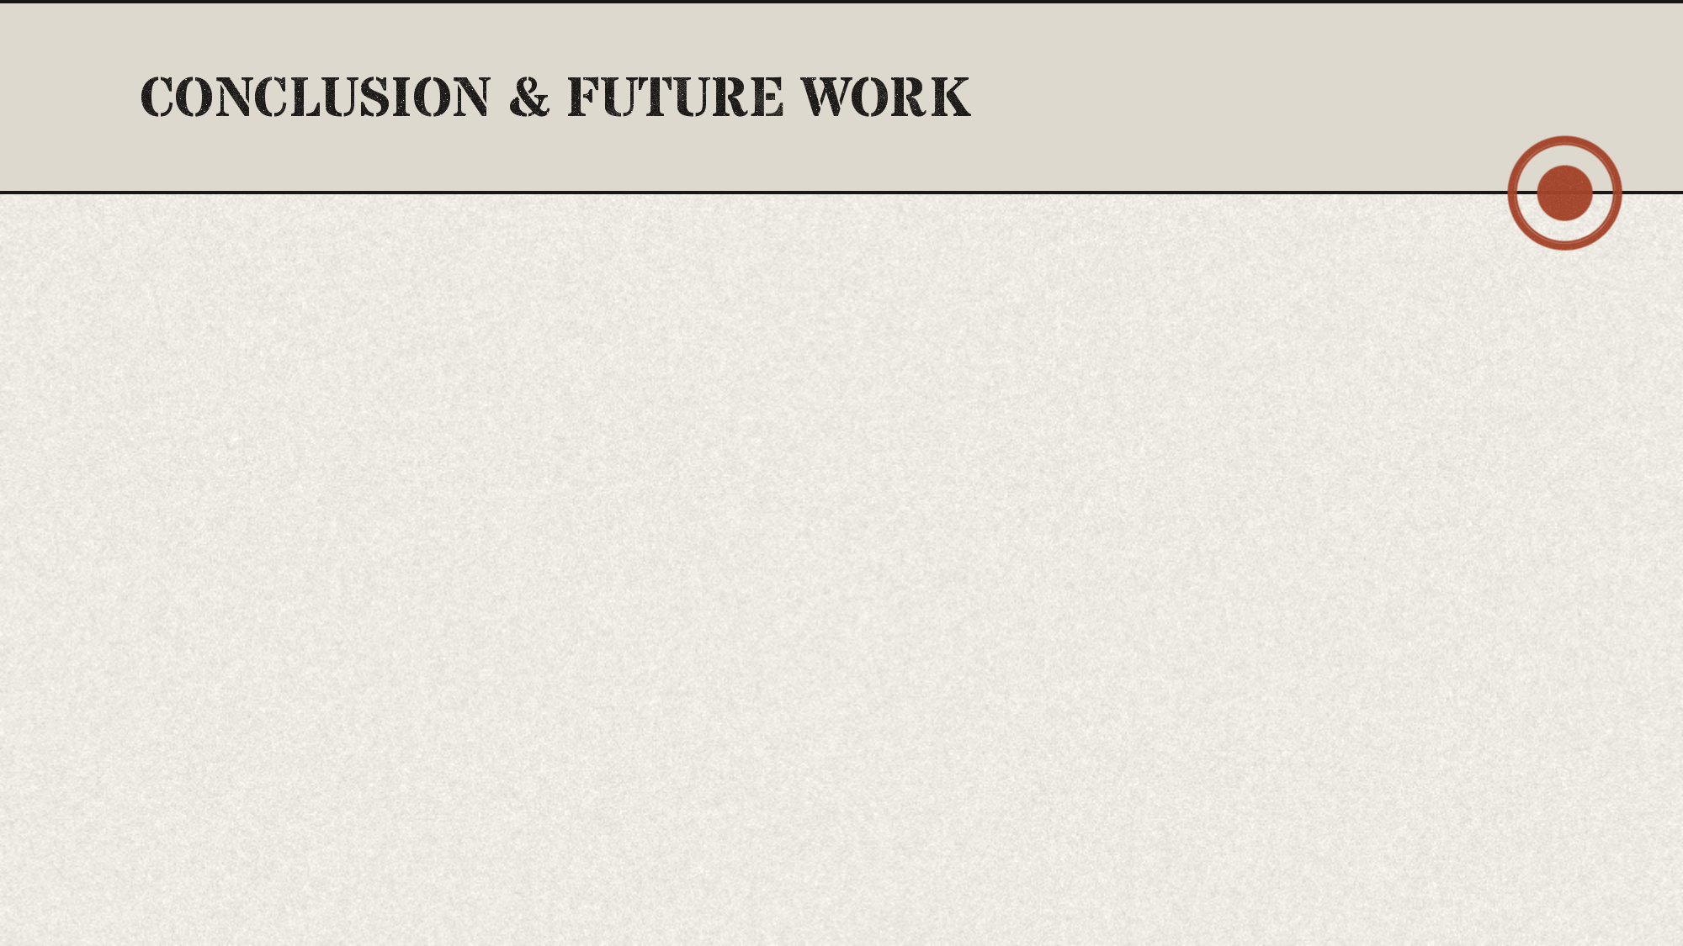
Open source tools rival costly platforms
Correlation turns isolated alerts into evidence
Small teams can now afford visibility
Machine learning could catch unknown threats
Future work should test larger networks
This approach scales beyond the lab

Slide 11


