Slide 1
INDUSTRIAL HUMAN RESOURCE GEO-VISUALIZATION
GNANAMBIGAI DHAMODHARAN

Slide 2
Comprehensive Overview of Worker Statistics and Geo-Visualization
Problem Statement
Objective
Tools
Approach
EDA(exploratory Data Analysis)
Main Workers Vs Marginal Workers
Marginal Workers Rural Vs Urban
Main Workers Rural Male And Female(%)
Marginal Workers Urban Male And Female(%)
Top 10 Workers By Nic Name
Geo-visualization
Conclusion

Slide 3
PROBLEM STATEMENT
Industrial Classification Importance: Understanding the distribution of the labor force across various sectors in India is crucial for assessing the country's economic landscape.
Main and Marginal Workers: The classification of main workers and marginal workers, excluding cultivators and agricultural laborers, is significant for analyzing employment trends and economic status.
Sex-Based Classification: The classification is based on gender, providing insights into the workforce composition by sex.
Section, Division, and Class: Further classification based on sections, divisions, and classes provides detailed insights into the workforce's structure and distribution.

Slide 4
OBJECTIVE
The primary aim of the study is to update and provide accurate information on the industrial classification of main and marginal workers to facilitate policy-making and employment planning effectively.
TOOLS
  Python as the programming language.
  Streamlit for web application.
  Pandas for data manipulation.
  Matplotlib for data visualization

Slide 5
APPROACH
Merge all the CSV data files provided and create a DataFrame.
Perform classical machine learning tasks such as Data Exploration, Data Cleaning, Feature Engineering, Model Building, and Model Testing.
Utilize Natural Language Processing for analyzing various core industries and group the business categories like Retail, Poultry, Agriculture, Manufacturing, etc.

Slide 6
EDA(EXPLORATORY DATA ANALYSIS)
Data Loading: Load the dataset containing state-wise counts of industrial classification of main and marginal workers.
Data Inspection: Inspect the dataset to understand its structure, including the number of rows and columns, data types, and any missing values.
Summary Statistics: Compute summary statistics for numerical variables such as mean, median, standard deviation, minimum, and maximum. This provides an overview of the distribution of the data.
Data Visualization: Create visualizations to explore the data distribution and relationships between variables.
Missing Values: Identify and handle missing values in the dataset. Determine if missing values are random or systematic and decide on appropriate strategies for imputation or removal.

Slide 7
EDA (cont..)
Outlier Detection: Detect outliers in the data using visualization techniques. Evaluate the impact of outliers on the analysis and decided to remove.
Feature Engineering: Create new features or transform existing features to extract meaningful information from the data. For example, derive new variables based on combinations of existing variables.
Correlation Analysis: Calculate correlations between numerical variables to identify potential relationships and dependencies. Visualize correlations using correlation matrices with heatmap.
Data Quality Assessment: Assess the overall quality of the dataset, including data completeness, consistency, and reliability. Identify any data quality issues and document them for further investigation

Slide 8
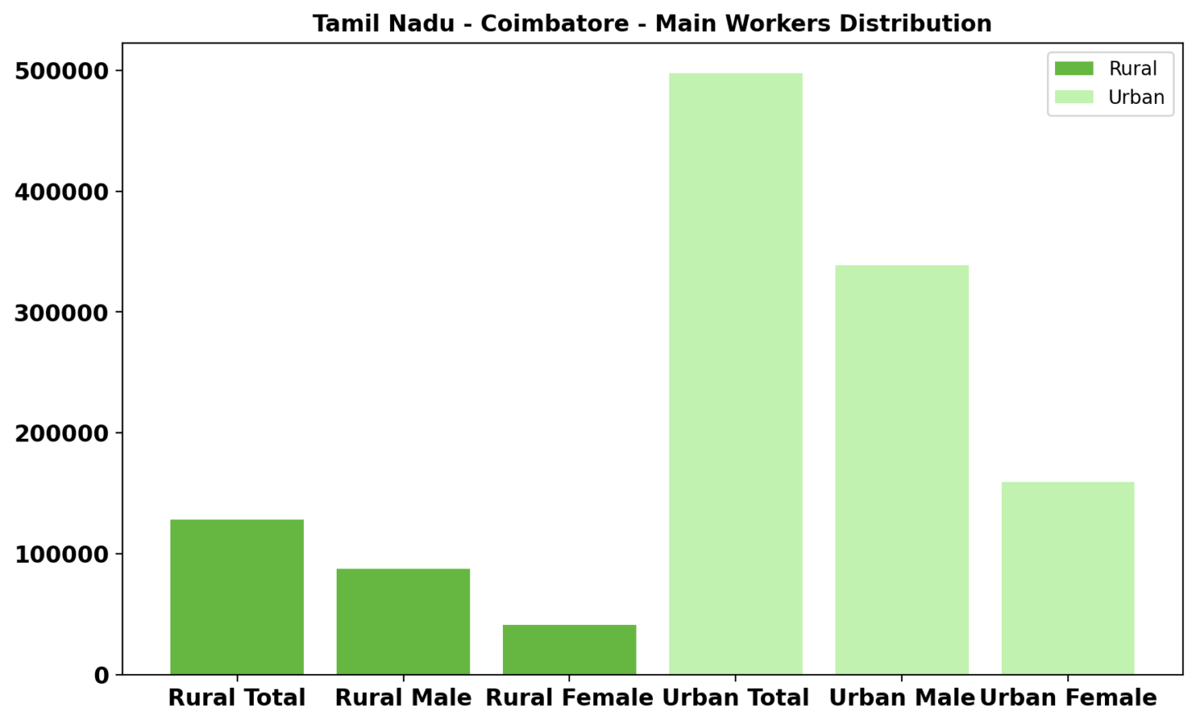
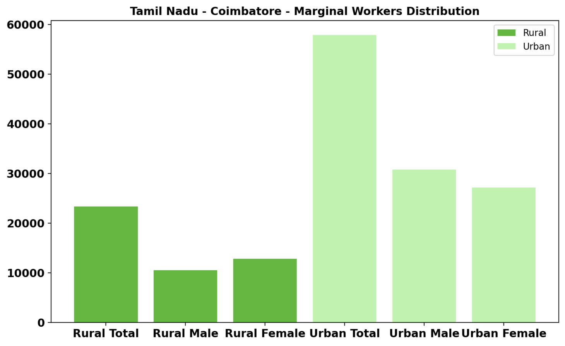
Main Workers vs Marginal Workers
Main Workers Rural and Urban
Marginal Workers Rural and Urban

Slide 9
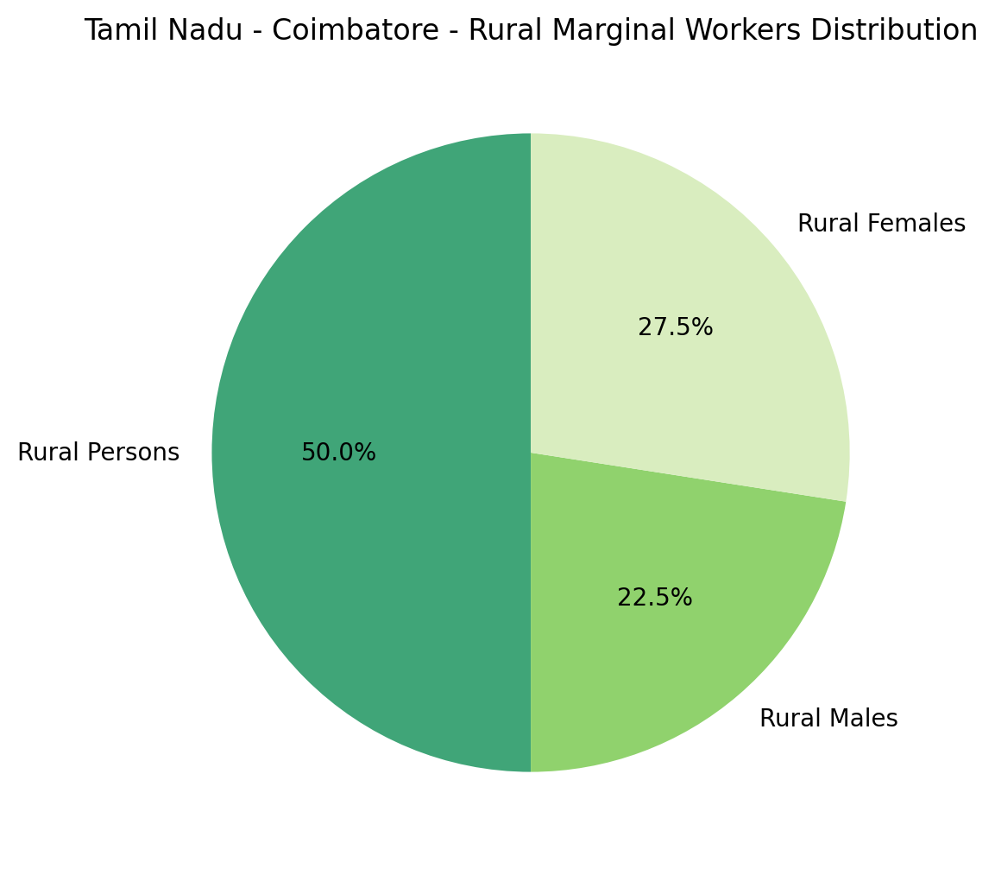
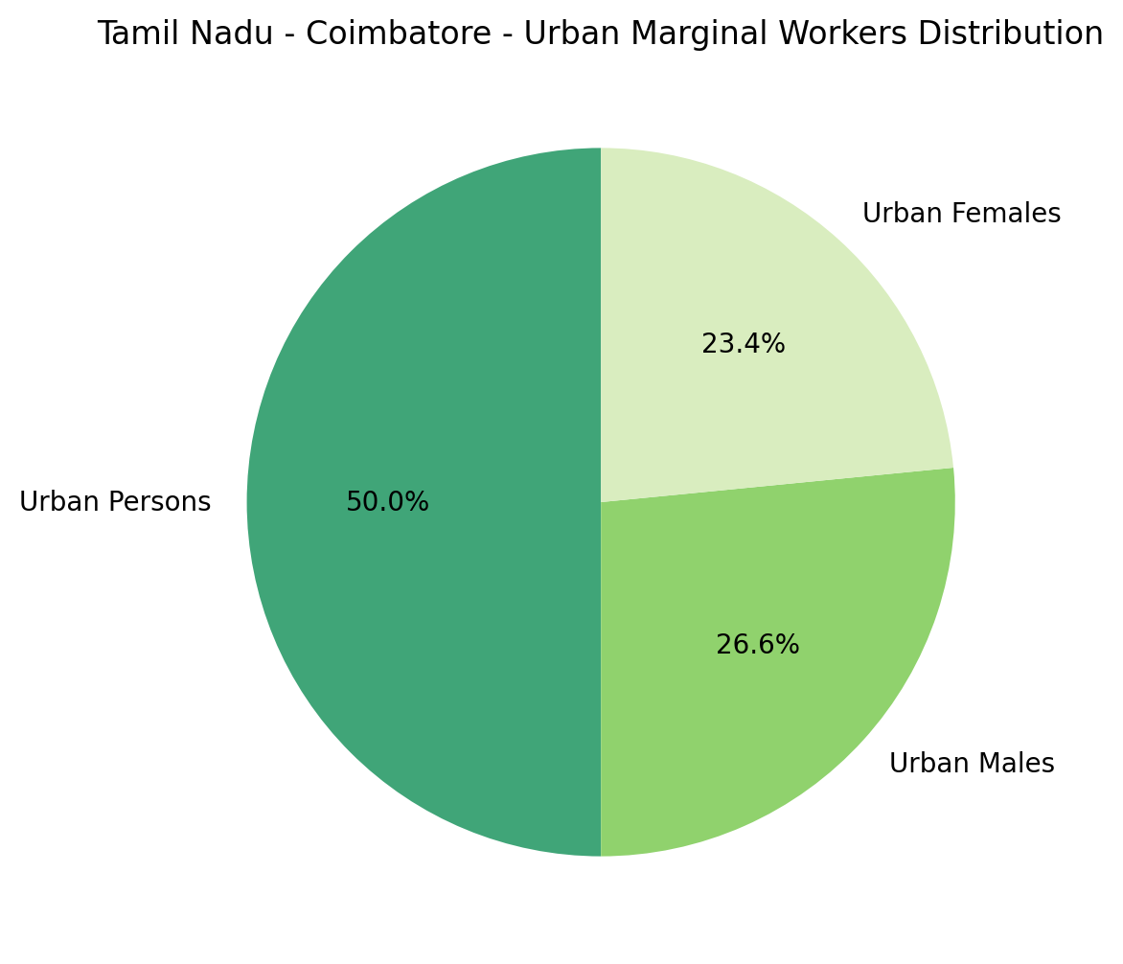
Marginal Workers Rural vs Urban
Marginal Workers Rural Male and Female (%)
Marginal Workers Urban Male and Female (%)

Slide 10
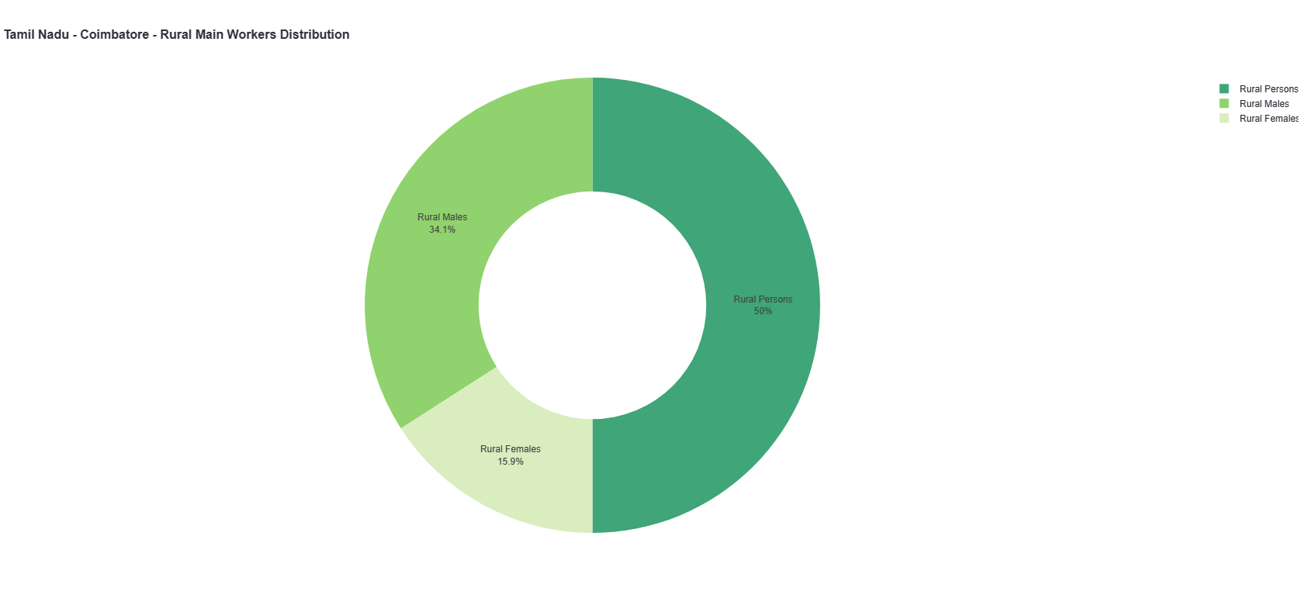
MAIN WORKERS RURAL MALE AND FEMALE(%)

Slide 11

MARGINAL WORKERS URBAN MALE AND FEMALE(%)

Slide 12
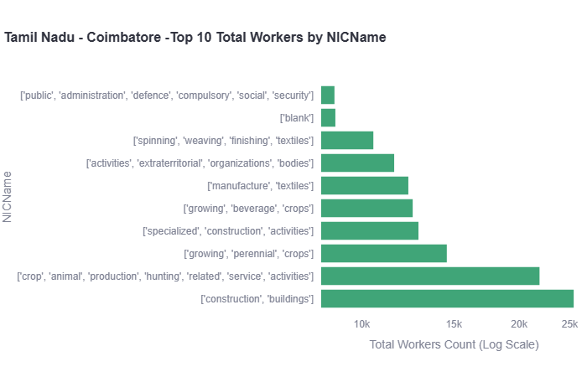
TOP 10 WORKERS BY NIC NAME

Slide 13
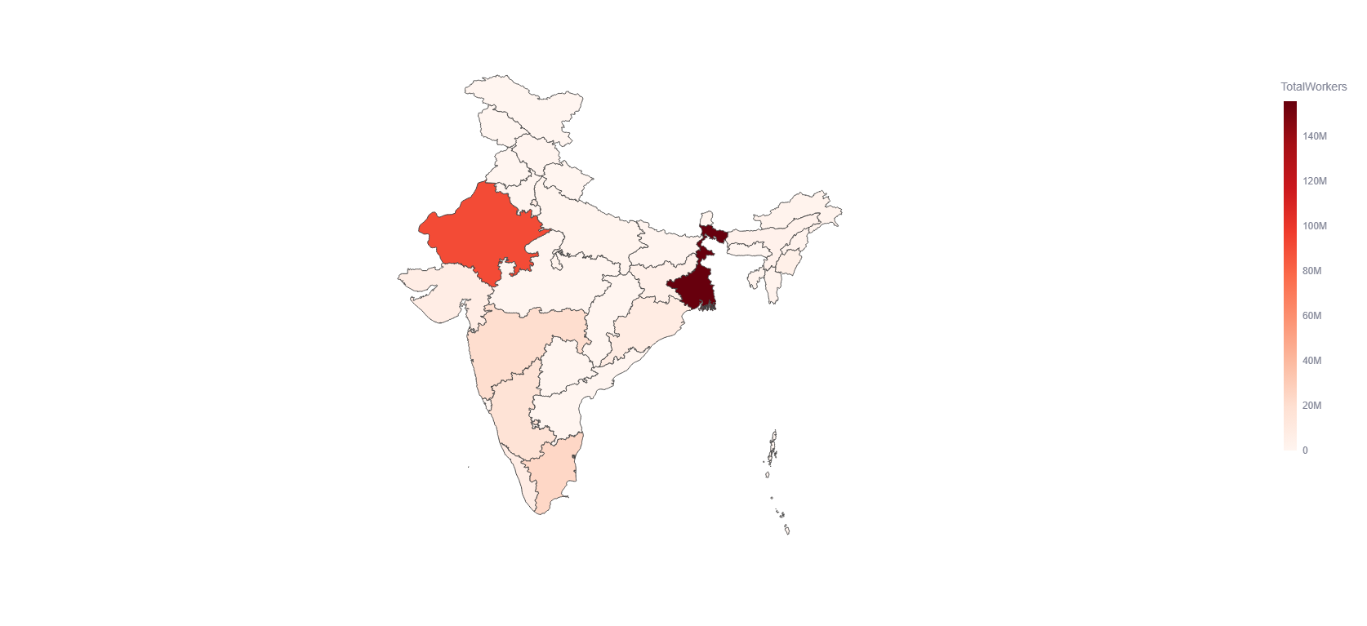
GEO-VISUALIZTION

Slide 14
CONCLUSION
Regional Distribution of Workers:
West Bengal emerges as the state with the highest total number of workers, indicating a significant workforce presence in the region. This suggests a robust economic activity and employment opportunities in West Bengal.
Rajasthan follows closely behind, indicating a substantial workforce contributing to the state's economy.
Gender Distribution in Rural and Urban Areas:
The analysis highlights an interesting trend in the distribution of female workers between rural and urban areas. It is observed that rural areas have a higher proportion of female workers compared to urban areas. This phenomenon may reflect the nature of employment opportunities and socio-economic factors influencing workforce participation in different regions.

Slide 15
THANK YOU!

