Slide 1
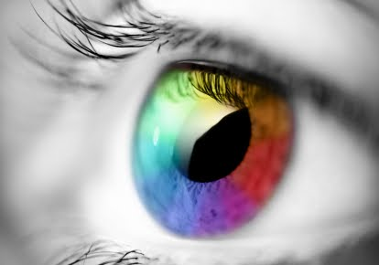
4.01 HTML, CSS and Color

Slide 2
Introduction
This presentation includes the following topics:
Additive color theory
Color Names
RGB Colors
Hex Colors

Slide 3
Additive Color
Colors on your computer monitor are displayed by combining red, green, and blue light.
It's a process known as "additive color". A computer works with light. Mix a computer's additive colors, red, green, and blue, together, you get white.

Slide 4
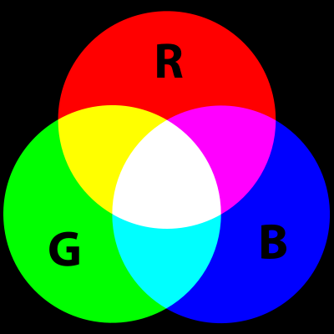
Additive color creating white
Additive colors are generated by light

Slide 5
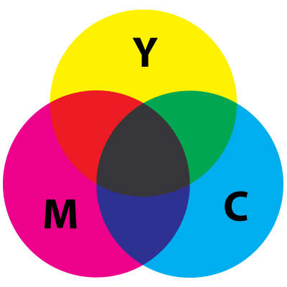
Subtractive color system
In contrast, the subtractive color system is the mixing of colors. In subtractive, the colors mix to create black.

Slide 6
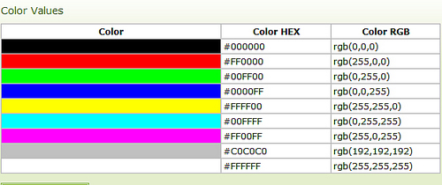
Color Value Examples in Hex and RGB

Slide 7
RGB color
The combination of red, green, and blue values ranges from 0 to 255.
That means there are 256 values for each color. 256 x 256 x 256 gives us more than 16 million colors that can be created using the RGB system.
Zero, "0", is the smallest representations of a color.
255 is the largest representation of a color

Slide 8
Hex color codes
Hexadecimal uses the numbers 0 to 9 and the letters A to F to represent color values.
In Hex the smallest representation of color is “00” and the largest representation of color is “FF”.
Copy & paste this link in your browser for more info:
http://www.w3schools.com/html/html_colors.asp

Slide 9
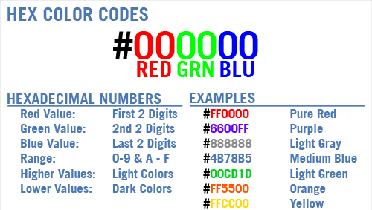
Understand Hex Color Codes

Slide 10
Color Names
There are currently 140 color names supported in HTML and CSS.
You can view the list by coping & pasting this link in your browser :
http://www.w3schools.com/html/html_colornames.asp

Slide 11
Hands-on color activity
http://www.w3schools.com/tags/ref_colormixer.asp?colorbottom=000000&colortop=FFFFFF
OR
https://kuler.adobe.com/create/color-wheel/

Slide 12
CSS
Colors should be defined using Cascading Style Sheets.
<style>
h1
{
background-color:#6495ed;
}
p
{
background-color:#e0ffff;
}
div
{
background-color:#b0c4de;
}
</style>

