Slide 1

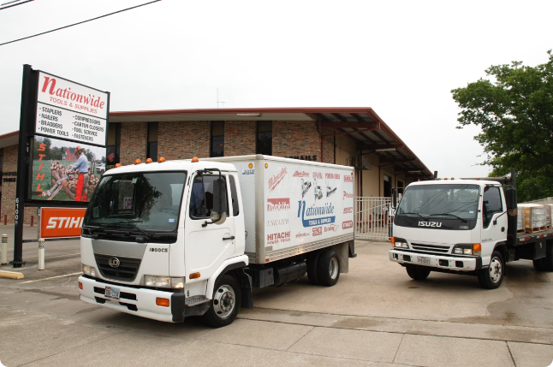
Optimizing Salesman Routes for Nationwide Distribution
Nationwide Distribution Company is a leading provider of goods across the country. They face the challenge of determining the most efficient routes for their sales representatives to reach all their clients, which can be modeled as the Traveling Salesman Problem (TSP).

Slide 2
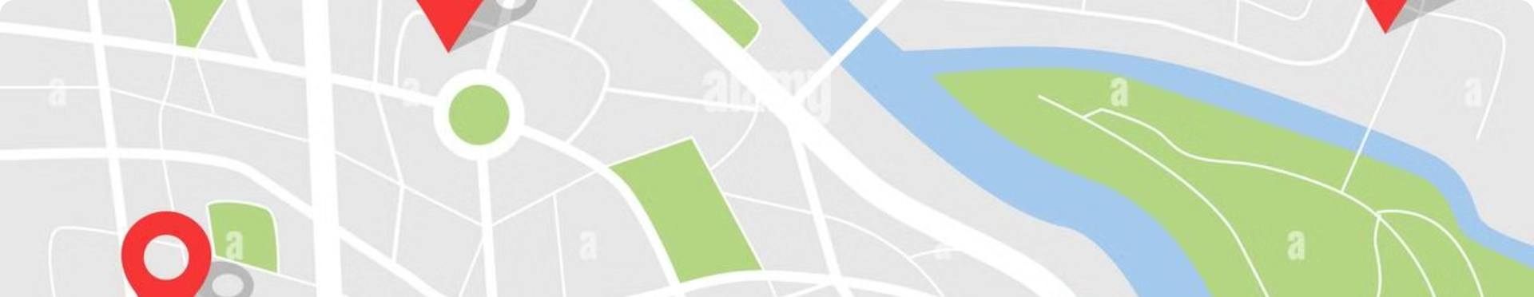
Challenges in Optimizing Salesman Routes
Large Number of Clients
Geographical Spread
Time Constraints
Nationwide Distribution has thousands of clients spread across the country, making it computationally infeasible to find the optimal route.
The clients are located in diverse regions, requiring the sales representatives to navigate complex road networks and travel long distances.
Sales representatives need to visit all clients efficiently within limited time windows, adding another layer of complexity to the problem.

Slide 3

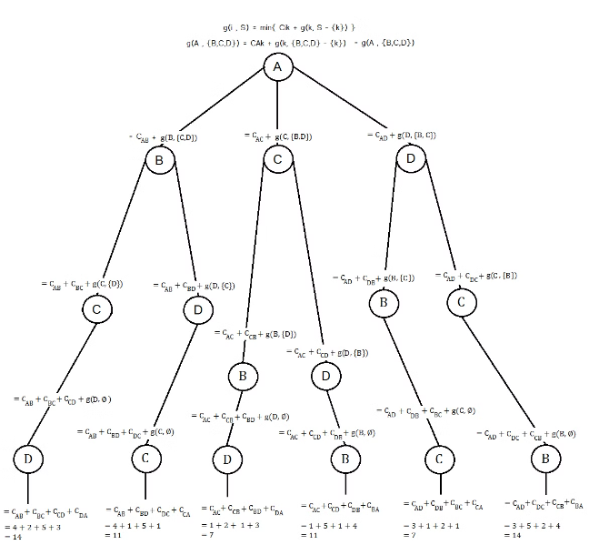
Overview of Traveling Salesman Problem (TSP)
1
Define Locations
Identify all the client locations that the sales representative needs to visit.
2
Calculate Distances
Determine the distances between each pair of client locations.
3
Find Optimal Route
Determine the route that visits all locations while minimizing the total distance traveled.

Slide 4
Approximation Algorithms for TSP
Heuristic Approaches
Polynomial Time
Guaranteed Bounds
Approximation algorithms use heuristic techniques to find solutions that are close to the optimal, but not necessarily the best.
These algorithms can find a solution in polynomial time, making them scalable for large problem instances.
Approximation algorithms provide a guaranteed upper bound on the quality of the solution compared to the optimal.

Slide 5

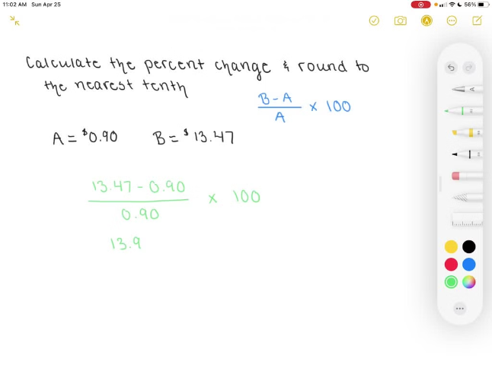
Nearest Neighbor Algorithm
1
Start at a Random Location
2
Choose Closest Next Stop
The algorithm begins by selecting a starting client location.
At each step, the algorithm selects the closest unvisited client location as the next stop.
3
Repeat Until All Visited
4
Simple and Fast
The Nearest Neighbor Algorithm is easy to implement and has a low computational complexity.
The process continues until all clients have been visited, forming a complete tour.

Slide 6


Implementing Approximation Algorithms
Client Data
Distance Calculation
Gather detailed information about the client locations, including their coordinates and any additional constraints.
Develop a method to efficiently calculate the distances between all pairs of client locations.
Algorithm Selection
Software Integration
Choose the most suitable approximation algorithm based on the problem characteristics and desired solution quality.
Integrate the selected approximation algorithm into the company's routing software to automate the process.

Slide 7





Advantages of Approximation Algorithms
Efficiency
Approximation algorithms can quickly provide near-optimal solutions, making them suitable for large-scale problems.
Solution Quality
These algorithms offer guaranteed bounds on the quality of the solution compared to the optimal, providing a reliable result.
Scalability
Approximation algorithms can handle large problem instances, allowing for effective routing optimization across Nationwide Distribution's extensive network.

Slide 8
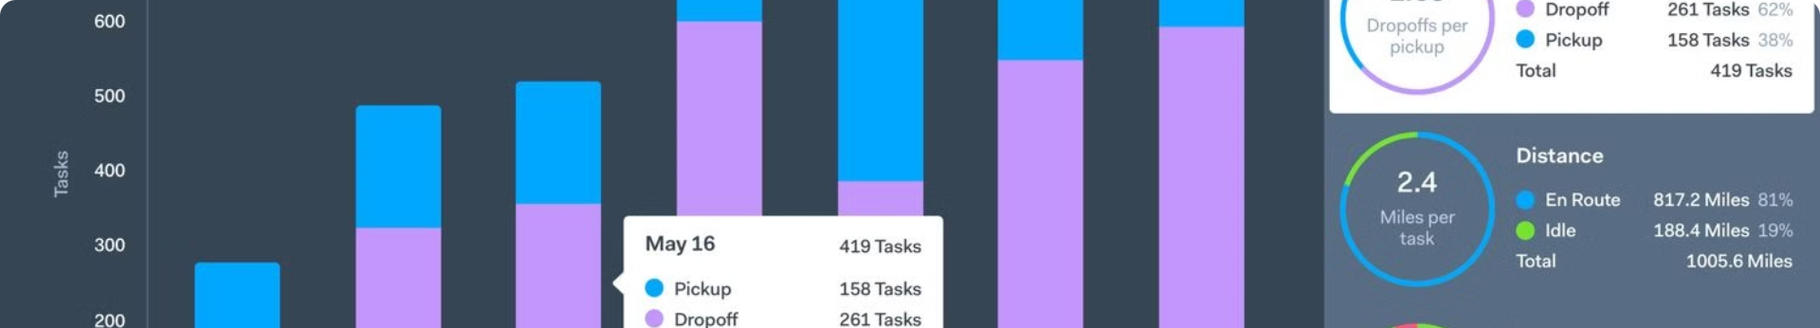
Measuring Route Optimization Success
Metric
Description
Total Distance
The overall distance traveled by the sales representative, which should be minimized.
Time Efficiency
The time taken to visit all clients, which should be within the required time constraints.
Client Satisfaction
The level of customer satisfaction with the sales representative's availability and response time.

Slide 9
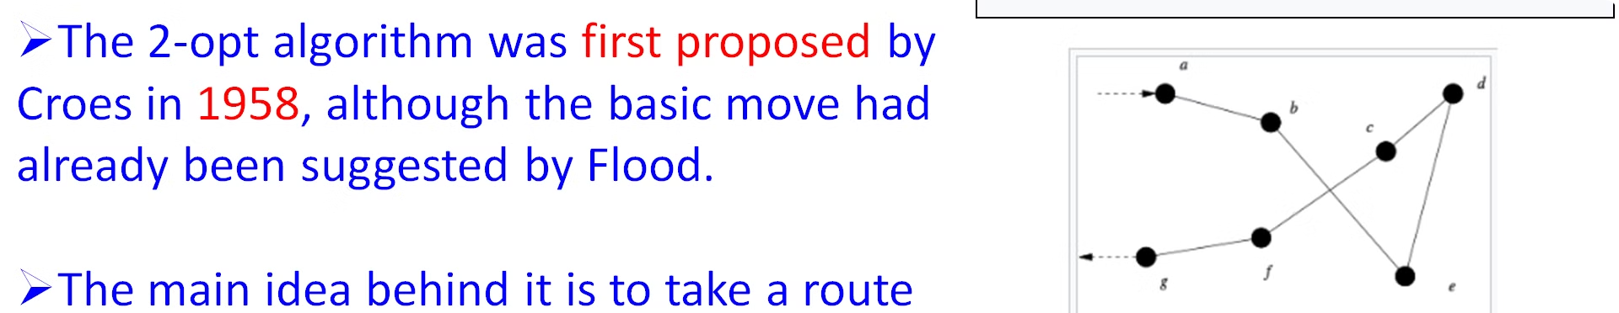



Integrating Approximation Algorithms
Data Collection
Algorithm Selection
Software Integration
Gather comprehensive data on client locations and requirements.
Choose the most suitable approximation algorithm based on the problem characteristics.
Incorporate the selected algorithm into the company's routing software.

Slide 10


Conclusion and Future Considerations
1
Continuous Optimization
2
Technological Advancements
Regularly review and update the route optimization process to account for changes in client locations and demands.
Explore the potential of emerging technologies, such as machine learning and AI, to further enhance the efficiency of the routing algorithms.
3
Collaboration with Clients
Engage with clients to better understand their preferences and incorporate their feedback into the route optimization process.

