Slide 1
MGFitness
Web and Mobile Technologies (B9IS124)
Assessment Title:
Develop a web application which is responsive and can be viewed across all devices.
Module Leader: Ehtisham Yasin
Team Members:
Mrudula Didde - 20006086
Gnanasekar Mani – 20020329

Slide 2

Contents :
Introduction
Overview
Sitemap
Features
Conclusion

Slide 3
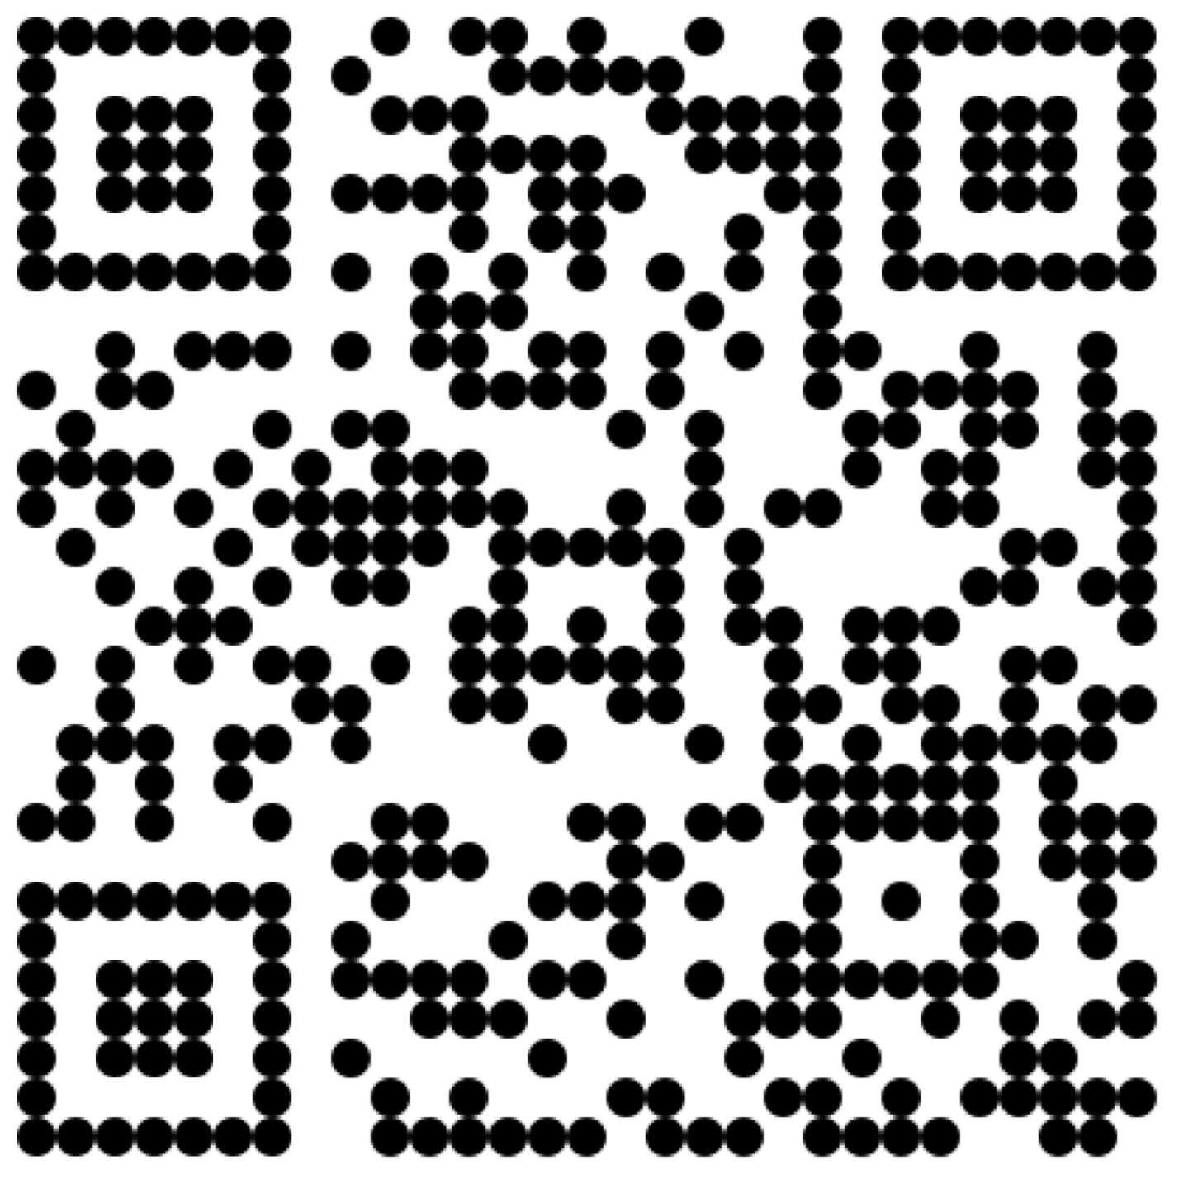
Scan QR code for MGFitness

Slide 4
Introduction :
At MGFitness, we are dedicated to providing you with the tools and equipment you need to achieve your fitness goals. Whether you're an experienced athlete or just starting your fitness journey, our powerful fitness equipment ensures you have everything you need to succeed. Our website is your gateway to discovering our wide selection of fitness equipment. From treadmills to elliptical machines, weights to yoga accessories, we offer a variety of products to suit every need and preference. Our website is designed to be user-friendly and intuitive. Browse our range, read detailed descriptions and view photos and videos to make an informed decision about your purchase.

Slide 5
Overview :
The website consists of a header, body and a footer.
It uses 3 layouts in total for homepage, details page and an about us page.
The user can click on the item and can reserve it by filling the form and submit.
The user can also use the contact form in the about us page to trigger a mail or to submit a query.
The user can use the search bar to find relevant items.
There is an image slider where multiple images of the product can be viewed in the detail page.
A video of the product can also be viewed.

Slide 6
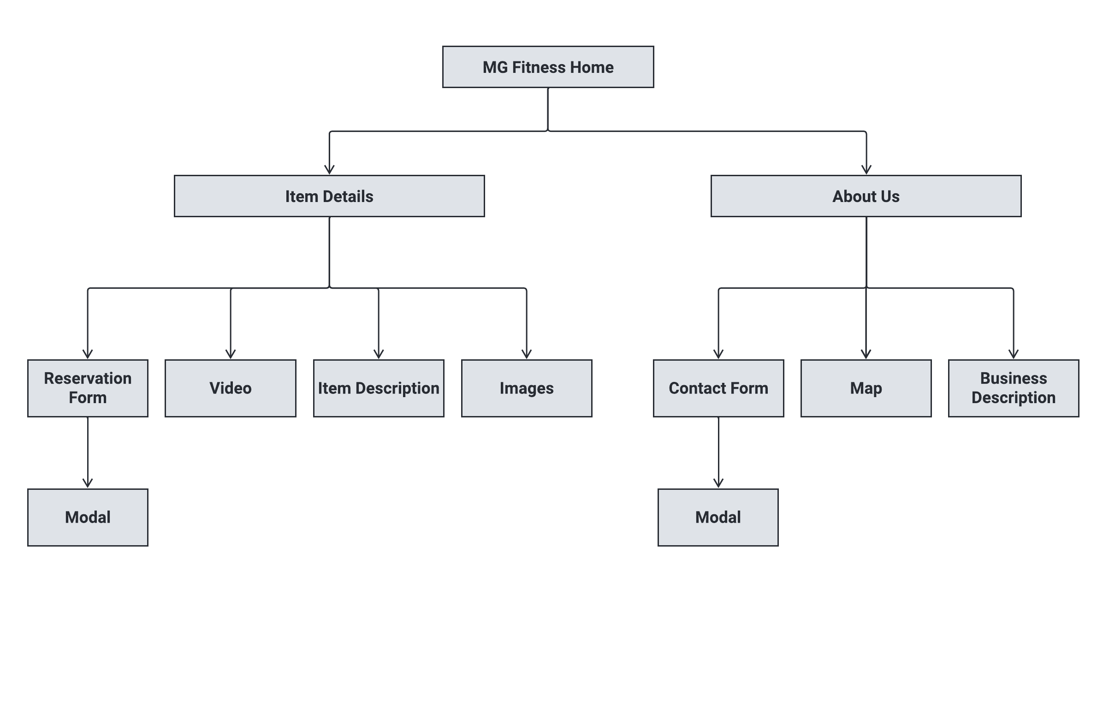
Sitemap :

Slide 7
Features :
Search : Users can search for specific items from the list of available equipments.
Slider : Sliders allow users to browse through multiple images by the use of arrows.
Listing : The available items are listed in the website for ordering.
Details : Each item has it’s own page where all the details are mentioned like price, features, video, description and images.
Reserve : User can reserve an item by filling the reservation form and submitting it.
Responsive : The website is compatible with all devices.
Contact : User can log queries or get in touch with the contact form.

Slide 8
Conclusion :
Our MG fitness website developed using HTML, CSS, Javascript and JQuery has resulted in a user friendly platform and will enhance the user experience.
The responsive design allows the user to browse through all the devices without any hassle.
It allows the user to browse through all the equipment available in stock and order an item from the website.
Reserving an item making it much easier and straight forward for the end user by submitting a form.

