Slide 1

Employee Management System

Slide 2
About Us
Name : P.Gnana Sai Jayanth
Background : B Tech (Data Science)
Reasons to Pursue Data Science:
1. I want to learn Data Science to make better decisions using data.
2. I enjoy finding patterns and useful insights from data.
Name : G.Bhaskar
Background : B Tech (Computer Science Engineering)
Reasons to Pursue Data Science:
1. I want to learn Data Science because it offers many job opportunities. 2. It provides excellent career growth.
Name : M.Kushal
Background : B Tech (Computer Science Engineering)
Reasons to Pursue Data Science:
1. I want to learn Data Science to understand data and find useful information from it. 2. It helps me too solve real-world problems in a better way.

Slide 3
Agenda
Business Problem
Objective of the Project
ER Diagram
Key analyis questions
Key Insights
Conclusion
Experience/Challenges working

Slide 4
Business Problem
Management lacks clear visibility into whether employees are being fairly placed, compensated, and promoted based on their experience, qualifications, and job roles.
This project analyzes employee data to identify potential issues such as career stagnation, salary disparities, qualification–role mismatches, unequal bonus distribution, and unusual leave patterns, helping HR make better workforce decisions.

Slide 5
Objective of the Project
Analyze employee experience, salary, qualifications, leave patterns, and raise history to identify career stagnation, salary disparities, and role mismatches.
Develop a workforce risk score to identify employees who may require HR attention.

Slide 6
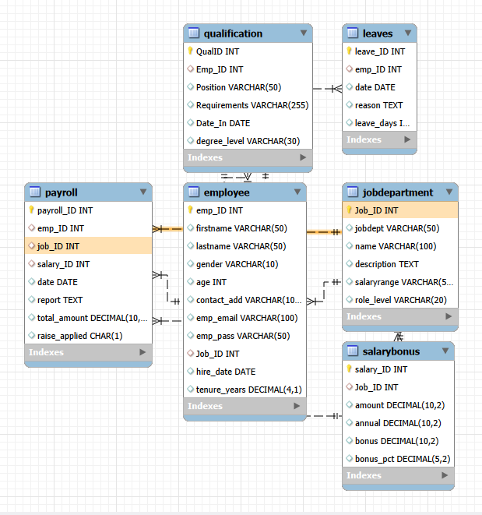
ER Diagram(Entity Relationship Diagram)
The Employee table acts as the central entity and is connected to the Department, Salary, Leave, Qualification, and Payroll tables through foreign keys.

Slide 7
Key analysis questions
Which employees have been with the organization for 5 or more years but are still in Junior or Mid-level roles?
Which employees are earning a monthly salary below the average salary of their respective department?
Which departments have the largest salary gap between the lowest-paid and highest-paid employees?
Which employees appear to have a mismatch between their educational qualification and current role level, such as highly qualified employees in lower roles or less-qualified employees in senior roles?
Which employees have taken the highest number of leaves and total leave days?
Which employees have the highest risk score based on career stagnation, below-department-average salary, and absence of salary raises?

Slide 8

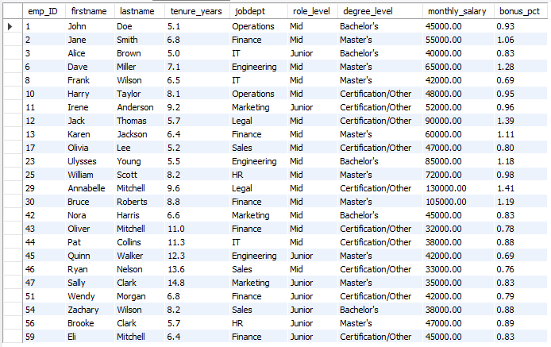
1. Write employees have been with the organization for 5 or more years but are still in Junior or Mid-level roles?
Output :
.
Observation:
The query retrieves all employee profiles for individuals who have been with the organization for 5 or more years and are currently holding Junior or Mid-level roles.

Slide 9
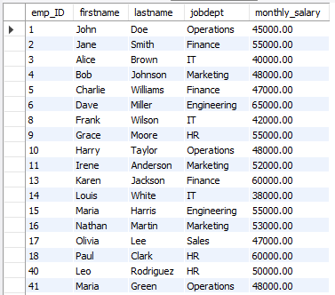
2. Write employees are earning a monthly salary below the average salary of their respective department?
Output :
.
Observation:
The query retrieves employee details for individuals whose monthly salary is lower than the average monthly salary of their respective department using a correlated subquery.

Slide 10

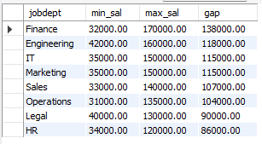
3. Which departments have the largest salary gap between the lowest-paid and highest-paid employees?
Output :
.
Observation:
The query calculates the minimum salary, maximum salary, and the salary gap for each department, ordering the results by the salary gap in descending order to identify the departments with the largest disparity.

Slide 11

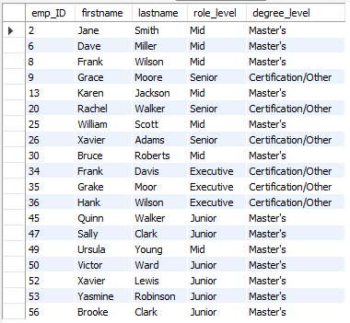
4. Which employees appear to have a mismatch between their educational qualification and current role level, such as highly qualified employees in lower roles or less-qualified employees in senior roles?
Output :
.
Observation:
The query retrieves employee details for individuals who either hold a Master's degree in Junior or Mid-level roles, or possess a Certification/Other degree level in Senior or Executive roles.

Slide 12

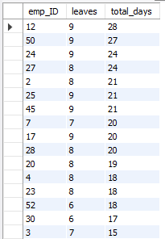
5. Which employees have taken the highest number of leaves and total leave days?
Output :
.
Observation:
The query calculates the total number of leave instances and the total leave days taken by each employee, grouping the results by employee ID and ordering them by total days in descending order.

Slide 13
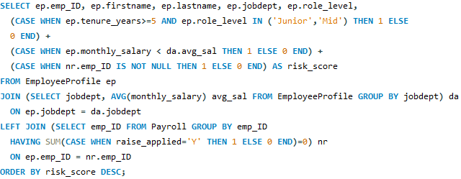
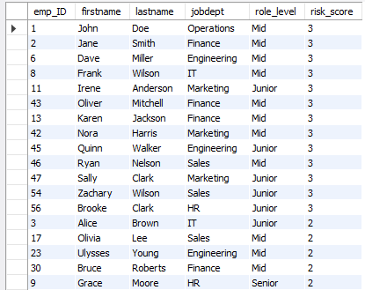
6. Which employees have the highest risk score?
Output :
.
Observation:
The query calculates a composite risk score for each employee based on tenure/role level, below-average salary, and lack of applied raises, ordering the results in descending order to highlight those with the highest risk score.

Slide 14
Key Insights
Identified employees facing career stagnation despite having higher experience.
Found salary disparities among employees and across departments.
Detected qualification–role mismatches where employee education does not align with role level.
Analyzed leave patterns to identify employees with unusually high leave usage.
Identified employees earning below their department’s average salary.
Developed a Workforce Risk Score to highlight employees who may require HR attention.
Learned how SQL-based analysis can support fairer, data-driven HR decisions related to salary, promotion, and employee placement.

Slide 15
Conclusion
The project provides HR with a clearer understanding of employee placement, compensation, career growth, qualifications, and leave patterns. By identifying career stagnation, salary disparities, role mismatches, unequal bonuses, and unusual leave trends, management can recognize areas where employees may not be treated fairly.
The Workforce Risk Score further helps prioritize employees who may require HR attention. Overall, the analysis supports more fair, transparent, and data-driven decisions related to salary, promotions, employee roles, and workforce management.

Slide 16
Experience/Challenges working
Learned to design and manage relational databases using SQL.
Improved SQL skills using JOINs, subqueries, GROUP BY, CASE, and aggregate functions.
Analyzed career stagnation, salary disparities, qualification mismatches, and leave patterns.
Faced challenges in combining multiple tables and debugging complex queries.
Gained experience in creating employee risk scores for HR decision-making.

Slide 17

THANK YOU

