Slide 1
Code Genie – AI Explainer and Code Generator
.

Slide 2
Problem Statement
Learning multiple programming languages is challenging for beginners
Most tools support only a single language
Lack of explanations makes understanding difficult
Need for a simple tool that generates code from English and explains it clearly

Slide 3
Objective
Develop an AI-powered web application
Convert natural language into working code
Support multiple programming languages
Explain code step-by-step in simple English
Provide user management and feedback system
Include admin monitoring features
.

Slide 4
Technology Stack
Layer
Technology
Frontend
Syntax Highlighting
Charts
Backend
Database
AI Model
API
HTML, CSS, JavaScript
Highlight.js
Chart.js
Python, Flask
SQLite
Meta LLaMA 3.1 8B Instruct
HuggingFace Inference API

Slide 5
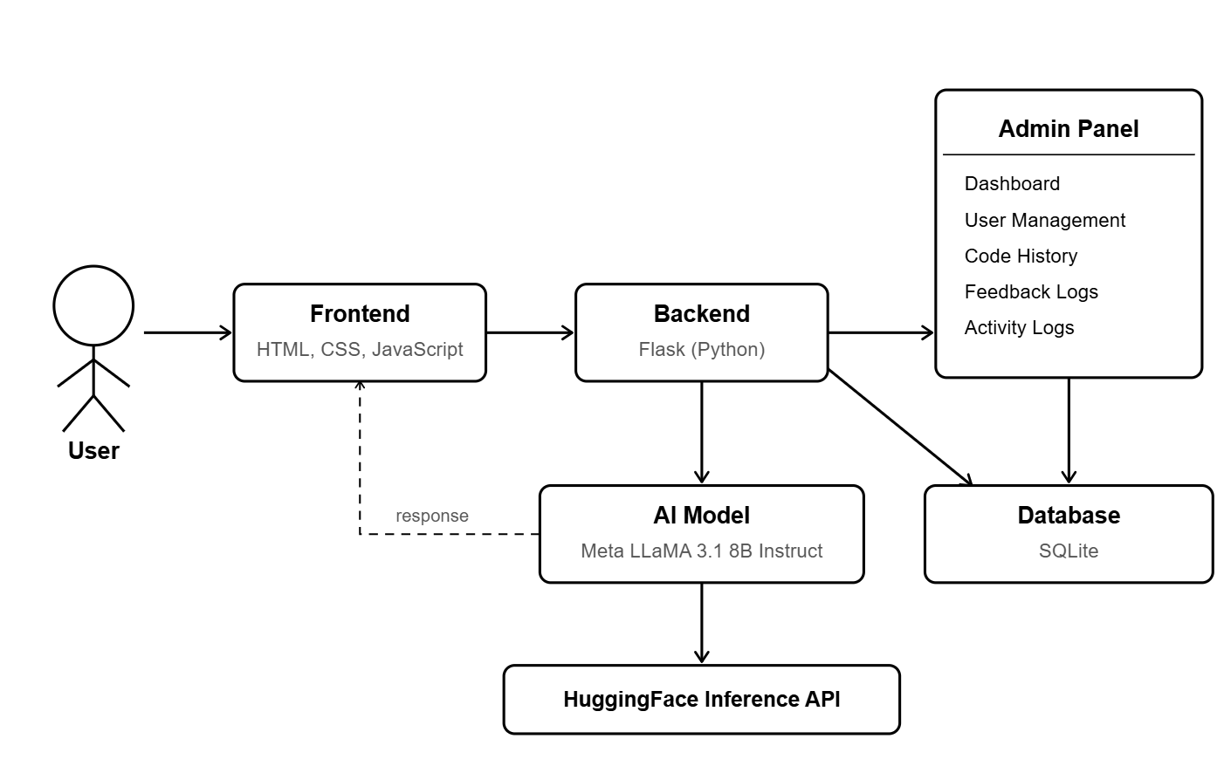
System Architecture
.

Slide 6
Working Flow of the System
User logs in
AI model generates code
Select Language
Code is displayed
Enter prompt
User clicks “Explain Code”
Request sent to backend
Explanation is generated

Slide 7
Features
AI-based code generation (5 languages)
Step-by-step code explanation
Syntax highlighting for readability
User profile with code history
Feedback and rating system
Admin dashboard for monitoring
.

Slide 8
Conclusion
Code Genie demonstrates the practical use of Generative AI in software development and learning. It makes programming easier by generating and explaining code through a simple interface. With support for multiple languages, user-friendly features, and admin monitoring, it provides a complete AI-powered solution.

Slide 9
Thank You
.

