Slide 1
Adaptive Feature Matching using Hierarchical Reinforcement Learning
Level-2 Adaptive Keypoint Budget Optimization & Benchmark Evaluation
Final Project Report | Verified Results across HPatches & MegaDepth-1500

Slide 2
MOTIVATION & CHALLENGE
The Problem: How Many Keypoints Should We Use?
The Keypoint Dilemma
• Traditional pipelines use a fixed number of keypoints:
Every image pair gets the exact same budget (e.g., 1000 or 4000 keypoints).
• Too few keypoints (e.g. 500)::
Hard pairs fail to match when lighting or perspective changes significantly.
• Too many keypoints (e.g. 4000)::
Easy pairs waste massive compute and extract redundant/noisy features.
• Core Reality::
No single fixed budget is optimal across diverse real-world images.
What We Need
✓ Dynamic allocation: High budget for complex viewpoint changes.
✓ Early stopping: Low budget for simple illumination variations.
✓ Zero manual tuning: An agent that automatically senses difficulty.
✓ Compute efficiency: Maximize accuracy while minimizing feature extraction cost.

Slide 3
CORE ARCHITECTURE
Our Solution: Adaptive Keypoint Budget via Reinforcement Learning
01
Level 1: Pipeline Selection
Selects the best detector and descriptor algorithm (e.g., SIFT, AKAZE, ORB) suited for the overall scene.
(Future Integration / Modular)
02
Level 2: Budget Allocation
Dynamically adjusts the keypoint count (+500, +1000, -500, STOP) for the chosen pipeline.
(Focus of this Evaluation)
03
Utility-Driven Objective
Maximizes matching accuracy while imposing a keypoint cost penalty (λ = 0.1).
(Learns When to Stop)

Slide 4
RL AGENT WORKFLOW
Inside the Level-2 RL Agent: Step-by-Step Execution
1. Observe
Reads 31-D state vector:
• Image pair statistics (contrast, brightness)
• Pipeline 1-hot encoding
• Matching score, inlier ratio, recent delta
2. Action
PPO Policy chooses 1 of 4 discrete actions:
• +500 keypoints
• +1,000 keypoints
• -500 keypoints
• STOP immediately
3. Evaluate
Runs detector/descriptor pool slice, executes BF match, and fits homography via RANSAC.
4. Reward
Reward = Δ Utility - Step Penalty
Utility = Accuracy - λ × (Keypoints / 4000)
Agent learns to stop when gains saturate.

Slide 5
BASELINE MOTIVATION
Why Fixed Budgets Fail: The Baseline Comparison
Fixed 500
26.89% AUC@3px
Keypoints: 495.6 KP Avg
Lightweight but suffers from low inlier count on viewpoint changes.
Fixed 1000
31.08% AUC@3px
Keypoints: 979.5 KP Avg
Standard default, but still fails on challenging perspective shifts.
Fixed 2000
35.07% AUC@3px
Keypoints: 1,897.0 KP Avg
Higher accuracy, but wastes compute on simple illumination pairs.
Fixed 4000
36.34% AUC@3px
Keypoints: 3,424.4 KP Avg
Brute-force upper bound; very slow and extracts redundant points.

Slide 6
BENCHMARK DESIGN
Experimental Setup: HPatches & RIPE Evaluation Protocol
HPatches Benchmark Split
• 116 Total Sequences in HPatches dataset.
• Held-out Test Split: 17 sequences = 85 image pairs.
• 8 Illumination sequences (40 pairs): Brightness variations.
• 9 Viewpoint sequences (45 pairs): Wide camera angles.
• Strict Isolation: Zero train/validation overlap with test set.
• 4,675 Total Evaluations: 85 pairs × 11 presets × 5 methods.
RIPE Homography AUC Metric
• Mean 4-Corner Reprojection Error: Pixel distance between estimated homography corners and ground truth.
• Normalized Cumulative AUC (Trapezoidal Integration):
• • AUC@1px: High precision registration (< 1 px).
• • AUC@3px: Primary benchmark threshold (< 3 px).
• • AUC@5px: General geometric alignment (< 5 px).
• Success Rates: Percentage of pairs with error < threshold.

Slide 7
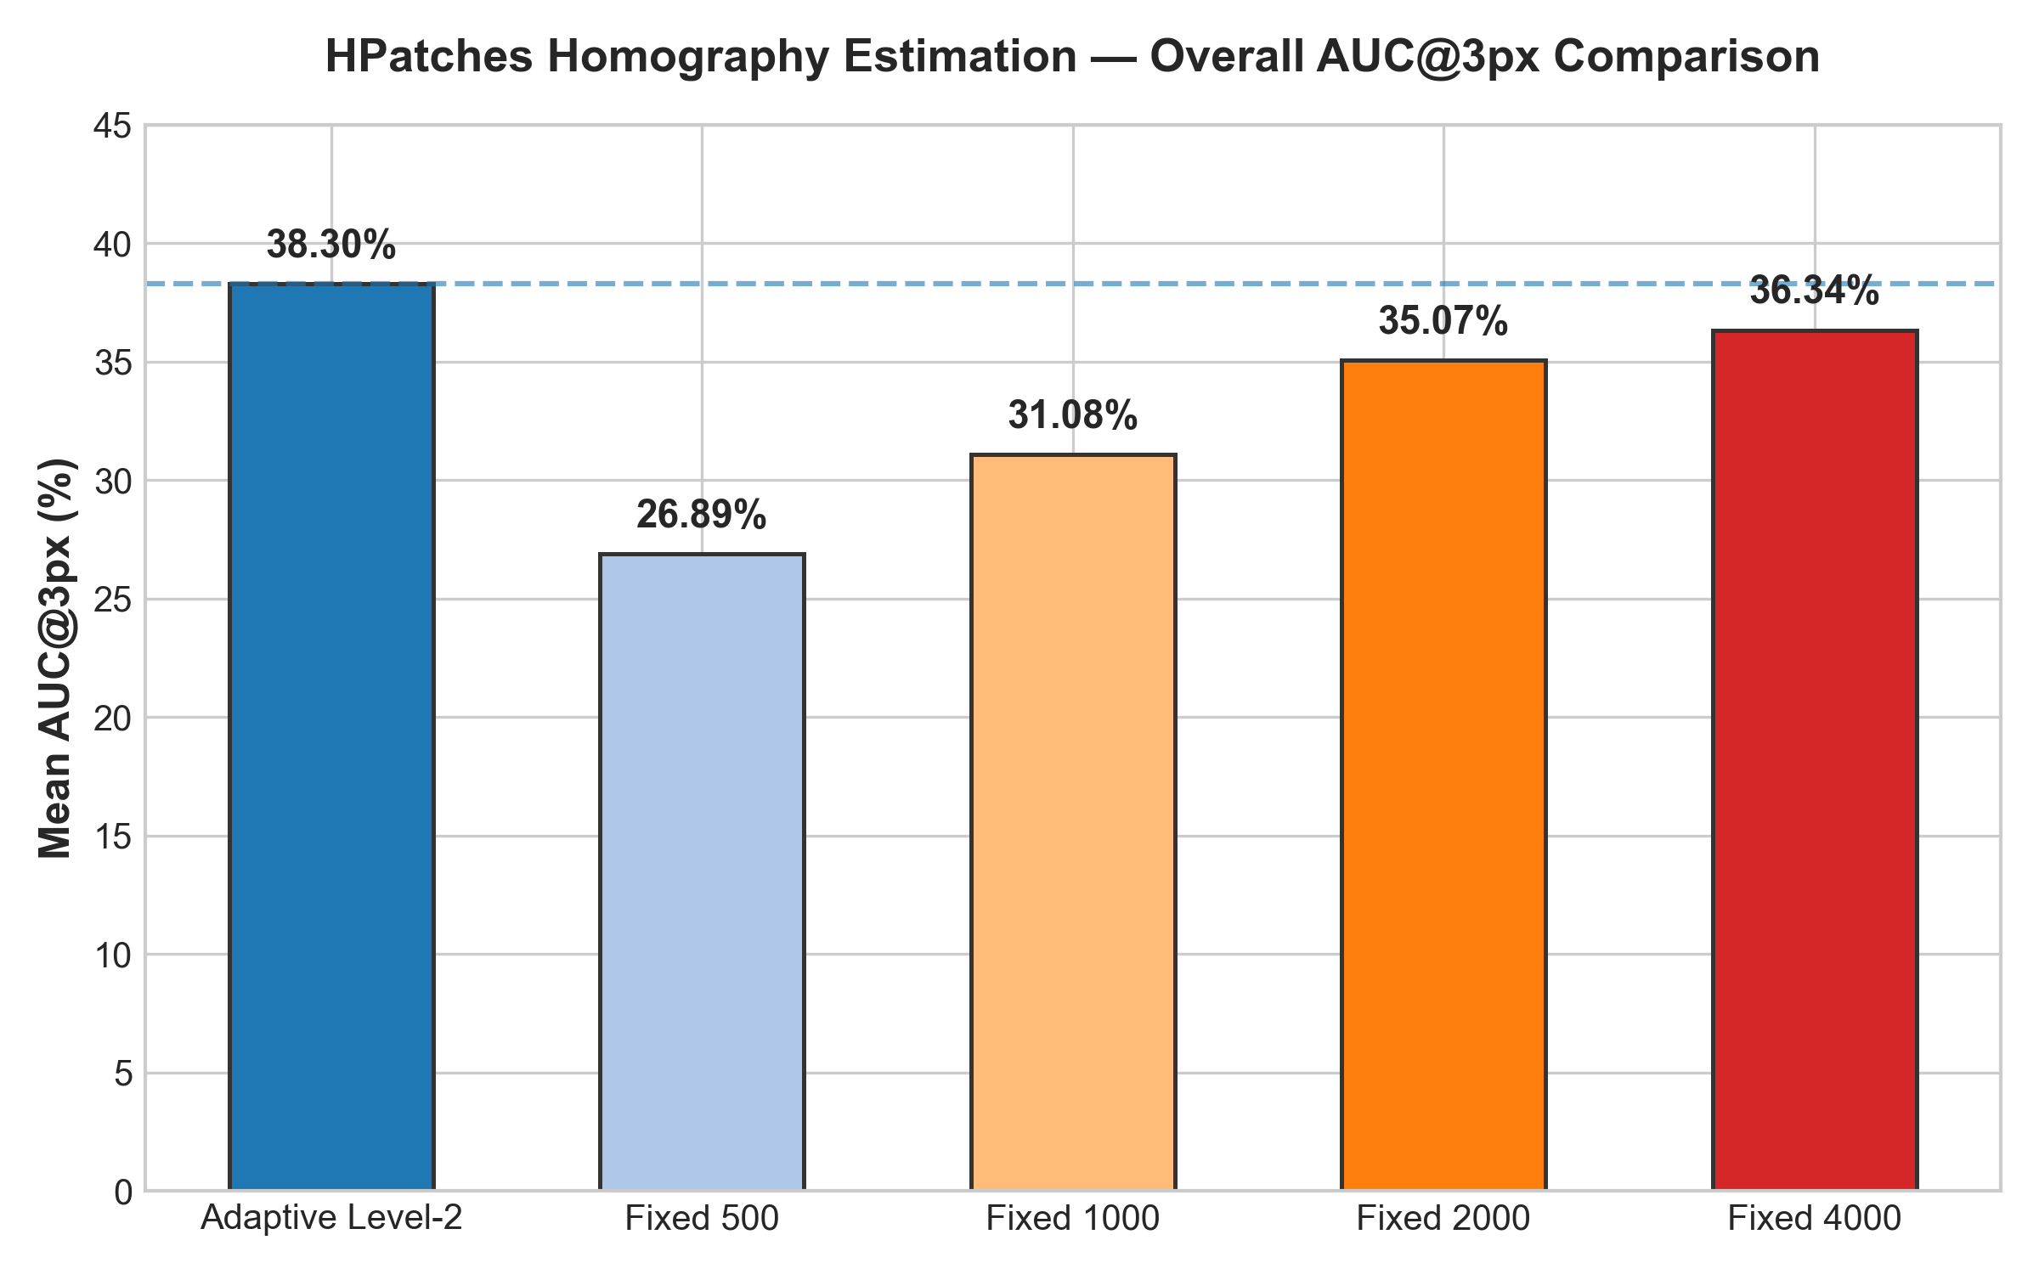
HPATCHES OVERALL PERFORMANCE
Main Result: Adaptive Level-2 Outperforms All Fixed Baselines
Key Verified Numbers
Adaptive Level-2:
38.30% AUC@3px (1,192 KP avg)
Fixed 4000:
36.34% AUC@3px (3,424 KP avg)
Fixed 2000:
35.07% AUC@3px (1,897 KP avg)
Fixed 1000:
31.08% AUC@3px (980 KP avg)
Fixed 500:
26.89% AUC@3px (496 KP avg)
Outcome: Adaptive Level-2 achieves highest overall accuracy while using ~65% fewer keypoints than Fixed 4000.

Slide 8
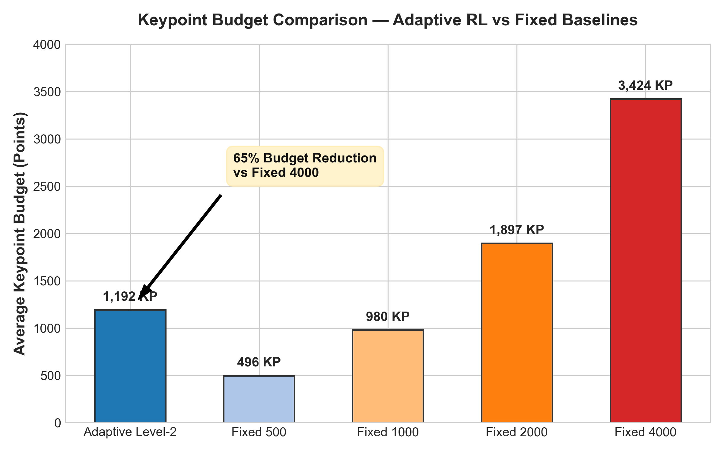
BUDGET EFFICIENCY
Accuracy vs Keypoint Cost: 65% Computational Reduction
Efficiency Breakdown
• vs Fixed 4000:
Saves 2,233 keypoints per pair on average (-65% budget reduction) while increasing AUC@3px by +1.96%.
• vs Fixed 2000:
Saves 705 keypoints per pair on average (-37% budget reduction) while increasing AUC@3px by +3.23%.
• vs Fixed 500:
Gains +11.41% AUC@3px and +21.72% in success rate by dynamically scaling up only when required.
• Adaptation by Difficulty:
Illumination pairs average 934 KP; Viewpoint pairs scale to 1,421 KP.

Slide 9
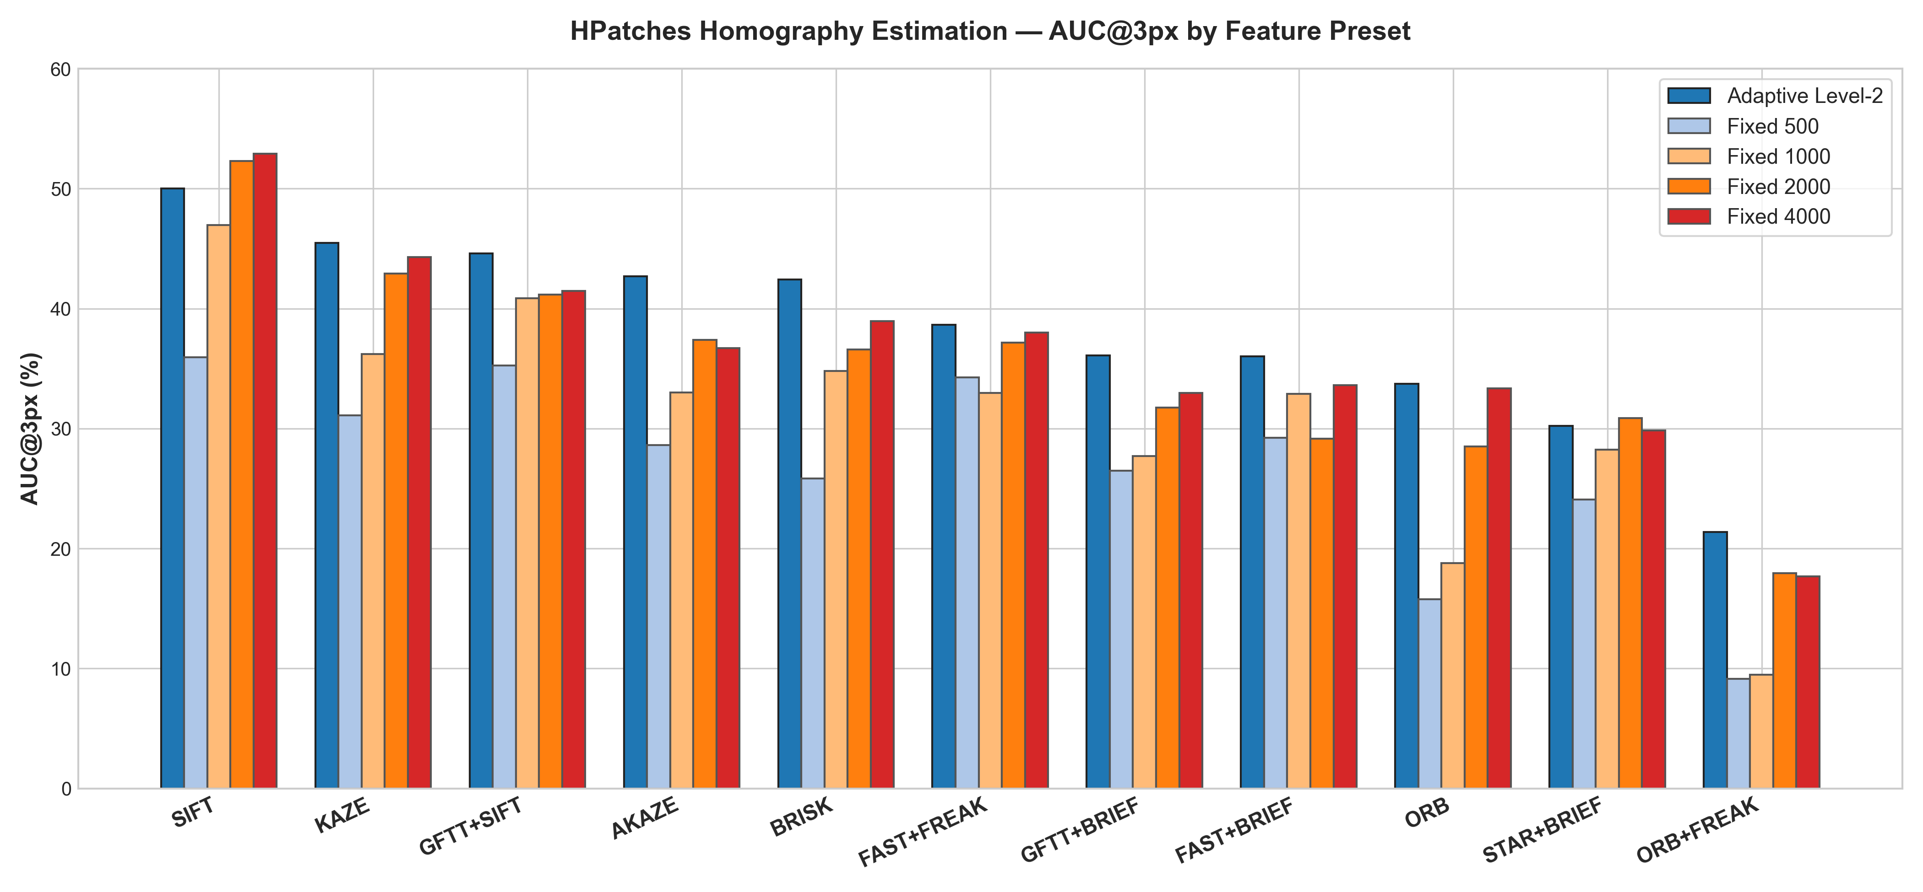
PRESET-LEVEL ANALYSIS
Performance Across All 11 Feature Matching Presets

Slide 10
PIPELINE COMPARISON
Preset Extremes: SIFT (Best) vs ORB+FREAK (Worst)
🏆 Best Preset: SIFT
• AUC@1px: 17.44% | AUC@3px: 50.03% | AUC@5px: 64.41%
• Success Rate @ 3px: 78.82% of all test pairs.
• Average Keypoints: 942 KP (2.94 steps).
• Why it excelled: SIFT's 128-D float descriptors provide high distinctive matching. The agent learns that SIFT achieves high inlier ratio quickly and terminates early, saving budget.
⚠️ Lowest Preset: ORB+FREAK
• AUC@1px: 3.73% | AUC@3px: 21.37% | AUC@5px: 33.69%
• Success Rate @ 3px: 44.71% of all test pairs.
• Average Keypoints: 1,235 KP (4.01 steps).
• Measured finding: ORB+FREAK produced the lowest measured AUC values on this benchmark. This tells us this specific hybrid pipeline was more difficult for the system on this dataset.

Slide 11
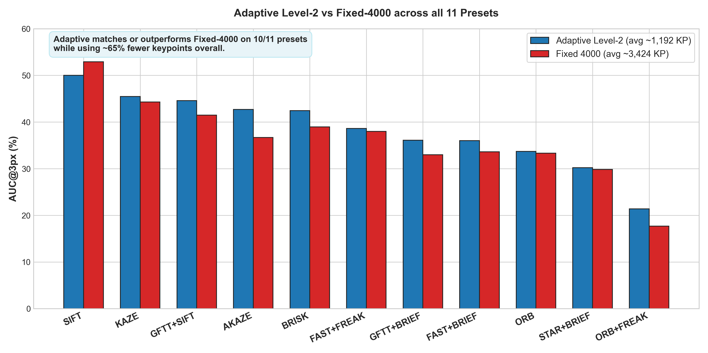
SUMMARY OF GAINS
Why Adaptive Level-2 is Superior: Head-to-Head vs Fixed-4000
10 of 11 Presets Match or Beat Fixed 4000
• AKAZE: 42.71% vs 36.69% (+6.02%)
• BRISK: 42.43% vs 38.96% (+3.47%)
• GFTT+SIFT: 44.61% vs 41.49% (+3.12%)
• GFTT+BRIEF: 36.09% vs 32.98% (+3.11%)
• FAST+BRIEF: 36.01% vs 33.60% (+2.41%)
• KAZE: 45.49% vs 44.30% (+1.19%)
• ORB: 33.72% vs 33.34% (+0.38%)
• STAR+BRIEF: 30.21% vs 29.83% (+0.38%)

Slide 12
OUTDOOR 3D BENCHMARK
MegaDepth-1500 Experiment: Testing 3D Relative Pose Estimation
Why MegaDepth-1500?
• HPatches evaluates planar homographies (2D transformations).
• MegaDepth evaluates 3D outdoor scenes with 6-DoF camera motion.
• Goal: Test whether the Level-2 RL agent can be trained directly on epipolar geometry.
• Dataset Split: 1,050 train pairs, 225 validation pairs, 225 test pairs.
• Training Budget: 170,528 timesteps matching the verified HPatches budget.
3D Relative Pose Metric
• Essential Matrix Estimation via 5-point RANSAC using camera intrinsics (K1, K2).
• Angular Pose Error: Maximum of rotation error and translation angle error: max(err_R, err_t).
• Pose AUC Reported at 5°, 10°, and 20° thresholds (RIPE protocol standard).
• Training Reward: Sampson epipolar distance surrogate: exp(-mean_sampson_error / 5.0).

Slide 13
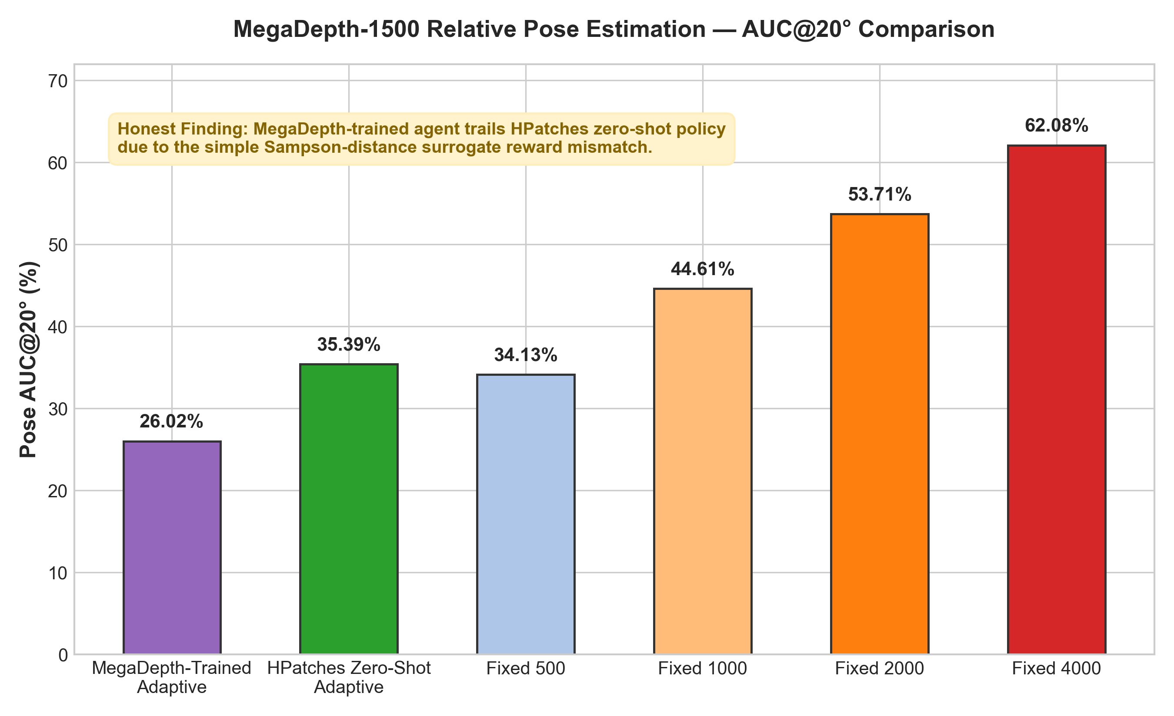
MEGADEPTH TEST RESULTS
MegaDepth Results: Honest Analysis of Surrogate Reward
Key Findings on MegaDepth
MegaDepth-Trained Adaptive:
26.02% AUC@20° (529 KP avg)
HPatches Zero-Shot Adaptive:
35.39% AUC@20° (619 KP avg)
Fixed 500 Baseline:
34.13% AUC@20°
Fixed 4000 Baseline:
62.08% AUC@20°
Interpretation: The simple Sampson-distance surrogate reward was insufficient to guide productive policy learning. The policy became overly conservative.

Slide 14
LESSONS & INSIGHTS
Key Insights: What Did We Learn?
1. Dynamic keypoint allocation is highly effective for 2D homography
Achieved higher accuracy than 4,000 fixed points while saving 65% of keypoint budget.
2. SIFT remains the strongest classical matching pipeline
Yielded 50.03% AUC@3px on HPatches test split; stopping early when inliers saturate.
3. Fixed budgets are fundamentally inefficient
Fixed 500 fails on hard scenes; Fixed 4000 is heavily redundant on clean scenes.
4. Reward formulation is critical for RL transfer
Using surrogate distance rewards for 3D pose estimation led to conservative budget stopping. Future 3D models require direct Essential matrix pose rewards.

Slide 15
ROADMAP
Project Scope: Limitations & Future Directions
Current Limitations
• Level 2 Only: Focus was on budget allocation; Level 1 pipeline selection was not trained end-to-end.
• MegaDepth Reward Surrogate: Utilized Sampson distance rather than exact 5-point angular error.
• Hardware Profiling: Efficiency measured via keypoint count, not physical millisecond runtime on edge chips.
• Aachen Out of Scope: 6-DoF visual localization benchmark was not evaluated in this phase.
Future Work
• Level 1 + Level 2 Integration: Train high-level pipeline selection on top of frozen Level 2 budget policy.
• Direct 3D Pose Rewards: Incorporate camera intrinsics into MegaDepth step rewards.
• Aachen Day-Night Evaluation: Benchmark on outdoor visual localization under extreme illumination shifts.
• Edge Device Deployment: Measure wall-clock latency on NVIDIA Jetson and mobile devices.

Slide 16
CONCLUSION
Adaptive Reinforcement Learning Solves the Fixed Keypoint Dilemma
On the HPatches benchmark under the RIPE evaluation protocol, our Level-2 Adaptive RL agent achieved 38.30% AUC@3px, beating the brute-force Fixed-4000 baseline (36.34%) while saving over 65% of keypoint extractions (1,192 vs 3,424 keypoints).
By sensing scene difficulty dynamically, the agent scales up keypoints on challenging viewpoint changes and stops early on clean illumination pairs, providing superior accuracy and computational efficiency.

