Slide 1
How Salary Drivers in Data Science Evolved Between 2020–2025: A Comparative Study of Regularized and Non-Linear Models
Name: Gnanesh Cheedarla
Student ID: 23065307
Supervisor Name: Sugata Kaviraj
Git Hub link: https://github.com/gnanesh1303/Final_project

Slide 2
Research Objective
Goal:
Analyze global Data Science salary trends (2020–2025).
Compare Regularized Linear Models (Ridge, Lasso, ElasticNet) vs Non-Linear Models (Random Forest, XGBoost).
Identify strongest salary-driving features (seniority, work mode, location, etc.).

Slide 3

Dataset Used:
Latest Data Science Job Salaries (2020–2025) by Saurabh Badole (Kaggle).
Shape of dataset:
Data Quality:
No missing values.
Covers six years (2020–2025).
Dataset link: https://www.kaggle.com/datasets/saurabhbadole/latest-data-science-job-salaries-2024

Slide 4
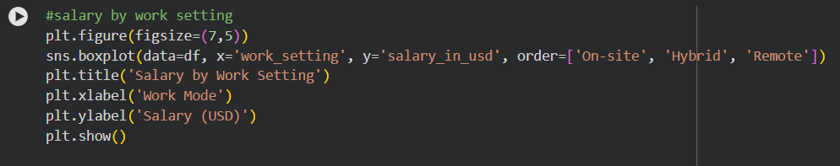

Slide 4 – Data Cleaning & Preprocessing
Standardized column names.
Created new features:
  work_setting (Remote / Hybrid / On-site).
  Simplified categorical levels (title-case).
Removed outliers (salary_in_usd > 400,000).

Slide 5
Exploratory Data Analysis (EDA)
Key Insights:
Average salary increased steadily from $93K (2020) → $157K (2024).
Small dip in 2025 due to global normalization (mean $151K).
Remote roles and senior positions earn the highest pay.
Large companies pay more on average.
Top roles: ML Engineer, AI Engineer, Data Architect.

Slide 6
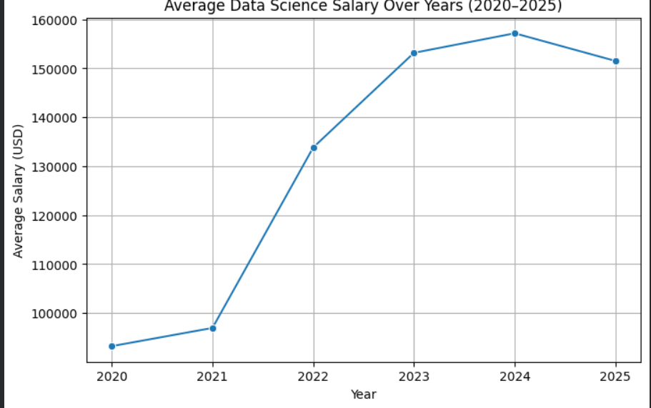
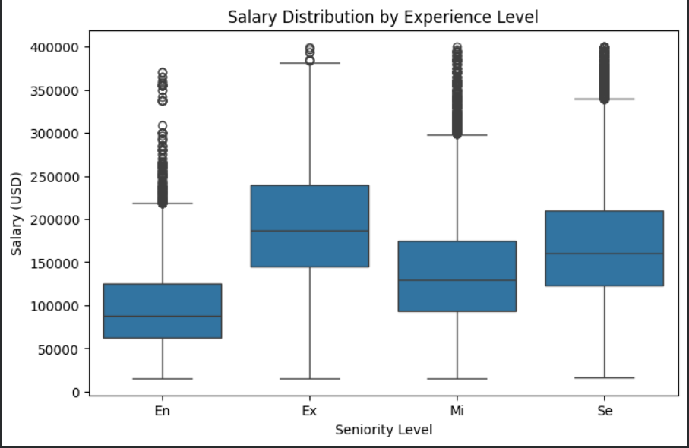
EDA Graphs

Slide 7
More EDA Highlights
Remote ratio rose sharply after 2020, stabilizing after 2023.
Salary gaps exist across regions — U.S. highest average.
Correlation heatmap shows strong link between experience level, company size, and salary.

Slide 8
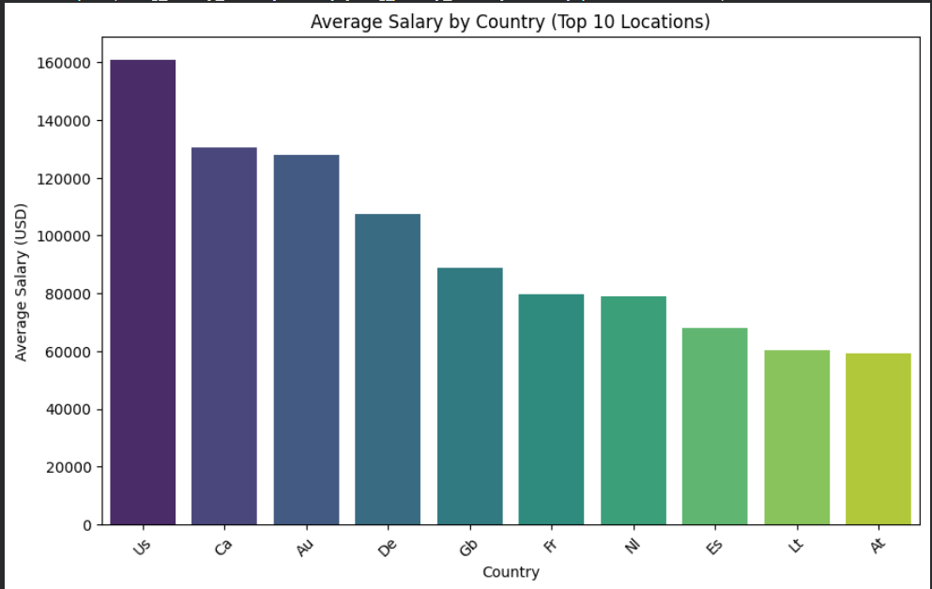
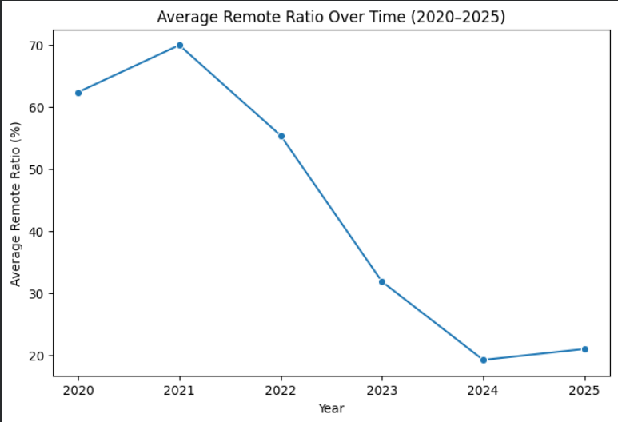
Average Salary by country and Average Remote ratio over time

Slide 9
Modelling Techniques
Target: salary_in_usd
Features: year, seniority_level, status, job_title, company_size, work_setting, employee_residence.
Models Used:
Regularized Linear Models: Ridge, Lasso, ElasticNet
Non-Linear Models: Random Forest, XGBoost
Pipeline:
One-Hot Encoding (categorical)
Standard Scaling (numeric)
80-20 Train/Test Split

Slide 10
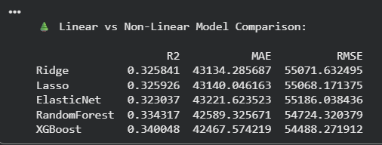
Model Results (before Hyper parameter Tuning)

Slide 11
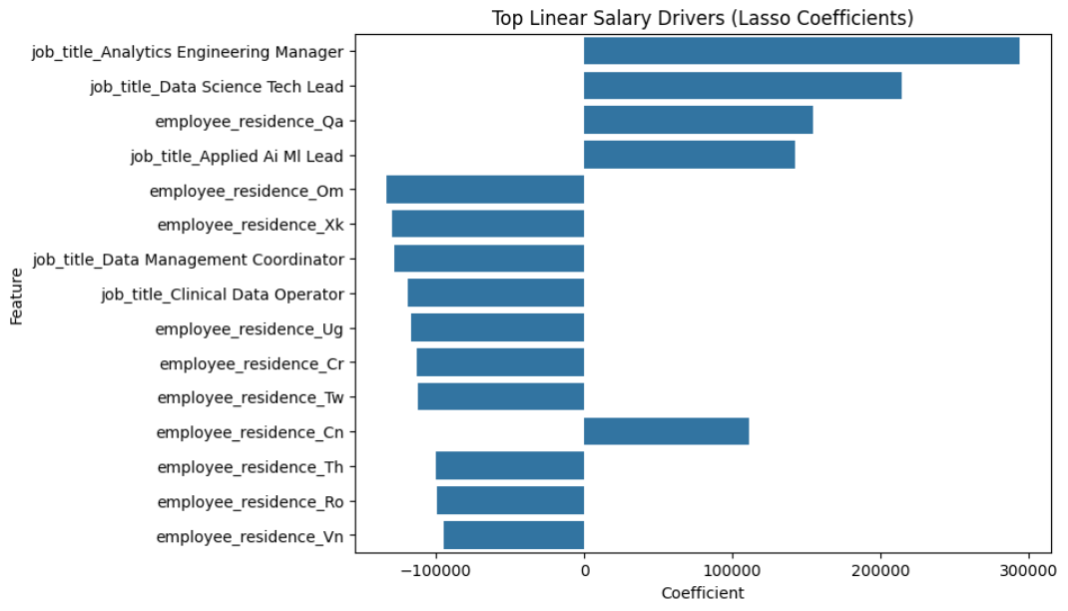
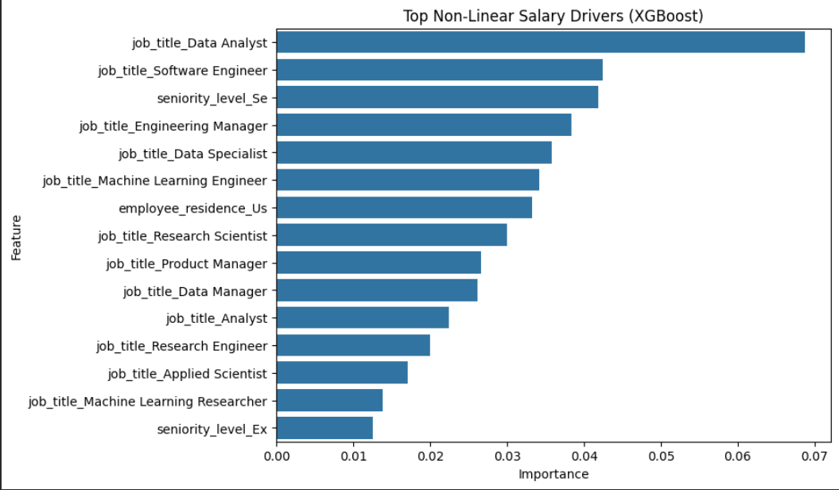
Feature Importance Comparision
Linear (Lasso):
  Strongest salary drivers: Seniority_Level, Company_Size, Year.
Non-Linear (XGBoost):
  Key interactions: Job_Title × Year, Work_Setting × Location, Seniority_Level.

Slide 12
Insights & Interpretation
Regularized models: Easier to interpret, capture direct linear trends.
Non-linear models: Capture complex interactions → higher accuracy.
Salary evolution: 2020–2024 rapid growth; 2025 slight correction.
Top salary factors: Seniority, company size, role type, work setting, and country.

Slide 13

Next Steps
Hyper Parameter Tuning.
Apply SHAP analysis for interpretability.
FPR

Slide 14

References
Rahhal, I., et al., 2024. Data science for job market analysis: A survey on labour market analytics. Expert Systems with Applications: https://www.sciencedirect.com/science/article/abs/pii/S0957417424009679
Bone, M., Ehlinger, E. & Stephany, F., 2023. Skills or Degree? The Rise of Skill-Based Hiring for AI and Green Jobs. arXiv [preprint] arXiv:2312.11942: https://arxiv.org/abs/2312.11942
Stephany, F., Mira, A. & Bone, M., 2025. Beyond pay: AI skills reward more job benefits. arXiv [preprint] arXiv:2507.20410: https://arxiv.org/abs/2507.20410

Slide 15

Thank You

