Slide 1
SMART TRAFFIC LIGHT SYSTEM USING IOT
PRESENTED BY
Gnaneshwar.G – 211423104167
Harish Kumar.S – 211423104209
GUIDE NAME: Mrs. S.Lincy Jemina .,M.E,(Ph.D).

Slide 2
THANK YOU FOR YOUR GUIDENCE
PROJECT CO-ORDINATORS
Dr. P. DEEPA , M.E, Ph.D.
Associate Professor
Department Of CSE
Panimalar Engineering College
Mrs. S.LINCY JEMINA , M.E, (Ph.D).
Assistant Professor
Department Of CSE
Panimalar Engineering College

Slide 3
OUTLINE
ABSTRACT
INTRODUCTION
LITERATURE REVIEW
EXISTING SYSTEM
PROPSED SYSTEM
SYSTEM ARCHITECTURE
PROPSED METHODOLOGY
RESULTS
CONCLUSION
FUTURE WORK

Slide 4
ABSTRACT
A Internet of Things-based smart traffic light system technology is a great example of how cities can increase traffic monitoring and reduce congestion in real time. This system uses IoT sensors like cameras, infrared detectors, and vehicle counters at intersections to measure traffic density. The information gathered by these sensors is transmitted wirelessly to middle control system, which processes the information and adjusts the traffic lights as needed. By adjusting the lights based on real-time traffic conditions, the system helps reduce the time drivers spend waiting at red lights.

Slide 5
INTRODUCTION
As the world's population moves from rural to In cities, traffic management has become a serious concern.
The number of vehicles in urban areas has grown quickly, putting a lot of pressure on city roads.
Traditional traffic signals, which either rely on manual control or fixed time cycles, are not good enough for handling these changing traffic conditions.
These systems can't adjust to real-time changes, leading to problems like traffic jams, Long journey times, more fuel consumption, and increased emissions.
Manual control helps during busy or emergency times, but it takes a lot of work and is not always accurate.

Slide 6

LITERATURE REVIEW
S: No | Title | Authors | Year | Decsription
1. | Smart Traffic Light System Using Internet of Things | vijay Gaikwad, Apoorva Holkar, Tejas Hande, Priyanka Lokhande, Vivek Badade | 2023 | The Smart Traffic Light System using IoT intelligently controls traffic flow using sensors and automation, reducing congestion and giving priority to emergency vehicles.
2. | Smart Traffic Light Control System | Arun Kumar Pipersenia | 2022 | An IoT-based system that automatically manages traffic flow for efficient and safe transportation.
3. | An Intelligent Traffic Signaling System Based on an IoT Infrastructure | S.C. Rai, S.P. Nayak, B. Acharya, V.C. Gerogiannis, et al. | 2023 | An IoT-enabled system that optimizes traffic signals using real-time data for smarter traffic management.
4. | IoT Based: Smart Traffic Light Controller | Faisal Al Kalbani, Nada Al Bulushi, Syed Imran | 2023 | An IoT-based system that dynamically controls traffic lights using real-time vehicle data for smoother traffic flow.
5. | IoT Based Smart Traffic Signal Monitoring System Using Vehicle Density | Gunashree HS, Harshitha DV, Siddesh Prasad BC, Karthik Kumar J, Mrs. Dimple R | 2023 | An IoT-based system that monitors and controls traffic signals based on real-time vehicle density to reduce congestion.

Slide 7
6. | An IoT Application in a Smart Traffic Management System | Shailesh Shivajirao Bhise | 2025 | An IoT-enabled system that enhances traffic management through real-time data collection and intelligent signal control.
7. | Smart Traffic Lighting System | Megha Balmiki, Sahali Dutta, Ankita Majumder, Osmeeta Chauhan, et al. | 2022 | An intelligent lighting system that uses sensors and IoT to manage traffic signals efficiently and reduce congestion.
8. | Smart Traffic Management Using Internet of Things (IoT) | Rahul Biju, Sakshi Jain, Nehal Hemdev, Teesha P Jain, Preeth T Jain, Dr. Anita Walia, Dr. Supriya Rai | 2023 | An IoT-based system that monitors and controls traffic in real-time to improve flow and reduce congestion.
9. | An IoT Based Smart Traffic Management System | Pratik Prakash, Aadarsh Singh, Aayush Parasrampuria, Gargi Sharma | 2021 | An IoT-enabled system that optimizes traffic flow and signal control using real-time vehicle data.
10. | IoT Based Intelligent Traffic Management System | G. Goutham, T. Maheshwar Reddy, N. Varun Reddy, V. Karthik, K. Sai Sudheer | 2020 | An IoT-enabled system that intelligently manages traffic flow and signals using real-time data.

Slide 8
EXISTING SYSTEM:
Most current traffic systems use fixed-time or manual control without real-time
sensing.
They operate on preset intervals, ignoring actual traffic flow or emergency vehicles.
Even semi-automated systems with road sensors lack flexibility during dynamic events.
Types of Existing Systems
Fixed Time Traffic Signal System
Works on a predetermined schedule (e.g., 30 seconds green for each lane).
The timer resets regardless of actual traffic presence.
2. Manually Controlled Signals
Traffic police or operators manage signals manually during peak hours.
Often used during events, VIP movement, or emergencies.

Slide 9
Disadvantages of the Existing System:
Non-Adaptive to Real-Time Traffic
Signals run on fixed timers, ignoring actual traffic flow.
Causes delays even when no vehicles are present.
No Emergency Vehicle Support
Cannot detect ambulances or fire trucks.
Emergency services face delays, risking lives.
Manual control is labor-intensive and error-prone.
Time and Fuel Wastage
Unnecessary waiting increases fuel consumption.
Idle engines contribute to pollution and emissions.

Slide 10
PROPOSED SYSTEM
The proposed system aims to develop an IoT-based Smart Traffic Light System that overcomes the limitations of traditional fixed-time traffic signals. The system utilizes sensors, cameras, microcontrollers, and wireless communication modules to intelligently monitor and control traffic flow in real time. By analyzing traffic density at each intersection, the system dynamically adjusts signal timings to minimize congestion and waiting time.

Slide 11
1.Real-TimeMonitoring
Detects traffic density using sensors/cameras to adjust signals dynamically.
2.Emergency Vehicle Priority
Clears path for ambulances/fire trucks using GPS, RFID, or camera input.
3.Reduced Wait Time & Congestion
Minimizes idle time, improving flow and commuter experience.
4.Lower Fuel Use & Emissions
Reduced idle time cuts fuel consumption and pollution.

Slide 12
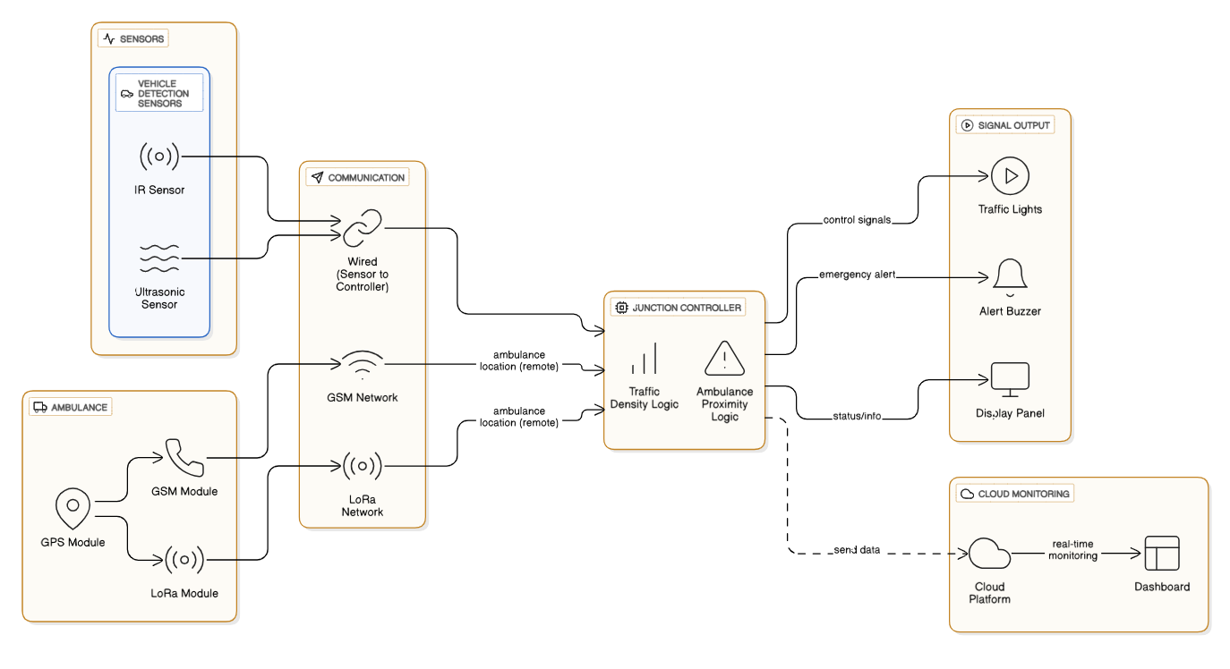
System Architecture

Slide 13
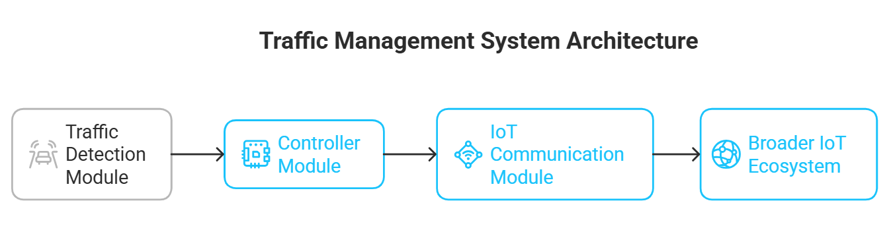
Proposed Methodology
The proposed system consist of Three modules
Traffic Detection Module
2. Controller Module
3. IoT Communication Module

Slide 14
Traffic Detection Module
The traffic detection module is designed to monitor how many cars are on the road. It uses infrared sensors to count all the vehicles present.Additionally, it has a camera that uses OpenCV to analyze a real-time video feed and identify vehicles. The system can also measure the size of each vehicle, giving priority to larger ones. This helps improve the flow of traffic and reduces traffic jams.

Slide 15
Controller Module
The controller module, which could be a Raspberry Pi, ESP32, or similar device, acts like the brain of the system. It gathers data from the sensors and cameras, processes that information, and uses the programmed logic to change how long traffic signals stay on. This module lets the traffic lights respond to how traffic is behaving instead of following a fixed schedule.

Slide 16
IoT Communication Module
This module enables communication between the traffic system and the cloud through Wi-Fi. Traffic data and signal data are transmitted to IoT platforms like ThingSpeak or Firebase, allowing local authorities to monitor the system from a distance. Connecting to the cloud also lets end-users view real-time updates and manually control the system when needed.

Slide 17
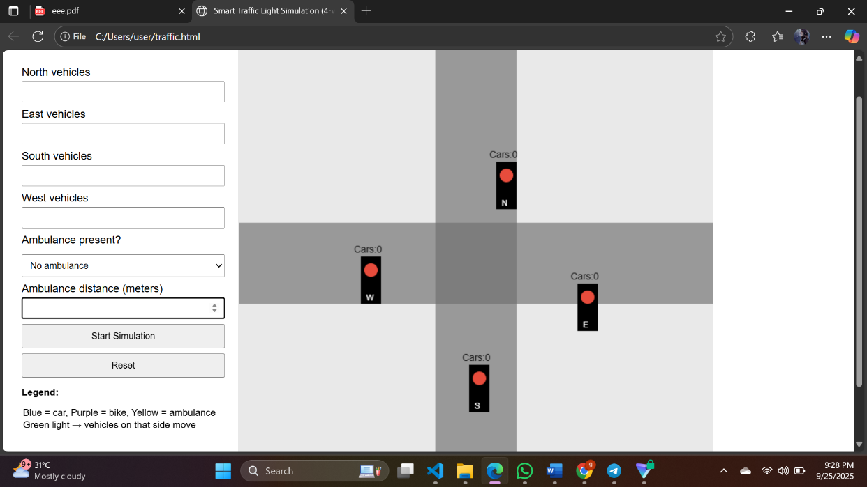
RESULTS

Slide 18
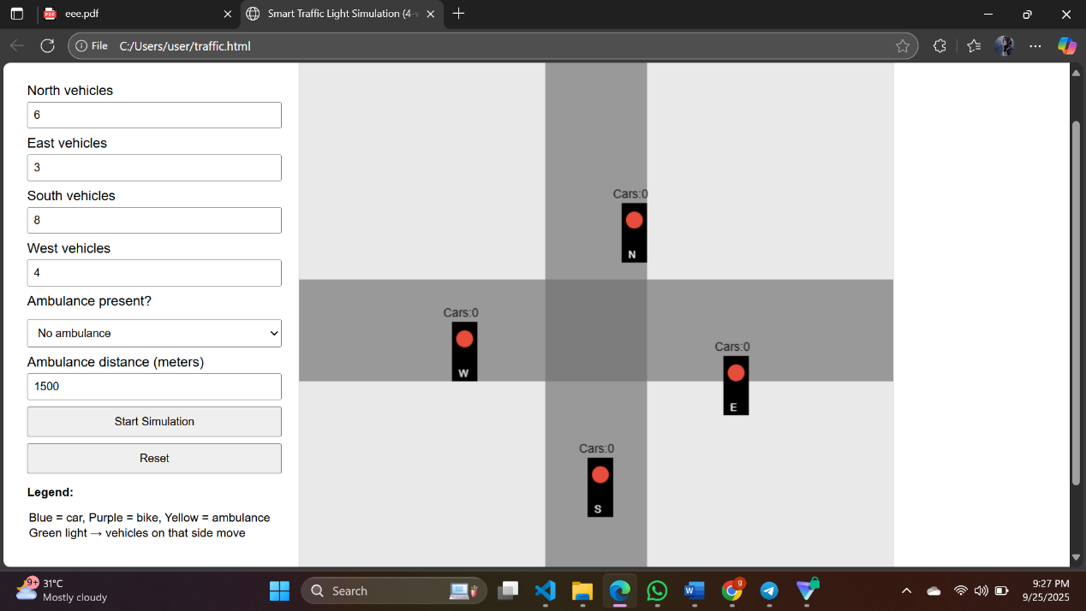

Slide 19
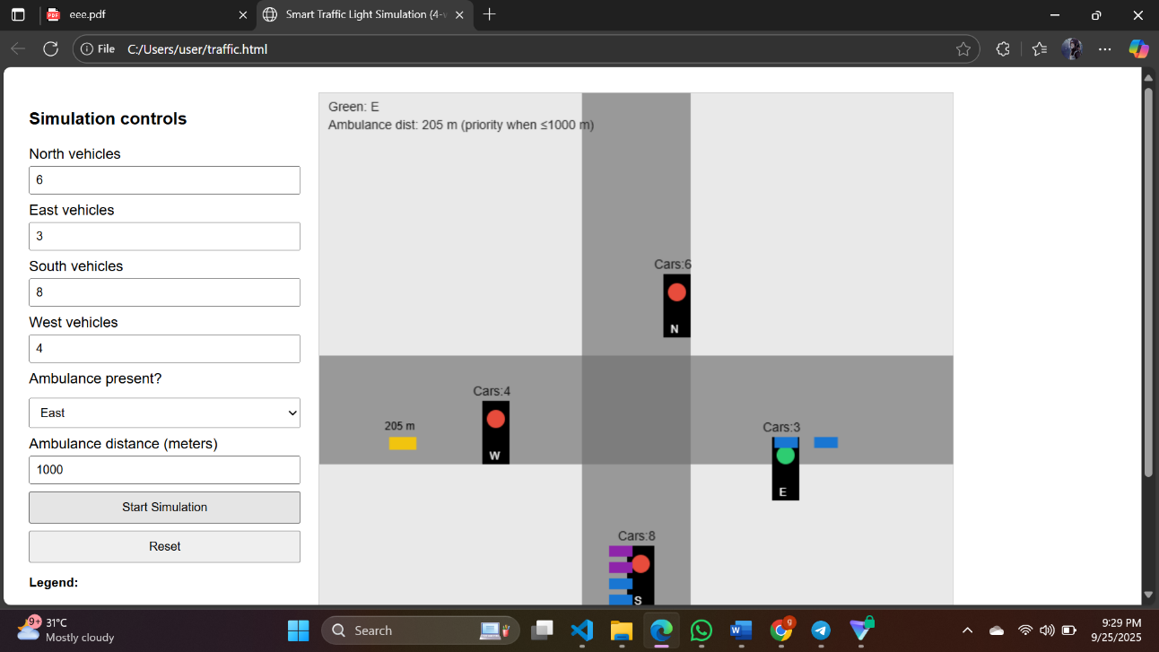

Slide 20
CONCLUSION
This Smart Traffic Light System solves the problems of traditional traffic management by being flexible. Unlike traffic lights that follow a fixed schedule or require manual control, this system changes in real time based on how busy or quiet the roads are. It can clear the way for emergency vehicles like ambulances and fire trucks on the go. Using IoT-enabled sensors such as cameras and cloud connections, it helps cut down waiting times, saves fuel, reduces pollution, and makes traveling easier for everyone.

Slide 21
FUTURE WORK
The Smart Traffic Light System using IoT can be further enhanced to increase efficiency, intelligence, and integration with modern urban infrastructure.
Future improvements may include:
Integration with AI and Machine Learning o Implement predictive traffic modeling to anticipate congestion before it occurs. o Enable adaptive learning from historical traffic patterns to optimize signal timings dynamically.
Vehicle-to-Infrastructure (V2I):
Communication o Allow vehicles to communicate directly with traffic lights for real time updates. o Improve emergency vehicle detection and dynamic rerouting.

Slide 22
THANK YOU

