Slide 1
CS OS PROJECT REVIEW
Context-Aware CPU Scheduling
for Heterogeneous Workloads
From proposed pipeline to working prototype: a heuristic classifier and adaptive
quantum mapper, implemented and benchmarked against a fixed-quantum baseline.
Operating Systems | Module 3 — Scheduling (CO2)
Team Review 2

Slide 2
RECAP FROM REVIEW 1
The Gap We're Targeting
1
2
3
No task-type awareness
Static quantum sizing
Reactive, not predictive
Batch, interactive, and latency-sensitive tasks are dispatched identically.
One time-slice length is forced onto very different task shapes.
Classical MLFQ demotes a task only after it has already misbehaved.
Proposed direction: a lightweight classifier in front of the existing scheduler — no ML, no kernel rewrite — that observes behaviour, classifies task type, and adapts the quantum accordingly.
Context-Aware CPU Scheduling — Review 2
2

Slide 3
PROPOSED METHODOLOGY
Detailed Architecture & Workflow
Task Arrives
→
Signal Collector
→
Heuristic Classifier
→
Quantum Mapper
→
Linux CFS (cgroups)
New/existing task becomes runnable
Samples I/O-wait ratio, burst length,
wake-up frequency, CPU share
Threshold rules -> batch / interactive /
latency-sensitive
Class -> quantum (ms) / cgroup
nice-weight
Task re-tagged, dispatched with
new quantum
Runs continuously as a user-space daemon — re-tags cgroups on a fixed interval; falls back to the default quantum when classification confidence is low.
Classification rules & resulting quantum
Signal pattern observed | Classified as | Quantum
Wake-ups ≥ 8/s and avg burst ≤ 6ms | Latency-sensitive | 2 ms
I/O-wait ≥ 40% and wake-ups ≥ 3/s | Interactive | 6 ms
Long bursts, low wake-up rate (default) | Batch | 20 ms
Why heuristic, not ML?
Threshold rules cost microseconds and need no training data or GPU — cheap enough to run on edge hardware, as proposed in Review 1.
Context-Aware CPU Scheduling — Review 2
3

Slide 4
IMPLEMENTATION
What We Built
scheduler.c
Single dependency-free C file (compiles with plain gcc, no libraries beyond libm). Implements the full pipeline: task model, SignalCollector, HeuristicClassifier, QuantumMapper, a fixed-quantum baseline scheduler, the context-aware adaptive scheduler, the discrete-time dispatch simulation, and the metrics + classifier-accuracy evaluation — all in one program.
collect_signals()
classify()
Signal Collector — samples I/O-wait, burst length, wake-ups, CPU share
Heuristic Classifier — 3 threshold rules -> batch / interactive / latency-sensitive
quantum_for_type()
run_simulation()
Quantum Mapper — classification -> quantum (2 / 6 / 20 ms)
Dispatch loop — round-robin over quanta, drives both schedulers
Scope note: the prototype simulates scheduling at quantum granularity rather than patching the Linux kernel directly — this validates the classify-then-adapt logic end-to-end, which is what the deployment daemon described in Review 1 would do, without requiring kernel build access on lab machines.
Context-Aware CPU Scheduling — Review 2
4

Slide 5
PROTOTYPE
Code Walkthrough — Heuristic Classifier (C)
static TaskType classify(const Signals *s) {
if (s->wake_ups_per_sec >= 8.0 &&
s->avg_burst_ms <= 6.0)
return LATENCY_SENSITIVE;
if (s->io_wait_ratio >= 0.4 &&
s->wake_ups_per_sec >= 3.0)
return INTERACTIVE;
return BATCH; /* conservative default */
}
Plain C struct + three threshold checks — no model weights, no training loop, no external library.
Compiles with gcc -O2 -Wall -lm; runs the full pipeline on every reschedule at negligible cost.
Deliberately conservative default: anything that doesn't match a specific pattern falls back to batch, the safest (least disruptive) class.
Context-Aware CPU Scheduling — Review 2
5

Slide 6
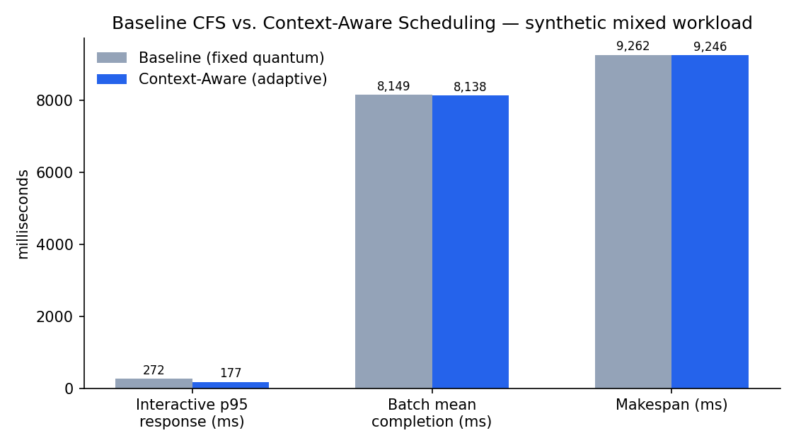
EVALUATION
Results — Baseline vs. Context-Aware
Classifier accuracy
79.2%
vs. hidden ground-truth task type, under noisy observed signals
Interactive p95 latency
-34.8%
271.9ms → 177.2ms — the headline win: short tasks preempted back sooner
Batch completion time
-0.1%
8,148.9ms → 8,138.1ms — essentially unchanged, as intended
Fairness (CPU-share stdev)
+50.5%
worse than baseline — open issue, see next steps
Context-Aware CPU Scheduling — Review 2
6

Slide 7
CONCLUSION
What's Working, What's Next
What the prototype confirms
Open issues & next steps
Heuristic pipeline classifies correctly ~79% of the time with zero training
Adaptive quantum cuts interactive p95 latency by ~35% under batch contention
Batch throughput is essentially unaffected — no regression traded away
Fairness regressed — tune quantum ratios so latency-sensitive tasks don't starve batch entirely
Replace synthetic profiles with traces from real cgroups v2 counters
Add a confidence score to the classifier and validate the low-confidence fallback path
Run on an actual Linux box with cgroup nice-weight writes instead of the simulator
The full prototype is a single C file (scheduler.c, no external libraries) — included separately for the demo.
Context-Aware CPU Scheduling — Review 2
7

