Slide 1
Development Control Services Overview on GIT JAN 2016 (Internal Use Only) Presented By – Saurabh Suman
Notes:
Intro me and what I do – DCS UKDC

Slide 2
Version control systems
What is Git?

Slide 3
Version control systems
“Distributed Version
Control System”

Slide 4
Version control systems
Version control (or revision control, or source control) is all about managing multiple versions of documents, programs, web sites, etc.
Some well-known version control systems are CVS, Subversion, Mercurial, and Git
CVS and Subversion use a “central” repository; users “check out” files, work on them, and “check them in” . This is the example of centralized version control.
Git treat all repositories as equal . This is the example of distributed OR Decentralized version control.

Slide 5
Centralized Version Control?
Traditional version control system
Server with database
Clients have a working version
Examples
CVS
Subversion
Visual Source Safe
Challenges
Multi-developer conflicts
Client/server communication

Slide 6
Distributed/Decentralized Version Control
Treat all repositories as equal
Every working checkout is a repository
Get version control even when detached
Other distributed systems include
Mercurial
BitKeeper
Bazaar

Slide 7
Version Control
what is version control ? Imagine a world with no version control tools..!!

Slide 8
Why Git?
Git has many advantages over earlier systems such as CVS and Subversion
More efficient, better workflow, etc.
Of course, there are always those who disagree

Slide 9
Download and install Git
Here’s the standard one: http://git-scm.com/downloads
Installing on Linux
sudo yum install git-all
Installing from Source
Download from https://github.com/git/git/releases
$ tar -zxf git-2.0.0.tar.gz
$ cd git-2.0.0
$ make configure
$ ./configure --prefix=/usr
$ make all doc info
$ sudo make install install-doc install-html install-info

Slide 10
Introduce yourself to Git
git config:
git config --global user.name “Your Name“
git config --global user.email your.emailid@domain.com
(Sets the name & Email you want attached to your commit transactions)
git config --global color.ui auto
You only need to do this once
If you want to use a different name/email address for a particular project, you can change it for just that project
cd to the project directory
Use the above commands, but leave out the --global

Slide 11
Git Branches
The central repo holds two main branches with an infinite lifetime:
•master
•develop
We consider origin/master to be the main branch where the source code of HEAD always reflects a production-ready state.
We consider origin/develop to be the main branch where the source code of HEAD always reflects a state with the latest delivered development changes for the next release. Some would call this the “integration branch”. This is where any automatic nightly builds are built from.
When the source code in the develop branch reaches a stable point and is ready to be released, all of the changes should be merged back into master somehow and then tagged with a release number.

Slide 12
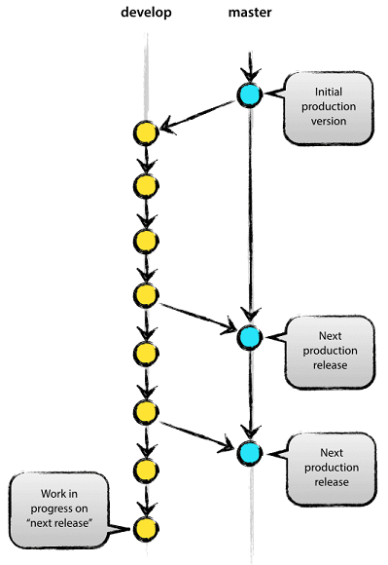
Git Branches

Slide 13
Supporting branches
The different types of branches we may use are:
Feature branches
Release branches
Hotfix branches
Feature branches :
Feature branches (or sometimes called topic branches) are used to develop new features for the upcoming or a distant future release. When starting development of a feature, the target release in which this feature will be incorporated may well be unknown at that point. The essence of a feature branch is that it exists as long as the feature is in development, but will eventually be merged back into develop (to definitely add the new feature to the upcoming release) or discarded (in case of a disappointing experiment).
Feature branches typically exist in developer repos only, not in origin.

Slide 14
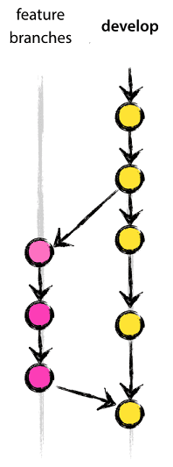
Supporting branches

Slide 15
Supporting branches
Release branches:
Release branches support preparation of a new production release. They allow for last-minute changes. Furthermore, they allow for minor bug fixes and preparing meta-data for a release (version number, build dates, etc.). By doing all of this work on a release branch, the develop branch is cleared to receive features for the next big release.

Slide 16
Supporting branches
Hotfix branches:
Hotfix branches are very much like release branches in that they are also meant to prepare for a new production release, albeit unplanned. They arise from the necessity to act immediately upon an undesired state of a live production version. When a critical bug in a production version must be resolved immediately, a hotfix branch may be branched off from the corresponding tag on the master branch that marks the production version.
The essence is that work of team members (on the develop branch) can continue, while another person is preparing a quick production fix.

Slide 17
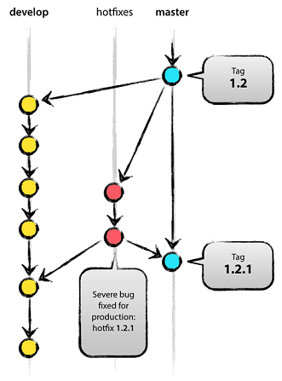
Supporting branches

Slide 18
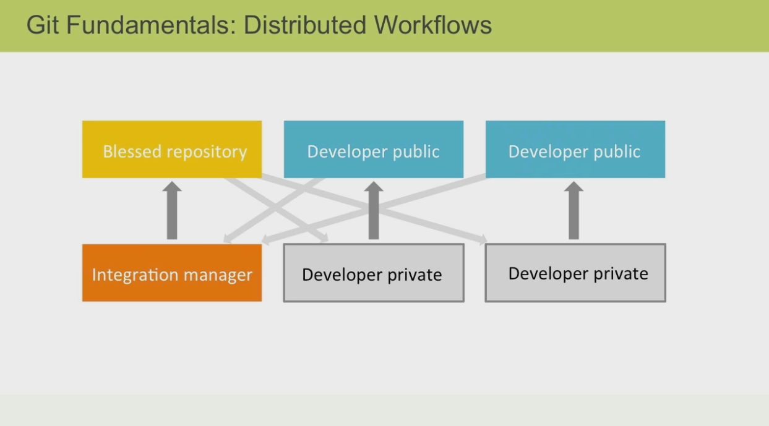
Supporting branches

Slide 19
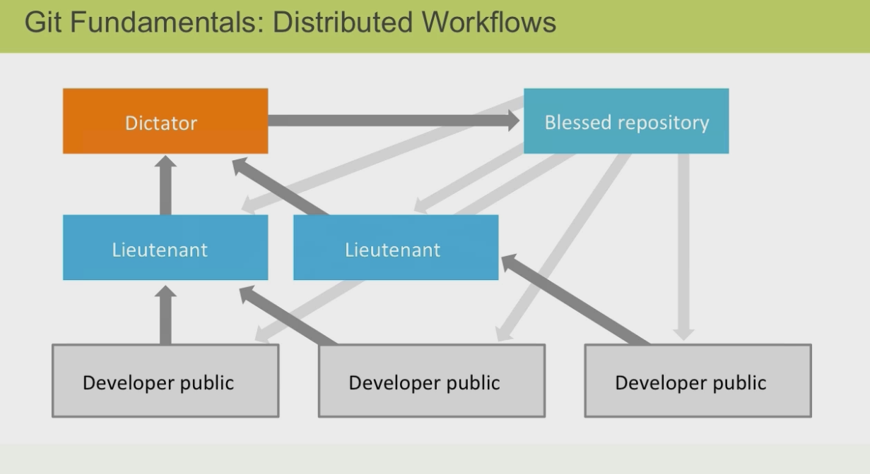
Supporting branches

Slide 20
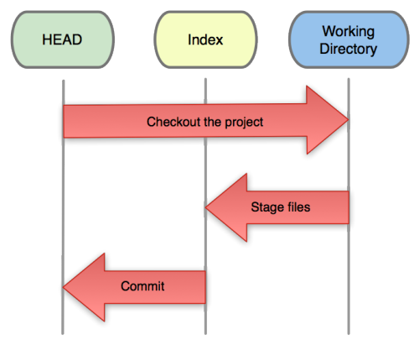
Introduce yourself to Git
Three trees of Git
The HEAD
last commit snapshot, next parent
Index
Proposed next commit snapshot
Working directory
Sandbox

Slide 21
Create and fill a repository
cd to the project directory you want to use
Type in git init
This creates the repository (a directory named .git)
Transform the current directory into a Git repository.
This adds a .git folder to the current directory and makes it possible to start recording revisions of the project.
git init <directory>
Create an empty Git repository in the specified directory.
Running this command will create a new folder called <directory containing nothing but the .git subdirectory.
git init --bare <directory>
Initialize an empty Git repository, but omit the working directory.
Shared repositories should always be created with the --bare flag

Slide 22
Create and fill a repository
Bare Repositories:
The --bare flag creates a repository that doesn’t have a working directory, making it impossible to edit files and commit changes in that repository. Central repositories should always be created as bare repositories because pushing branches to a non-bare repository has the potential to overwrite changes. Think of --bare as a way to mark a repository as a storage facility, opposed to a development environment. This means that for virtually all Git workflows, the central repository is bare, and developers local repositories are non-bare.

Slide 23
Create and fill a repository
cd to the project directory you want to use
Type in git init
This creates the repository (a directory named .git)
You seldom (if ever) need to look inside this directory
Type in git add .
The period at the end is part of this command!
Period means “this directory”
This adds all your current files to the repository
Type in git commit –m "Initial commit"
You can use a different commit message, if you like

Slide 24
Git add options
-n --dry-run
Don’t actually add the file(s), just show if they exist and/or will be ignored.
-v --verbose
Be verbose.
-f --force
Allow adding otherwise ignored files.
-p --patch
Interactively choose hunks of patch between the index and the work tree and add them to the index. This gives the user a chance to review the difference before adding modified contents to the index.
-e --edit
Open the diff vs. the index in an editor and let the user edit it. After the editor was closed, adjust the hunk headers and apply the patch to the index.
-u --update
Update the index just where it already has an entry matching <pathspec>. This removes as well as modifies index entries to match the working tree, but adds no new files.
-A --all

Slide 25
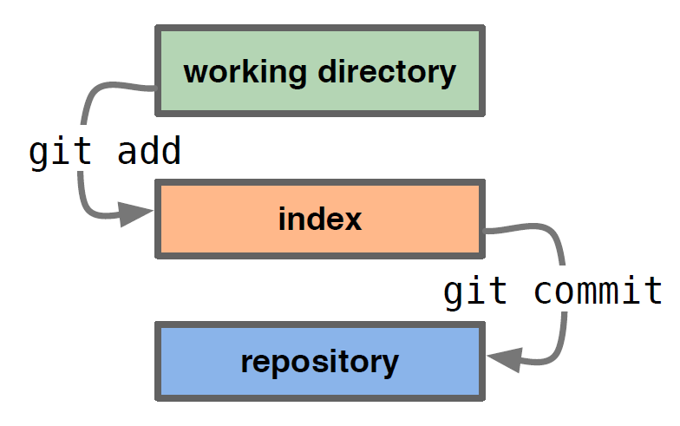
Basic Workflow
A basic workflow:
(Possible init or clone) Init a repo
Edit files
Stage the changes
Review your changes - git status
Commit the changes
$ git status
On branch develop
Your branch is up-to-date with 'origin/develop'.
nothing to commit, working directory clean

Slide 26
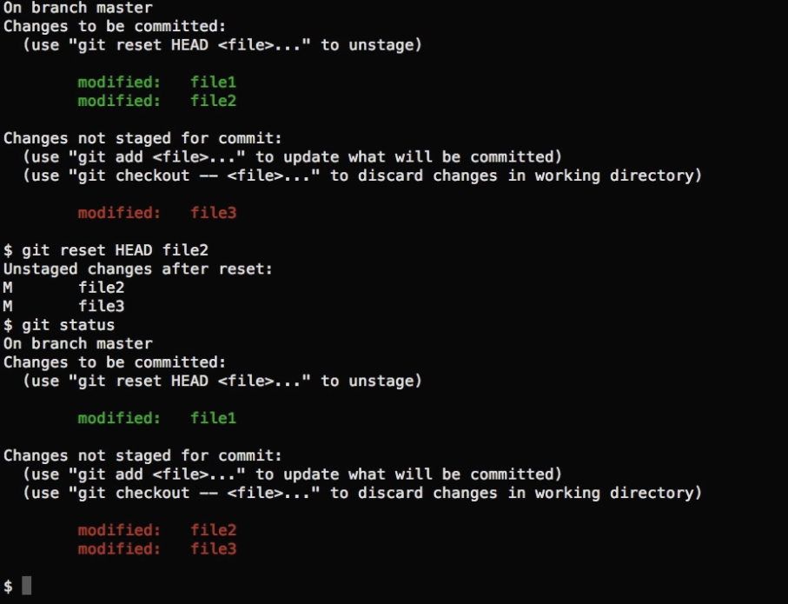
Reset from staging area

Slide 27
Clone a repository
git clone URL
git clone URL mypath
These make an exact copy of the repository at the given URL

Slide 28
Clone a repository
View changes
Git diff
Show the difference between working directory and staged
Git diff --cached
Show the difference between staged and the HEAD
View history
Git log

Slide 29
Merging
Steps to merge two branch
Checkout the branch you want to merge onto
Merge the branch you want to merge

Slide 30
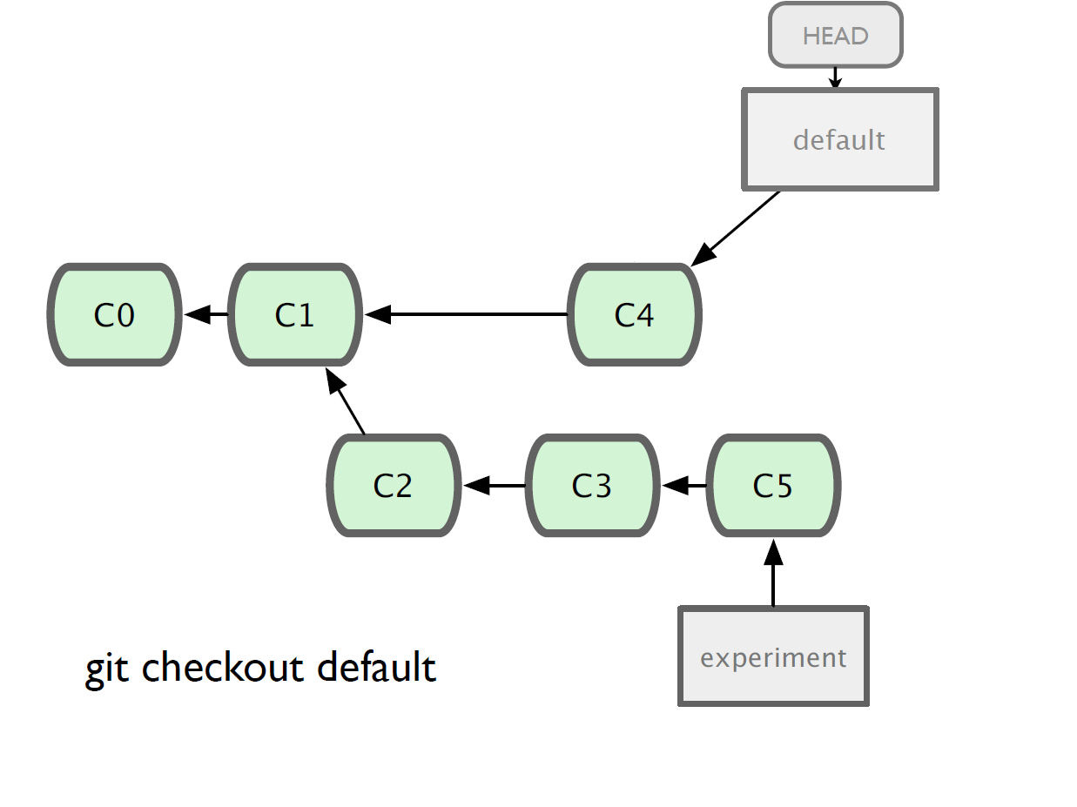
Merging

Slide 31
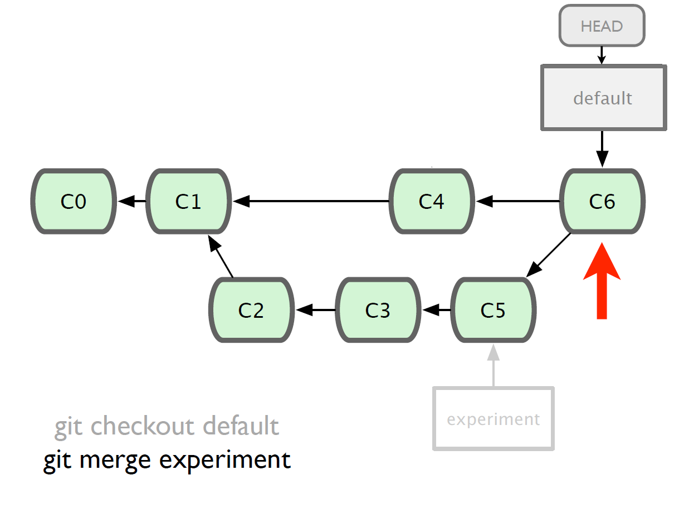
Merging

Slide 32
“git revert” vs “git reset”
git revert
- This command creates a new commit that undoes the changes from a previous commit. This command adds new history to the project (it doesn't modify existing history).
git reset
- This command is a little more complicated. It actually does a couple of different things depending on how it is invoked. It modifies the index (the so-called "staging area"). Or it changes which commit a branch head is currently pointing at. This command may alter existing history (by changing the commit that a branch references).

Slide 33
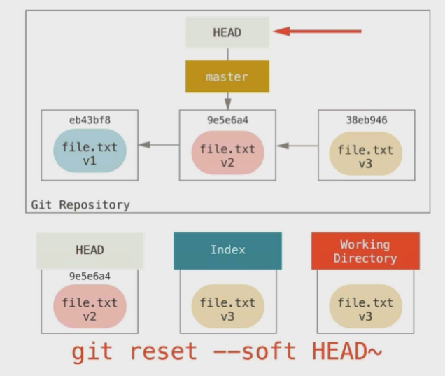
git reset
Moving head to parent position from V3 to V2 and V3 will be available in working directory because we use soft command

Slide 34
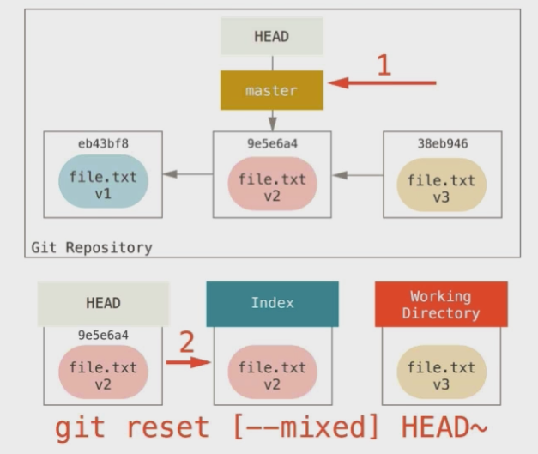
git reset
In this case head will be moved to V2 and V3 will be available in the index are mean it is modified but not staged

Slide 35
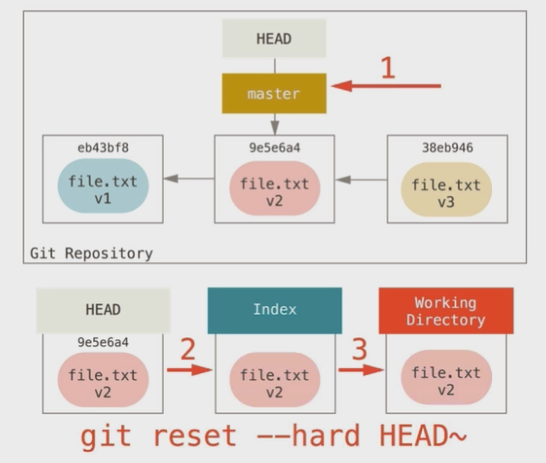
git reset
In this case due to use of –hard it will delete the changes even from working directory

Slide 36
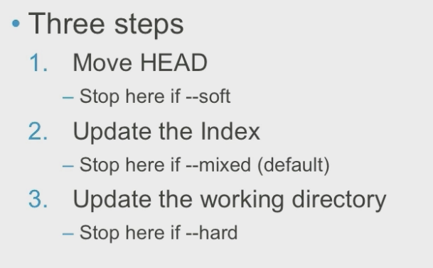
Level of reset

Slide 37
Git Tools - Stashing
Stashing
Often, when you’ve been working on part of your project, things are in a messy state and you want to switch branches for a bit to work on something else. The problem is, you don’t want to do a commit of half-done work just so you can get back to this point later. The answer to this issue is the git stash command.
Stashing takes the dirty state of your working directory — that is, your modified tracked files and staged changes — and saves it on a stack of unfinished changes that you can reapply at any time.
$ git stash Saved working directory and index state \ "WIP on master: 049d078 added the index file" HEAD is now at 049d078 added the index file (To restore them type "git stash apply")
Your working directory is clean:

Slide 38
Distributed Workflow
Distributed Workflow
fetch, pull and push

Slide 39
Git fetch
git fetch
The git fetch command imports commits from a remote repository into your local repo. The resulting commits are stored as remote branches instead of the normal local branches that we’ve been working with. This gives you a chance to review changes before integrating them into your copy of the project.
git fetch <remote>
Fetch all of the branches from the repository. This also downloads all of the required commits and files from the other repository.
git fetch <remote> <branch>
Same as the above command, but only fetch the specified branch.

Slide 40
Git fetch

Slide 41
Git pull
pull = fetch + merge
Merging upstream changes into your local repository is a common task in Git-based collaboration workflows. We already know how to do this with git fetch followed by git merge, but git pull rolls this into a single command.
git pull <remote>
Fetch the specified remote’s copy of the current branch and immediately merge it into the local copy. This is the same as git fetch <remote> followed by git merge origin/<current-branch>.
Pulling via Rebase
The --rebase option can be used to ensure a linear history by preventing unnecessary merge commits. Many developers prefer rebasing over merging, since it’s like saying, “I want to put my changes on top of what everybody else has done.” In this sense, using git pull with the --rebase flag

Slide 42
Git pull VS Git fetch
•When you use pull, Git tries to automatically do your work for you. It is context sensitive, so Git will merge any pulled commits into the branch you are currently working in. pull automatically merges the commits without letting you review them first. If you don’t closely manage your branches, you may run into frequent conflicts.
•When you fetch, Git gathers any commits from the target branch that do not exist in your current branch and stores them in your local repository. However, it does not merge them with your current branch. This is particularly useful if you need to keep your repository up to date, but are working on something that might break if you update your files. To integrate the commits into your master branch, you use merge.

Slide 43
Git push
git push
Pushing is how you transfer commits from your local repository to a remote repo. It's the counterpart to git fetch, but whereas fetching imports commits to local branches, pushing exports commits to remote branches. This has the potential to overwrite changes, so you need to be careful how you use it. These issues are discussed below.
git push <remote> <branch>
git push <remote> --force
Do not use the --force flag unless you’re absolutely sure you know what you’re doing.
git push <remote> --all
Push all of your local branches to the specified remote.
git push <remote> --tags
Tags are not automatically pushed when you push a branch or use the --all option. The --tags flag sends all of your local tags to the remote repository.

Slide 44
Git merge
git merge
Putting a forked history back together again. The git merge command lets you take the independent lines of development created by git branch and integrate them into a single branch.
Usage
git merge <branch>
Merge the specified branch into the current branch.
git merge --no-ff <branch>
Merge the specified branch into the current branch, but always generate a merge commit (even if it was a fast-forward merge). This is useful for documenting all merges that occur in your repository.

Slide 45
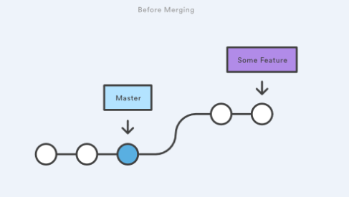
fast-forward merge
A fast-forward merge can occur when there is a linear path from the current branch tip to the target branch.

Slide 46
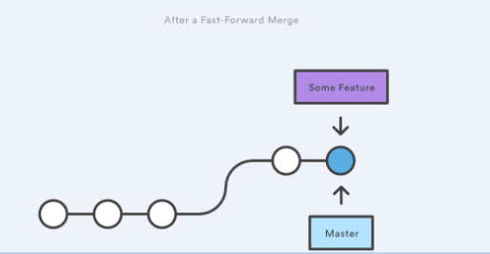
fast-forward merge

Slide 47
fast-forward merge
Example:
The code below creates a new branch, adds one commit to it, then integrates it into the main line with a fast-forward merge.
# Start a new feature
git checkout -b new-feature
# Edit some files
git add <file>
git commit -m "Start a feature"
# Merge in the new-feature branch
git checkout master
git merge new-feature
git branch -d new-feature

Slide 48
fast-forward merge
Example:
The code below creates a new branch, adds one commit to it, then integrates it into the main line with a fast-forward merge.
# Start a new feature
git checkout -b new-feature
# Edit some files
git add <file>
git commit -m "Start a feature"
# Merge in the new-feature branch
git checkout master
git merge new-feature
git branch -d new-feature

Slide 49
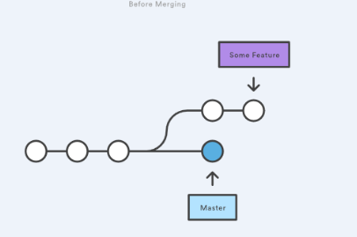
3-way merge
A fast-forward merge is not possible if the branches have diverged. When there is not a linear path to the target branch, Git has no choice but to combine them via a 3-way merge. 3-way merges use a dedicated commit to tie together the two histories.

Slide 50
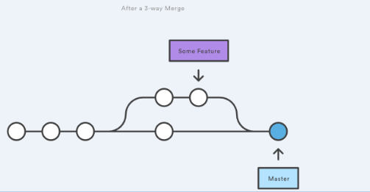
3-way merge

Slide 51
3-way merge
# Start a new feature
git checkout -b new-feature master
# Edit some files
git add <file>
git commit -m "Start a feature"
# Develop the master branch
git checkout master
# Edit some files
git add <file>
git commit -m "Make some changes to master"
# Merge in the new-feature branch
git merge new-feature
git branch -d new-feature

Slide 52
3-way merge OR fast-forword
While you can use either of these merge strategies, many developers like to use fast-forward merges (facilitated through rebasing) for small features or bug fixes, while reserving 3-way merges for the integration of longer-running features. In the latter case, the resulting merge commit serves as a symbolic joining of the two branches.

Slide 53
Few GIT Commands
$ git log
Lists version history for the current branch
$ git log --follow [file]
Lists version history for a file, including renames
$ git diff [first-branch]...[second-branch]
Shows content differences between two branches
$ git show [commit]
Outputs metadata and content changes of the specified commit

Slide 54
Few GIT Commands
$ git rm [file]
Deletes the file from the working directory and stages the deletion
$ git rm --cached [file]
Removes the file from version control but preserves the file locally
$ git mv [file-original] [file-renamed]
Changes the file name and prepares it for commit
$ git reset [commit]
Undoes all commits after [commit], preserving changes locally
$ git reset --hard [commit]
Discards all history and changes back to the specified commit

Slide 55
Few GIT Commands
$ git fetch [bookmark]
Downloads all history from the repository bookmark
$ git merge [bookmark]/[branch]
Combines bookmark’s branch into current local branch
$ git push [alias] [branch]
Uploads all local branch commits to GitHub
$ git pull
Downloads bookmark history and incorporates changes

Slide 56
Few GIT Commands
git stash
Temporarily stores all modified tracked files
$ git stash list
Lists all stashed changesets
$ git stash pop
Restores the most recently stashed files
$ git stash drop
Discards the most recently stashed changeset

Slide 57
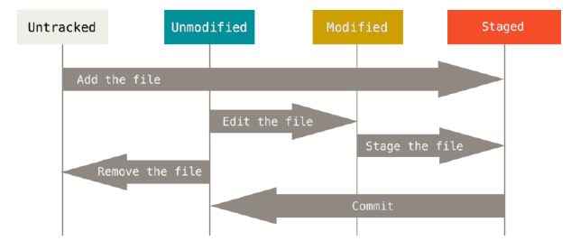
The lifecycle of the status of your files

Slide 58
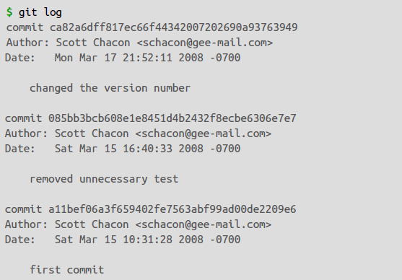
Viewing the Commit History

Slide 59
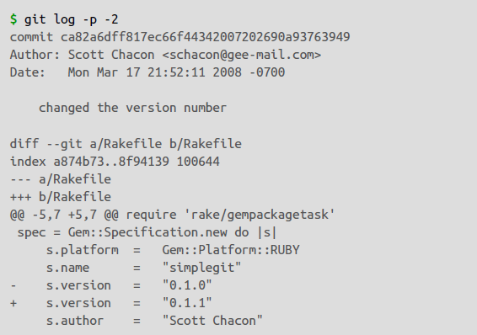
Viewing the Commit History
One of the more helpful options is -p, which shows the difference introduced in each commit. You can also use -2, which limits the output to only the last two entries:

Slide 60
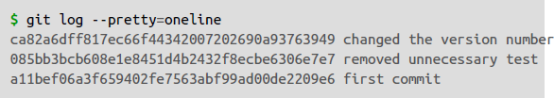
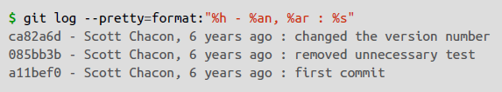
Viewing the Commit History

Slide 61
Viewing the Commit History
Option Description of Output
%H Commit hash
%h Abbreviated commit hash
%T Tree hash
%t Abbreviated tree hash
%P Parent hashes
%p Abbreviated parent hashes
%an Author name
%ae Author email
%ad Author date (format respects the --date=option)
%ar Author date, relative
%cn Committer name
%ce Committer email
%cd Committer date
%cr Committer date, relative
%s Subject

Slide 62
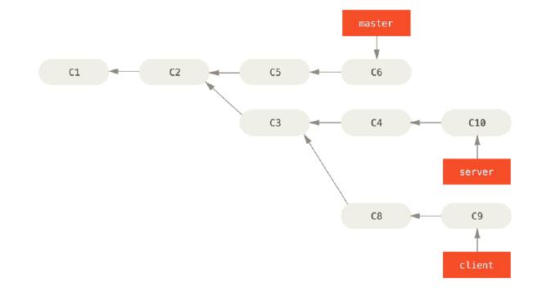
Rebase

Slide 63
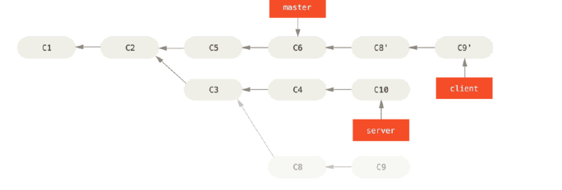
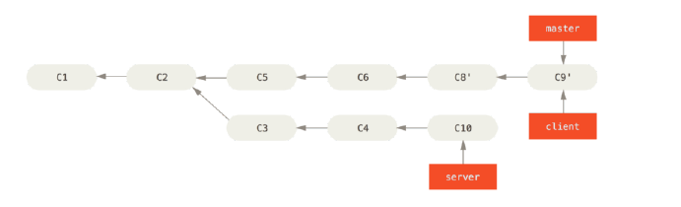
Rebase
$ git rebase --onto master server client
$ git checkout master
$ git merge client

Slide 64
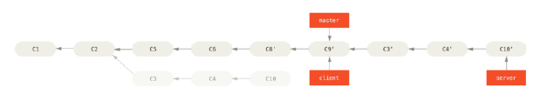

Rebase
$ git rebase master server
$ git checkout master
$ git merge server
remove the client and server branches because all the work is integrated
$ git branch -d client
$ git branch -d server

Slide 65

Thank You..!

