Slide 1
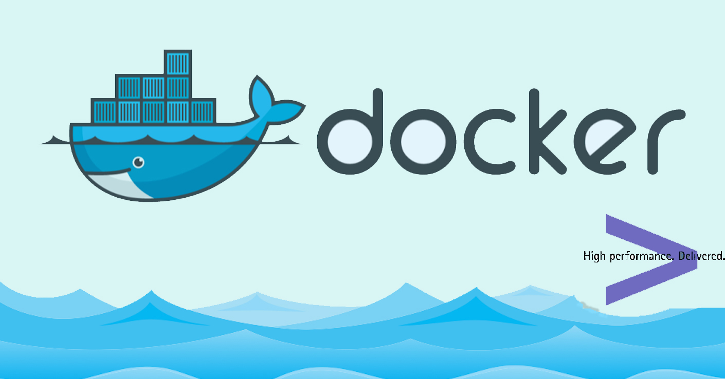
Docker – Introduction
Presented By- Biplab Kumar Biswas
Shrinidhi K S

Slide 2
Agenda
What is Docker? And it’s platform
Why Docker?
Docker Engine
Installing Docker on your PC
Docker Client and Daemon
Docker Images and Containers
Docker Commands
Creating a Docker Image from a Dockerfile
Managing Docker images
Mounting Volumes
Linking Containers
Inspecting Container

Slide 3
What is Docker?
Docker is a platform for developing, shipping and running applications using container virtualization technology.
Docker platform:
Docker Engine
Docker Hub
Docker Machine
Docker Swarm
Docker Compose
Kitematic

Slide 4
Before Docker ( Small History)
One Application on one Physical Server.
Application
Operating System
Physical Server

Slide 5
Problems in the previous approach:
Huge Cost
Wasted Resource
Difficult to Scale
Difficult to migrate
Vendor Lock in
Slow Deployment times
And so on…. ☹

Slide 6
Next Step… HVM
One physical server can contain multiple application.
Each application runs in a virtual machine (VM)
App
App
App
Guest OS
Guest OS
Guest OS
VM
VM
VM
Hypervisor
Host Operating System
Physical Server

Slide 7


Benefits of VMs
Better resource pooling
One physical machine is divided into multiple virtual machines
Easier to scale
VM’s in the cloud
Rapid elasticity
Pay as you go model

Slide 8
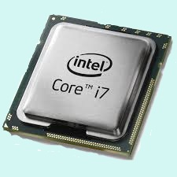
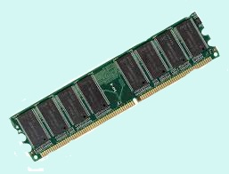
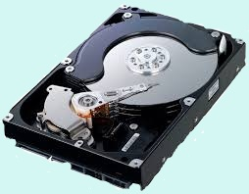
Limitation of VMs
Each VM still requires
CPU allocation
Storage
RAM
An entire guest operating system
The more VM’s you run, the more resource you need
Guest OS means wasted resources
Application portability is not guaranteed

Slide 9
Containers
Container based virtualization uses the kernel on the host’s operating system to run multiple guest instances
Each guest instance is called container
Each container has its own
Root file system
Processes
Memory
Devices
Network Ports

Slide 10
Container
Container
Container
APP
APP
APP
Guest Operating System
OS Kernel
Physical Server

Slide 11
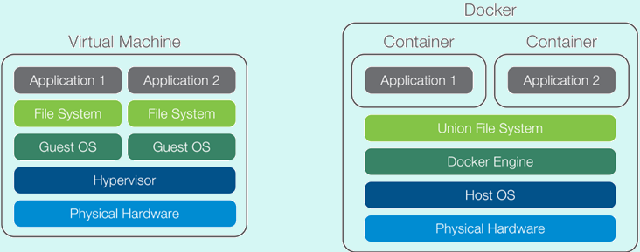
Container VS VMs
Containers are more lightweight
No need to install guest OS
Less CPU, RAM and storage space required
More containers per machine than VMs
Greater portability

Slide 12
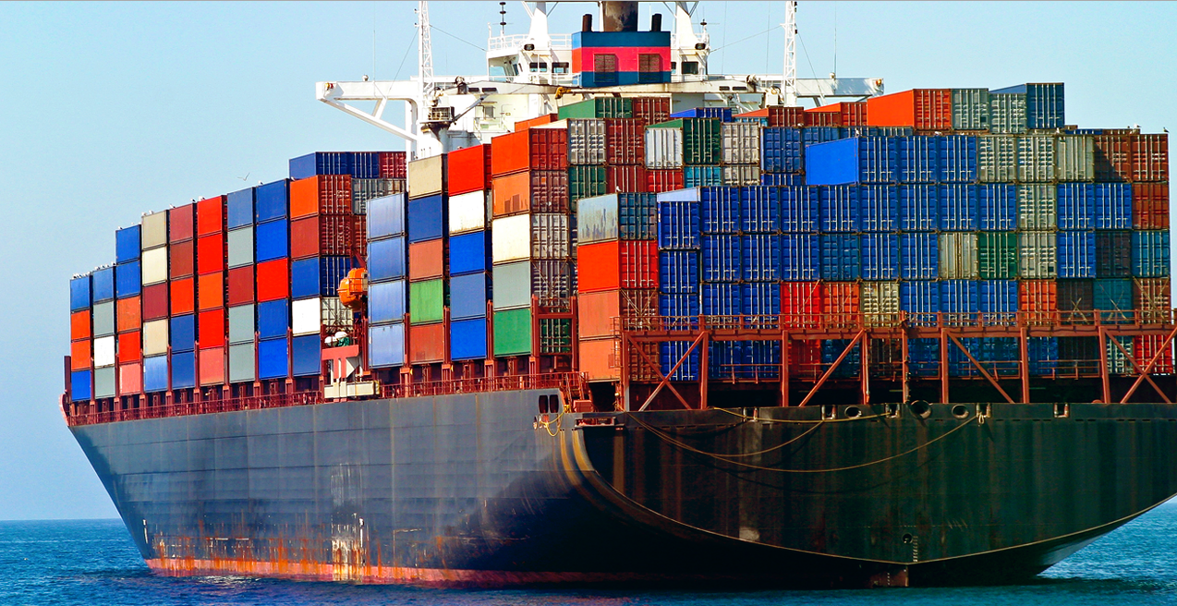
Container Visualization
We can think of Docker containers as physical shipping containers.
Docker facilitates a way to package and distribute software.
The component that fills the shipping container role is called an “image”.

Slide 13
Docker Engine
Container
Container
Docker Engine is the program
that enables container to be
built, shipped and run
Docker Engine uses Linux
kernel namespaces and
control groups
Namespaces gives us the
isolated workspace
APP
APP
Docker Engine
Linux Operating System
Linux Kernel
Physical Server

Slide 14
Installation
Linux users
https://docs.docker.com/engine/installation/
Mac OS X users
https://docs.docker.com/docker-for-mac/
Windows 10 users
https://docs.docker.com/docker-for-windows/

Slide 15
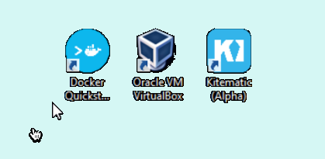
Windows 7 users
Download the docker-toolbox from the below URL
https://www.docker.com/products/docker-toolbox
The docker-toolbox includes the Oracle VirtualBox as an accompanying installer. This is required to create a boot2docker Virtual-machine.
Since docker uses Linux container feature, it can’t be used on a window machine. The above point explains why docker-toolbox installs VirtualBox.
Docker-quickstart terminal acts as a bridge between you and the hosted VM that is boot2docker to launch commands that you type on it.

Slide 16
Docker Client and Daemon
Host
Client/server architecture
Client takes user input and
send them to daemon
Daemon builds, runs and
distributes containers
Client and daemon can run
on the same host or on
different hosts
CLI client and GUI (Kitematic)
Check Client and Daemon version:
docker version
Docker Daemon
Container 1
Client
Container 2
Container 3
Container 4

Slide 17
Docker Images and Containers
Images
Read only templates used to create containers
Built by docker user
Stored in docker hub or your own docker
registry or on your local registry
Containers
Isolated application platform
Contains everything needed to run application
Based on one or more image
Image
Container

Slide 18
Benefits of Docker
Separation of concerns
Developers focus on building apps
System admin focus on deployment
Fast development cycle
Application portability
Build in one environment, ship to another
Scalability
Easily spin up new container if needed
Run more apps on one host machine

Slide 19
Why Developers care?
Build once…run anywhere
A clean, safe, hygienic and portable runtime environment for your app.
No worries about missing dependencies, packages and other pain points during subsequent deployments.
Run each app in its own isolated container, so you can run various versions of libraries and other dependencies for each app without worrying
Automate testing, integration, packaging…anything you can script
Reduce/eliminate concerns about compatibility on different platforms, either your own or your customers.
Cheap, zero-penalty containers to deploy services? A VM without the overhead of a VM? Instant replay and reset of image snapshots? That’s the power of Docker

Slide 20
Why We(DevOps) care?
Configure once…run anything
Make the entire lifecycle more efficient, consistent, and repeatable
Increase the quality of code produced by developers.
Eliminate inconsistencies between development, test, production, and customer environments
Support segregation of duties
Significantly improves the speed and reliability of continuous deployment and continuous integration systems
Because the containers are so lightweight, address significant performance, costs, deployment, and portability issues normally associated with VMs

Slide 21
Intro to Docker Images
Docker Hub
https://hub.docker.com/
Accenture Docker Hub
https://dockerhub.accenture.com/

Slide 22
Local Images
docker image command will list all the images in local registry
When creating a container, daemon will search for local registry and use it if found
If no local image is found, the docker daemon will look in docker hub.
Usage:
docker image [options] [repository[:tag]]
Options :
-a, -all Show all images(default)
--help Print usage
-q, --quiet Only Show ID

Slide 23
Creating a Docker Container
To create a container we use docker run command
Usage:
docker run [OPTIONS] image [COMMAND] [ARG….]
Options
-a, --attach Attach to STDIN, STDOUT or STDERR
-d, --detach Run container in background and print container ID
-e, --env Set environment variables
-h, --hostname Container host name
--help Print usage
-i, --interactive Keeps STDIN open even if not attached
--name Assign a name to the container
-t, --tty Allocate a pseudo-TTY

Slide 24
Containers can be started in three different modes
Single-Thread Mode
Ex : docker run ubuntu echo “Hello World”
Interactive Mode
Ex : docker run –it ubuntu bash
Detached Mode
Ex : docker run –d ubuntu ping 127.0.0.1 –c 50

Slide 25
Find the Docker Containers
docker ps can be used to list running containers
Usage:
docker ps [OPTIONS]
Options
-a, --all Shows all the containers (running + dead)
-l, --latest Shows latest created containers
--since Shows containers created since/after given container ID or Name
--before Shows containers created before given container ID or Name

Slide 26
Docker Logs
docker logs can be used to fetch logs of a container
Usage
docker logs [OPTIONS] container
Options
--details Shows extra details provided to logs
-f, --follow Follow log output
--help Prints usage
-t, --timestamps Show time stamps
--tail=“ “ Number of lines to show from the end of the logs

Slide 27
Docker Stop
docker stop command can be used to stop one or more running containers by sending them SIGTERM and then SIGKILL after a grace period
Usage
docker stop [OPTIONS] container [CONTAINERS…]
Options
--help Prints the usage
-t, --time= Seconds to wait for stop before killing it

Slide 28
Docker Start
docker start command can be used to start one or more containers
Usage
docker start [OPTIONS] container [CONTAINER…]
Options
-a, --attach Attach STDOUT/STDERR and forward signals
--help Print usage
-I, --interactive Attach container’s STDIN

Slide 29
Docker Exec
docker exec command can be used to run a new command in a running container
Usage
docker exec [OPTIONS] container command [ARG…]
Options
-d, --detach Run command in detached mode
-i, --interactive Keep STDIN open
-t, --tty Allocate a pseudo-tty

Slide 30
Deleting Containers
docker rm command can be used to delete/remove one or more containers
Usage
docker rm [OPTIONS] container [CONTAINER…]
Options
-f, --force Force remove running container
-l, --link Remove specified link
-v, --volumes Remove the volumes associated with the container

Slide 31
Deleting Docker Image
docker rmi command can be used to delete one or more images
Usage
docker rmi [OPTIONS] image [IMAGE…]
Options
-f, --force Force removal of the image
--help Print the usage
--no-prune Do not delete untagged parents

Slide 32
Building Docker Images
There are two ways to build a docker image,
We can commit the changes we made in a container thus giving a new docker image
We can build a new docker image using Dockerfile

Slide 33
Docker Commit
docker commit command saves the changes in a container as a new image
Usage
docker commit [OPTIONS] container [REPO[:TAG]]
Options
-a, --author =“ “ Author name
-c, --change Apply specified Dockerfile instruction while committing the image
-m, --message Commit message
-p, --pause Pause container during commit

Slide 34
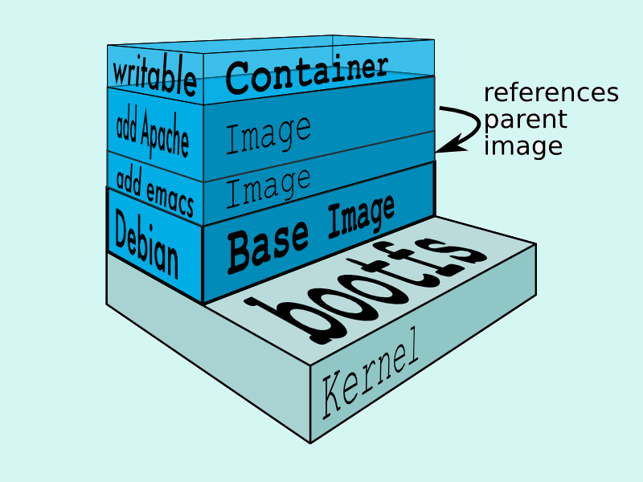
Image Layers
Images are composed of multiple layers
A layer is also just another image
Every image contains a base layer
Docker uses a copy on write system
Layers are read only

Slide 35
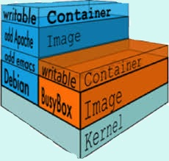
The Container Writable Layer
Docker creates a top writable layer for containers
Parent images are read-only
All the changes are made at the writable layer

Slide 36
Dockerfile
Dockerfile is a configuration file that contains instructions for building a Docker image
Provides a more effective way to build images compared to using docker commit
Easily fits into continuous integration and deployment process

Slide 37
README.md and .dockerignore files
.dockerignore file contains the list of the list of files that has to be excluded docker build context
This helps to avoid unnecessarily sending large or sensitive files and directories to the daemon
README.md is metadata file about the image
It can contain information about image such as what is built into it and how to run it and so on

Slide 38
Dockerfile Instructions
Instructions specify what to do when building an image
FROM instruction specifies what the base image should be
Maintainer instruction allows you to set the author field of generated images
Run instruction specifies command to execute
Ex:
FROM ubuntu:14.04
MAINTAINER shrinidhi.ks
RUN apt-get install –y curl
RUN apt-get install –y vim

Slide 39
Docker Build
docker build command is used to build image from the Dockerfile
Usage
docker build [OPTIONS] path
Options
-q, --quiet Suppress the build output and print the Image ID on the success
--no-cache Do not use cache when building the image
-t, --tag Name and optionally a tag in the ‘name:tag’ format

Slide 40
RUN Instruction
Each RUN instruction will execute the command on top of the writable layer and perform commit of the image
Can aggregate multiple RUN instructions by using “&&”
Ex:
RUN apt-get update &&\
apt-get install –y curl &&\
apt-get install –y vim

Slide 41
CMD Instruction
CMD defines a default command to execute when a container is created
CMD performs no action during image build
Shell format and EXEC format
Can only be specified once in Dockerfile
Can be overridden at run time
Shell format
CMD ping 127.0.0.1 –c 50
EXEC format
CMD [“ping”, “127.0.0.1”, “-c”, “50”]

Slide 42
Entrypoint Instruction
Defines the command that will run when a container is executed
Run time arguments and CMD instructions are passed as parameters to the ENTRYPOINT instruction
Shell and EXEC form
EXEC form can accept arguments at the run time
Containers are essentially runs as an executable
ENTRYPOINT [“ping]

Slide 43
ENV Instruction
ENV instruction sets the environment variable <key> to the <value>
Multi-assignment form
ENV myName=shrinidhi myProject=DCSC
Single assignment form
ENV myname shrinidhi
ENV myProject DCSC

Slide 44
COPY Instruction
COPY instruction copies new files or directories from <SRC> and adds them to the filesystem of the of the container at the path <DEST>
SRC file should be relative to the source directory
Ex :
COPY start.sh /start.sh
COPY “start server.sh” /”start server.sh”

Slide 45
ADD Instruction
ADD instruction copies new files , directories or remote file URLs from <SRC> and adds them to filesystem of the container at the path <DEST>
Ex:
ADD mysql.tar.gz /mysql.tar.gz

Slide 46
EXPOSE Instruction
The EXPOSE instruction informs Docker that the container listens on the specified network ports at runtime
It does not make the ports of the container accessible to the host
Ex :
EXPOSE 3036

Slide 47
Dockerfile for Tomcat
FROM java:latest
ENV CATALINA_HOME /product/apache-tomcat
ENV PATH $CATALINA_HOME/bin:$PATH
ENV TOMCAT_MAJOR 7
ENV TOMCAT_VERSION 7.0.55
ENV TOMCAT_TGZ_URL https://archive.apache.org/dist/tomcat/tomcat- $TOMCAT_MAJOR/v$TOMCAT_VERSION/bin/apache-tomcat-$TOMCAT_VERSION.tar.gz
RUN groupadd -g 600 apps && \
useradd -g apps -u 1005 tomcat && \
curl -fSL "$TOMCAT_TGZ_URL" -o tomcat.tar.gz && \
tar -xzf tomcat.tar.gz -C /product && \
rm tomcat.tar.gz && \
ln -s /product/apache-tomcat-$TOMCAT_VERSION /product/apache-tomcat && \
chown -R tomcat:apps /product/apache-tomcat-$TOMCAT_VERSION
EXPOSE 8080
USER tomcat
CMD $CATALINA_HOME/bin/startup.sh && tailf $CATALINA_HOME/logs/catalina.out

Slide 48
docker push
Push an image to the registry
Usage:
docker push [OPTIONS] NAME[:TAG]
Options
--help Prints the usage
Local repo name should be same as the Docker Hub repo
Ex:
docker push test/image

Slide 49
docker pull
The docker pull command can be used to pull an image from docker registry
Usage
docker pull [OPTIONS] name[:TAG] [REGISTRY_HOST[:REGISTRY_PORT]
Options
-a, --all Download all the tagged image
Ex :
docker pull postgress

Slide 50
Managing Images and Containers
Docker
Container
Image Registry
Container A
Push
Source Code Repository
Search
Pull
Build
Run
Dockerfile
For
A
Container B
Container A
Docker
Docker Engine
Host 1 OS (Linux)
Host 2 OS 2 (Linux)

Slide 51
Volumes
A Volume is designated directory in a container, which is designed to persist data, independent of the container’s life cycle
Volume changes are excluded when updating an image
Persist when docker is deleted
Can be mapped to a host folder
Can be shared between containers
Volumes are mounted when creating or executing container
Volume paths specified must be absolute
Ex :
docker run –it –v /testfolder ubuntu:14.04
docker run –it –v /testfolder:/tmp/testfolder ubuntu:14.04

Slide 52
Volumes in Dockerfile
VOLUME instruction creates a mount point
Can specify arguments JSON array or string
Can not map volumes to host directories
Volumes are initialized when the container is executed
Ex :
VOLUME /myvol
VOLUME [“myvol1”, “myvol2”]

Slide 53
Uses of Volumes
De-couple the data that is stored from the container which created the data
Good for sharing data between containers
Can setup a data container which has a volume you mount in other containers
Mounting folders from the host is good for testing purposes but generally not recommended for production use

Slide 54
Linking Containers
Linking is a communication method between containers which allows them to securely transfer data from one to another
Source and recipient containers
Recipient containers have access to data on the source continuers
Links are established based on container names
Container
Container
Web App
Database
recipient
Host
source

Slide 55
Creating a Link
Create the source container first
Create the recipient container and use the –link option
Ex:
Create the source container using mysql
docker run –d --name database mysql
Create the recipient container and link it to source container
docker run –d –P --name portal --link database:db nginx

Slide 56
Uses of Linking
Containers can talk to each other without having to expose ports to the host
Essential for micro service application architecture
Ex :
Container with Sonarqube
Container with Jenkins
Job on Jenkins needs to talk to Sonarqube

Slide 57
Inspecting the Container
docker inspect command displays all the details about a container
Output details in JSON array
Use grep to find a specific property
Ex:
To display all the details of the specified container
docker inspect <container name | id>
To display IP address of the specified container
docker inspect <container name | id> | grep IPAddress

Slide 58
Copying files to Container
docker cp command can be used to copy files/folders between a container and the local system
Usage
docker cp [OPTIONS] container:destination/path localsystem/path
docker cp [OPTIONS] localsystem/path container:destination/path
Options:
--help Prints the usage
Ex:
docker cp tomcat:/tmp/abc ./abc

Slide 59
References:
https://docs.docker.com
https://docs.docker.com/engine/reference/commandline
https://en.wikipedia.org/wiki/Docker_(software)
https://en.wikipedia.org/wiki/Operating-system-level_virtualization

Slide 60
Thank You ☺

