Slide 1

DCSC Training Week
Development
Operations
AWS Session - 1

Slide 2


AWS Presenter
Development
Operations
Anoop Makhija
Associate Manager
Current roles include delivery/implementation of ADOP/B in VIP project and in a part of the DCSC team

Slide 3
Agenda
Development
Operations
AWS History
AWS Features
AWS Platform
Amazon Elastic Compute Cloud (EC2)
Training labs

Slide 4
AWS History
Development
Operations
In late 2003, Chris Pinkham and Benjamin Black presented a
paper describing a vision for Amazon's retail computing
Suggested selling it as a service and prepared a business case
AWS officially launched in 2006
2007 over 180,000 developers on the platform
2010 all amazon.com moved over AWS platform
On April 30, 2013, AWS began offering a certification program
for computer engineers with expertise in cloud computing
Training labs

Slide 5
AWS Features
Development
Operations
Flexible: AWS enables organizations to use various programming models, operating systems, databases, and architectures with which they are already familiar. In addition, this flexibility helps organizations mix and match architectures in order to serve their diverse business needs.
Cost-effective: Pay only for what they use, without up-front or long-term commitments.
Scalable and elastic: Organizations can quickly add or scale down AWS resources to meet customer demand and manage costs.
Secure: Provides end-to-end security and end-to-end privacy, AWS builds services in accordance with security best practices, provides the appropriate security features in all services.
Training labs

Slide 6
AWS Platform
Development
Operations
Deployment & Management
Analytics
Application Services
Compute
Storage
Database
Networking
AWS Global Infrastructure
Training labs

Slide 7
AWS Platform
Development
Operations
AWS Global Infrastructure
The AWS Cloud infrastructure is built around Regions and Availability Zones (“AZs”)
Each region consist of multiple Availability Zones (“AZs”)
Availability Zones consist of one or more discrete data centers, each with redundant power, networking and connectivity, housed in separate facilities.
The AWS Cloud operates 33 Availability Zones within 12 geographic Regions around the world.
52 Edge location
Training labs

Slide 8
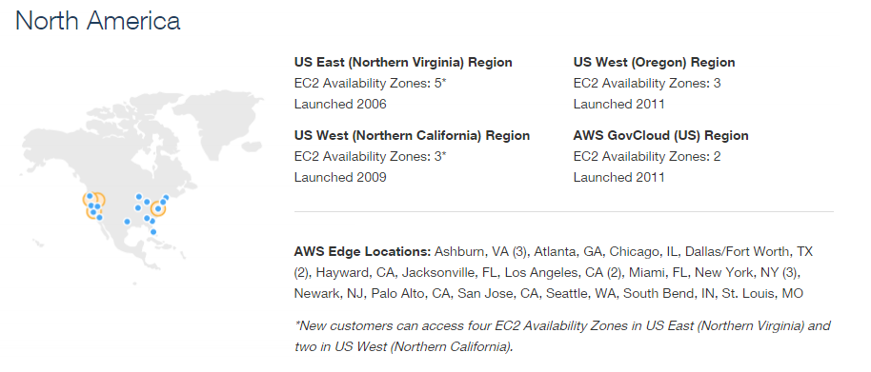
AWS Platform
Development
Operations
Training labs

Slide 9



AWS Platform
Development
Operations
.
Networking
Amazon Route 53
Domain Name System
(DNS) web service.
AWS DirectConnect
Private connectivity
between AWS and your
datacenter
Amazon VPC
Private, isolated
section of the AWS
Cloud
Training labs

Slide 10



AWS Platform
Development
Operations
.
Compute
Amazon EC2
Elastic Virtual servers
in the cloud
Auto Scaling
Automated scaling
of EC2 capacity
Elastic Load Balancing
Dynamic traffic distribution
Training labs

Slide 11




AWS Platform
Development
Operations
.
Storage
Amazon EBS
Block storage for use
with Amazon EC2
Amazon S3
Internet scale
storage
Amazon Glacier
Storage for archiving
and backup
AWS Storage Gateway
Integrates on-premises
IT and AWS storage
Training labs

Slide 12



AWS Platform
Development
Operations
.
Database
Amazon RDS
Managed relational
database service
Amazon DynamoDB
Managed NoSQL database service
Amazon ElastiCache
Caching Service
Training labs

Slide 13


AWS Platform
Development
Operations
Analytics
Amazon Redshift
Warehouse service
Amazon Kinesis
Real-time processing of streaming data
Amazon Elastic MapReduce
Hosted Hadoop
framework
Training labs

Slide 14





AWS Platform
Development
Operations
Application Services
Amazon SQS
managed message queuing service
Amazon SNS
managed push messaging service
Amazon SES
email sending service
Training labs
Amazon Elastic Transcoder
Media transcoding
Amazon CloudSearch
managed search solution

Slide 15





AWS Platform
Development
Operations
Deployment & Management
AWS OpsWorks
Dev-Ops framework
for application lifecycle
management
AWS CloudFormation
Templates to deploy
& manage
AWS Elastic Beanstalk
Automate resource
management
AWS IAM
Manage users, Monitor resources
groups & permissions
Amazon CloudWatch
Monitor resources
Training labs
AWS CloudTrail
API call logging for
governance & compliance

Slide 16
Amazon Elastic Compute Cloud (EC2)
Development
Operations
Amazon Machine Images (AMIs) are the basic building blocks of Amazon EC2
An AMI is a template that contains a software configuration (operating system, application server and applications) that can run on Amazon’s computing environment
AMIs can be used to launch an instance, which is a copy of the AMI running as a virtual server in the cloud.
Training labs

Slide 17
Amazon Elastic Compute Cloud (EC2)
Development
Operations
Getting Started with Amazon EC2
Step 1: Sign up for Amazon EC2
Step 2: Create a key pair
Step 3: Launch an Amazon EC2 instance
Step 4: Connect to the instance
Step 5: Terminate instance
Training labs

Slide 18
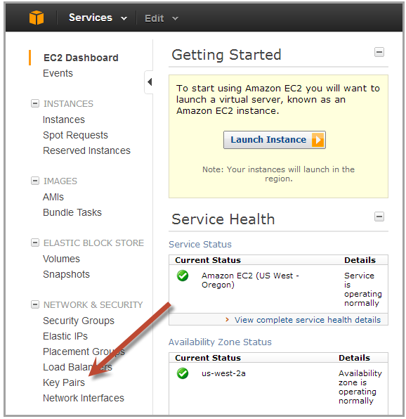
Amazon Elastic Compute Cloud (EC2)
Development
Operations
Creating a key pair
Open the Amazon EC2 console at http://console.aws.amazon.com/ec2/
On the navigation bar select region for the key pair
Click Key Pairs in the navigation pane to display the list of key pairs associated
Training labs

Slide 19
Amazon Elastic Compute Cloud (EC2)
Development
Operations
Creating a key pair (cont.)
Click Create Key Pair
Enter a name for the key pair in the Key Pair Name field of the dialog box and click Create
The private key file, with .pem extension, will automatically be downloaded by the browser.
Training labs

Slide 20
Amazon Elastic Compute Cloud (EC2)
Development
Operations
Launching an Amazon EC2 instance
Sign in to AWS Management Console and open the Amazon EC2 console at http://console.aws.amazon.com/ec2/
From the navigation bar select the region for the instance
From the Amazon EC2 console dashboard, click Launch Instance
Training labs

Slide 21
Amazon Elastic Compute Cloud (EC2)
Development
Operations
On the Create a New Instance page, click Quick Launch Wizard
In Name Your Instance, enter a name for the instance
In Choose a Key Pair, choose an existing key pair, or create a new one
In Choose a Launch Configuration, a list of basic machine configurations are displayed, from which an instance can be launched
Click continue to view and customize the settings for the instance
Training labs

Slide 22
Amazon Elastic Compute Cloud (EC2)
Development
Operations
Select a security group for the instance. A Security Group defines the firewall rules specifying the incoming network traffic delivered to the instance. Security groups can be defined on the Amazon EC2 console, in Security Groups under Network and Security
Review settings and click Launch to launch the instance
Close the confirmation page to return to EC2 console
Click Instances in the navigation pane to view the status of the instance. The status is pending while the instance is launching
Training labs

Slide 23
Amazon Elastic Compute Cloud (EC2)
Development
Operations
Connecting to an Amazon EC2 instance
There are several ways to connect to an EC2 instance once it’s launched.
Remote Desktop Connection is the standard way to connect to Windows instances.
An SSH client (standalone or web-based) is used to connect to Linux instances.
Training labs

Slide 24
Amazon Elastic Compute Cloud (EC2)
Development
Operations
Terminating Instances
If the instance launched is not in the free usage tier, as soon as the instance starts to boot, the user is billed for each hour the instance keeps running.
The terminated instance cannot be restarted.
To terminate an instance:
Open the Amazon EC2 console
In the navigation pane, click Instances
Right-click the instance, then click Terminate
Click Yes, Terminate when prompted for confirmation
Training labs

Slide 25
Amazon Elastic Compute Cloud (EC2)
Development
Operations
Demo
Training labs

Slide 26

Q & A ?
Development
Operations

