Slide 1



Slide 2
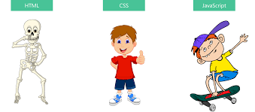
HTML CSS JS

Slide 3
CSS and its Types
Inline Style (inside the tag using style attribute)
Internal Style (Using Style tag in head )
External Style sheet with link

Slide 4
CSS Rules
Selector {
Property : value;
}
(Almost) everything you do in CSS follows this basic pattern

Slide 5
CSS Rules - Example
h1 {
Color: purple;
}
Mark all <h1> elements purple

Slide 6
Selectors
universal selector *
Element selector button img
Selector List h1,h2
ID Selector # only one
class selector .
Descendant selector - tags nested inside another tag li a{}
Adjacent selector - paragarap imediately preceed by h1 h1+p{}
Direct descendant - div>li{}

Slide 7
Pseudo Class
a:hover
a:active
a:visited

Slide 8
Color and Background color
Color – text color
Background-color
Named colors
RGB

Slide 9
Fonts
font-family: 'Courier New', Courier, monospace;
font-style: italic;
font-variant: small-caps;
font-weight: bold;
font-size: 50px;
color: red;

Slide 10
Online Fonts
fonts.google.com

Slide 11
Background
background-color: beige;
background-image: url(user.png);
background-repeat: no-repeat;
background-size: cover;
background-position: top right;
background: linear-gradient(red,blue);

Slide 12
Text Properties
letter-spacing: 5px;
text-decoration: underline;
vertical-align: sub;
text-transform: uppercase;
text-align: left;
text-indent: 50px;
line-height: 50px;

Slide 13
List Properties
list-style-type: circle;
list-style-image: url(button.png);

Slide 14
Box Model
Border
Padding
Margin
Width and Height
Display Property

Slide 15
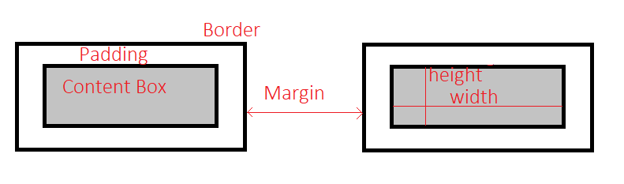
Box Model

Slide 16
Border Properties
border-width: 20px;
border-color: rebeccapurple;
border-style: solid;
border: solid;
border-radius: 10px;

Slide 17
Padding Properties
padding-left: 10px;
padding-top: 20px;
padding-right: 10px;
padding-bottom: 20px;

Slide 18
Margin Properties
margin-left:10px ;
margin-top: 10px ;
margin-right: 10px;
margin-bottom: 10px;

Slide 19
Display
display: inline;
display: block;
display: inline-block;
display: flex;

Slide 20
FlexBox
CSS Flexible box module – one dimensional layout model
Flexible and efficient layout
Space , alignment, order can be handled easily

Slide 21
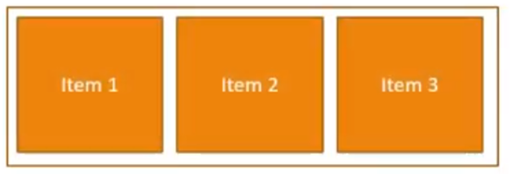
Terminology
Flex container
Flex items

Slide 22
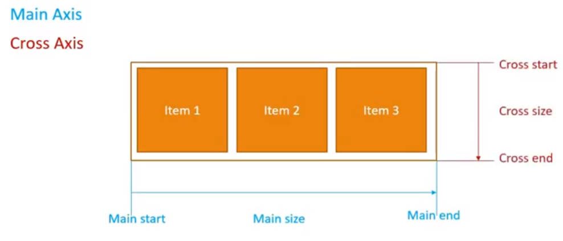
Flexbox axes

Slide 23
Flex Container Properties
display:flex;
flex-direction: row;
flex-wrap:nowrap;
flex-flow: column;
justify-content: center;
align-items: flex-start;
align-content: space-around;

Slide 24
Flex Item Properties
order:2;
align-self: auto;

Slide 25
CSS Grid

Slide 26
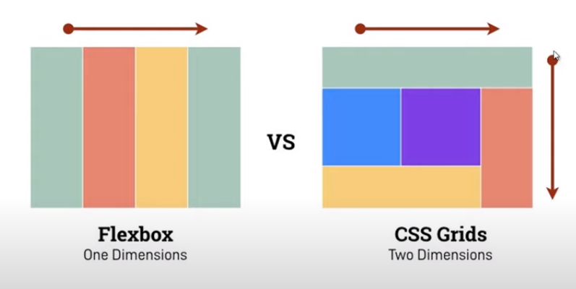
Grid

Slide 27
Two dimensional layout
Rows and columns

Slide 28
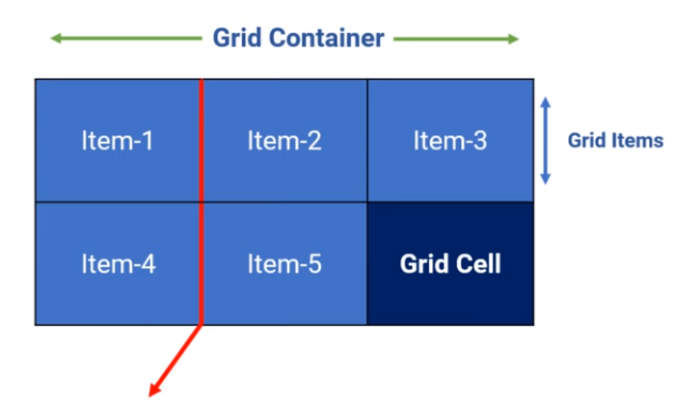
Grid Terminology

Slide 29
Properties
display: grid;
grid-template-columns: 20% 20% 20% 20% 20%;
grid-template-rows: 20% 20% 20% 20% 20%;

Slide 30


Slide 31
Bootstrap
Framework
Open source
To build fast responsive websites
https://getbootstrap.com/

Slide 32
To use Bootstrap
Include from CDN
Download and use

Slide 33
CDN
"https://cdn.jsdelivr.net/npm/bootstrap@5.0.2/dist/css/bootstrap.min.css

Slide 34
Button Example
<button type="button" class="btn btn-primary">Primary</button>
<button type="button" class="btn btn-secondary">Secondary</button>
<button type="button" class="btn btn-success">Success</button>
<button type="button" class="btn btn-danger">Danger</button>

Slide 35
SASS
Syntactically Awesome Style Sheets
Provides extra features than CSS.
Browsers cannot read SASS file.
Uses a sass compiler that converts SASS file to a normal CSS file.
SASS is compatible with every version of CSS.
It provides various supports of programming languages like variables, nesting, and mixins.
Variables are used to store CSS values that can be reused
Variables are declared with $ symbol.

Slide 36
SASS Example
$buttoncolor: blue;
header button{
color:$buttoncolor;
}
article button{
color: $buttoncolor;
}
footer button{
color: $buttoncolor;
}

Slide 37
HTML5 Modernizr
Old Browsers do not support many new features introduced in HTML and CSS
Modernizr helps to test whether new features in HTML & CSS are supported by our browsers.
Create CSS rules for the features.
Automatically rules are applied on the webpages if the browser does not support the features.

