Slide 1

Application Development Practices (ADP)

Slide 2
Course Overview - Topics
HTML
CSS
Bootstrap
JavaScript
TypeScript
Shell Programming
Linux
GIT
Web Hosting
Agile

Slide 3
HTML
Basic HTML Elements
Tables
List and Hyperlinks
Images
Frames
Forms
Form Elements and Media

Slide 4
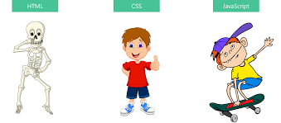
HTML CSS JS

Slide 5
HTML CSS JS
HTML (Hyper Text Markup language)
To create the structure
CSS(Cascading Style Sheet)
To style the website
JS (JavaScript)
To add functionality

Slide 6
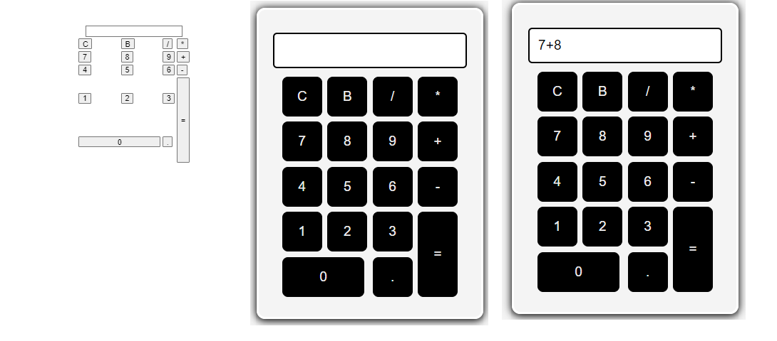
Example
https://codepen.io/Muhammad-Abraiz/pen/mdjpqEm

Slide 7


Slide 8
Basic Structure
<html>
<head>
<title>Document</title>
</head>
<body>
</body>
</html>

Slide 9
Tags & Attributes
Tags:
Tag surrounds the content and apply meaning to it.
It is written between < and > brackets.
<table></table>
Attribute:
Provides extra information about the element
<input type="radio" />

Slide 10
Tags
Paragraph <p>
Heading <h1> to <h6>
Line Break <br>
Horizontal Rule<hr>

Slide 11
Tags
Abbreviation tag : <abbr>
Marked tag: <mark>
Strong tag: <strong>
Emphasized tag : <em>
Definition tag: <dfn>

Slide 12
<div> and <span>
Inline
Block

Slide 13
Semantic Elements
Clearly describes its meaning to both the browser and the developer.
Examples
<article>
<aside>
<details>
<figcaption>
<figure>
<footer>
<header>
<main>
<nav>
<section>
<summary>
<time>

Slide 14
Table
<table></table>
tr,td,th
thead,tbody,tfoot
colspan,rowspan
Attributes
border
cellspacing
Cellpadding
bgcolor

Slide 15
HTML Entities
Reserved characters in HTML must be replaced with character entities.
< &lt;
> &gt;
Space &nbsp;
& &amp;
© &copy;

Slide 16
Subscript superscript
H<sub>2</sub>O
H₂O
H<sup>2</sup>O
H²O

Slide 17
Lists
Ordered List or Numbered List
Unorder List or Bulleted List
Description list or Definition List

Slide 18
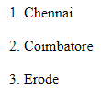
Ordered List
<ol>
<li>Chennai</li>
<li>Coimbatore</li>
<li>Erode</li>
</ol>

Slide 19
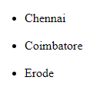
Unordered List
<ul>
<li>Chennai</li>
<li>Coimbatore</li>
<li>Erode</li>
</ul>

Slide 20
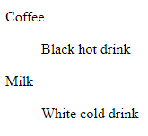
Description list
<dl>
<dt>Coffee</dt>
<dd>Black hot drink</dd>
<dt>Milk</dt>
<dd>White cold drink</dd>
</dl>

Slide 21
Nested Lists
List within another list
Example
Coffee
Tea
Black tea
Green tea
Milk

Slide 22
Attributes
Type
<ol type=""> (A | a | i | 1 | I)
<ul type=""> (square | disc | circle)
Start
<ol start=""></ol> (4, d etc)
Value
<li value="7"></li>

Slide 23
<ol>
<li value="100">Coffee</li>
<li>Tea</li>
<li>Milk</li>
<li>Water</li>
<li>Juice</li>
</ol>
100. Coffee
101. Tea
102. Milk
103. Water
104. Juice

Slide 24
Links / Anchor tag
<a href=“url”>Link Text</a>
<a href="https://iamneo.ai/">IamNeo</a>

Slide 25
Link + List
<ul>
<li><a href="https://neopat.io/">NeoPat</a></li>
<li><a href="https://neocolab.io/">NeoColab</a></li>
</ul>

Slide 26
Link + Table
<table border="1">
<tr>
<td>Iamneo</td>
<td>NeoColab</td>
<td>NeoPat</td>
<td><a href="https://neocolab.io/">NeoExam</a></td>
</tr>
</table>

Slide 27
Images
<img src="" alt="">
Attributes
src - Specifies the path to the image
alt - Specifies an alternate text for the image, if the image for some reason cannot be displayed
Width
Height

Slide 28
Link + Images
<a href="https://iamneo.ai/">
<img src="https://iamneo.ai/wp-content/uploads/2022/07/iamneo-logo.png" alt=""/>
</a>

Slide 29
Frames
To display multiple pages in single window
Frame tag
Attribute
Src
name
<frame name = "left" src = "/html/left.htm" />
<frame scrollbar="no">
<frame marginheight="20">
<frame marginwidth="20">

Slide 30
iframe
Iframe tag
Attribute
Frameborder
Width
height

Slide 31
Forms

Slide 32
Form Elements Basics
<form>
action
Where the data should be sent

Slide 33
Common input types
<input>
type attribute
Text
Password
Color
placeholder attribute
Name attribute

Slide 34
Labels
The <label> element defines a label for several form elements
The <label> element also help users who have difficulty clicking on very small regions (such as radio buttons or checkboxes) - because when the user clicks the text within the <label> element, it toggles the radio button/checkbox.
The for attribute of the <label> tag should be equal to the id attribute of the <input> element to bind them together.

Slide 35
Example
<form action="/action_page.html">
<label for="fname">First name:</label><br>
<input type="text" id="fname" name="fname"><br><br>
<input type="submit" value="Submit">
</form>

Slide 36
Button
<button>
Type
button
<button type="button" onclick="alert('Hello World!')">Click Me!</button>

Slide 37
Check Box and Radio Button
Check Box
Name
Checked
Radio button
Name
Value

Slide 38
Dropdown Box - Select & Option
<Select>
<Option>
value
<label for="cars">Choose a car:</label>
<select id="cars" name="cars">
<option value="volvo">Volvo</option>
<option value="saab">Saab</option>
<option value="fiat">Fiat</option>
<option value="audi">Audi</option>
</select>

Slide 39
Default Select Value
<option value="fiat" selected> Fiat
</option>
<select id="cars" name="cars" size="3">
<select id="cars" name="cars" size="4" multiple>

Slide 40
Range and Text area
The <textarea> element defines a multi-line input field (a text area):
<textarea name="message" rows="10" cols="30">
The cat was playing in the garden.
</textarea>

Slide 41
Form Validations
Attribute
Required
Email
URL

Slide 42
FieldSet and Legend
<form action="/action_page.php">
<fieldset>
<legend>Personalia:</legend>
<label for="fname">First name:</label><br>
<input type="text" id="fname" name="fname" value="John"><br>
<label for="lname">Last name:</label><br>
<input type="text" id="lname" name="lname" value="Doe"><br><br>
<input type="submit" value="Submit">
</fieldset>
</form>

Slide 43
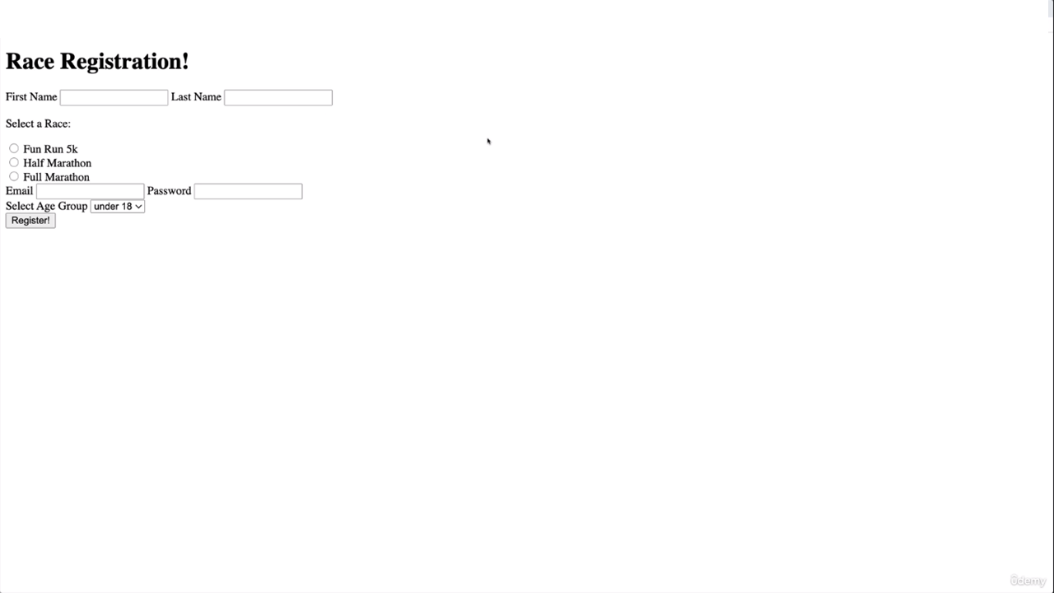

Slide 44
Media
<Audio>
<Video>
Src
Controls
muted

