Slide 1

Note: The data and information in this document is reflective of a hypothetical situation and client. This document is to be used for KPMG Virtual Internship purposes only.
Sprocket Central Pty Ltd
Data analytics approach
[Division Name] - [Engagement Manager], [Senior Consultant], Gnaneshwari Mahimaluru [Junior Consultant]

Slide 2
Note: The data and information in this document is reflective of a hypothetical situation and client. This document is to be used for KPMG Virtual Internship purposes only.
Agenda
Introduction
Data Exploration
Model Development
Interpretation

Slide 3
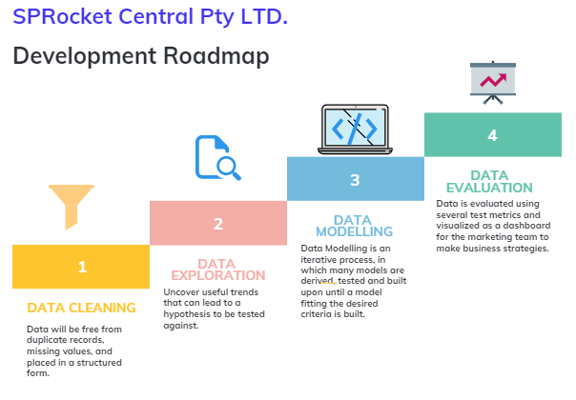
Note: The data and information in this document is reflective of a hypothetical situation and client. This document is to be used for KPMG Virtual Internship purposes only.
Introduction

Slide 4
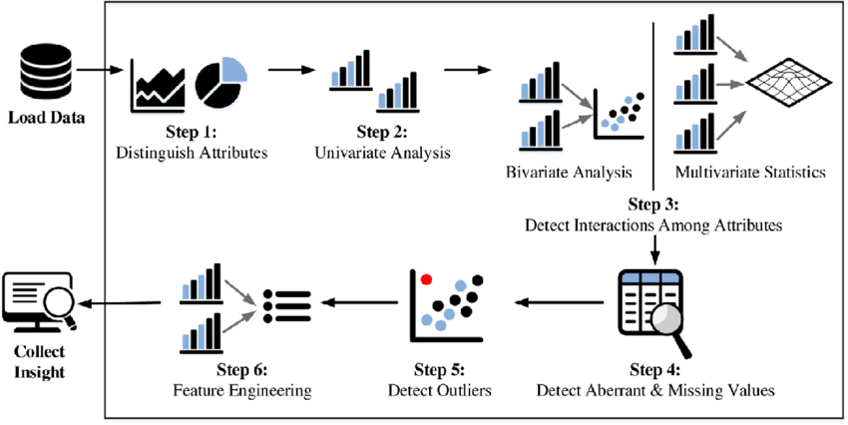
Data Exploration
Data exploration is the first step of data analysis used to explore and visualize data to uncover insights from the start or patterns to dig deeper.
Significance of performing an EDA:
Reduces the risk of imbalance distribution of the dataset by checking the skewness of a particular field.
High Correlation between multiple variables can lead to overfitting problem which can be checked using correlation analysis.
To Infer better variables/predictors out of the existing variables that can turn out to be a good predictor if it correlates with the output variable.
Removes the redundant values from the dataset by treating missing values and outliers.
fig. Steps for Data Exploration.

Slide 5
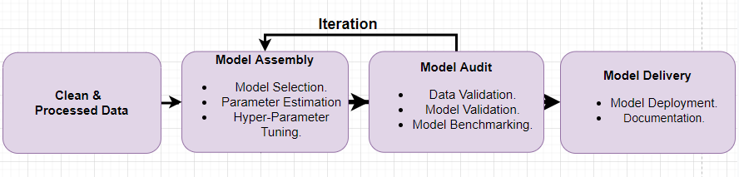
Model Development
Model development is an iterative process, in which many models are derived, tested and built upon until a model fitting the desired criteria is built.
Fig. Model Development Steps.
The Initial step is to determine a hypothesis questioning the problem statement and then perform statistical testing to determine if the hypothesis is valid or not.
Evaluate the performance of the models using factors such as ROC Curves, Precision, Recall, AUC Curve, Accuracy, F1-score etc.
Finally, deploy and document the best model’s performance, assumptions and certain limitations.

Slide 6
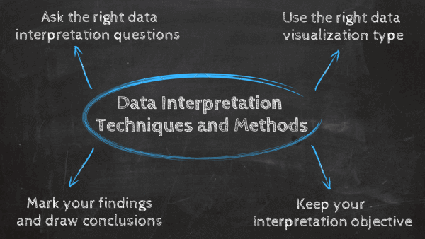
Interpretation
Data interpretation is the final step of data analysis where we turn results into a presentable format to gain clear and useful insights for business strategies.
Quantitative and qualitative methods are distinct types of data analyses both offering different type of data interpretation & decision making abilities.
Data dashboards decentralize data without compromising on the necessary speed of thought while blending both quantitative and qualitative data.
We will be reporting the insightful findings in the form of a dashboard which will demonstrate the Customer Demographic , Target Customers, Top Selling Goods etc. to help the team to make appropriate business decisions.
Fig. Data Interpretation techniques.

Slide 7
Note: The data and information in this document is reflective of a hypothetical situation and client. This document is to be used for KPMG Virtual Internship purposes only.
Introduction
customers analysis
Age distributions
Number of bike purchases in 3 years / percentages purchases
Job industry category.
Wealth segments
Number of cars own on each states

Slide 8
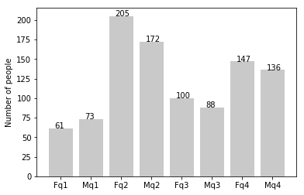
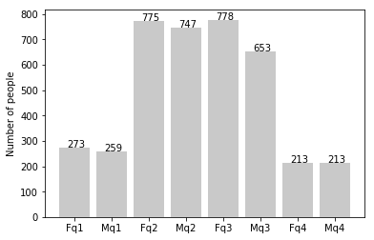
Note: The data and information in this document is reflective of a hypothetical situation and client. This document is to be used for KPMG Virtual Internship purposes only.
Data Exploration
new
Customers’ age distribution
As we can see, mostly our new customers are between 25 to 48 years old.
Number of customers from 48 to 59 years old has big drops on percentages.
There is a slightly increase in number of customers over 59 years old in term of percentages
It looks like the percentages of under 25 years old not really change.
old

Slide 9
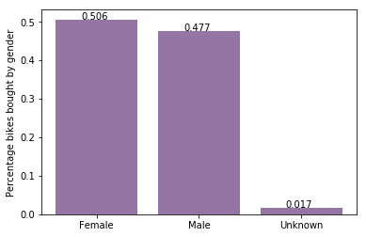
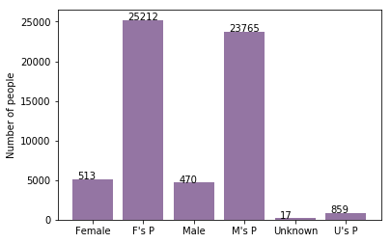
Note: The data and information in this document is reflective of a hypothetical situation and client. This document is to be used for KPMG Virtual Internship purposes only.
Model Development
Bike purchases last 3 years
As we can see, our new customers mostly Female with 50.6% purchases with total of 25,212 bikes
Male contributed to 47.7% purchases with 23,765 bikes
So we should focus on advertises on Female customers than Male customers

Slide 10
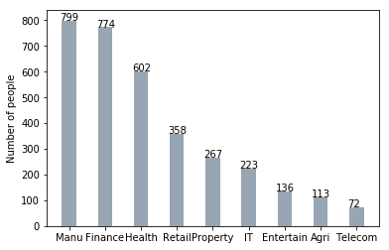
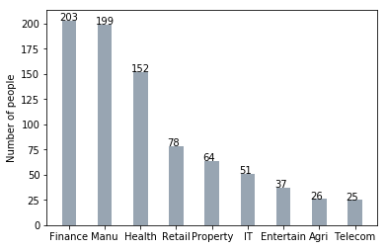
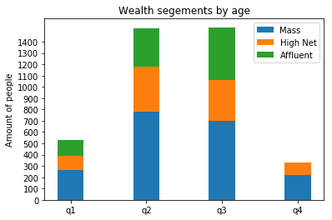
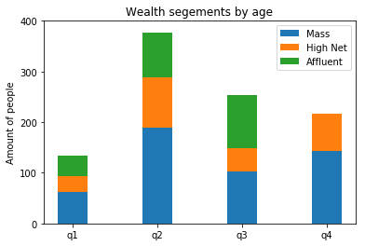
Note: The data and information in this document is reflective of a hypothetical situation and client. This document is to be used for KPMG Virtual Internship purposes only.
Interpretation
Job industry category
Mostly our new customers are on Finance industry and our Manufacturing customers are still on top 2.
The rest industries is still same
Wealth segments
In all ages, the number of Mass Customers is the highest so we should focus on this social class.
After that, we should focus on High Net Customer.
Then Affluent Customers but mostly second and third quadrant

Slide 11
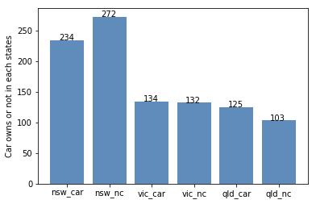
Note: The data and information in this document is reflective of a hypothetical situation and client. This document is to be used for KPMG Virtual Internship purposes only.
Interpretation
Numbers of cars owned
NSW should be considered the most since numbers of customers don’t own cars is significantly larger than that own.
VIC and QLD has more customers that own car that who don’t but we can try to have something so that those owns car will buy bikes.

Slide 12
Note: The data and information in this document is reflective of a hypothetical situation and client. This document is to be used for KPMG Virtual Internship purposes only.
Appendix

Slide 13
Note: The data and information in this document is reflective of a hypothetical situation and client. This document is to be used for KPMG Virtual Internship purposes only.
Appendix
All supporting items in that attachment.

