Slide 1
PROJECT-2
IPL DATA ANALYSIS
USING NUMPY, MATPLOTLIB LIBRARIES

Slide 2
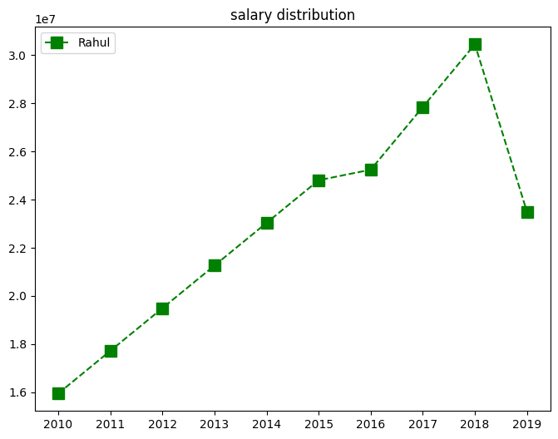
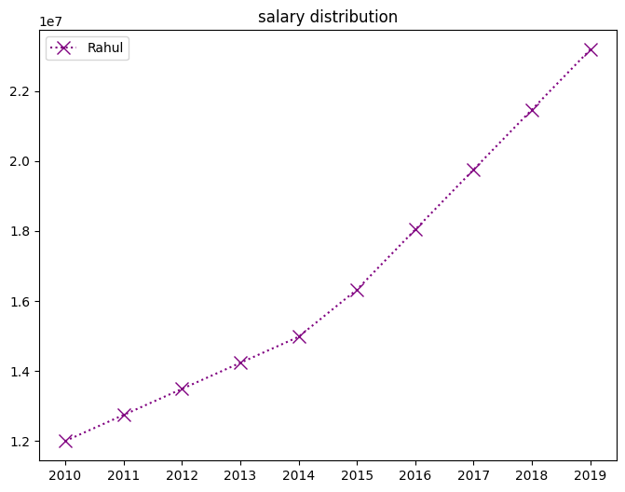
Salary Plots Comparision

Slide 3
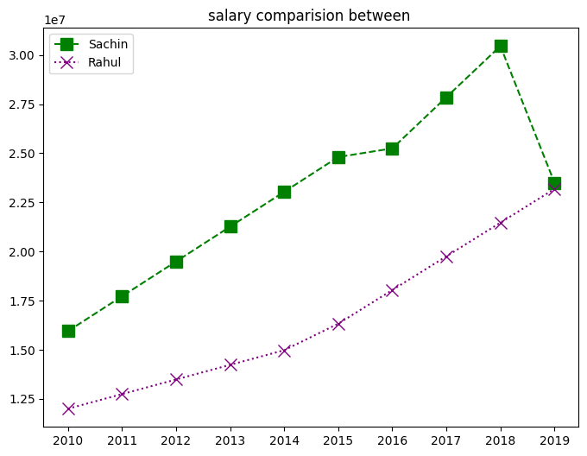
Insights of comparison

Slide 4
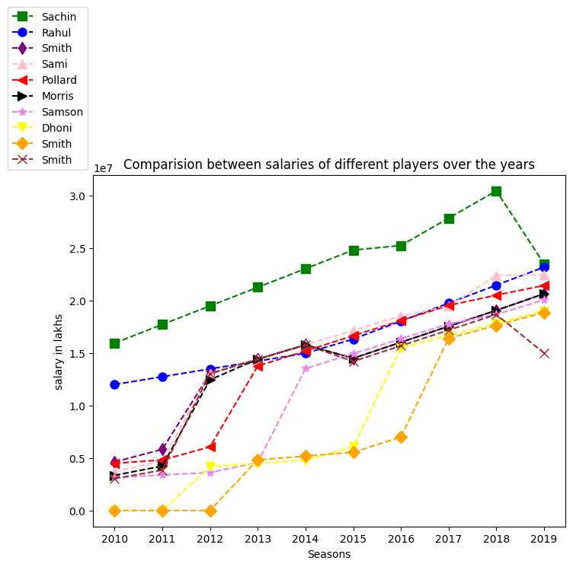
Attribute (Salaries) comparision between all players
Here is a comparision of the salaries of the players over the years(seasons)
From this Graph we can draw the below conclusions:
Sachin got the highest salaries among the other players in the years 2010 to 2018
In the year 2019 sachin salary is equal to rahul's salary

Slide 5
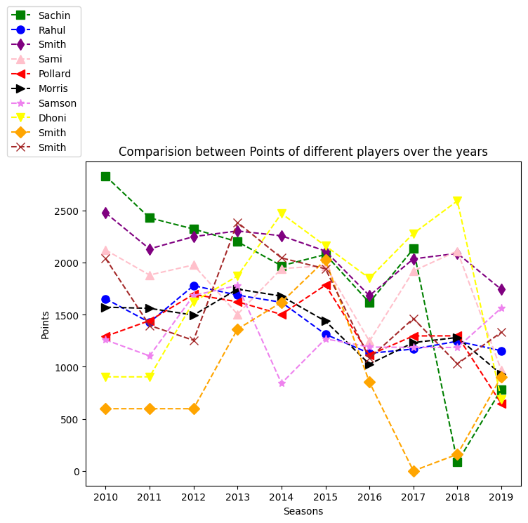
Attribute (Points) comparision between all players

Slide 6
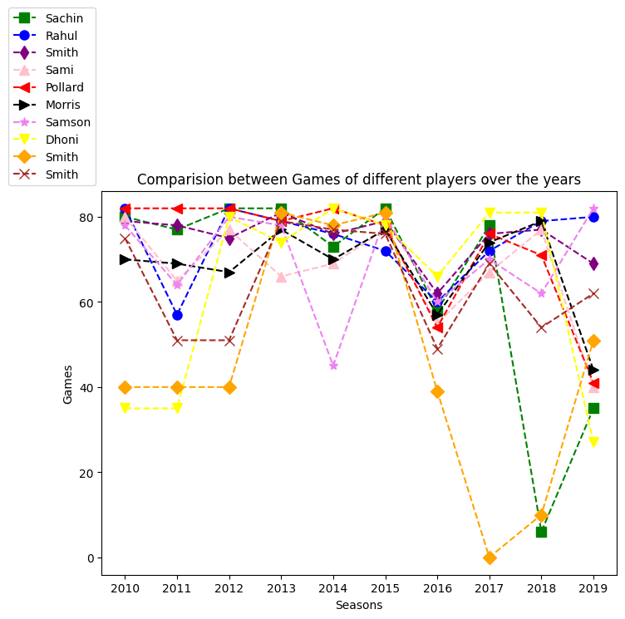
Attribute (Games) comparision between all players

Slide 7
THANK YOU
AUTHOR:
GNANESHWARI MAHIMALURU
GITHUB LINK :-
https://github.com/gnaneshwari1802/NareshDataScienceTasksAndProjects
GMAIL:-
gnaneshwari.m2009@gmail.com

