Slide 1

Factors Influencing the Choice of Online Learning Platforms
BUSINESS RESEARCH METHODS · FINAL RESEARCH PRESENTATION
A study of Indian learners
Gnaneshwari M · PGBA25005
PGDM-BA 2025–27 · SoIM Hyderabad · Guide: Dr. Rajkumar Rayabaram · 3 October 2026
Notes:
Good morning, sir. I'm Gnaneshwari, PGBA25005. My project looks at what makes Indian learners choose an online learning platform, and whether the cost of mobile data matters. It is a small pilot study.

Slide 2

Agenda
1
Research problem, literature gap and objectives
2
Conceptual framework and hypotheses
3
Methodology, sampling and measurement
4
Findings, interpretation and data quality
5
Limitations, recommendations and conclusion
2
Notes:
I'll cover the problem and goals, the framework, how I collected data, what I found, and then limitations, suggestions and conclusion.

Slide 3
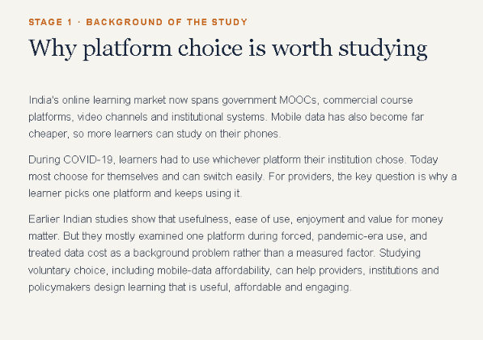

Slide 4
Research problem and gap
What influences Indian learners' choice of, and continued use of, online learning platforms, and what role does mobile-data affordability play?
Single platform
Compulsory use
Data cost
Earlier Indian studies cover one platform or type, such as Microsoft Teams or free online courses.
Much of the evidence is from the pandemic, when learners had no choice.
None of the studies I reviewed measured whether learners can afford mobile data.
Why it matters: platform providers, institutions and policymakers can use the findings to design accessible, affordable and engaging online learning.
Source: review of 8 Indian studies, 2020–2023
3
Notes:
Many platforms compete for Indian learners, so providers need to know what makes a learner pick one and keep using it. Studies so far have three gaps: they look at one platform at a time, much of the evidence is from the pandemic when learners had no choice, and none checked whether learners can afford mobile data. My question is: what influences platform choice and continued use, and where does data cost fit in? The answer helps providers, institutions and policymakers.

Slide 5
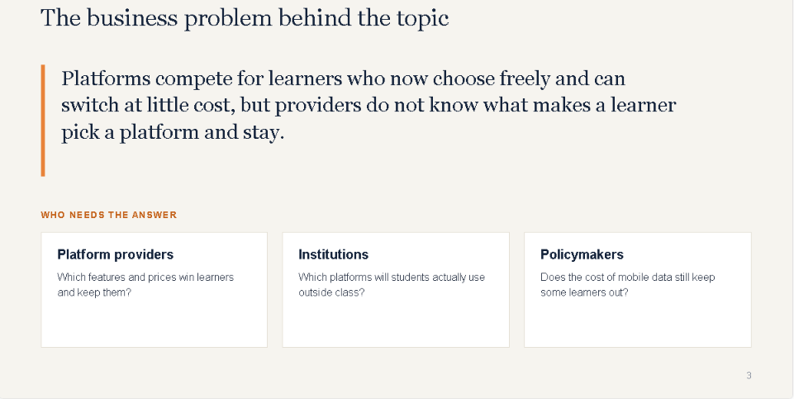

Slide 6
Review of literature
Muthuprasad et al. (2021)
70% were ready for online classes; most preferred smartphones; rural connectivity was a challenge.
307 agricultural students
Bast (2021)
Receptiveness to online learning was significantly higher among urban than rural students.
1,318 students
Mohan et al. (2020)
Habit, enjoyment, content and usefulness predicted intention to use; ease of use, social influence and support did not.
412 postgraduates, UTAUT2
Meet et al. (2022)
Value for money, enjoyment, support, usefulness and ease of use all had positive effects (together explaining 69.9% of intention to use).
483 students, UTAUT2
Pal & Vanijja (2020)
Two usability tests gave similar results; the device used made no difference to usability.
University students, MS Teams
UTAUT2 is a widely used model of why people adopt a technology (see slide 6). MOOC = free open online course.
Also reviewed: Mishra et al. (2020); Singh & Sharma (2021); Ravishankar et al. (2023). Eight studies in total.
4
Notes:
I reviewed eight Indian studies from 2020 to 2023. Their results on the factors in the UTAUT2 model are mixed, so I check them again with my own sample. None looked at data affordability separately.

Slide 7
Research objectives
General objective: examine the factors influencing Indian learners' choice and continued use of online learning platforms.
Established factors (H1–H6)
Added variable (H7)
Usefulness, ease of use, social influence, support available, enjoyment and value for money
Mobile-data affordability, tested alongside value for money and support available
Each hypothesis predicts that a higher score on a factor means a learner is more likely to choose and keep using a platform. For example, H1: the more useful learners find a platform, the more likely they are to choose it.
5
Notes:
The main goal is to find out what influences learners' choice and continued use of platforms. I have seven specific goals, one per factor: six well-known factors plus mobile-data affordability, which I added.

Slide 8

Conceptual framework
Independent variables: the 7 factors (H1–H7)
H1 Usefulness (performance expectancy)
H2 Ease of use (effort expectancy)
Dependent variable (outcome)
H3 Social influence
H4 Support (facilitating conditions)
Platform choice and continued use
H5 Enjoyment (hedonic motivation)
H6 Value for money (price value)
H7 Mobile-data affordability (added variable)
H1 to H7: each factor is expected to influence platform choice and continued use. UTAUT2 (Unified Theory of Acceptance and Use of Technology) is a well-known model of why people adopt a technology (Venkatesh et al., 2012). The mobile-data affordability scale is my addition.
6
Notes:
My framework uses UTAUT2, a well-known model of how people adopt technology. The six factors are: usefulness, whether the platform helps me learn; ease of use; social influence, meaning pressure from peers and teachers; support available, such as devices and help; enjoyment; and value for money. These are H1 to H6. H7 is mine: mobile-data affordability, whether the learner can pay for the data needed. I left out habit because I study choice, not long-term use. These are the ideas the study is built around. With my data I describe each factor; I do not test the hypotheses. In research terms, the seven factors are the independent variables, the things that may influence the outcome. Platform choice and continued use is the dependent variable, the outcome.

Slide 9
Research methodology
Design
Approach
A descriptive online survey, done once (cross-sectional)
Numbers-based. Each statement is rated 1 (Strongly Disagree) to 5 (Strongly Agree), called a Likert scale
Instrument
Analysis
49-question form (details on the next slides)
Percentages and average scores per factor (3 = neutral, above 3 = agree). No statistical tests, because only total counts were available.
7
Notes:
This is a descriptive online survey, done once. Each statement is rated from 1, Strongly Disagree, to 5, Strongly Agree. This is called a Likert scale, and it turns opinions into numbers we can compare. I calculated percentages and the average score for each factor. An average of 3 is neutral and above 3 means agreement. I did not run statistical tests, because I only had total counts per question from Google Forms, not each person's full answers.

Slide 10
Population and sampling
Population
Indian learners aged 18+ who used at least one online learning platform in the last six months
Sampling frame (list)
None: no complete list of platform users exists
Technique
Convenience sampling (people I could reach); 38 responses
Data collection
Self-administered online questionnaire (Google Forms), shared through personal and institutional networks
8
Notes:
The target group is Indian learners aged 18 and above who used at least one platform in the last six months. No list of such learners exists, so I used convenience sampling: I shared the form with people I could reach through personal and institutional networks. I got 38 responses, so the findings describe this group and cannot be applied to all of India.

Slide 11
The questionnaire: 49 items
A
3
Screening
items
Is the person eligible for the study?
B
9
Platform use
items
Platform, access, device and who pays
C
Views on platforms
31
items
31 statements rated 1–5 on 8 factors, plus 1 attention check
D
6
Demographics
items
Age, gender, location, education
Full questionnaire in the report appendix. Likert: 1 = Strongly Disagree, 5 = Strongly Agree.
9
Notes:
The questionnaire has 49 questions in four sections: 3 to check eligibility, 9 on platform use, 31 statements rated 1 to 5, and 6 on background. The full wording is in the report appendix.

Slide 12
Measurement framework
Factor (construct)
Questions
No.
Source
Usefulness (performance expectancy)
C1–C4
4
Venkatesh et al. (2003, 2012)
Ease of use (effort expectancy)
C5–C8
4
Venkatesh et al. (2003, 2012)
Social influence
C9–C11
3
Venkatesh et al. (2003, 2012)
Support (facilitating conditions)
C12–C15
4
Venkatesh et al. (2003, 2012)
Enjoyment (hedonic motivation)
C16–C18
3
Venkatesh et al. (2012)
Value for money (price value)
C19–C21
3
Venkatesh et al. (2012)
Mobile-data affordability
C22–C26
5
My own items; C26 score reversed
Platform choice & continued use
C27–C30
4
Venkatesh et al. (2012); C30 is my own
Attention check
C31
1
Checks careless answers; not scored
Types: C1–C26 are independent variables and C27–C30 the dependent variable, all rated 1–5. Sections B and D are profile (categorical) variables. Section A and C31 are screening and quality checks, not analysed.
C1, C2 … are question numbers in Section C of the questionnaire. All use a 5-point scale (1 = strongly disagree, 5 = strongly agree).
10
Notes:
This table shows which questions measure which factor. Six factors are adapted from established scales. The mobile-data questions, C22 to C26, are my own and not yet tested for reliability, and C26 is worded negatively, so its score is reversed. C31 is an attention check and is not scored. Types of variables: C1 to C26 are independent variables and C27 to C30 are the dependent variable, all rated on the 1 to 5 scale. The platform-use and background questions, Sections B and D, are profile variables, which are categories such as gender or device. Section A and C31 are screening and quality checks, so they are not analysed as results.

Slide 13
Why each question is asked
Section / factor
Why it is included
A: Screening (3 items)
Confirms 18+ and a platform used in the last six months: the target population.
B: Platform use (9 items)
Platform, who pays and device used: describes the sample and shows whether data cost matters.
C: Performance, effort (C1–C8)
Two main drivers in the UTAUT2 model: is the platform useful, and is it easy to use?
C: Other drivers (C9–C21)
Peers and teachers, support, enjoyment, value for money: the other UTAUT2 drivers.
C: Data affordability (C22–C26)
My added variable (H7); no prior study I reviewed measured it separately.
C: Platform choice (C27–C30)
The outcome the seven factors are compared with: platform choice and continued use.
C: Attention check (C31)
Catches careless answering. Used to judge data quality; not scored.
D: Demographics (6 items)
Describes who responded and shows how far the sample represents Indian learners.
The full question wording is in the report appendix.
11
Notes:
Here is why each part is included. Section A checks the person is 18 or above and used a platform recently. Section B records which platform, who pays and which device, so I can describe the group and see whether data cost matters. In Section C, usefulness and ease of use are the two main drivers in the UTAUT2 model; the others are social influence, support, enjoyment and value for money. The mobile-data questions are my added factor, H7, because no earlier study I reviewed measured it. C27 to C30 are the outcome, platform choice and continued use. C31 is the attention check. Section D describes who responded.

Slide 14




Findings: respondent profile
81.6%
68.4%
63.2%
55.3%
live in a metro city
chose their platform themselves
are female
are postgraduate students
Source: primary data, n = 38 (share of respondents in each group)
12
Notes:
Each ring shows the share of the 38 respondents in that group: 81.6% live in metro cities, 68.4% chose their platform themselves, 63.2% are female and 55.3% are postgraduate students. So the group is not representative of all India.

Slide 15
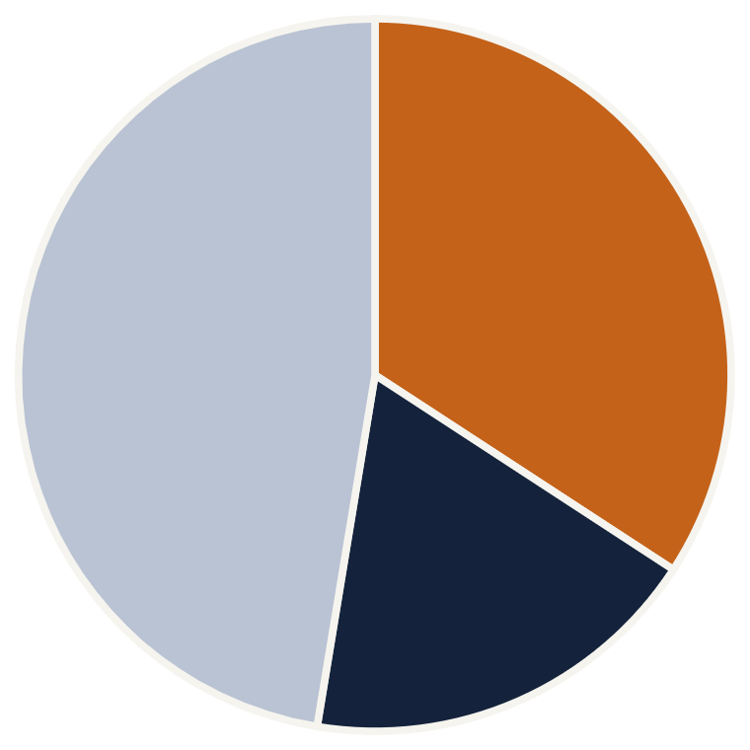
Findings: platforms and access
Most-used platform
Access and device
73.7%
44.7%
23.7%
23.7%
YouTube channels 34.2%
Udemy 18.4%
Laptop as main device
Free access
Own mobile data
Pay for access
All other platforms 47.4%
Source: primary data, n = 38. Data cost may be understated for Tier-2, Tier-3 and rural learners.
13
Notes:
The pie shows the most-used platform: YouTube learning channels 34.2%, Udemy 18.4% and all others 47.4%. The columns show access: 73.7% mainly use a laptop, 44.7% get access free, 23.7% rely mainly on their own mobile data and the same share pay for access themselves. So data cost may matter more for learners outside metro cities than this sample shows.

Slide 16
Findings: average score per factor
Support available
3.47
Enjoyment
3.46
Usefulness
3.42
Platform choice (outcome)
3.39
Ease of use
3.37
Mobile-data affordability
3.32
Value for money
3.27
Social influence
3.18
1 Strongly disagree
3 Neutral
5 Strongly agree
Each dot is an average score (1 to 5); the line is neutral (3). All sit just above it, so no factor clearly stands out.
Source: primary data, n = 38. Each dot is the mean score; the vertical line marks the neutral point (3).
14
Notes:
Each dot is the average score for a factor on the 1 to 5 scale, and the line marks the neutral point, 3. All eight are just above it, between 3.18 and 3.47. In order: support available 3.47, enjoyment 3.46, usefulness 3.42, platform choice 3.39, ease of use 3.37, mobile-data affordability 3.32, value for money 3.27 and social influence 3.18.

Slide 17
Interpretation by hypothesis
Hypothesis
Mean
Preliminary reading
H1 Usefulness
3.42
Platforms seen as moderately useful for learning goals
H2 Ease of use
3.37
Platforms seen as fairly easy to use
H3 Social influence
3.18
Weakest signal; other people's views push least
H4 Support available
3.47
Highest; resources and support are largely in place
H5 Enjoyment
3.46
Learning is moderately enjoyable
H6 Value for money
3.27
Value for money only slightly above neutral
H7 Mobile-data affordability
3.32
Not a clear constraint here: a Wi-Fi and laptop sample
Overall: all averages are just above neutral (3.18 to 3.47). The top-to-bottom gap is only 0.29 points, so no factor can be ranked above another.
Means show agreement only. Whether each factor influences platform choice is not yet tested.
15
Notes:
This is a first reading of each hypothesis against its average, not a test. Usefulness at 3.42: platforms are seen as moderately useful. Ease of use at 3.37: fairly easy. Social influence at 3.18 is the weakest. Support available at 3.47 is the highest, so resources are largely in place. Enjoyment at 3.46: learning is moderately enjoyable. Value for money at 3.27 is only slightly above neutral. Mobile-data affordability at 3.32 is not a clear problem in this Wi-Fi and laptop group. The gap from top to bottom is only 0.29, so no factor can be ranked above another.

Slide 18


Findings: data-quality check
Totals only
23.7%
44.7%
Only total counts per question, so no reliability checks or hypothesis tests yet
Next: remove ineligible respondents and those who failed the attention check before any tests.
9 of 38 said they had not used a platform recently (question A3), yet completed the survey
17 of 38 passed the attention check, a question that catches careless answers (45%)
Source: primary data, n = 38
16
Notes:
I want to be upfront about two issues. 9 of 38 respondents said they had not used a platform recently, yet completed the survey, because the form did not stop them. And only 17 of 38, 45%, passed the attention check, a question that catches careless answers. So the results are preliminary. Next I will remove those respondents before any tests.

Slide 19
Limitations and future scope
Limitations
Future scope
• 38-response convenience sample, skewed to metro, postgraduate and female respondents
• Keep each respondent's own answers; remove ineligible and failed-check rows
• Data-quality issues noted on the previous slide
• Larger, more diverse sample including Tier-2, Tier-3 and rural learners
• Averages and percentages only: H1 to H7 not tested
• My mobile-data questions are not yet validated
• Run statistical tests on H1 to H7
• Compare commercial, government and institutional platforms
17
Notes:
Limitations: a small convenience sample skewed to metro, postgraduate and female respondents; averages and percentages only; my mobile-data questions are not yet validated; and the data-quality issues. For the main study I will keep each respondent's own answers, use a larger and more varied sample, run statistical tests, and compare commercial, government and institutional platforms.

Slide 20



Managerial recommendations
Invest in access and experience
Design for low data
Show value and endorsement
For Tier-2, Tier-3 and rural learners, offer low-data modes, offline downloads and audio-only options. This sample probably understates the need.
Support available and enjoyment scored highest. Keep improving device and app compatibility, learner support and engaging content.
Value for money and social influence scored lowest. Test clearer value-for-money messages and peer or instructor endorsement.
Differences between constructs are small, so treat these as indicative.
18
Notes:
Three suggestions, each based on the scores, and all indicative. First, invest in access and experience, since support available and enjoyment scored highest. Second, design for low data: low-data modes, offline downloads and audio-only options, because this sample probably understates the need. Third, show value for money and peer endorsement, since those scored lowest.

Slide 21

Conclusion
Learners in this sample chose platforms voluntarily and agreed moderately and similarly across all factors. H1 to H7 are not yet tested.
• Support available and enjoyment score highest.
• Mobile-data affordability is not a clear constraint in this metro, Wi-Fi sample.
Thank you. Questions?
19
Notes:
Learners in this sample chose platforms voluntarily and agreed moderately and similarly across all factors. H1 to H7 are not yet tested. Support and enjoyment scored highest, and data cost was not a clear problem in this metro, Wi-Fi group. Thank you, I'm happy to take questions.

Slide 22
References
Bast, F. (2021). Perception of online learning among students from India set against the pandemic. Frontiers in Education, 6, 705013.
Pal, D., & Vanijja, V. (2020). Perceived usability evaluation of Microsoft Teams as an online learning platform during COVID-19 using SUS and TAM in India. Children and Youth Services Review, 119, 105535.
Meet, R. K., Kala, D., & Al-Adwan, A. S. (2022). Exploring factors affecting the adoption of MOOC in Generation Z using extended UTAUT2 model. Education and Information Technologies, 27(7), 10261–10283.
Ravishankar, K., Jan, N. A., Subramani, A. K., & David, R. (2023). Extending the TAM model to evaluate the impact of online learning on students' knowledge and career growth during COVID-19. Int. J. Management in Education, 17(6).
Mishra, L., Gupta, T., & Shree, A. (2020). Online teaching-learning in higher education during lockdown period of COVID-19 pandemic. Int. J. Educational Research Open, 1, 100012.
Singh, A., & Sharma, S. (2021). Adoption intention and effectiveness of digital collaboration platforms for online learning: The Indian students' perspective. Interactive Technology and Smart Education, 18(4).
Mohan, M. M., Upadhyaya, P., & Pillai, K. R. (2020). Intention and barriers to use MOOCs: An investigation among the post graduate students in India. Education and Information Technologies, 25(6), 5017–5031.
Venkatesh, V., Morris, M. G., Davis, G. B., & Davis, F. D. (2003). User acceptance of information technology: Toward a unified view. MIS Quarterly, 27(3), 425–478.
Muthuprasad, T., Aiswarya, S., Aditya, K. S., & Jha, G. K. (2021). Students' perception and preference for online education in India during COVID-19 pandemic. Social Sciences & Humanities Open, 3(1), 100101.
Venkatesh, V., Thong, J. Y. L., & Xu, X. (2012). Consumer acceptance and use of information technology: Extending the unified theory of acceptance and use of technology. MIS Quarterly, 36(1), 157–178.
20
Notes:
Full reference list with DOIs is in Chapter 5 of the report.

