Slide 1


Digital Marketing Internship at CARE Hospitals
Quality CARE India Limited · Hyderabad, Telangana
Internship Period: May 2026 – June 2026 · Role: Digital Marketing Intern
GNANESHWARI MAHIMALURU
PGDM – BUSINESS ANALYTICS
PGBA25002
Notes:
1

Slide 2
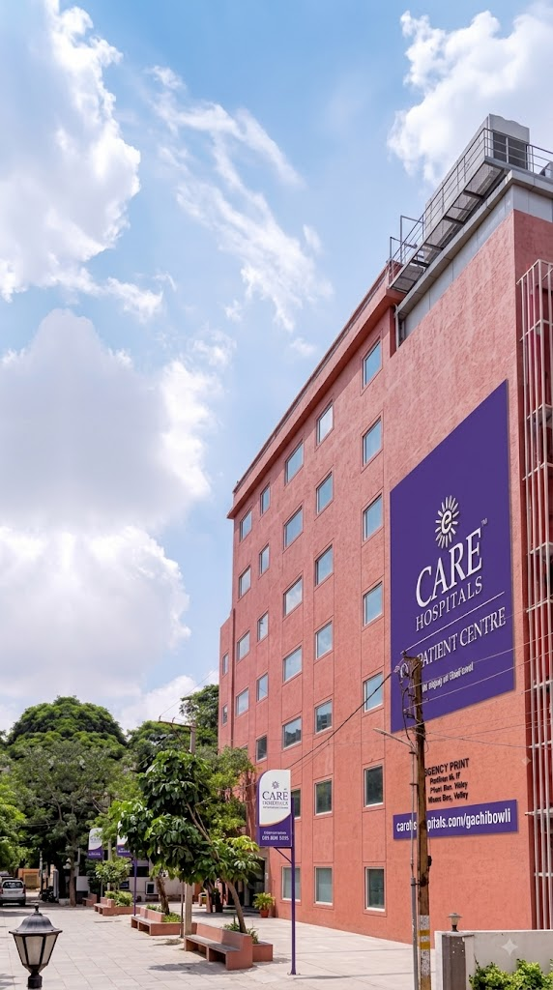
About CARE Hospitals
CARE Hospitals is a multi-specialty healthcare organization based in Hyderabad, committed to patient-focused care across a wide range of medical services. As part of Quality CARE India Limited, the institution emphasizes quality treatment, advanced medical infrastructure, and compassionate patient support.
  220-bed tertiary care hospital
  20+ medical specialties
  7 modern operation theatres
  120+ critical care beds
  Advanced diagnostic and surgical technology
  Multidisciplinary and patient-focused healthcare
  Experienced specialists and nursing teams
Notes:
2

Slide 3
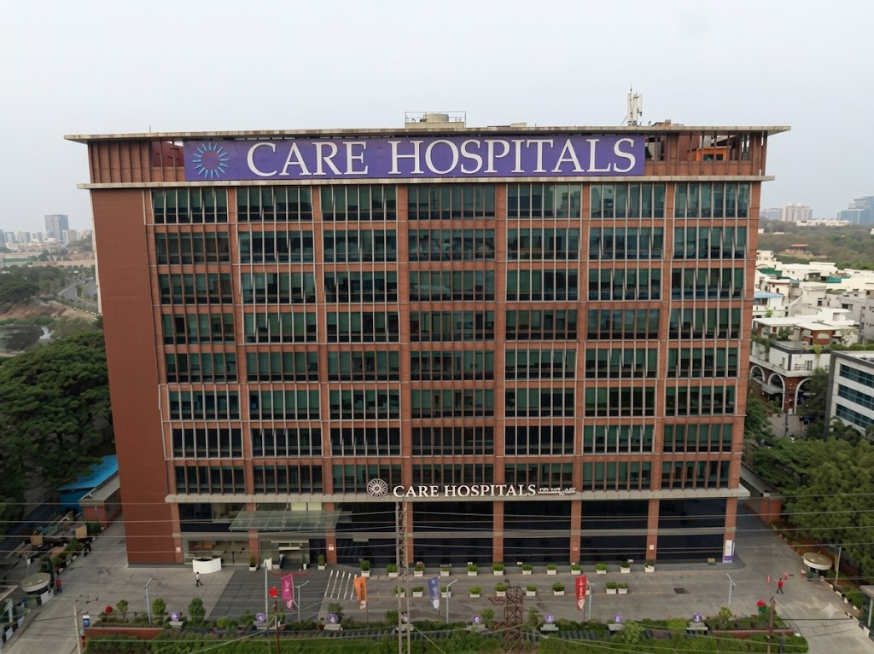
Multi-Specialty Care
Comprehensive medical services across diverse specialties and departments
Patient-Centered Mission
Delivering compassionate, quality-focused healthcare experiences
Digital Communication
Leveraging digital channels for awareness, engagement, and outreach

Slide 4
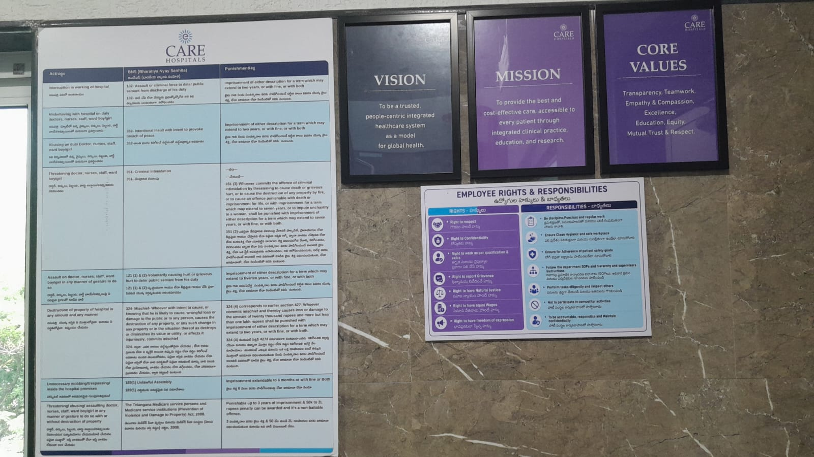

Slide 5
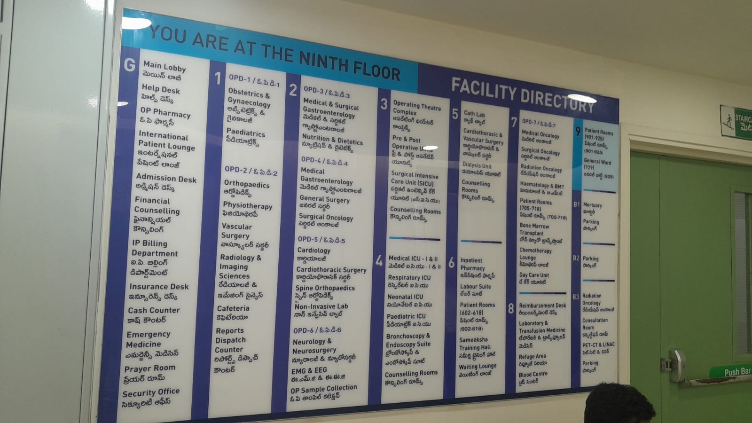
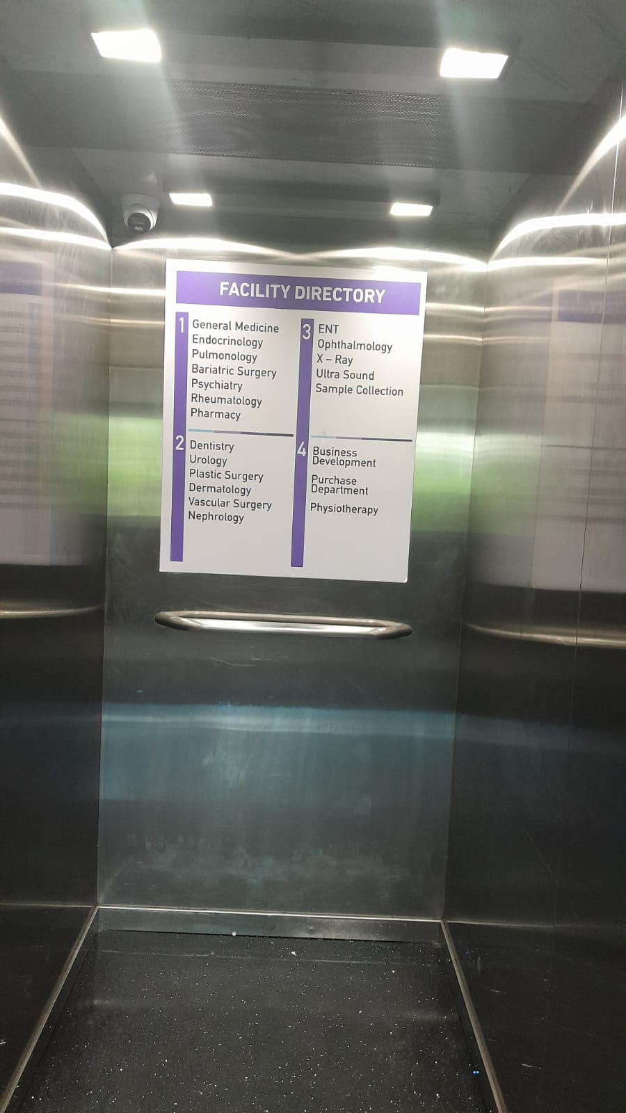
In Patient Center (Block B)
Out Patient Center (Block A)

Slide 6
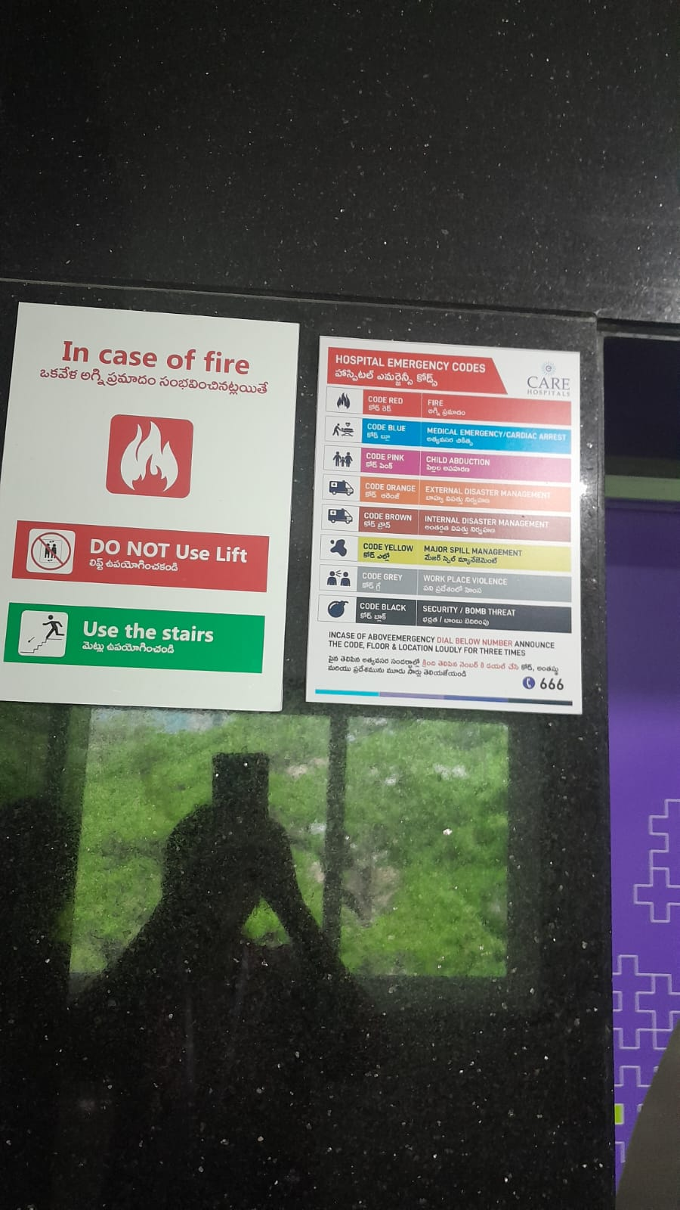

Slide 7
Internship Timeline / Work Environment
Internship Timeline
  Joined: May 2026
  Completed: June 27th
Department: Sales & Marketing
Exposure to Sales & Marketing Head
Temporary internship break: 7–11 June due to JCI audit
Resumed internship: 12 June
Participated in departmental / marketing interactions

Slide 8






Internship Objectives
Structured goals to bridge academic knowledge with real-world healthcare digital marketing practice.
Healthcare Digital Marketing
Social Media Practices
Understand digital strategies specific to the healthcare sector
Learn platform-specific content and engagement approaches
Competitor Analysis
Patient Engagement
Evaluate digital strategies of competing healthcare organizations
Understand how feedback drives service improvement
Awareness Campaigns
Hospital Operations
Support healthcare communication and awareness initiatives
Gain practical exposure to digital communication in a hospital setting
Notes:
3

Slide 9

Digital Marketing Activities
A structured workflow guided all internship activities — from initial research through content creation, digital communication, and performance analysis.
Content Planning
Digital Communication
Research
Creation
Feedback
Each phase built on the previous, ensuring content was well-researched, purposeful, and aligned with CARE Hospitals' communication goals.
Notes:
4

Slide 10
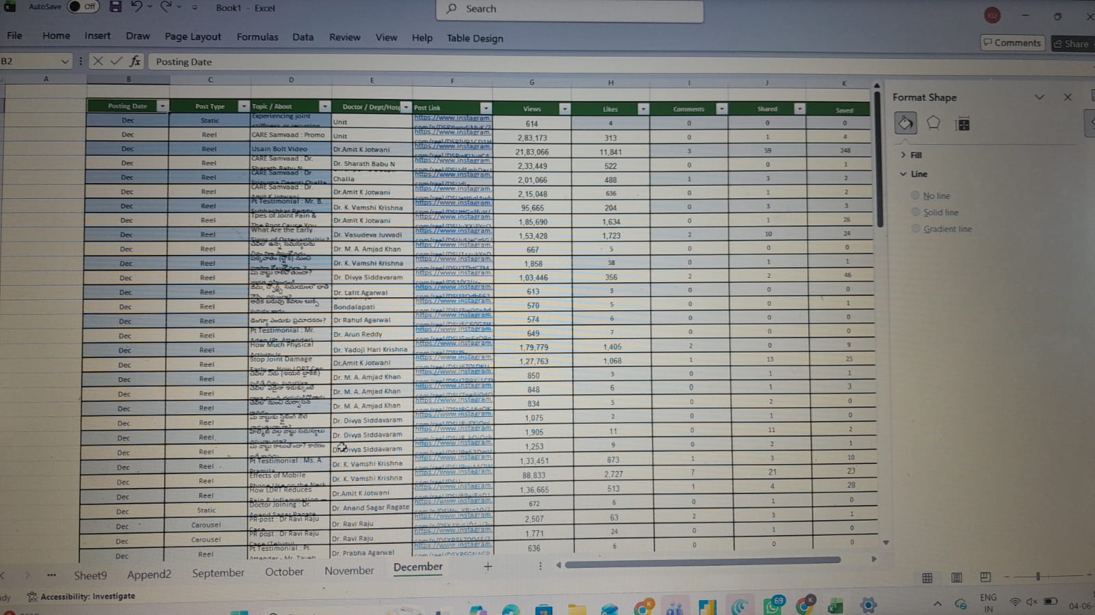

Slide 11
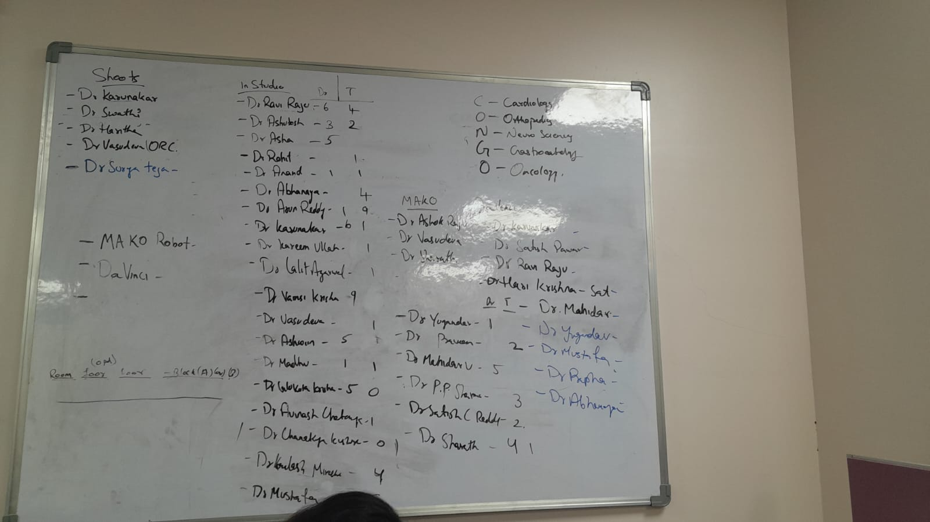

Slide 12
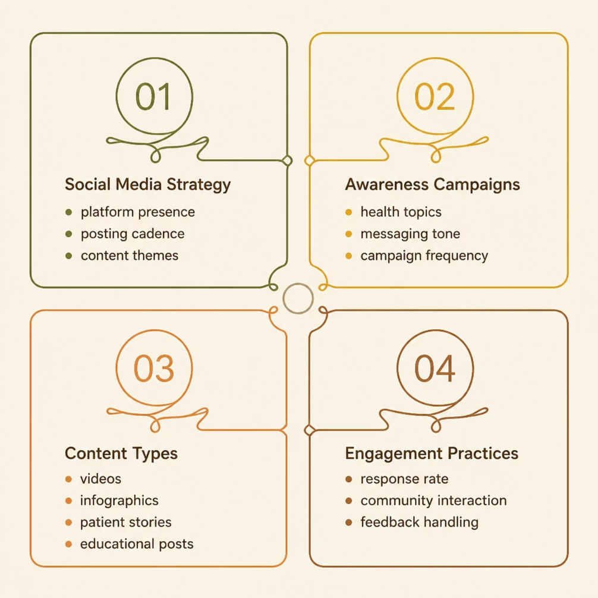




Competitor Analysis
A systematic evaluation of nearby hospitals' digital presence helped identify industry benchmarks and content opportunities for CARE Hospitals.
Competitors reviewed:
KIMS Hospitals
Yashoda Hospitals
Apollo Hospitals
AIG Hospitals
CARE Hospitals
Parameters compared:
Social media presence
Healthcare awareness campaigns
Content themes and formats
Doctor-focused content
Patient engagement practices
Use of videos/reels
Health education and promotional communication
Social Media Strategy
Awareness Campaigns
Content Types
Engagement Practices
Reviewed posting frequency, platform usage, and content themes
Studied healthcare topics and messaging approaches used by peers
Analyzed formats — videos, infographics, posts, and patient stories
Observed how competitors interact with patients and audiences online
Notes:
5

Slide 13
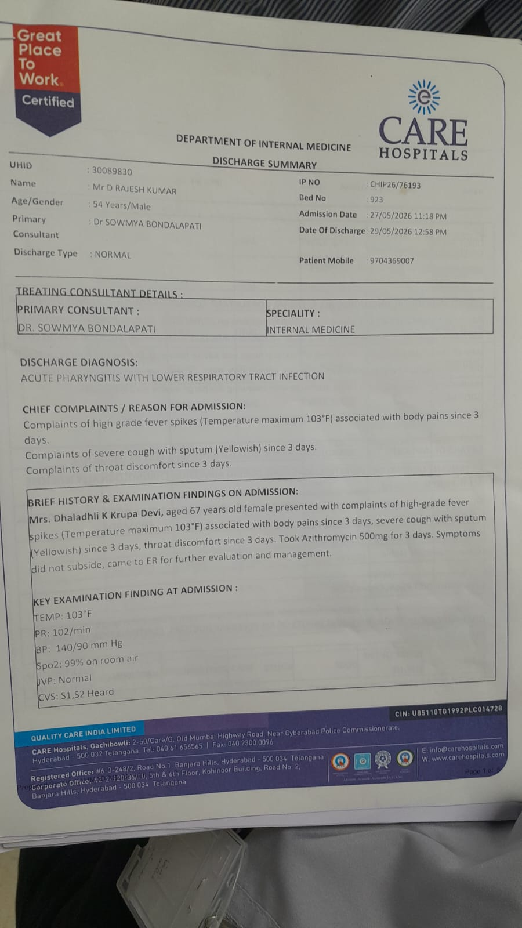
Patient Awareness & Communication Gap
Observed issues reported by a patient:
  Mismatch of information in the discharge summary
  Patient reported that the discharge summary had not been properly checked
  Patient expressed concerns regarding nursing care during treatment
  Patient showed a dark circular mark on the lower right hand following blood collection
Key Observations During Internship
  Patient feedback highlighted gaps in documentation accuracy and communication.
  One patient reported a mismatch in the discharge summary, where information under the brief history and examination findings appeared inconsistent with the patient’s case.
  The patient also expressed concerns about doctor review of discharge documents and the quality of nursing care during treatment.
  Such feedback can influence patient trust, satisfaction, and overall hospital experience.
  From a marketing perspective, patient experience is closely connected to hospital reputation and communication.
  Opportunity: Strengthen feedback mechanisms, documentation verification, patient communication, and service-quality monitoring.
Accurate information + effective communication + responsive service → stronger patient trust
and engagement.
Notes:
5

Slide 14

Patient Feedback & Data Verification
Contributed to improving the accuracy of hospital records and enhancing patient engagement through structured feedback collection and data verification.
Analysis
Insight
Identify satisfaction patterns and inconsistencies.
Confirm verified information and improvement opportunities.
Data Collection
Improvement
Gather patient feedback and departmental records.
Update records and enhance patient communications.
Feedback Analysis
Information Verification
Service Improvement
Collected and reviewed patient responses to identify satisfaction patterns
Checked doctor profiles, departments, and room allocations for accuracy
Identified opportunities to enhance patient experience and digital records
Notes:
6

Slide 15
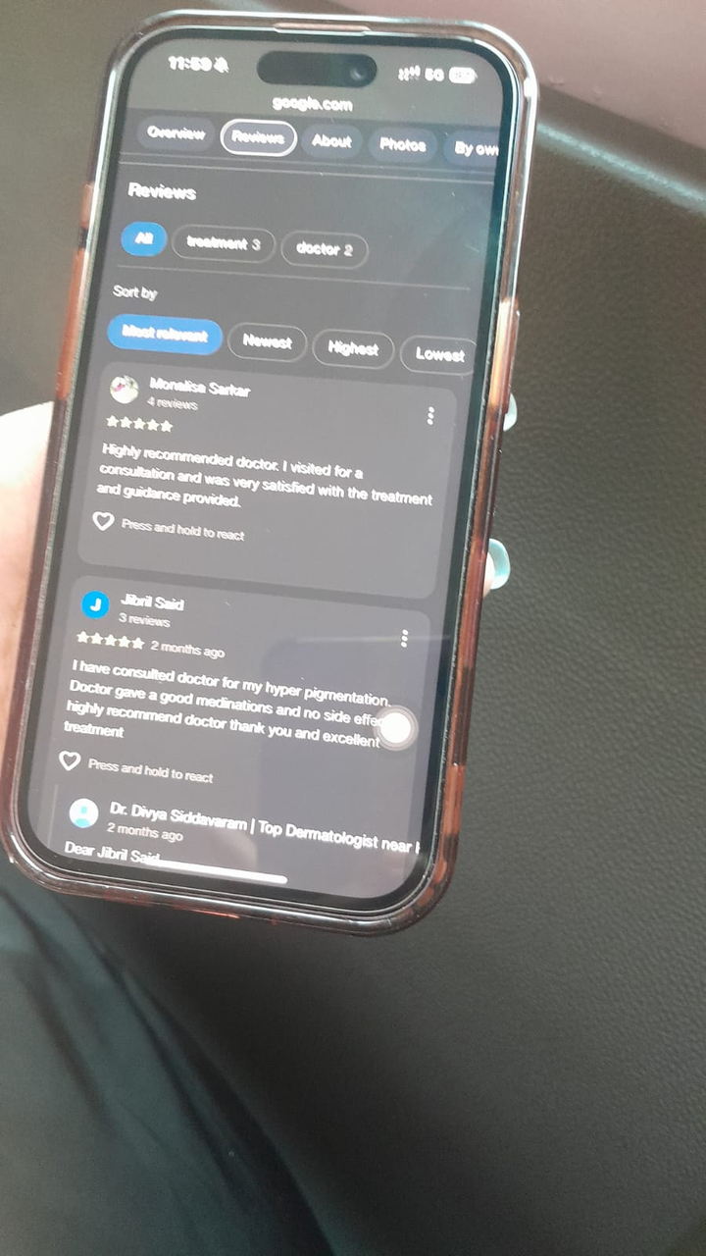
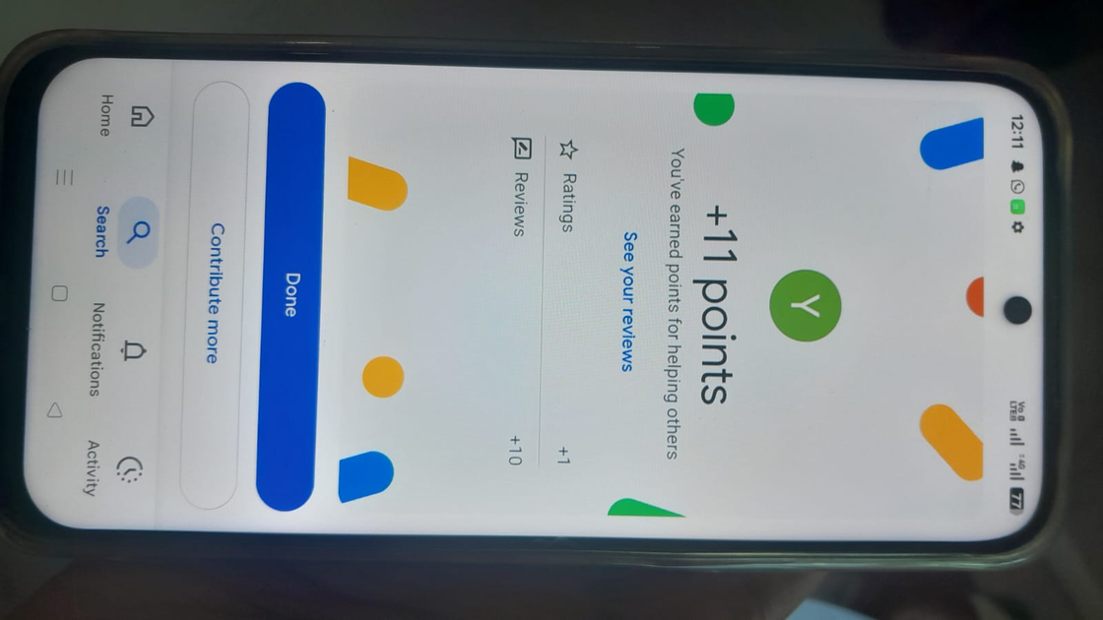
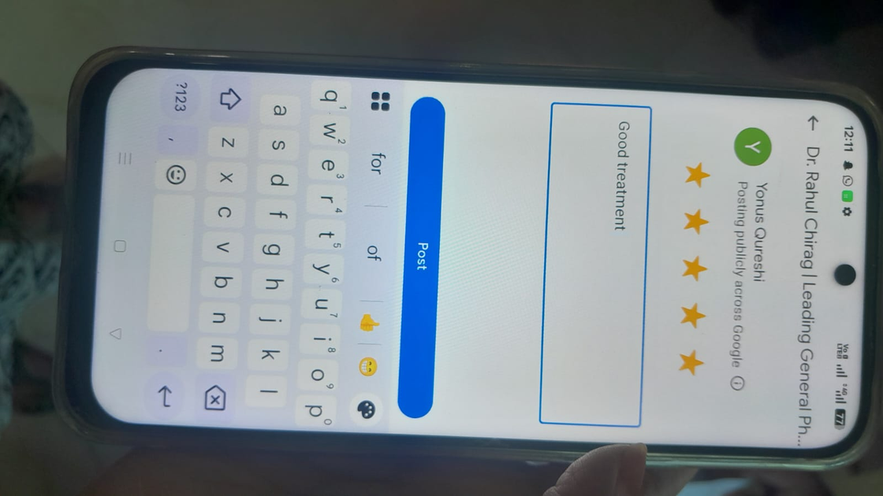
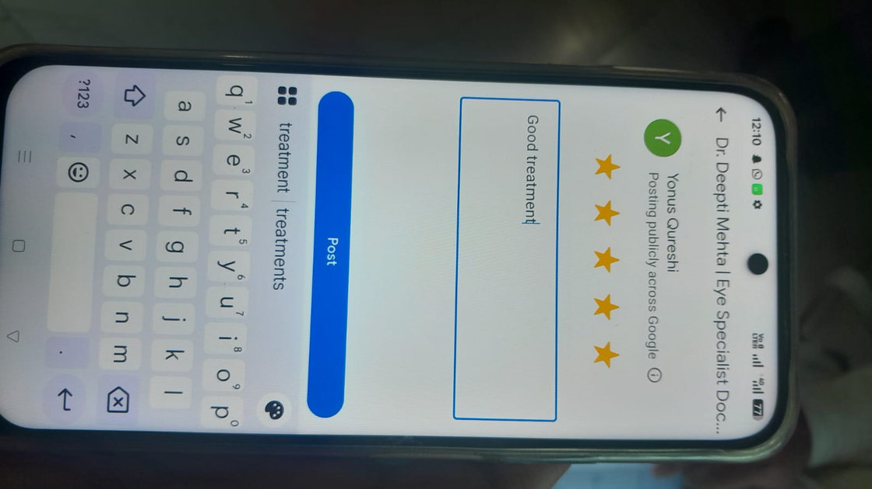

Slide 16
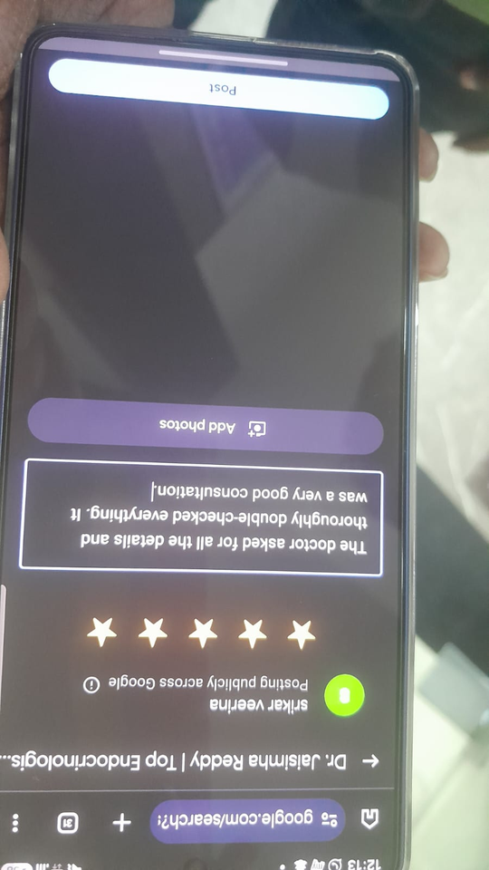
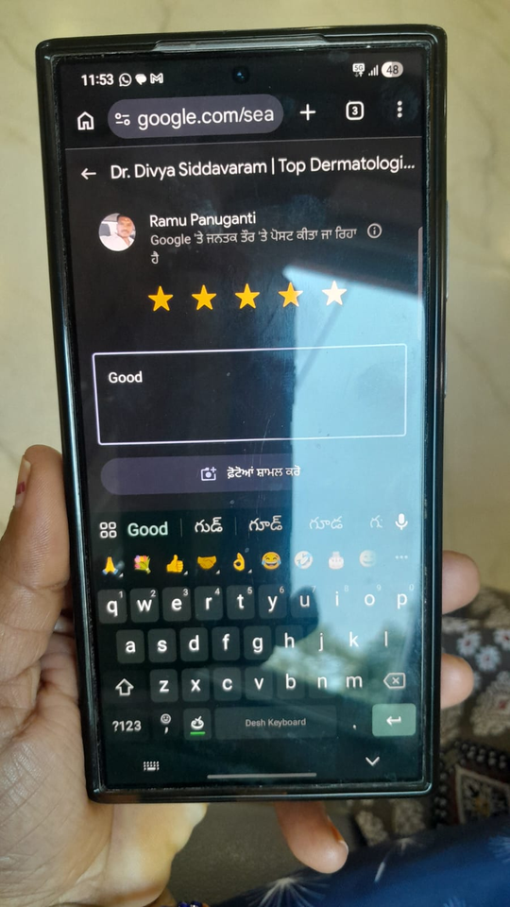

Slide 17



Healthcare Awareness Campaign
ROBOTIC-ASSISTED BARIATRIC SURGERY
Developed a patient-friendly awareness campaign on robotic-assisted bariatric surgery — from research and scripting to video creation and content delivery.
Topic Research
Content & Script Development
Awareness Video Creation
Studied the procedure, benefits, and patient considerations to build accurate, accessible content
Developed ideas, wrote scripts, and prepared patient-friendly communication materials
Produced an engaging awareness video using AI-assisted tools for visuals and voiceover
Notes:
7

Slide 18






AI Tools in Content Creation
AI-powered tools supported each stage of the content creation workflow — enhancing efficiency while maintaining editorial oversight and accuracy.
Idea
Script
Visuals
Voice
Video
ChatGPT
Google Flow AI
Gemini AI
Scripts, ideas, and content assistance
Visual and video generation
Research and content assistance
Canva
ElevenLabs
Visual design and creative content
AI voiceovers for video content
Notes:
8

Slide 19
Campaign / Video Created
Robotic Bariatric Surgery video
https://youtube.com/shorts/EfKeGjykakA?feature=share
Notes:
8

Slide 20




Key Learnings & Skills Gained
The internship built practical capabilities across four key domains relevant to healthcare digital marketing and business analytics.
Digital Marketing
Analytics & Research
  Healthcare branding
  Social media strategy
  Digital outreach
  Competitor analysis
  Patient feedback analysis
  Information verification
Content & AI
Professional Skills
  Content creation
  Video development
  AI-assisted workflows
  Team collaboration
  Professional communication
  Hospital operations insight
Notes:
9

Slide 21




Internship Takeaways
Gained hands-on exposure to healthcare digital marketing in a real hospital environment
Understood the critical role of accurate digital information in patient trust and engagement
Learned how patient feedback analysis supports meaningful service improvement
Developed practical experience in creating healthcare awareness content using AI tools
Connected academic Business Analytics learning with real-world healthcare operations
Notes:
10

Slide 22
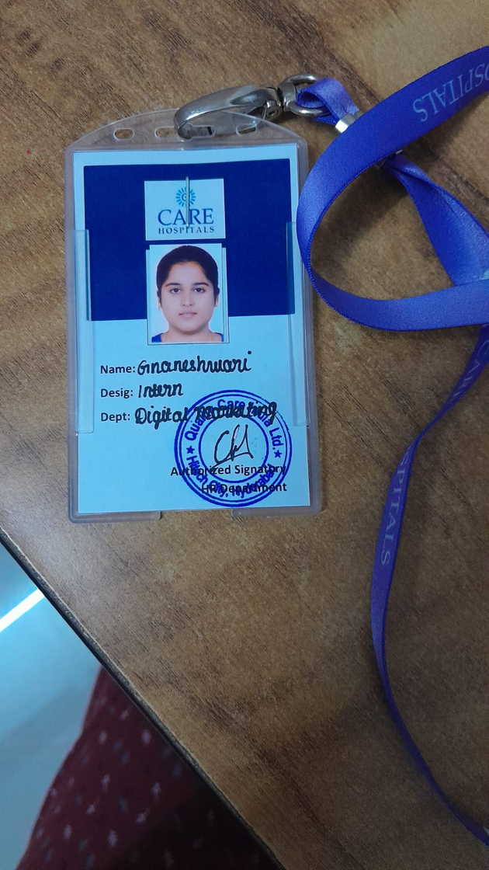
Thank You
Gnaneshwari Mahimaluru | PGDM – Business Analytics
CARE Hospitals Internship | May – June 2026
Notes:
11

