Slide 1
Investor Pitch: Boutique Fashion Business
Presented by: Gnaneshwari Mahimaluru
Roll No: PGBA25002
Program: PGDM-BA
Professor: KNV Subramanyam

Slide 2

Business Overview
A modern boutique fashion brand focusing on customized ethnic and fusion wear for young professionals. Our brand delivers customized ethnic and fusion wear specifically tailored for the modern, young professional demographic.

Slide 3
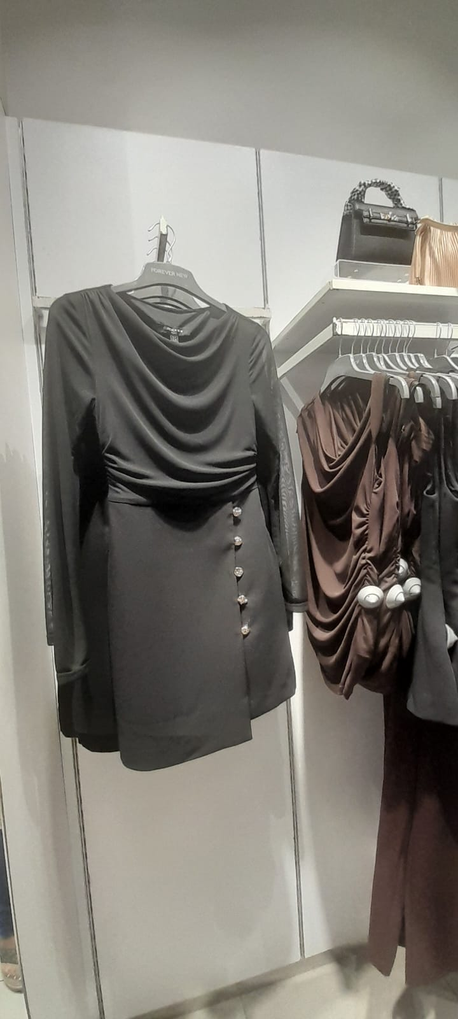
Problem Statement
Customers struggle to find affordable, personalized fashion with high-quality design and fast delivery.

Slide 4
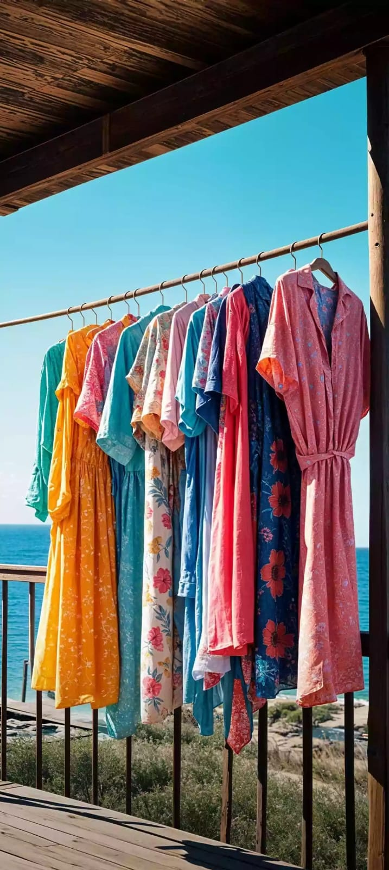
Our Solution
Customized boutique designs tailored to individual styles
Digital consultation services for personalized styling
Efficient supply chain ensuring fast delivery
Trend-based fashion collections for modern professionals

Slide 5
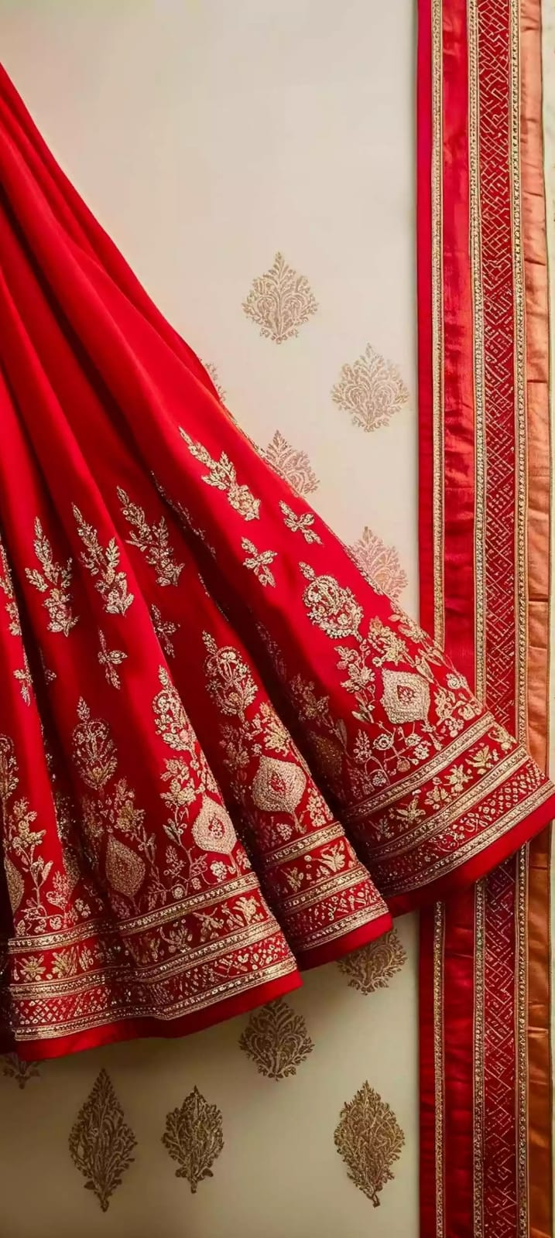





Products & Services
Exclusive designer sarees with modern aesthetics
Versatile fusion wear for daily and formal occasions
Fully customized outfits based on customer preferences
Professional styling consultation packages
Integrated online ordering platform for convenience

Slide 6




Target Market
Urban women aged 20-40 looking for unique styles
Ambitious working professionals in metropolitan areas
Fashion-conscious buyers seeking personalized designs
Active online shoppers familiar with digital platforms

Slide 7
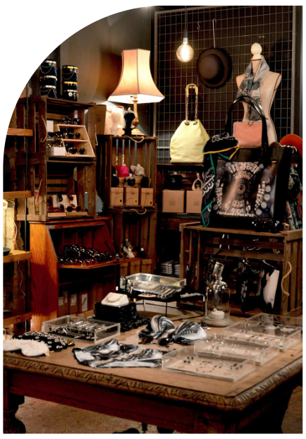
Industry Opportunity
Growing fashion and boutique industry with increasing demand for personalized fashion and online retail.

Slide 8
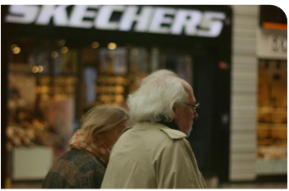

Business Performance So Far
Initial customer base established through local outreach
Rapidly growing social media traction and engagement
Consistent positive feedback from early adopters
High percentage of repeat clients and referrals

Slide 9




Revenue Model
Direct product sales, customization fees, premium styling packages, and online boutique store.
Open flagship store in a key metropolitan hub
Customization fees for personalized outfit designs
High-margin premium styling packages
Scalable online boutique store sales channel

Slide 10





5-Year Growth Strategy
Expand product lines
to include more fusion varieties
Increase online presence
through digital marketing
Collaborate with influencers
to boost brand awareness
Open flagship store
in a key metropolitan hub

Slide 11
Financial Projections
Revenue and profit expected to grow steadily with scaling operations and brand recognition.

Slide 12
Funding Requirement
Seeking investment for inventory, marketing, technology platform, and expansion.
Capital for inventory acquisition and raw materials
Aggressive marketing and branding campaigns
Development of a robust technology platform
Operational funds for business expansion

Slide 13

Business Valuation
Valuation based on projected revenue growth, market size, brand potential, and scalability. Our current valuation reflects a high growth potential in the booming boutique fashion sector.

Slide 14

Exit Strategy & Closing
Potential exit via acquisition or IPO. Join us in building a scalable boutique fashion brand for modern consumers. Thank you for your time. Let's redefine boutique fashion together.

