Slide 1
DIGITAL HEALTH TWIN PLATFORM
Healthcare Management Platform for Clinical Operations
AI-Powered Continuous Health Monitoring, Risk Prediction & Personalized Care
Gnaneswar Reddy
Keerthi Challa
Srija Thota
Nishikant
Santosh C

Slide 2
WHY IT MATTERS
Problem Statement
Traditional healthcare monitoring struggles to keep pace with patient risk
1
Fragmented Records
2
Monitoring Gaps
Patient data is scattered across disconnected systems.
Continuous vital monitoring is difficult to sustain manually.
3
Delayed Awareness
4
Late Prediction
Doctors may not immediately notice abnormal vital changes.
Risk prediction often happens only after symptoms are significant.
5
Manual Care Plans
6
Adherence Tracking
Personalized care plans require significant manual effort.
Patients need continuous monitoring and adherence tracking.
02
Notes:
1. Healthcare data today is fragmented across multiple systems, making a unified patient view hard to achieve.
2. Continuous, real-time vital monitoring is operationally difficult without automation.
3. Because monitoring isn't continuous, doctors often notice abnormal trends late.
4. Risk prediction today is largely reactive — it happens after symptoms already appear.
5. Building personalized care plans manually doesn't scale across a growing patient population.

Slide 3
Proposed Solution
Healthcare Management Platform for Clinical Operations is a centralized, intelligent healthcare platform built around a continuously-updated Digital Health Twin.
1
2
3
4
5
Patient Management
Real-time Vital Monitoring
FHIR-based Health Data Exchange
Kafka-based Streaming
AI / ML Disease Prediction
6
7
8
9
10
Explainable AI (SHAP)
Continuous Monitoring
Alert Generation
Doctor / Admin Dashboards
AI-Generated Care Plans
End-to-End Flow
Patient Data
Digital Twin
Real-Time Monitoring
Risk Prediction
Alerts
AI Care Plan
Doctor Approval
Patient Follow-up
03
Notes:
1. Healthcare Management Platform for Clinical Operations Group 2 unifies ten core capabilities into one platform instead of siloed tools.
2. The Digital Twin is continuously refreshed with real patient vitals and history.
3. FHIR and Kafka give us standards-based, real-time interoperability.
4. ML prediction and SHAP explainability turn raw data into trustworthy risk insight.
5. The flow ends in a closed loop: prediction leads to alerts, care plans, doctor approval, and follow-up.

Slide 4
USER EXPERIENCE
Patient, Doctor & Admin Dashboards
Three role-based experiences, one unified platform
Pt
Dr
Ad
Patient
Doctor
Admin
View health information
View assigned patients
Manage patients
View vitals
View patient health information
Manage doctors
View predictions
View predictions
Assign doctors to patients
View care plan
Review alerts
Manage ML models
Track adherence
Review / approve care plans
Manage alerts
Monitor patient progress
08
Notes:
1. Each role gets a purpose-built dashboard rather than one generic screen.
2. Patients can track their own vitals, predictions, care plan, and adherence.
3. Doctors manage assigned patients, review alerts, and approve AI-generated care plans.
4. Admins control platform operations — patients, doctors, model lifecycle, and alerts.
5. Role-based access via Keycloak keeps each view secure and scoped appropriately.

Slide 5
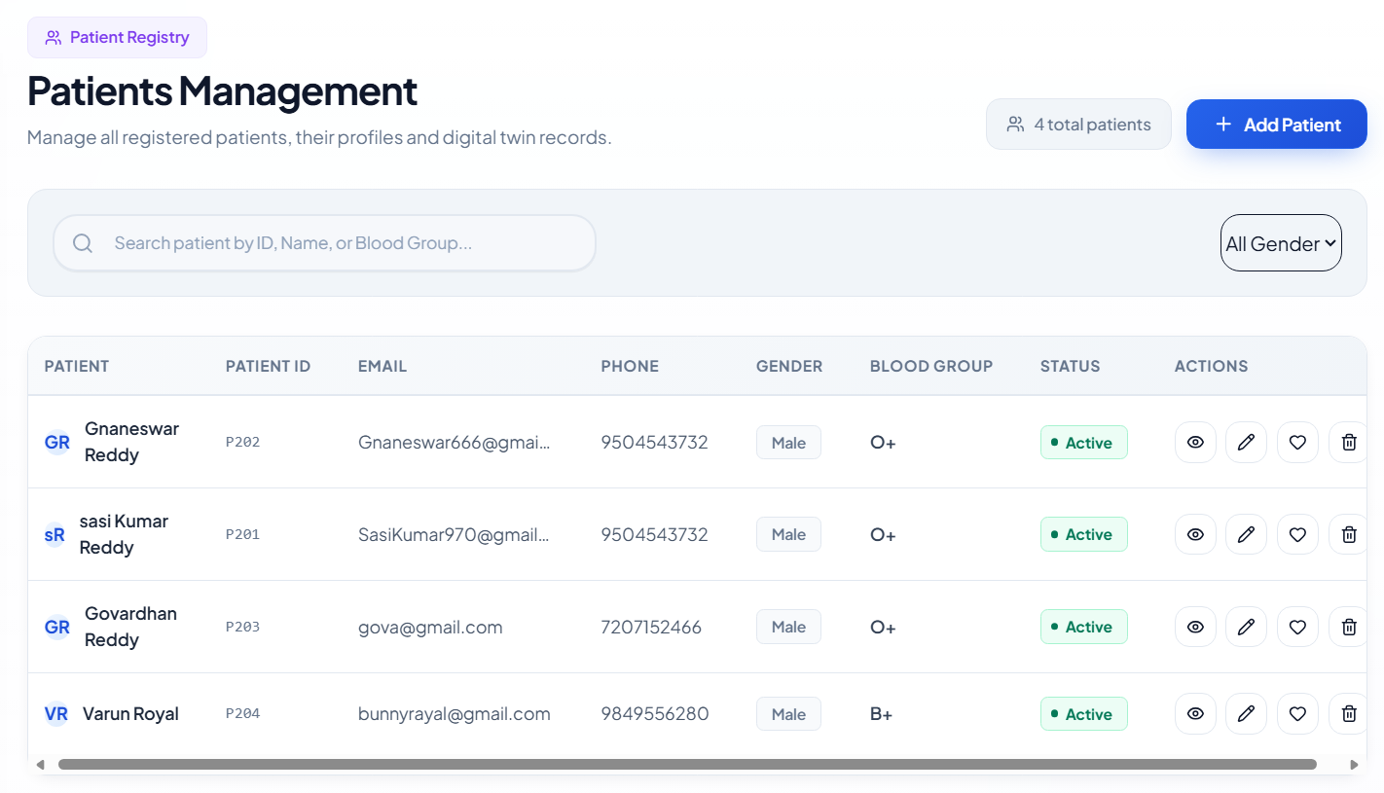
MILESTONE 1
Digital Health Twin Foundation
Core Platform, Patient Data & Identity
Built patient management functionality
Established the Digital Health Twin concept
Developed Spring Boot microservices
Implemented REST APIs across services
Integrated MongoDB for twin & patient data
Implemented FHIR resources for patient and observation data
Created React-based patient / doctor interfaces
Added authentication & role-based access with Keycloak
Auth Service (Keycloak)
Patient Service
Health Twin Service
Key Services
MongoDB
Patient Service
Health Twin Service
FHIR Service
Auth Service
API Gateway
04
Notes:
1. Milestone 1 laid the foundation: patient management and the Digital Health Twin concept itself.
2. We built independent Spring Boot microservices, each exposing clean REST APIs.
3. MongoDB stores patient and twin data, while FHIR resources standardize clinical data exchange.
4. React gives patients and doctors a responsive interface, secured with Keycloak's role-based access.
5. The Digital Twin is the core idea: a continuously updated digital state that mirrors the real patient.

Slide 6
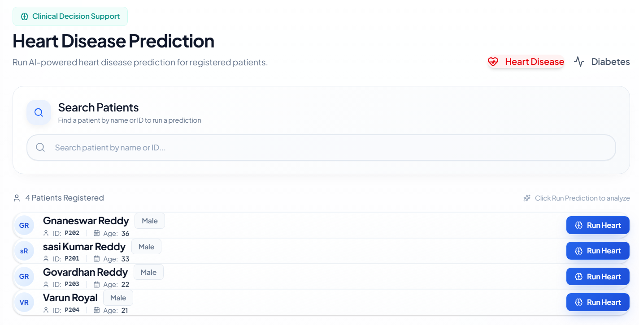
MILESTONE 2
AI-Based Health Risk Prediction
Machine Learning Models & Model Management
Prediction Models
D
Diabetes Prediction
Patient Input
Heart Disease Prediction
ML Model
H
Prediction
Probability
Technology
Python
TensorFlow
Flask
SHAP
Model Management Module
View models
Add / update models
Delete models
Activate / deactivate models
React
Prediction Service
Flask ML API
ML Model
Models exposed via Flask REST APIs, integrated with the Spring Boot Prediction Service.
05
Notes:
1. Milestone 2 introduces the AI/ML layer: diabetes and heart disease risk prediction.
2. Models are built in Python with TensorFlow and Scikit-learn, served through Flask.
3. Predictions flow from patient input to probability, risk level, and a recommendation.
4. The Model Management module lets admins add, update, activate, or retire models without code changes.
5. The Spring Boot Prediction Service integrates the Flask ML API and stores results in MongoDB.

Slide 7
MILESTONE 2 · CONTINUED
Explainable AI using SHAP
Why explainability matters in healthcare AI
Clinicians cannot act on a black-box score. SHAP (SHapley Additive exPlanations) reveals which patient features contributed to a prediction, giving doctors the transparency they need to trust and validate AI-driven risk assessments.
Prediction
SHAP
Important Features
Doctor Understanding
Example: Contributing Clinical Features
Scope of SHAP
Glucose
SHAP explains how the ML model arrived at a prediction — it does not itself make medical decisions.
Blood Pressure
BMI
It provides interpretability for the ML prediction, supporting — not replacing — clinical judgment.
Age
Other Clinical Features
06
Notes:
1. Explainability is essential in healthcare — doctors need to know why a model flagged a patient as high-risk.
2. SHAP breaks a prediction down into the contribution of each input feature.
3. In this example, glucose, blood pressure, and BMI are the strongest contributors.
4. It's important to be clear: SHAP explains the model's reasoning, it does not make medical decisions itself.
5. This interpretability builds clinician trust and supports safe adoption of AI in care.

Slide 8
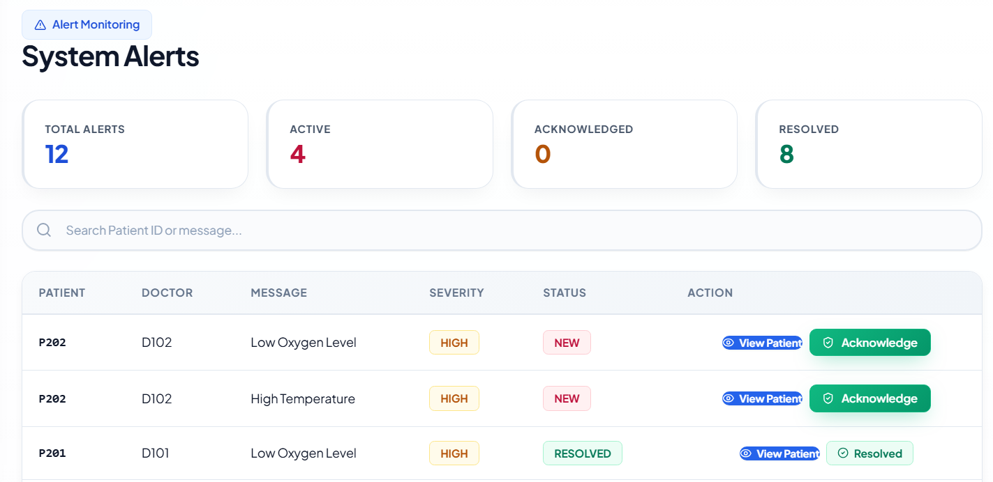
MILESTONE 3
Continuous Monitoring & Intelligent Alerts
Streaming Vitals with Kafka & Real-Time
Risk Evaluation
Real-time vitals are continuously collected
Kafka streams health data across services
Vitals are published to Kafka topics
The system monitors for abnormal conditions
Alerts are generated when thresholds / risk conditions are detected
Wearable / Patient Data
Vital Data
Kafka
Kafka Topics
FHIR / Monitoring Service
vitals-stream
alerts-stream
Risk Evaluation
notification-stream
Alert Service
Why Kafka?
Doctor / Patient Notification
Real-time streaming · Decoupled microservices · Scalable event processing · Reliable async communication
07
Notes:
1. Milestone 3 closes the loop between raw vitals and actionable clinical alerts.
2. Vitals stream continuously into Kafka topics, decoupling data producers from consumers.
3. The FHIR / monitoring service consumes this stream and evaluates risk in near real time.
4. When thresholds are crossed, the Alert Service notifies the doctor and patient immediately.
5. Kafka gives us scalability and reliability — critical for a system handling continuous health data.

Slide 9
MILESTONE 4
AI-Powered Personalized Care Plans
Beyond Prediction — Actionable, Personalized Recommendations
✕ Instead of only saying:
Care Plan Generation Flow
“Patient is at risk.”
Patient Data + ML Prediction + Risk Level
AI Care Plan Generator
✓ The system generates:
Actionable, personalized recommendations
Personalized Care Plan
Doctor Review
Care Plan Contents
Health goal
Medication info
Patient
Diet recommendations
Exercise recommendations
Adherence Tracking
Follow-up / review date
Adherence
Progress Update
Doctor approval status
Progress
09
Notes:
1. Milestone 4 moves the platform from prediction to action.
2. Rather than a bare risk flag, the system produces a structured, personalized care plan.
3. Plans cover goals, medication, diet, exercise, follow-up, and adherence tracking.
4. Generation is powered by a locally-running LLM — Ollama serving Qwen 2.5 3B — for data-private inference.
5. Every plan passes through doctor review before reaching the patient, keeping a human in the loop.

Slide 10
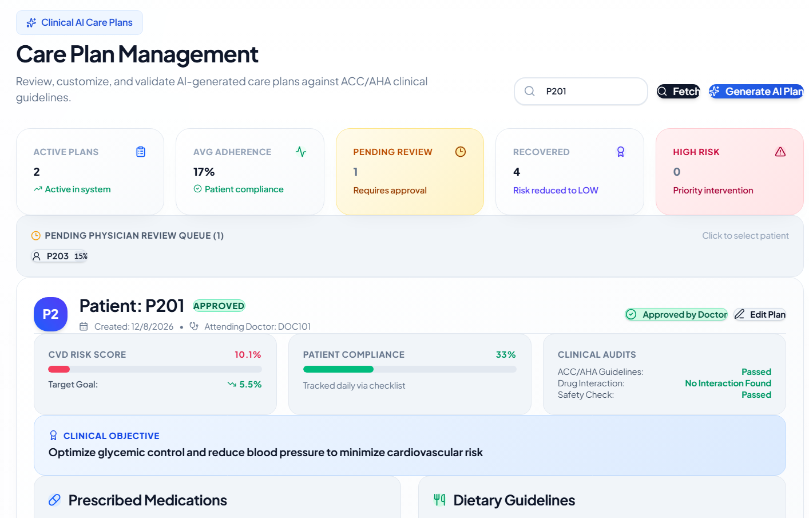
MILESTONE 4 · CONTINUED
Patient Dashboard
React Frontend
POST
CarePlan Controller
CarePlan Service
GET
Prediction / Patient Data
Groq
Qwen 2.5 3B
PUT
Generated Recommendations
CarePlan stored in MongoDB
PUT
Doctor Approval
GET
10
Notes:
1. The CarePlan Controller and Service form the backend spine for AI care-plan generation.
2. Structured patient and prediction data is sent to Ollama, which runs Qwen 2.5 3B locally.
3. Generated recommendations are stored in MongoDB and routed to the doctor for approval.
4. Five REST endpoints cover the full lifecycle: generate, fetch, approve, update progress, and view history.
5. This keeps AI generation, doctor oversight, and patient visibility cleanly separated in the API design.

Slide 11
WRAP-UP
Achievements, Future Scope & Conclusion
Achievements
Future Scope
Microservices-based healthcare platform
Integration with real wearable devices
Digital Health Twin architecture
More disease prediction models
Role-based dashboards
Advanced anomaly detection
Kafka-based streaming
Diabetes & heart disease prediction models
Voice-based patient assistant
Explainable AI using SHAP
Mobile application
Model management module
Improved clinical decision support
Continuous monitoring & alerts
Integration with additional healthcare standards
Groq AI care-plan generation
More advanced personalized AI recommendations
Care-plan management & adherence tracking
Cloud deployment and large-scale monitoring
“Healthcare Management Platform for Clinical Operations transforms healthcare data into continuous, intelligent and personalized patient care.”
12
Notes:
1. Across four milestones, we delivered a complete, working healthcare platform — not just a prototype.
2. Key achievements span the Digital Twin foundation, ML prediction, streaming and alerts, and AI care plans.
3. Future work focuses on real wearables, more models, and mobile access to broaden real-world impact.
4. We also see room to deepen clinical decision support and scale the platform to the cloud.
5. In summary: the platform turns fragmented healthcare data into continuous, intelligent, personalized care.

Slide 12
THANK YOU
Questions & Discussion
Healthcare Management Platform for Clinical Operations
AI-Powered Continuous Health Monitoring, Risk Prediction & Personalized Care
Notes:
1. Thank the panel / audience for their time and attention.
2. Invite questions on any milestone — architecture, ML, streaming, or AI care plans.
3. Be ready to discuss trade-offs, such as why Kafka and FHIR were chosen.
4. Have the future-scope points ready in case of 'what's next' questions.

