Slide 1
Work-Integrated Learning Program Division First Semester 2020-2021 M.Tech (Data Science and Engineering) Data Mining Assignment - Chronic Kidney Disease

Slide 2
Agenda
Overview
Data Understanding
Data Pre-processing
Exploratory Data Analysis
Model Building
Model Enhancements
Evaluation & Outcomes
Conclusion

Slide 3
Problem Statement

Slide 4
Overview
Problem Statement:
Given 24 health related attributes taken in 2-month period of 400 patients. We are asked to
Identify the factors causing the chronic Kidney Disease.
Build a model that can help to identify if the patient is suffering from kidney chronic disease or not.
Overview:
Chronic kidney disease describes the gradual loss of kidney function.
The kidneys filter wastes and excess fluids from the blood, which are then excreted in urine. When chronic kidney disease reaches an developed stage, dangerous levels of fluid, electrolytes and wastes can build up in the body.
Patients can have multiple complications like high blood pressure, Anemia, diabetes, loss of appetite, poor nutritional health and nerve damage.
Diagnostics:
The physician usually monitor the blood pressure and kidney function with urine and blood tests (various attributes) which are contributors for the kidney chronic disease

Slide 5
Data Understanding

Slide 6
Introduction & Case Study
“Chronic Kidney Disease data is used for data analysis and predict the causes and possibilities on different health conditions and symptoms of patients. It is useful to reduce the percentage of affected patients every year”
Kidney Functionality
Chronic Kidney Disease is a condition characterized by a gradual loss of kidney function over time which has important job of filtrating the blood and removal of impurities.
Kidneys filter wastes and extra fluids from blood which are then extracted in form of urine.
Adverse Affects
When chronic kidney disease reaches an advanced stage, dangerous levels of fluid, electrolytes and wastes can build up in the patient body which causes the nephrons (million of tiny filters) to break and stop working. At certain point, the nephrons cannot filter the blood causing adverse affects to the patient health condition.
Diagnose
Various parameters are used to diagnose the Chronic Kidney Disease which include detail history of the patient, clinical examination, laboratory investigations, urine analysis and imaging studies
This case study is done based on the 24 parameters that are considered for diagnosing the patient

Slide 7
Class Words and Descriptions
Attribute | Class Word | Data Type | Descriptions
age | Age | numerical | The age of the patient in years
bp | blood_pressure | numerical | Blood pressure (BP) is the pressure of circulating blood against the walls of blood vessels.Uncontrolled high blood pressure can cause arteries around the kidneys to narrow, weaken or harden. Thus resulting in kidney failure.
sg | specific_gravity | nominal | Urinary specific gravity (SG) is a measure of the concentration of solutes in the urine. Urine specific gravity results will fall between 1.002 and 1.030 if your kidneys are functioning normally.
al | albumin | nominal | Albumin is a protein made by your liver. Albumin helps keep fluid in your bloodstream so it doesn't leak into other tissues. Low albumin levels can indicate a problem with your liver or kidneys.
su | sugar | nominal | A high level of sugar in your blood can cause problems in many parts of your body and over-time this can lead to kidney disease and kidney failure
rbc | red_blood_cells | nominal | Red blood cells are made by the bone marrow. When your kidneys are damaged, they produce less erythropoietin (EPO), a hormone that signals your bone marrow—the spongy tissue inside most of your bones—to make red blood cells. With less EPO, your body makes fewer red blood cells, and less oxygen is delivered to your organs and tissues.
pc | puss_cells | nominal | Pus Cells are signs of infection.Bilirubin is a waste product from the breakdown of old red blood cells. It is normally removed from the blood by the liver.
pcc | puss_cell_clumps | nominal | Pus Cell clumps in urine indicate the presence of an infection or inflammation, especially in the kidney.
ba | bacteria | nominal | The most common bacterial infection is urinary tract infection (UTI), such as a bladder or kidney infection
bgr | blood_glucose_random | numerical | A random glucose test is one method for measuring the amount of glucose or sugar circulating in a person's blood. Doctors carry out this test and use the result to determine whether a person is likely to have diabetes.

Slide 8
Class Words and Descriptions
Attribute | Class Word | Data Type | Descriptions
bu | blood_urea | numerical | Blood urea levels tend to increase when the kidneys or liver are damaged
sc | serum_creatinine | numerical | The amount of creatinine in your blood should be relatively stable. An increased level of creatinine may be a sign of poor kidney function
sod | sodium | numerical | A high value in sodium in urine can imply kidney disease but at the same time sodium can be high due to several other reasons too, such as intake of certain kind of medicines.
pot | potassium | numerical | If there is too much of pot, healthy kidneys will filter out the extra potassium, and remove it from your body through urine. However, when kidneys do not work well, they may not be able to remove enough potassium.Thus the value will be high.
hemo | haemoglobin | numerical | Hemoglobin levels in individuals with chronic kidney disease fluctuate frequently above or below the recommended target levels within short periods of time even though the calculated mean hemoglobin remains within the target range of 11 to 12 g/dl.
pcv | packed_cell_volume | numerical | Also known as the haematocrit test, the PCV or Packed Cell Volume Test is a test done to diagnose polycythaemia, dehydration or anaemia in certain patients. It is generally a part of the full blood count test
wbcc | white_blood_cell_count | numerical | Elevated white blood cell (WBC) count is a well-known predictor of chronic kidney disease (CKD) progression. However, elderly patients commonly fail to develop a high WBC count in response to several diseased states and may instead present a low WBC count

Slide 9
Class Words and Descriptions
Attribute | Class Word | Data Type | Descriptions
rbcc | red_blood_cell_count | numerical | When your kidneys are damaged, they produce less erythropoietin (EPO), a hormone that signals your bone marrow—the spongy tissue inside most of your bones—to make red blood cells. With less EPO, your body makes fewer red blood cells, and less oxygen is delivered to your organs and tissues.
htn | hypertension | nominal | Hypertension can cause damage to the blood vessels and filters in the kidney, making removal of waste from the body difficult
dm | diabetes_mellitus | nominal | One cause of kidney failure is diabetes mellitus, a condition characterised by high blood glucose (sugar) levels. Over time, the high levels of sugar in the blood damage the millions of tiny filtering units within each kidney.
cad | coronary_artery_disease | nominal | When you have heart disease, your heart may not pump blood in the right way. Your heart may become too full of blood. This causes pressure to build in the main vein connected to your kidneys, which may lead to a blockage and a reduced supply of oxygen rich blood to the kidneys. This can lead to kidney disease.
appet | appetite | nominal | As chronic kidney disease progresses to end-stage renal disease, signs and symptoms might include: Nausea. Vomiting. Loss of appetite.
pe | pedal_edema | nominal | Pedal edema (foot and ankle swelling) is one of the cardinal signs of congestive heart failure (HF) but can also be due to other systemic or local conditions, including chronic kidney disease, liver disease, thyroid disorders, venous insufficiency, and venous thrombosis
ane | anemia | nominal | When you have kidney disease, your kidneys cannot make enough EPO. Low EPO levels cause your red blood cell count to drop and anemia to develop. Most people with kidney disease will develop anemia.
class | classification | nominal | Confirmed / Not confirmed Kidney Disease. Derived value

Slide 10
Data Preprocessing

Slide 11
Data Preprocessing
Data preprocessing plays a vital role while applying data mining techniques for supervised and unsupervised dataset. Data preprocessing is the process of cleaning and transforming raw data prior to processing and doing analysis.
It is an important step and often involves reformatting data, making corrections to data, replacing missing values, removing outliers and combining of data sets to enrich data for performing further steps on data analysis and applying ML algorithms.
For this given CSV dataset - KidneyChronic.csv, we observe the below techniques need to be performed.
Defining the types of data.
Discretization of continuous variables
Separation of nominal/numeric datasets and combine
Outliers
Data Transformation
Missing Data

Slide 12
Steps Performed : Typecasting and Handling NULLs
Step 1 : Removing of incompatible values (‘?’) and replacing with NaN and transforming other garbage values (‘\t’) to appropriate formats.
Ex : df = df.replace('?', np.nan) and df = df.replace('\tno', 'no’)
Step 2 : Data Type Conversion by converting the numeric into float and nominal into category types.
Ex : df['bp'] = df['bp'].astype('float64’) and
df['sg'] = df['sg'].astype('category')
Step 3 : Renaming the columns to appropriate field names for user readability
Ex : "sg":"specific_gravity",
"al":"albumin",
Step 4 : Once the above steps are performed the basic data is now ready for doing Exploratory Data Analysis.

Slide 13
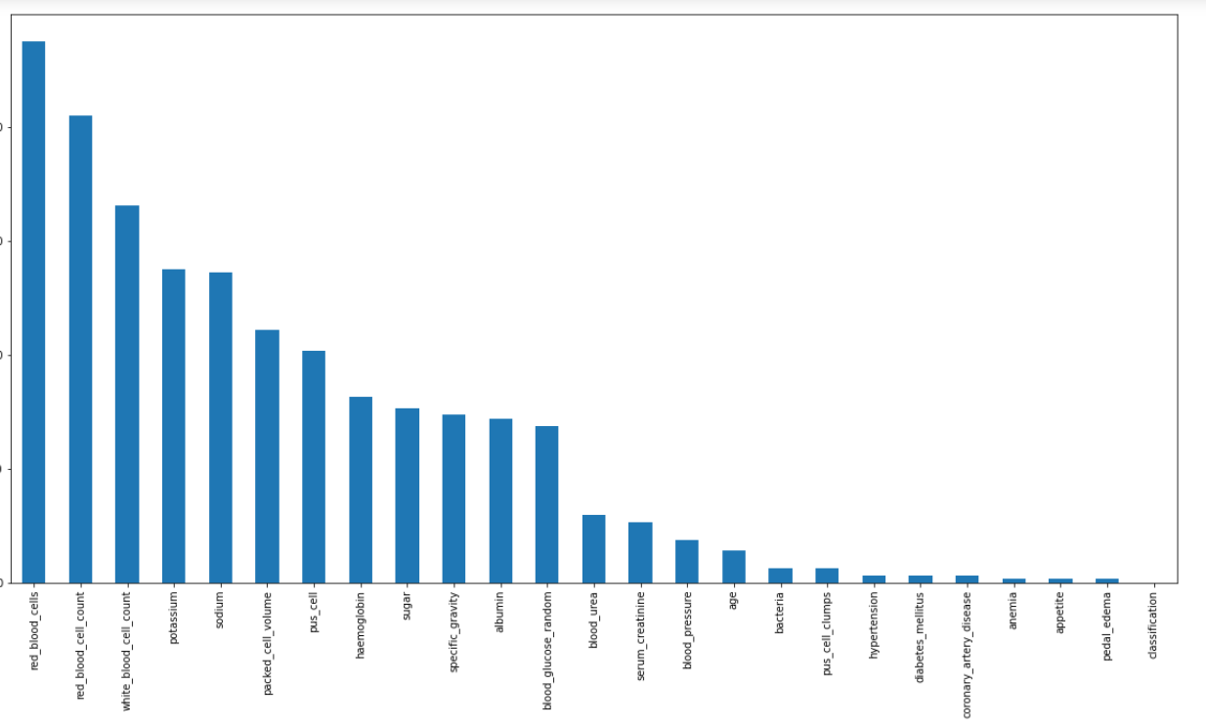
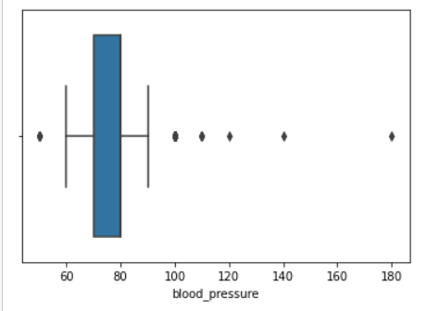
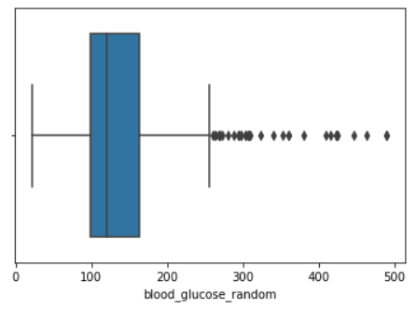
Steps Performed : Handling Missing values and Outliers
The dataset clearly has many missing values and cannot be totally ignored or dropping these attributes will not give an accurate model.
Step 5 : Divide the given attributes into numerical and categorical datasets.
Step 6 : Find out the mean of the numerical attributes corresponding to each class, and then replace the missing data with that mean value altogether.
Step 7 : For blood_pressure and blood_glucose_random as there are few outliers, we will remove them and will treat them as missing values
Step 8 :For Blood Urea, we trim the values which are beyond the upper whisker for the blood_urea attribute
Step 9 : The rest of the attributes are simply replace the missing values with MEAN.

Slide 14
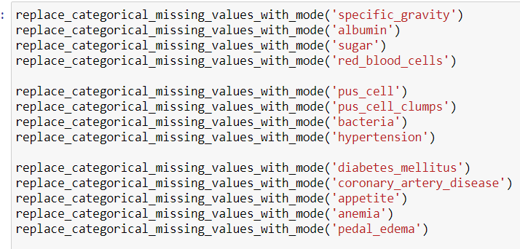
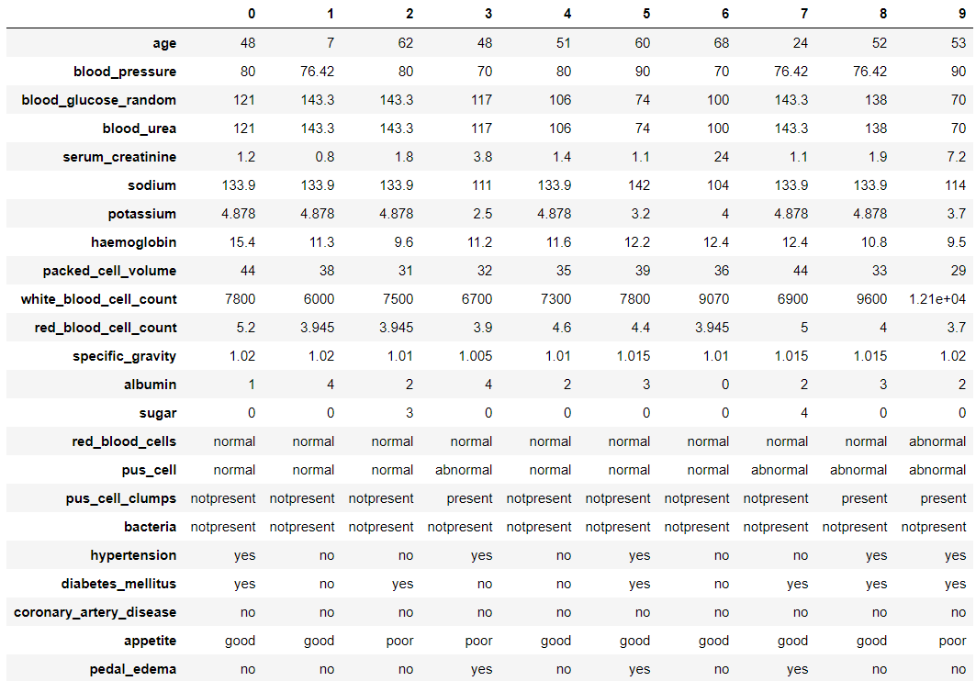
Steps Performed : Handling Missing values and Outliers
Step 10 : For all the missing values of the categorical attributes, we will find the MODE and replace the missing values for each categorical attributes.
Step 11 : Merge both the data frames for numeric and categorical datasets to have a full complete dataset without any missing values.

Slide 15
Exploratory Data Analysis

Slide 16
EDA – Why it is needed ?
EDA is a crucial step to take before diving into machine learning or statistical modeling because it provides the context needed to develop an appropriate model for the problem at hand and to correctly interpret its results.
In data mining, Exploratory Data Analysis (EDA) is an approach to analyzing datasets to summarize their main characteristics, often with visual methods. EDA is used for seeing what the data can tell us before the modeling task.
It is not easy to look at a column of numbers or a whole spreadsheet and determine important characteristics of the data. It may be tedious, boring, and/or overwhelming to derive insights by looking at plain numbers.
Exploratory data analysis techniques have been devised as an aid in this situation.
Exploratory data analysis is generally cross-classified in two ways. First, each method is either non-graphical or graphical. And second, each method is either univariate or multivariate

Slide 17
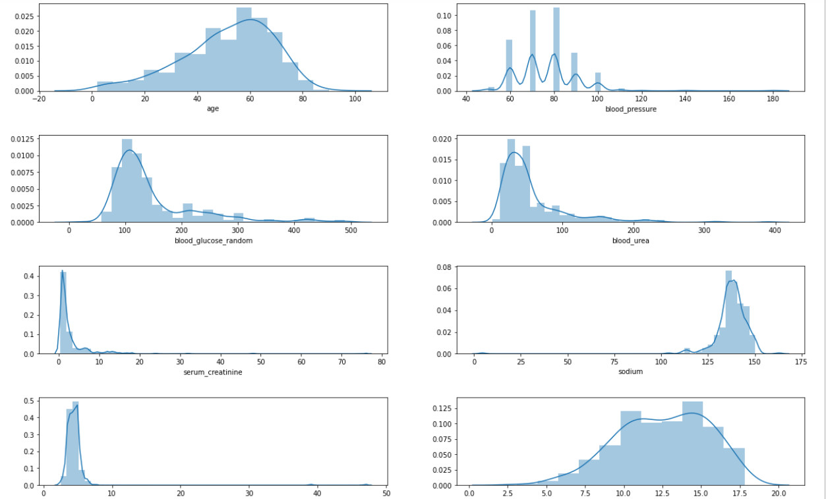
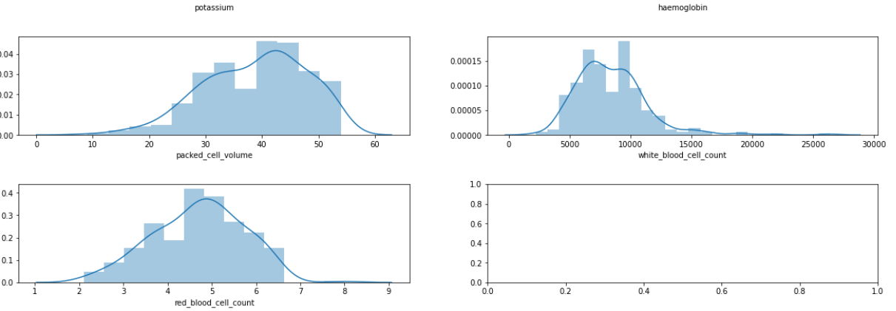
What was done in this study?
We compared by checking each attribute of Numerical features using sub-plot graphs.
Observations :
Age looks a bit left skewed.
Blood Glucose Random is right skewed
Blood Urea is also a bit right skewed
Rest of the features are lightly skewed.

Slide 18
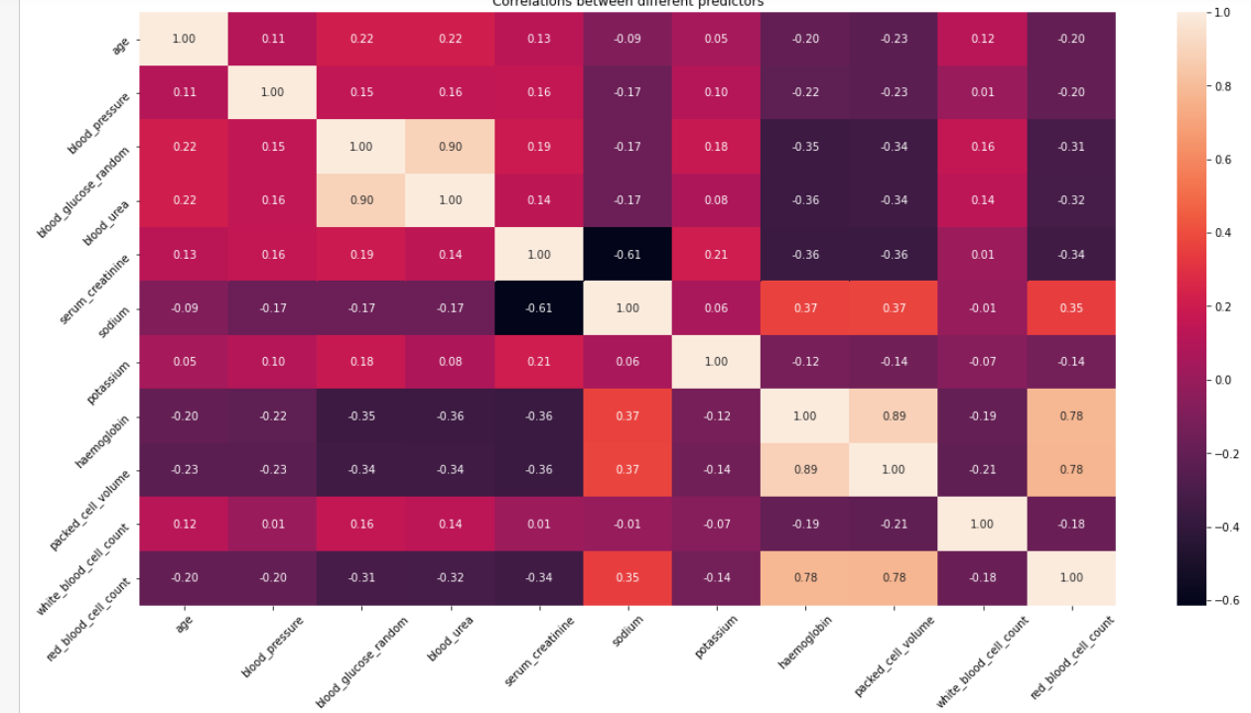
What was done in this study?
We plotted the heat map to identify the correlation for the numeric attributes.
Observation :
Positively Correlated | CORR(haemoglobin, red_blood_cell_count) = 0.78 CORR(packed_cell_volume, red_blood_cell_count) = 0.78 CORR(haemoglobin, packed_cell_volume) = 0.89
Negatively Correlated | CORR(serum_creatinine, sodium) = -0.61 CORR(blood_urea, haemoglobin) = -0.55

Slide 19
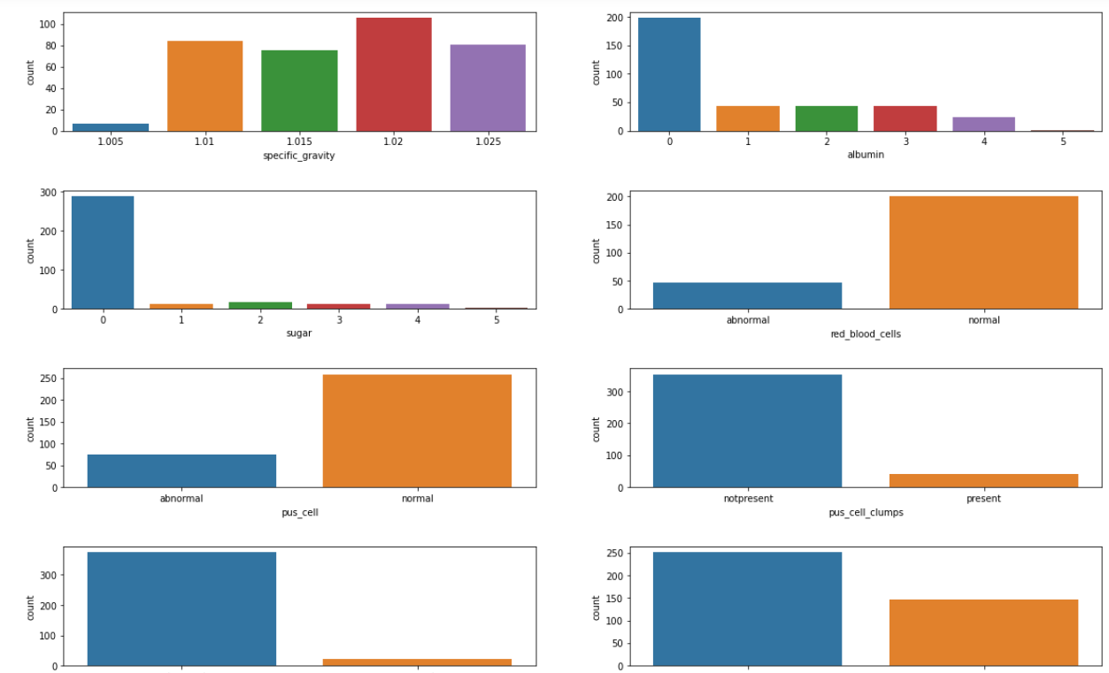
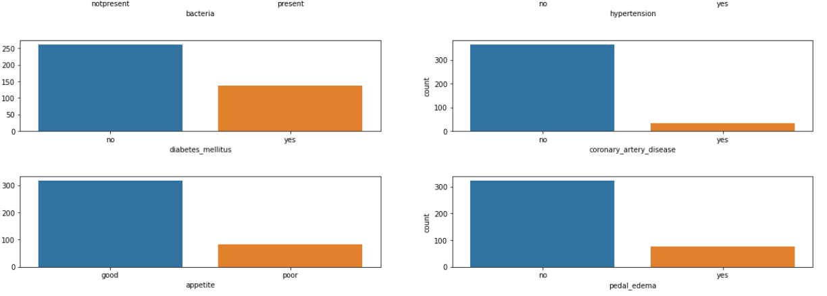
What was done in this study?
We plotted distribution of categorical features :
Observation :
A few features have imbalanced categories.
Stratified folds will be necessary while cross validation.

Slide 20
Steps Performed : Handling Missing values and Outliers
The dataset clearly has many missing values and cannot be totally ignored or dropping these attributes will not give an accurate model.
Step 5 : Divide the given attributes into numerical and categorical datasets.
Step 6 : Find out the mean of the numerical attributes corresponding to each class, and then replace the missing data with that mean value altogether.
Step 7 : For blood_pressure and blood_glucose_random as there are few outliers, we will remove them and will treat them as missing values
Step 8 :For Blood Urea, we trim the values which are beyond the upper whisker for the blood_urea attribute
Step 9 : The rest of the attributes are simply replace the missing values with MEAN.

Slide 21
Model Building

Slide 22
5 Key Steps for Effective Model building
Below are the five key steps we considered while creating a model.
Step 1 : Collect Data
Given the problem we want to solve, need to investigate and obtain data that will be used to feed the machine. The quality and quantity of information we get are very important since it will directly impact how well or badly the model will work.
Step 2 : Prepare the Data
This is the step to check if there are correlations between the different characteristics that can be obtained. It is necessary to make a selection of characteristics since the ones we choose will directly impact the execution times and the results. We can also reduce dimensions by applying PCA if necessary.
Step 3 : Choose the model.
There are several models that we can choose according to the objective that we might have: we will use algorithms of classification, prediction, linear regression, clustering, i.e. k-means or K-Nearest Neighbor, Deep Learning, i.e Neural Networks, Bayesian, etc.
Step 4 : Train/enhance the model
We will need to train the datasets to run smoothly and see an incremental improvement in the prediction rate. We divide the data into test and train data and model it accordingly.
Step 5 : Evaluation
We will have to check the machine created against the evaluation data set. If we reach 90% or more, we can have good confidence in the results that the model gives us.

Slide 23
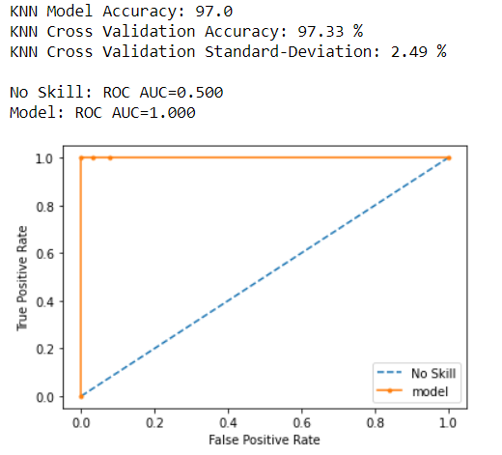
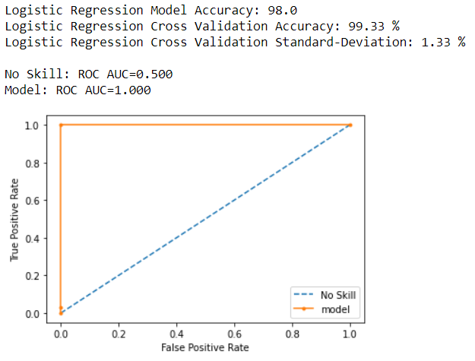
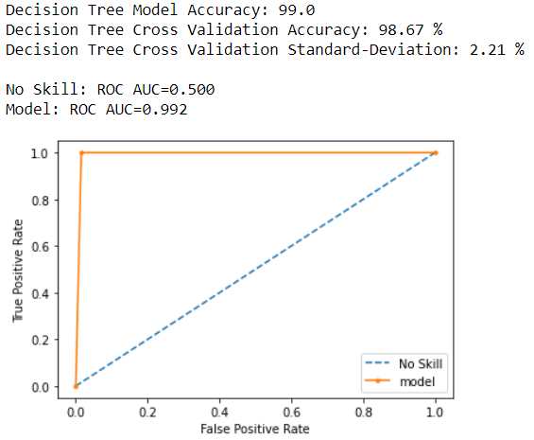
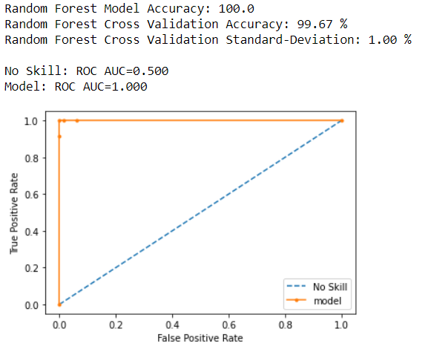
Building the Baseline model
Approach :
We have applied the following classification algorithms to build our initial models. a. Logistic Regression b. KNN c. Decision Trees d. Random Forest
Conclusion :
Based on the evaluation of the 4 models that we have built for our dataset, we can conclude the following things:
Random Forest gives the best model accuracy of 100.0
Also, Random Forest has the best CV accuracy mean and std values.
KNN performs the worst with the given dataset having model accuracy.

Slide 24
Model Enhancements

Slide 25
Applying PCA : Approach
Step 1 : Standardization by calculating (z).
z=(value-mean)/(standard_deviation)
Step 2 : Covariance Matrix Computation
+ : two variables increase or decrease together. corelated
- : both variables inversely corelated.
Step 3 : Compute Eigenvalue and Eigenvector of Covariance matrix to identify the Principle Components
Principle Component - new variables constructed as linear combinations or mixture of initial variables
Step 4 : Feature vector selection
- Choose whether to keep all the components or discard those with lesser significance (low eigenvalues) and form ones a matrix of vector.
Step 5 : Recast data along the Principle Component Axes
Final Dataset = FeatureVector^{T} - StandardizedOriginalDataset^{T}
Variables - x, y, z ; Matrix - | Cov(x,x) | Cov(x,y) | Cov(x,z)
 | Cov(y,x) | Cov(y,y) | Cov(y,z)
 | Cov(z,x) | Cov(z,y) | Cov(z,z)

Slide 26
Evaluation and Outcomes

Slide 27
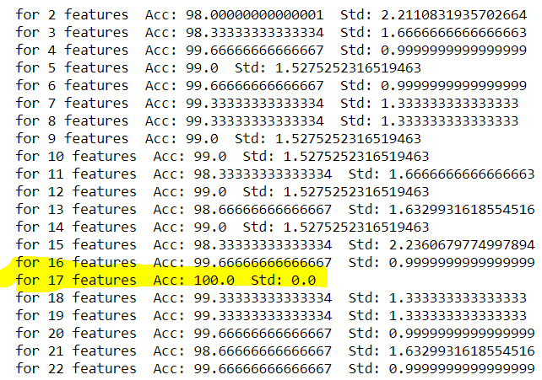
Observations and Feature vector selection
Since the model having 17 features through PCA gives the 100% accuracy.
So this indicates that all the 24 attributes are contributing (if not equally or substantially) towards the final classification

Slide 28
Conclusion

Slide 29
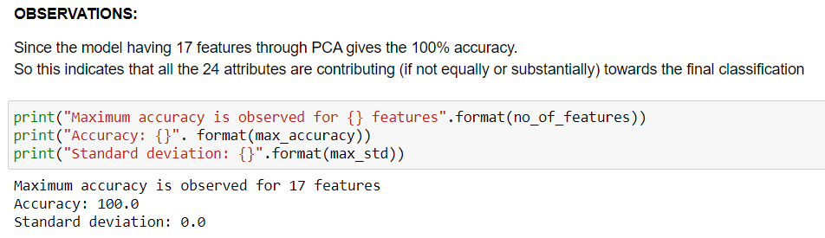
Conclusion
We have a model which has achieved an accuracy of 100%,
So this indicates that no feature or attribute should be dropped from the dataset, as all of them are contributing uniquely towards the classification.
The final model (rn_classifier) provides a more reliable model to determine if a patient is suffering from chronic kidney disease or not.

Slide 30
UMANG MISHRA - 2020FC04103 AMAL SHAJI - 2020FC04101 GNANESWAR S V V - 2020FC04102
SUBMITTED AND PREPARED BY

