Slide 1

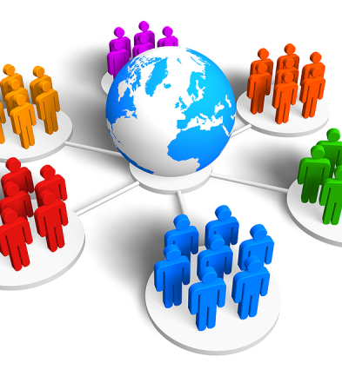


Data-Driven Consumer Grouping using Classification Algorithm
Abstract & Outline Review

Slide 2

Problem Statement
As per the fact, 27.2 percent of the world’s population is shopping online. These numbers are rising rapidly over the years and are expected to continue doing so. In 2021, e-commerce sales are expected to account for 18.1 percent of retail sales worldwide. Now every retail store like groceries, meat, food products, sports equipment, dress, etc., started developing their e-commerce websites. The key challenge these companies face is diagnosing the target potential consumer groups.

Slide 3
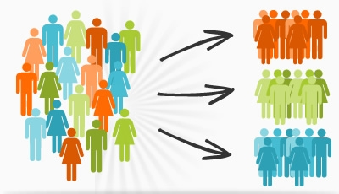
Solution
Consumer Grouping

Slide 4
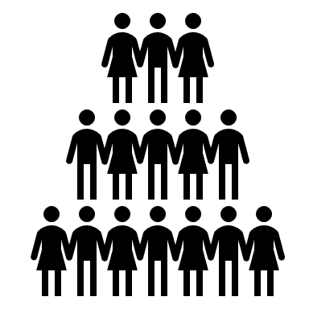
Existing Consumer Grouping Strategies
Behavioral Grouping: A Customer’s Choice
Loyalty, Engagement, Usage, Occasion
EX: Benefits sought from product or service, Readiness to buy or purchase, common characteristics.
Psychographic Grouping: A Customer’s Lifestyle
Lifestyle, Opinions, Interests, Values
EX: Habits, hobbies, activities, interests
Demographic Grouping: A Customer’s Profile
Gender, Religion, Education, Income
EX: Marital Status, Occupation, Religion
Geographic Grouping: A Customer’s Home
Density, Weather, Country, Religion
EX: Country, State, City, Population Density, Climatic conditions

Slide 5
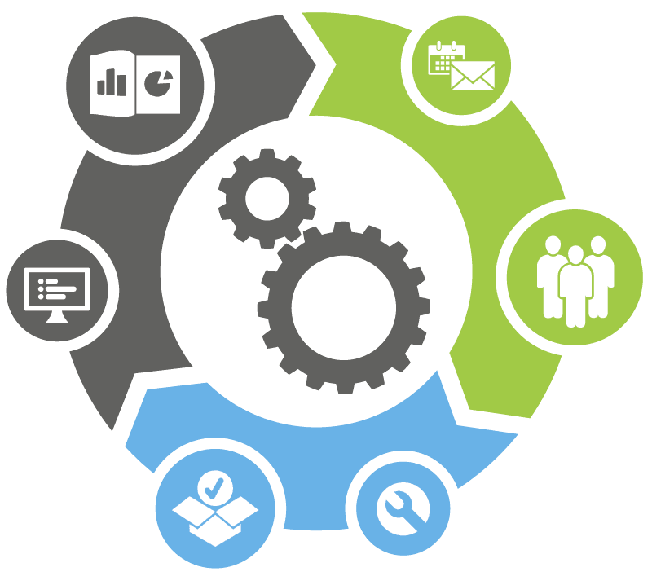
Proposed Approach
Classifying Groups based on Products
Classifying Groups based on Consumer consumption habits such as number of transactions made over a period, types of Product purchased, Total bill amount. And creating the Consumer Groups.
Once Consumer Groups are created, finally will create multiple classifiers which will group the consumers into one of the consumer groups created and compare the precision of various models and will select the best one with higher precision.

Slide 6

Data Set
I am making use of public transactional data set which contains all the transactions over a period of 1 year for a UK-based and registered non-store online retail. The company mainly sells unique all-occasion gits. Many customers of the company are wholesalers.
Data set Link: http://archive.ics.uci.edu/ml/datasets/online+retail#

Slide 7
Attribute Information
InvoiceNo: Invoice number. Nominal, a 6-digit integral number uniquely assigned to each transaction. If this code starts with letter 'c', it indicates a cancellation.
StockCode: Product (item) code. Nominal, a 5-digit integral number uniquely assigned to each distinct product.
Description: Product (item) name. Nominal.
Quantity: The quantities of each product (item) per transaction. Numeric.
InvoiceDate: Invoice Date and time. Numeric, the day and time when each transaction was generated.
UnitPrice: Unit price. Numeric, Product price per unit in sterling.
CustomerID: Customer number. Nominal, a 5-digit integral number uniquely assigned to each customer.
Country: Country name. Nominal, the name of the country where each customer resides.

Slide 8

Completion Criteria
There are lot of consumer grouping done on this public dataset. Such as
Customer Segmentation with RFM (https://www.kaggle.com/mahmoudelfahl/cohort-analysis-customer-segmentation-with-rfm#Implementation-of-K-Means-Clustering)
Customer Segmentation & Sales Prediction (https://rpubs.com/maulikpatel/234158)
My suggested approach of consumer grouping using classification algorithms should have a better precision scores.

Slide 9

Questions

Slide 10

Thank You

