Slide 1
Development and Deployment with WSGI in Django
Django User Group in London (DJUGL), February 2010.
By Gustavo Narea.

Slide 2
Who's speaking?
Gustavo.
Works for Web 2.0 company.
Repoze and TurboGears core developer.
Believes in WSGI above all else.

Slide 3
What's WSGI?
Python “standard”.
Like CGI, at the Python level.
Useful for development too.
Makes possible framework-independent components.
Established for more than 6 years.

Slide 4
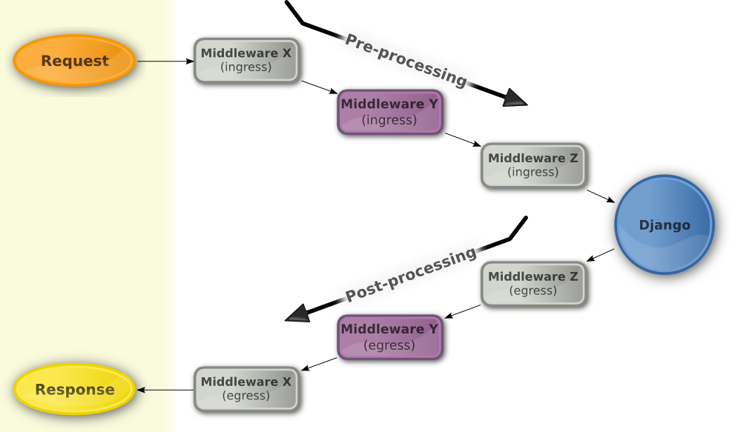
Where is Django?

Slide 5
twod.wsgi
One goal: Improve Django's WSGI support.
Won't break existing applications.
Stable, no known bugs.
First release very soon.
Hopefully merged into a future Django release.
Testers and contributors are welcome!

Slide 6
Things you can do now

Slide 7
Use PasteDeploy config files
Suitable for configuration, unlike Python code.
Complement or replace (your choice) settings.py
Widely used.
INI format.
Extremely flexible.
Wave goodbye to DJANGO_SETTINGS_MODULE!

Slide 8
Run initialisation code
One-off code when the application has started up.
Before any import from Django or your application.
Or right after your application has been set up.

Slide 9
Use WSGI middleware
Not only for deployment.
Can be configured in INI files or Python code.

Slide 10
Get a better development server
manage runserver is OK, but Paste's rocks.
It's multi-threaded.
Can serve your application in different modes.
Can serve your media.
Often used in deployment too!

Slide 11
Mount applications
Serve Trac as a Django view.
Or the PHP-powered WordPress!
Filter the input they get.
Filter the response they return.
Mount them on-the-fly.
Single Sign-On for free!

Slide 12
Write functional tests with WebTest
More reliable replication of production environment.
More features.
Can parse HTML, XML and JSON responses.
Can fill out forms and submit them.
twod.wsgi has a Nose plugin for WSGIfied Django applications.

Slide 13
Get more from requests
Request objects now have way more members.
They come from WebOb.
HttpRequest members still available.
A real proxy to the WSGI environment.
Short-cuts to standard HTTP request headers.

Slide 14
Expose the URL arguments
/posts/hello-world has one routing argument (e.g., post_slug=”hello-world”).
Dispatchers in Web frameworks should make them available in the request.
Django does thanks to twod.wsgi.
Useful for generic, 3rd party libraries.

Slide 15
Let's get practical

Slide 16
What's next?
Check if there's anything for you in the Paste project (pythonpaste.org).
Or Repoze (repoze.org).
Spread the word about it!

Slide 17
Thank you!
Slides will be published on http://dev.2degreesnetwork.com/
twod.wsgi Web site: http://packages.python.org/twod.wsgi/
Development Web site: http://bitbucket.org/2degrees/twod.wsgi/
Follow @2degrees on identi.ca.

