Slide 1


Slide 2

The Rulebook

Slide 3
Species

Slide 4
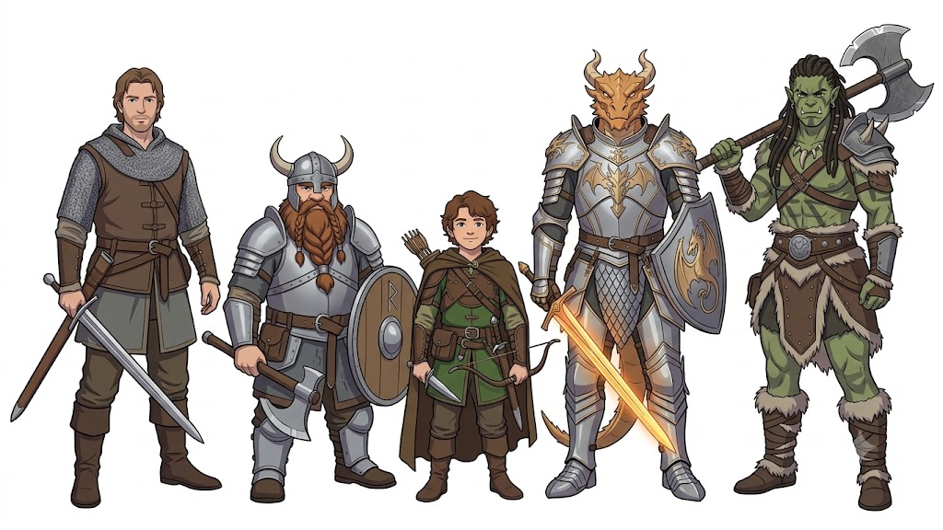

Slide 5
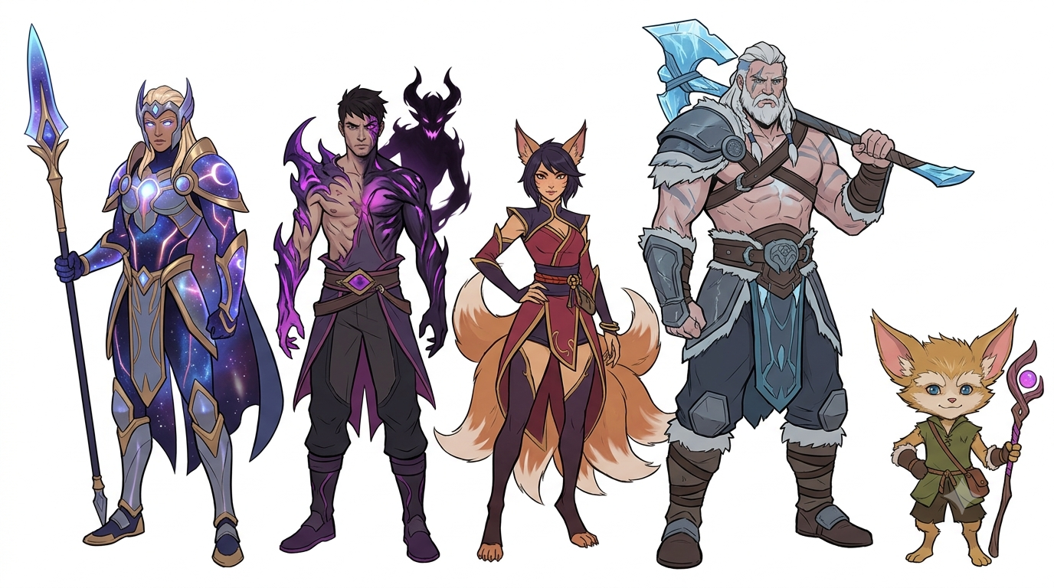

Slide 6
Classes

Slide 7
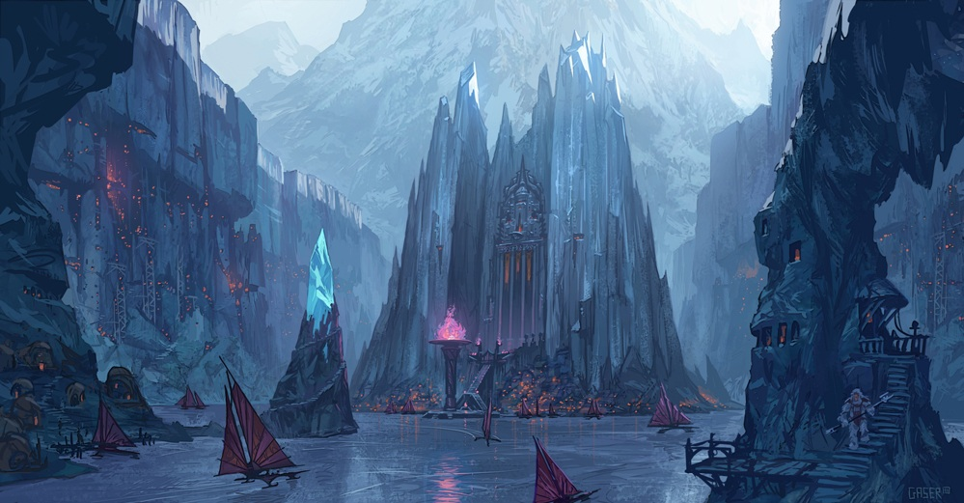
Region | Class | Subclass (5.5e Core) | In-Game Class
Frejlord | Barbarian | Path of the Berserker | Winter's Claw Bloodrager
 |  | Path of the Wild Heart | Totem Warrior
 |  | Path of the world tree | Hearth-Keeper
 |  | Path of the Zealot | Storm-Touched Fanatic

Slide 8

Region | Class | Subclass (5.5e Core) | In-Game Class
Bandle City | Bard | College of Dance | Fae-Step Prankster
 |  | College of Glamour | Glittering Pixie Weaver
 |  | College of Lore | Bandle Tree Chronicler
 |  | College of Valor | Bandle Scouts

Slide 9

Region | Class | Subclass (5.5e Core) | In-Game Class
Mount Targon | Cleric | Life Domain | Solari Dawn-Bringer
 |  | Light Domain | Aspect of the Sun Zealot
 |  | Trickery Domain | Lunari Shadow-Weaver
 |  | War Domain | Targon Peak Crusader

Slide 10

Region | Class | Subclass (5.5e Core) | In-Game Class
Ixtal | Druid | Circle of the Land | Ixtali Axiom Warden
 |  | Circle of the Moon | Primeval Jungle Apex Shapeshifter
 |  | Circle of the Sea | Ixtali Elemental Tides
 |  | Circle of the Stars | Axiomatic Constellation Seer

Slide 11
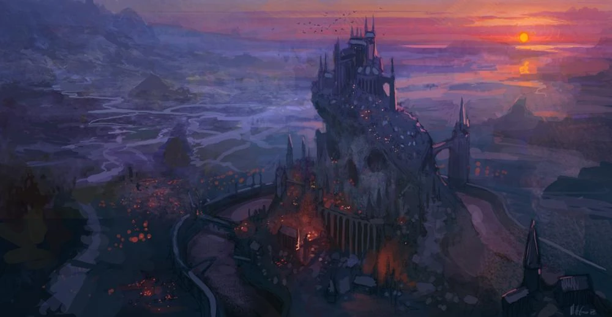
Region | Class | Subclass (5.5e Core) | In-Game Class
Noxus | Fighter | Battle Master | Trifarian Tactician
 |  | Champion | Flesh-Arena Gladiator
 |  | Eldritch Knight | Black Rose Spellblade
 |  | Psi Warrior | Noxian Mind-Weaver Soldier

Slide 12

Region | Class | Subclass (5.5e Core) | In-Game Class
Ionia | Monk | Warrior of Mercy | Balance Healer of Navori
 |  | Warrior of Shadow | Order of Shadow Infiltrator
 |  | Warrior of the Elements | Dragon Spirit Disciple
 |  | Warrior of the Open Hand | Kinkou Fist-Master

Slide 13

Region | Class | Subclass (5.5e Core) | In-Game Class
Demacia | Paladin | Oath of Devotion | Dauntless Vanguard Shield-Bearer
 |  | Oath of Glory | Silverwing Paladin
 |  | Oath of the Ancients | Petricite Warden
 |  | Oath of Vengeance | Mageseeker Inquisitor

Slide 14

Region | Class | Subclass (5.5e Core) | In-Game Class
Bilgewater | Ranger | Beast Master | Jaull-Hunter Harpooner
 |  | Fey Wanderer | Syndicate Cutthroat Tracker
 |  | Gloom Stalker | Slaughterdock Wraith-Stalker
 |  | Hunter | Bilgewater Bounty Hunter

Slide 15

Region | Class | Subclass (5.5e Core) | In-Game Class
Piltover | Rogue | Arcane Trickster | Hextech Vault-Breaker
 |  | Assassin | Enforcer Intelligence Operative
 |  | Soulknife | Hex-Blade Operative
 |  | Thief | Rooftop Scavenger

Slide 16
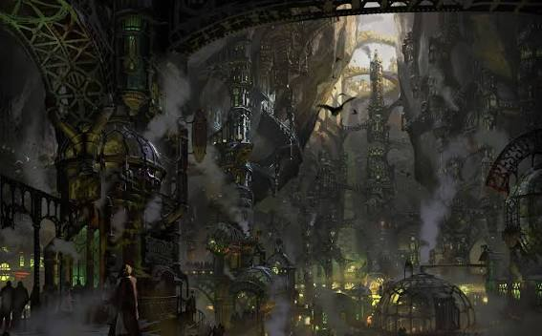
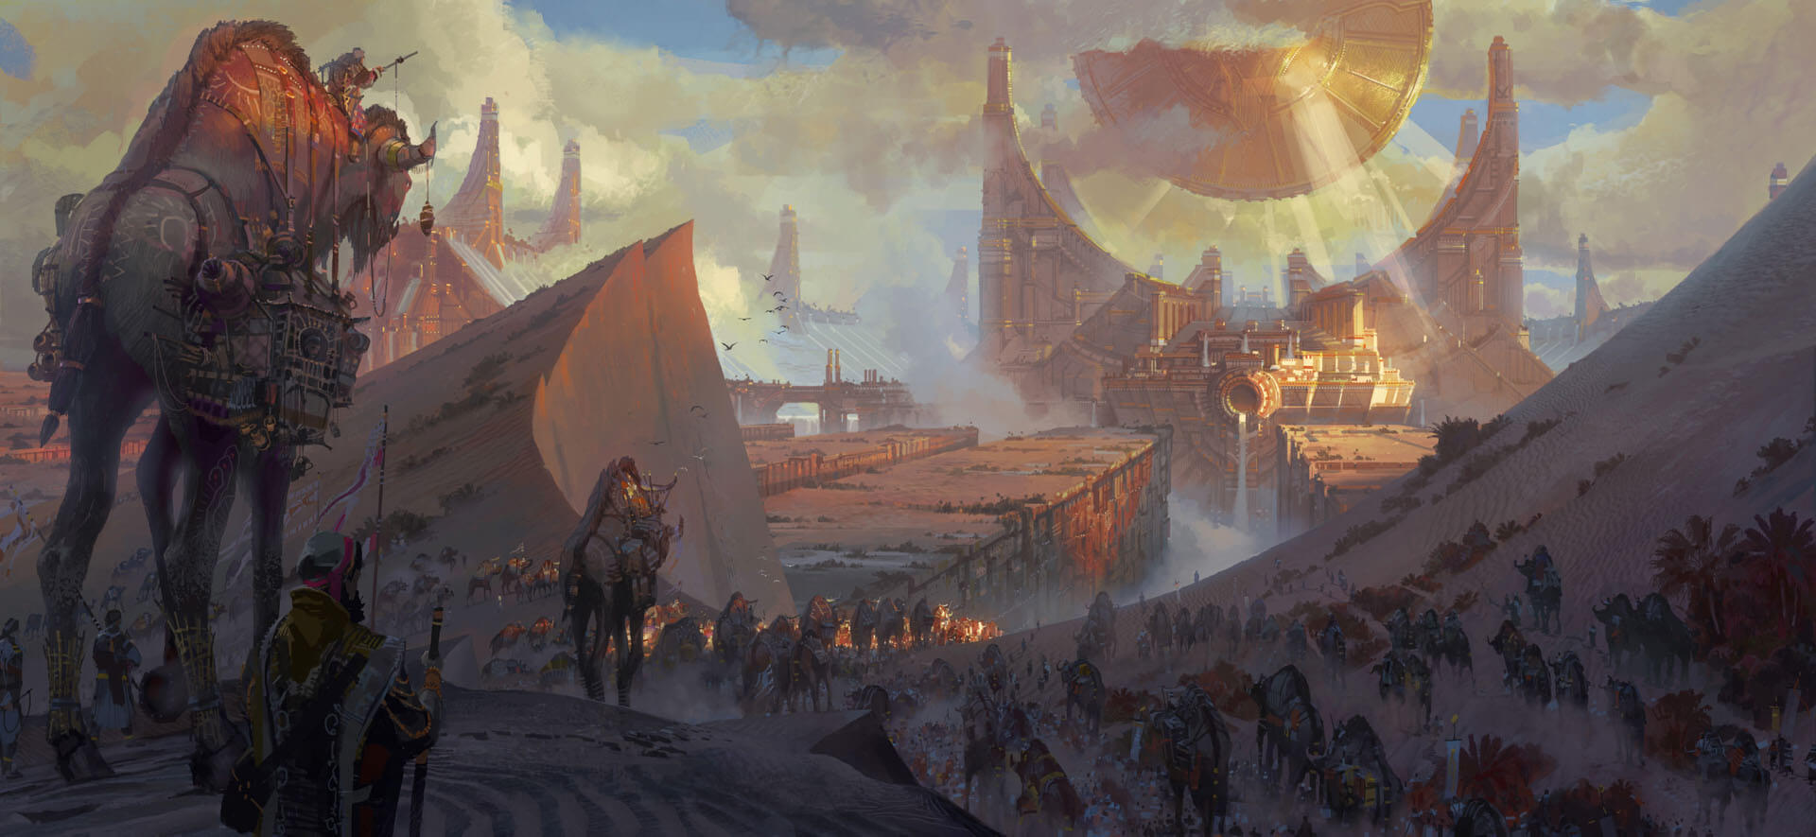
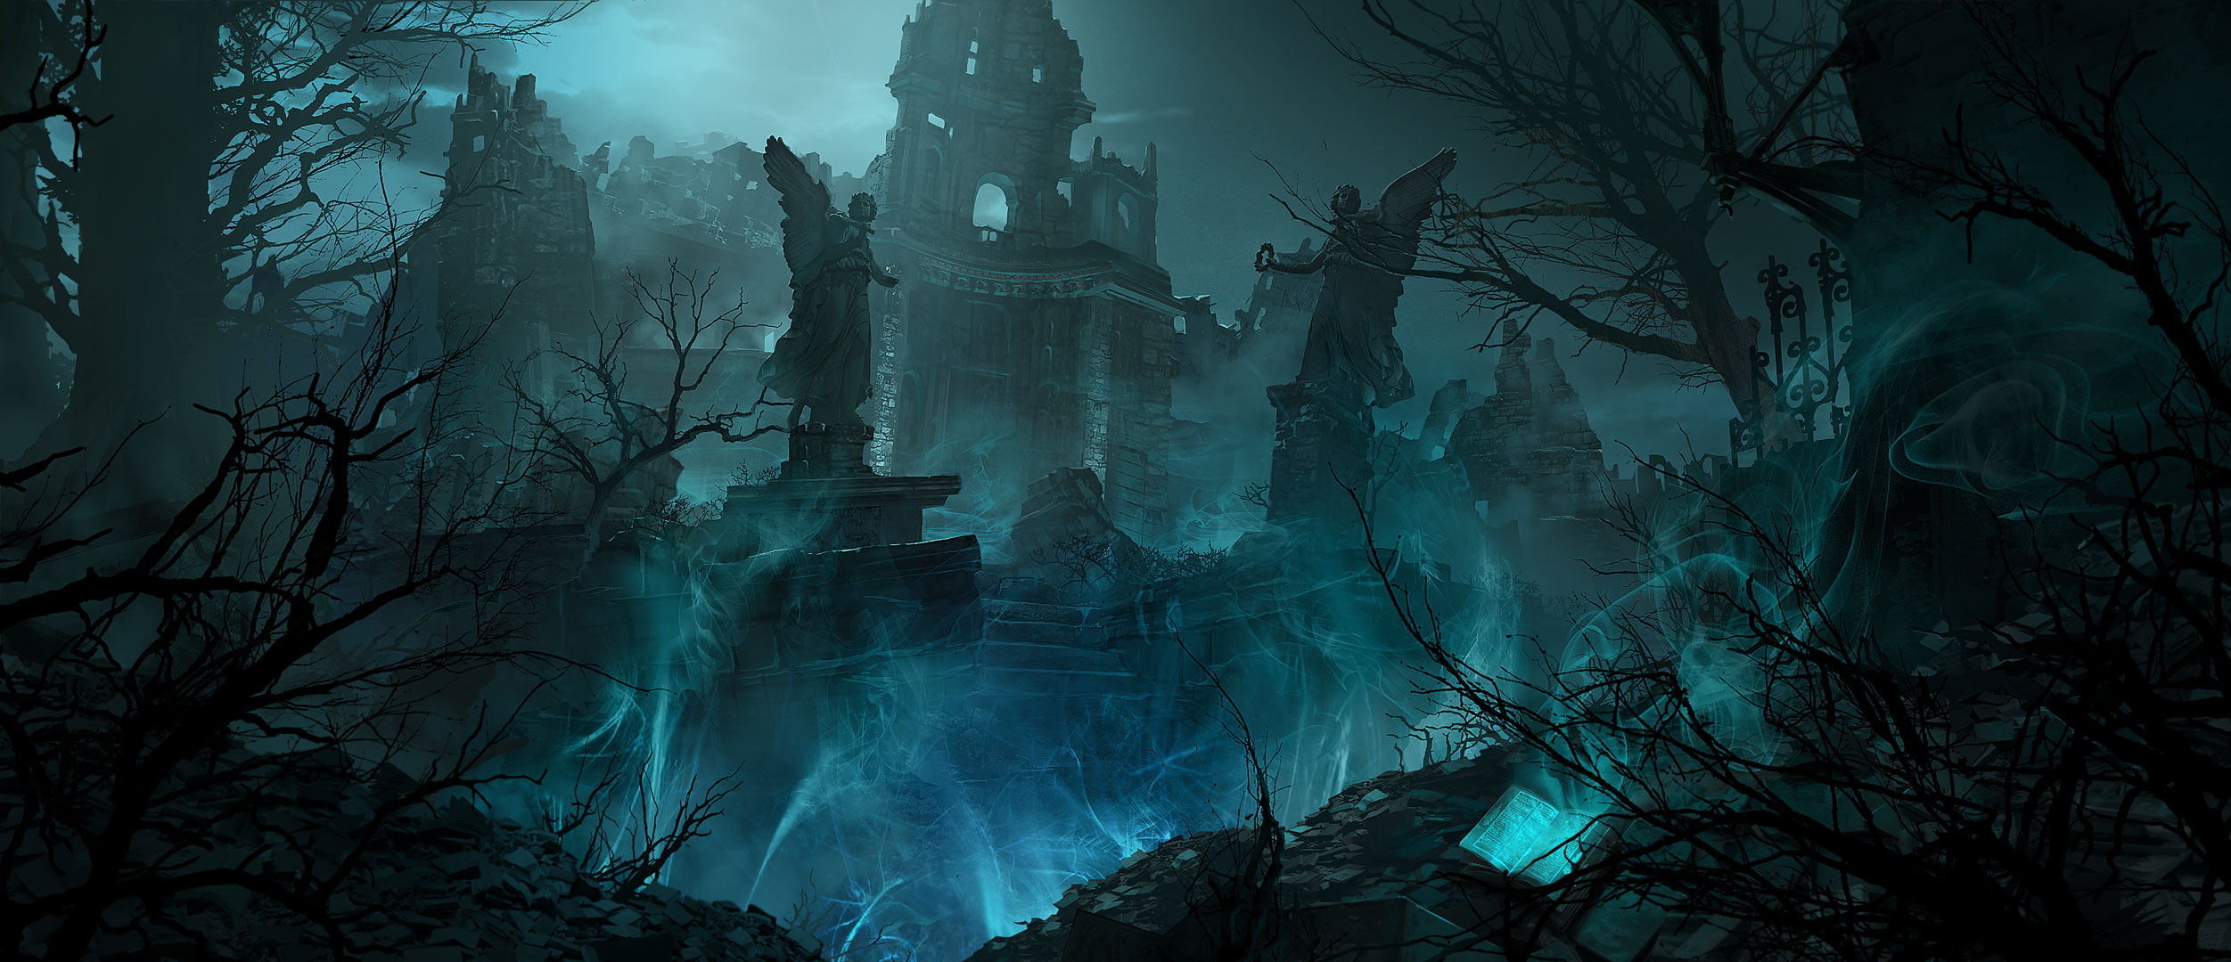
Sorcerer | Aberrant Sorcery
Sorcerer | Wild Magic Sorcery
Wizard | Evoker
Sorcerer | Clockwork Sorcery
Warlock | Celestial Patron
Warlock | Great Old One Patron
Wizard | Abjurer
Wizard | Illusionist
Sorcerer | Draconic Sorcery
Warlock | Archfey Patron
Warlock | Fiend Patron
Wizard | Diviner

Slide 17


???

Slide 18
Finalised List
Lucid – Monk – Elf (Vastayan) – Order Of Shadows
Black Baron – Cleric – Aasimar (Aspect) – Life Domain
Vignan – Paladin – Dragonborn- Oath of the Ancients
HK – Fighter – Human - Champion
Sebastian – Human – Wizard – Illusionist

Slide 19
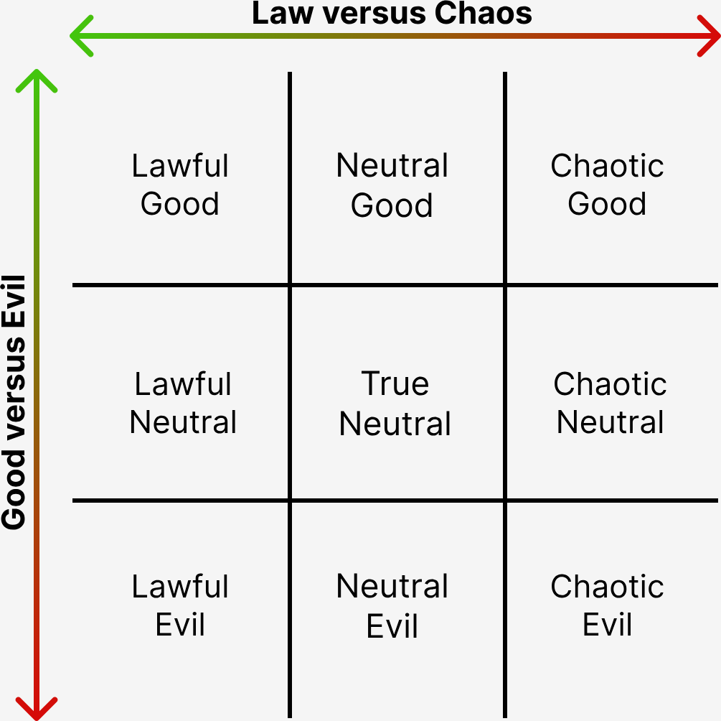
Alignment

