Slide 1

Creepy crawlers
Natalie Garza

Slide 2
✨Player Goals
The idea driving the game is the fact that food-stressed caterpillars will resort to cannibalism. We can clearly make decisions and the idea itself will drive the game play. For example, a couple of rules that have stemmed from this idea:
The bugs spawned will be sparser as the game progresses, thus making the players crawler win the game by eating other crawlers.
Other crawlers will already be food-stressed and will automatically resort to eating the player.
The longer crawlers will eat the smaller ones.
You only have one life, in the caterpillar world it's do or die. In the end the crawler must eat its fellow caterpillars to win the game, this is the only way if it wants to survive long enough to become a butterfly.

Slide 3
✨Game Rules
User steers crawler through a maze using the up, down, left, and right arrows on a keyboard.
Crawlers can eat little bugs to grow their tail by one unit. Bugs are generated randomly on the edges of the map.
If one crawler is bigger than another by at least one unit they may eat that one’s head and grow their own tail by one unit.
Crawlers may nibble the tails of others to shorten their length. If the tail is nibbled towards the middle of their body, their entire tail from that point of contact is also removed.
You win the game by reaching a tail size of 9, once you achieve this you are taken to the next level.
As player gets longer, they start speeding up due to inertia.
If you eat a bug the new unit will be the same color as the head of the crawler, if you eat other crawlers head then the new unit will be the color of the head that was eaten.

Slide 4
✨Game World
User progresses through three different levels in the game. The higher levels will dictate the spawning frequencies of the bugs and the crawler types spawned.
Consists of passages where crawlers will able to maneuver through. There will be one tunnel that will transport you to the other side of the map.
Users crawler bumping into a wall will stop crawlers’ motion, it will not move unless the user changes its direction. Crawlers in constant motion, so if there is no obstacle in user’s way it will continue to crawl even when user is not pressing any keys.
Every level will have the same map layout, variations in opponent difficulty will differentiate the levels.

Slide 5
✨In-Game Characters
Crawlers
There are three varieties of crawlers that will differ in speed and smarts. Easy, medium, and hard.
Depending on how far along the game the crawlers will spawn at longer lengths.
Opponents don’t eat each other, they may only eat other bugs to grow their tail.
Want to make the different behaviors of crawlers like Pac-man where the objective of each crawler changes depending on rank. H is like Blinky where its objective is to chase the player, M is like Pinky where its objective is to chase the players location 4 tiles ahead, and E is like Inky where its movement is unpredictable (either like Blinky, Pinky, or Clyde).
Bugs
Each Bug has a lifecycle, they can freely roam around and if they aren’t eaten by the time their timer is up, they must make their way to the closest spawning spot and disappear.

Slide 6

Splash: I want to display the quote “Food-stressed caterpillars will resort to cannibalism”, vector graphic animation is displayed
Press any button to take you to home screen
Home: Play game instructions and ‘press z to start’ dialogue and an icon that can denote sound on/sound off. Sound toggled by pressing x.
Press z to take you to Play screen
Play: Map takes up whole screen and there will be a sound and z to quit dialogue.
Quit action takes you to Home screen
End: This is shown only when you beat the game. Maybe make it your crawler turning into a butterfly…
Press any button to take you to Splash screen
✨Path State Charts

Slide 7
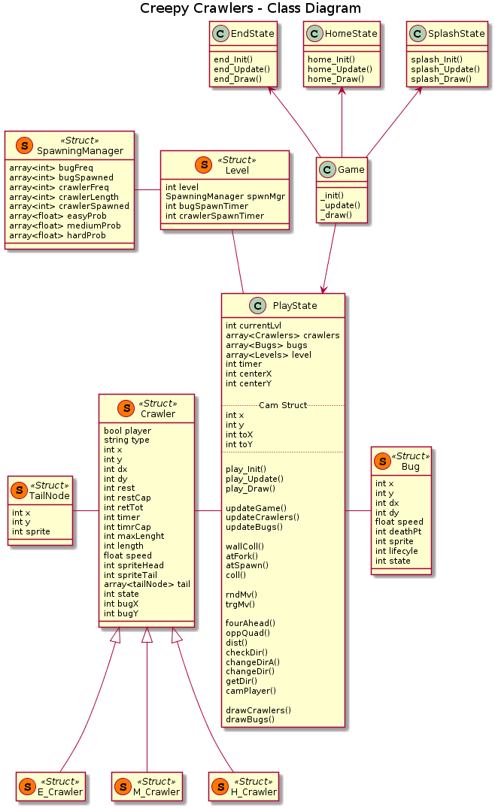
✨Class Diagram

