Slide 1
OPINION PHRASE MINING OF RESTAURANT REVIEWS
Done By: Gazi Naven & Azmayeen Fayeque Rhythm

Slide 2
Contents
Problem
Solution
Project
Data Processing
Reviews Processing
Frequent Itemset Mining
Results

Slide 3

What is the Problem
Poorly Rated Restaurants have no way to understand what customers really want
Difficult to learn from learn from large number of feedback/ reviews
No way to compare and understand what people like in good rated restaurants
Notes:
Currently, we found no cohesive mechanism for lower rated restaurants to learn what areas customers are focused on. Hence there is no way to compare and learn what customers like in good restaurants which could allow bad restaurants to improve

Slide 4
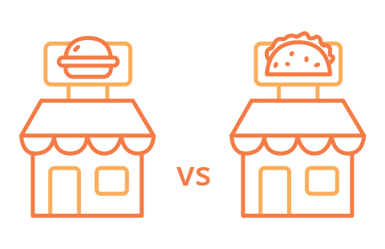
Our Solution
A Program That:
Clusters Similar Restaurants According to Average Income of People in Restaurant Location
Finds Lower Rated and Higher Rated Restaurants in Respective Clusters
Extracts Frequent Patterns from Descriptive Phrases in Customer Reviews
Compares Patterns from Higher and Lower Rated Restaurants
Notes:
We wanted to find similar restaurants and cluster them together so that we are not making comparison across restaurants that have no common characteristics to each other. The biggest similarity that we found would be the most effective to use is the type of customers they intend to serve. By type of customers we mean income level of the customers. Hence, this would give us a better understanding of what the customers of different income levels look for.

Slide 5
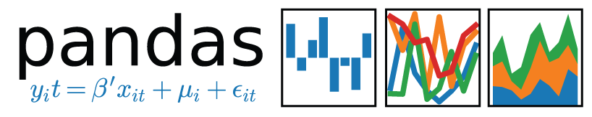

Project : Data Processing
Library used:
Extracts Restaurants and Food Places Only
Over 65,000 businesses taken into account
Business Dataset
Business Categories
Notes:
From the Yelp Dataset we extracted over 65,000 businesses, their reviews and ratings. It does not take into account only restaurant businesses.

Slide 6

Data Processing: Merging Datasets
BUSINESS DATASET
REVIEW DATASET
AVG INCOME DATASET
ZIPCODE
ZIPCODE
BUSINESS ID
BUSINESS ID
Notes:
[Yelp business dataset and Average Income dataset merged on ZIPCODE]
[Yelp business dataset and Yelp review dataset merged on review]
Everything besides business id, income level, avg. adjusted gross income, zipcode, review and ratings is cleaned while merging the dataset, thereby creating the mega dataset.

Slide 7
Data Processing: Dividing Dataset
DIVIDING BY SIMILAR INCOME
LOW INCOME
(< $ 90,000 per household)
LOWER MIDDLE INCOME
( > $ 90,000 & < $200,000 per household)
MEGA DATASET
AVG. HOUSEHOLD INCOME
HIGHER MIDDLE INCOME
( > $200,000 & < $300,000 per household)
HIGH INCOME
( > $300,000 & < $400,000 per household)
Notes:
We divide the dataset into groups by similar income level. Here the four categories are represented by the income level.

Slide 8
Data Processing: Dividing Dataset
EACH DATASET DIVIDED ACCORDING TO RESTAURANT RATING (Stars)
HIGHER MIDDLE INCOME
STARS
1-2.5
Star Ratings
2.6 – 3.9 Star Ratings
Above 4 Star Ratings
Notes:
Each income level represents the type of restaurant they visit which is also divided into three groups. Thus, each income level dataset is divided into three datasets based on the star ratings of that type of restaurants.

Slide 9
Review Processing
Review Sentences
Parts of Speech Tagging
Tokenize
Extracting Basic Pattern
Pruning
Notes:
The review processing of a sentence uses the Stanford nlp library to tokenize sentences, tag them with a parts of speech and finally create a basic pattern. The pattern is then run through a pruning step where it cleans all patterns that has stopwords.

Slide 10
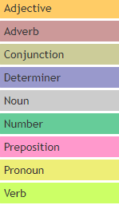

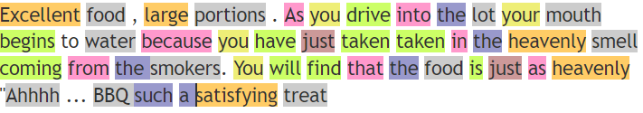
Parts of Speech Tagging
Library Used: Stanford NLP
Notes:
The example sentence is tokenized and each word is tagged with a parts of speech.

Slide 11
Extracting Basic Patterns
Noun Compound Modifier (nn): Excellent food, large portions * parsed to nn * (food, portions)
Adjective complement (acomp): The food is just as heavenly * parsed to acomp * (just, heavenly)
Adjectival modifier(amod): You will find food is just as heavenly*parsed to amod*(food, heavenly)
amod(N,A) → <N,A> “Ahhh.. BBQ. Such a satisfying treat. → (treat, satisfying)
Notes:
Example of various modifiers within Stanford nlp. These modifiers are used to create the basic pattern.

Slide 12
Pruning Patterns : StopWords
Eliminate patterns which contain any stopwords to keep only significant patterns
Pruned Patterns
Significant Patterns
(water begins)
(smell smokers)
(just heavenly)
(food Excellent)
(smell heavenly)
(treat satisfying)
Notes:
This gives an example of pruned patterns vs significant patterns. This will clean the pruned patterns which does not give us any insight on the food or service of the restaurant.

Slide 13
Output : Opinion Phrases
Excellent food, large portions. As you drive into the lot your mouth begins to water because you have just taken in the heavenly smell coming from the smokers. You will find that the food is just as heavenly
"Ahhhh... BBQ. such a satisfying treat.
INPUT
OUTPUT
[food Excellent, smell heavenly, food heavenly, treat satisfying]
Notes:
The slide shows the output which are relevant opinion phrases.

Slide 14
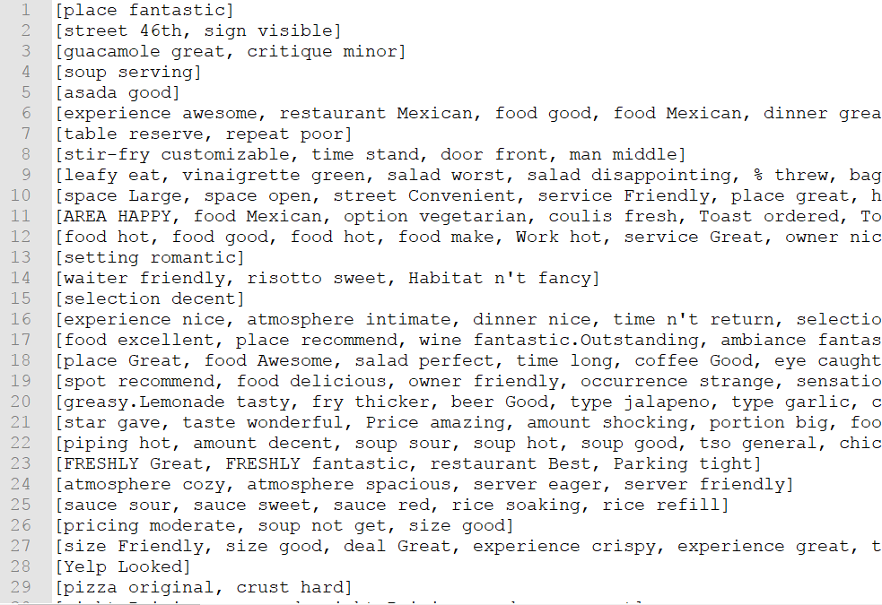
Frequent Itemset Mining
Library Used: pymining
Input : Opinion Patterns
RElim Algorithm used
Minimum Support : 1% of the dataset
Output : Frequent Patterns
Pattern | Frequency
({' hour happy'}) | 953
({' service good'}) | 1087
({' food delicious'}) | 835
({' place great'}) | 1416
({' food great'}) | 1464
({' staff friendly'}) | 1634
({' service great'}) | 1766
({' food good'}) | 2498
Notes:
Using pymining library, we used the Relim algorithm to mine the patterns and find frequent patterns. Minimum support used was 1%.

Slide 15
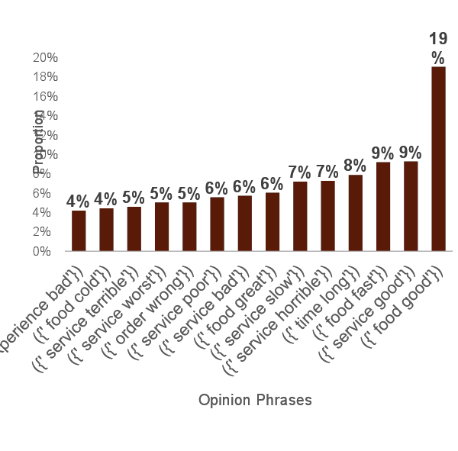
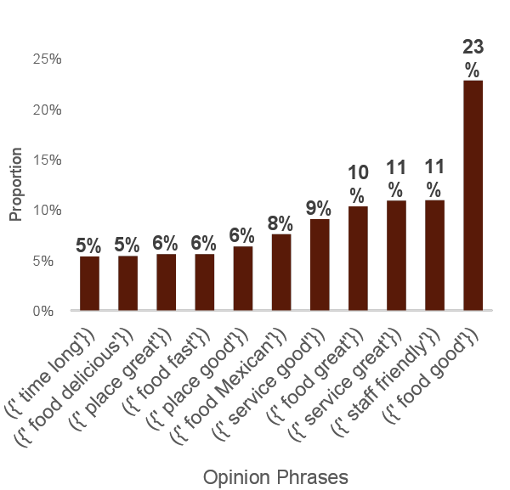
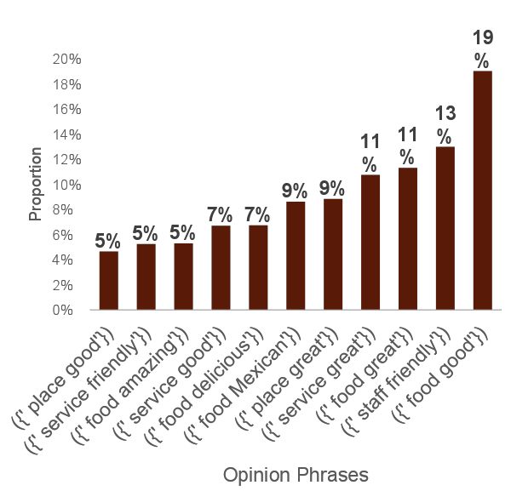
Results : Low Income
Notes:
Low Income Restaurants divided into three categories by their star ratings and found the most common opinion phrases in each category. We can see the proportion of the frequently found opinion phrases which gives us insight about the quality of the food and service of that specific group of restaurants.

Slide 16
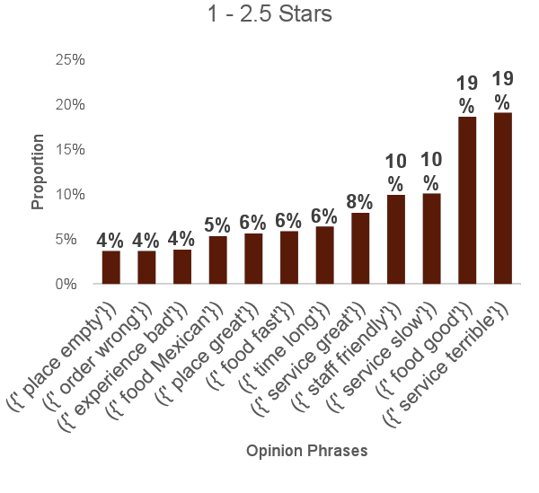
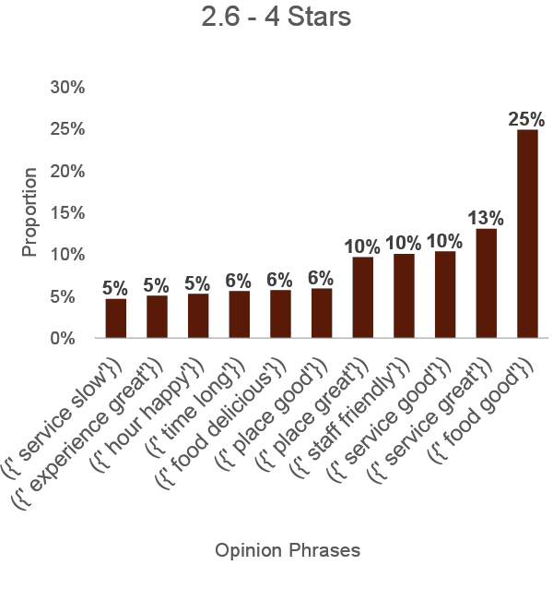
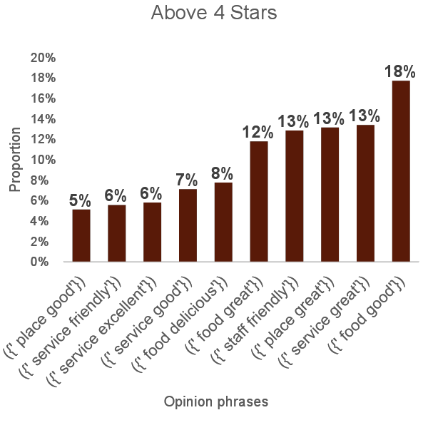
Results : Lower Middle Income
Notes:
Lower Middle Income Restaurants divided into three categories by their star ratings and found the most common opinion phrases in each category. We can see the proportion of the frequently found opinion phrases which gives us insight about the quality of the food and service of that specific group of restaurants.

Slide 17
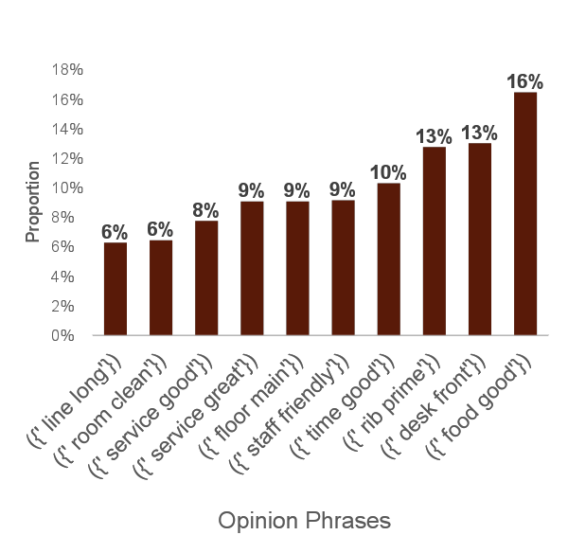
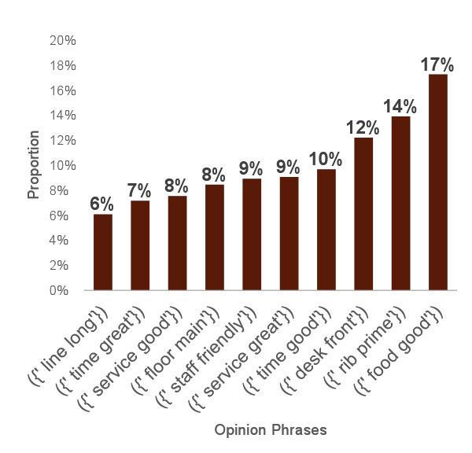
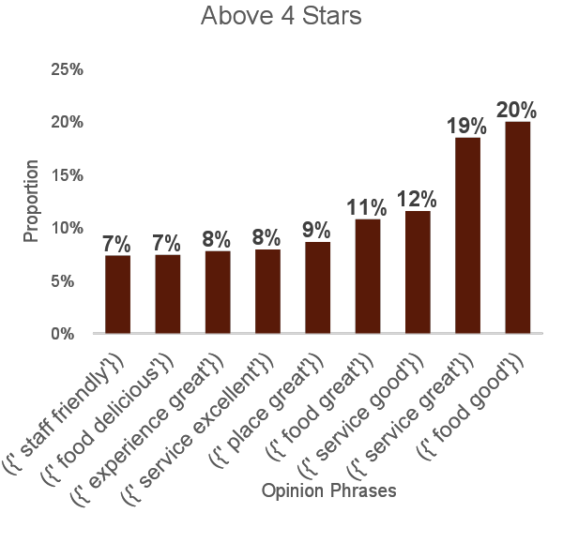
Results : Higher Middle Income
Notes:
Higher Middle Income Restaurants divided into three categories by their star ratings and found the most common opinion phrases in each category. We can see the proportion of the frequently found opinion phrases which gives us insight about the quality of the food and service of that specific group of restaurants.

Slide 18
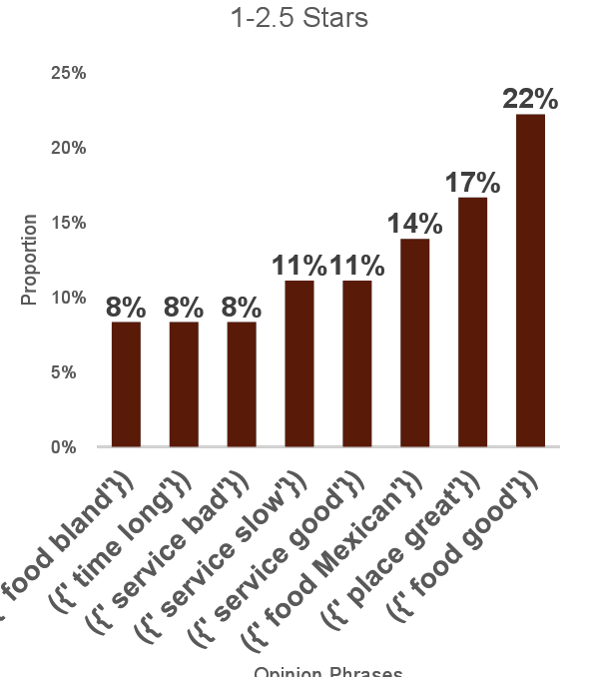
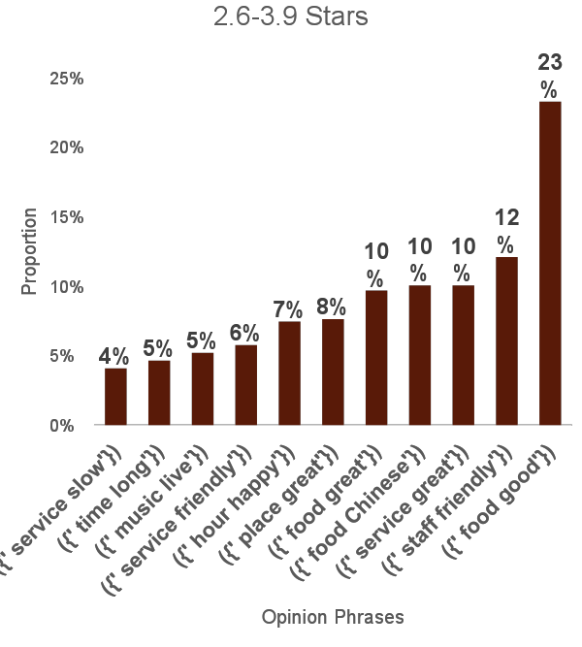
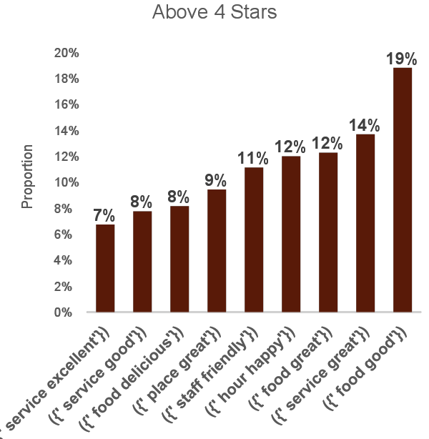
Results: High Income
Notes:
High Income Restaurants divided into three categories by their star ratings and found the most common opinion phrases in each category. We can see the proportion of the frequently found opinion phrases which gives us insight about the quality of the food and service of that specific group of restaurants.

Slide 19
Conclusion
Restaurants with lower than 3 stars also appear to have positive review patterns
(food good) appears to be the highest pattern in both high rated and low rated restaurants
All the low rated restaurant reviews have patterns about poor restaurant service ([time long] & [ service slow])
Need to look more into overall sentiment of sentences and provide weights to patterns

