Slide 1
Sandbox for Agentic Application with Cloud Native Stack
Xu Wang · Ant Group & Kata Containers
Yu Hu · Japan AI
Notes:
Timing: 0:45
Talk track:
Open with the premise: agents are useful because they can act, and that same ability creates the need for an execution boundary. Introduce yourself as a Kata Containers co-founder and frame this talk as a design plus an honest work-in-progress demo—not a finished product launch.
[Sources]
- Speaker-provided biography and project history, July 2026.
- README.md
[/Sources]

Slide 2
Agent tools need a stronger boundary
An agent can write code, invoke tools, install packages, and follow network paths.
Untrusted input · The prompt is not a trust boundary.
Useful credentials · The workload may reach data, tokens, and internal services.
Long-lived loops · A failed task can leave processes, storage, network access, and cost behind.
Execution needs an explicit security and lifecycle boundary.
Notes:
Timing: 1:45
Talk track:
Contrast an ordinary application request with an agent loop. The agent can synthesize code, pull packages, call tools, and keep trying. The problem is not that every agent is malicious; the problem is that inputs, generated code, and side effects have different trust levels. The boundary must survive mistakes and adversarial inputs.
[Sources]
- README.md
- Docs/General-Arch.md
[/Sources]

Slide 3
A sandbox is a lifecycle—not a Pod
Create → configure → execute → observe → reset → destroy
Before start · Bind identity, policy, resources, runtime, and image inputs.
During execution · Expose only the filesystem, network, credentials, and tools the task requires.
After execution · Collect evidence, remove resources, revoke access, and release capacity—even on failure.
A Pod is one object inside this lifecycle; it is not the lifecycle itself.
Notes:
Timing: 1:45
Talk track:
Define sandbox as an end-to-end lifecycle. Stress that policy attachment, readiness, evidence, reset, and deletion all matter. This is why the Kubernetes Agent Sandbox API is relevant: it gives the ecosystem a declarative object around the lifecycle rather than treating a Pod as the whole abstraction.
[Sources]
- https://agent-sandbox.sigs.k8s.io/
- Docs/General-Arch.md
[/Sources]

Slide 4
Strong isolation needs a separate kernel
SHARED-KERNEL CONTAINER
Fast startup and high density
Mature OCI and Kubernetes workflow
The host kernel remains the shared trust boundary
VM-BACKED SANDBOX
A guest kernel per sandbox boundary
Kata preserves the container workflow
Startup and memory overhead must be engineered, not ignored
Notes:
Timing: 2:00
Talk track:
Be precise: containers are not weak or obsolete; they are the right packaging and orchestration unit. For agent-generated or untrusted execution, however, a separate guest kernel changes the security boundary. Kata lets us add that boundary without abandoning the container workflow. The cost is real and must be measured.
Partner cue: Optionally summarize the shared-kernel versus guest-kernel distinction in Japanese.
[Sources]
- https://katacontainers.io/
- Docs/Minimal-Deployment-AWS.md
[/Sources]

Slide 5
Compose, do not reinvent
Control plane · runtime · images · lifecycle
Notes:
Timing: 0:20
Talk track:
Transition: no single project solves the whole sandbox problem. The proposal is to compose stable contracts and upstream projects, then make the integration reproducible.
[Sources]
- README.md
- Docs/General-Arch.md
[/Sources]

Slide 6
One stack, two planes, one security boundary
Agentic application
IMAGE PATH
OCI registry
Kubernetes Agent Sandbox API
Kubernetes scheduling · RuntimeClass · CRI
Dragonfly distribution
containerd · Nydus snapshotter
Kata runtime-rs · Dragonball VMM
Nydus lazy image
KVM / optional PVM · guest kernel boundary
Control stays declarative.
Execution crosses a VM boundary.
Notes:
Timing: 3:00
Talk track:
Walk top to bottom. Agent Sandbox is the lifecycle API. Kubernetes scheduling and RuntimeClass select the dedicated node pool and runtime. containerd keeps the CRI contract, Nydus supplies the image filesystem, Kata plus Dragonball create the VM-backed sandbox, and KVM or PVM supplies the virtualization substrate. On the right, Dragonfly and Nydus optimize how image data reaches the node. The architectural claim is composability, not a new monolith.
[Sources]
- Docs/General-Arch.md
- Docs/Minimal-Deployment-AWS.md
- https://agent-sandbox.sigs.k8s.io/
- https://katacontainers.io/
[/Sources]

Slide 7
Kubernetes stays the control plane
DESIRED STATE
Agent Sandbox · Create and manage the sandbox lifecycle declaratively.
Scheduler · Use labels, taints, tolerations, and a dedicated sandbox pool.
RuntimeClass · Select the xolis-kata handler explicitly.
NODE CONTRACT
CRI · Keep the standard Kubernetes-to-containerd contract.
containerd · Map the handler to Kata and the image path to Nydus.
Policy · Prevent ordinary workloads from bypassing the sandbox runtime.
Notes:
Timing: 2:00
Talk track:
Explain why the design keeps containerd and CRI. Kubernetes already has the control-plane contract we need. RuntimeClass selects the Kata handler; labels, taints, and tolerations prevent accidental placement; the Agent Sandbox object manages lifecycle above it. The dedicated sandbox pool is a security and operability boundary.
[Sources]
- https://kubernetes.io/blog/2016/12/container-runtime-interface-cri-in-kubernetes/
- Docs/Minimal-Deployment-AWS.md
[/Sources]

Slide 8
Kata defines the boundary; PVM widens reach
KATA + DRAGONBALL
VM-isolated execution with the container workflow
runtime-rs with an embedded VMM path
Guest kernel and root filesystem per sandbox
KVM + OPTIONAL PVM
AWS first path: native nested KVM on supported nodes
PVM is an experimental fallback when VT is not exposed
Separate AMI, node pool, RuntimeClass, and observability
Notes:
Timing: 2:00
Talk track:
Kata supplies the guest-kernel boundary while retaining Kubernetes and OCI semantics. Dragonball is the VMM path in this design. For AWS, use supported nested KVM first. PVM is not presented as automatically faster or cheaper; it is an experimental portability option when the host does not expose virtualization extensions. Keep the two pools operationally separate.
[Sources]
- https://katacontainers.io/
- Docs/PVM-AWS-Evaluation.md
- https://lpc.events/event/18/contributions/1766/
[/Sources]

Slide 9
Nydus and Dragonfly move less data, sooner
NYDUS
OCI-compatible image artifacts
Lazy, on-demand filesystem reads
containerd snapshotter integration
DRAGONFLY
Distribution, cache, and peer-to-peer delivery
Reduce repeated registry traffic at scale
Add after the minimal execution path is reproducible
Notes:
Timing: 1:45
Talk track:
Explain the latency chain: a fast VMM does not help if every sandbox must eagerly download and unpack a large image. Nydus enables on-demand reads through the containerd snapshotter. Dragonfly addresses repeated distribution at cluster scale. The minimal AWS proof of concept deliberately validates Kata and Nydus first, then adds Dragonfly when the basic path is reproducible.
[Sources]
- https://nydus.dev/
- https://d7y.io/
- Docs/Minimal-Deployment-AWS.md
[/Sources]

Slide 10
Disposability requires guaranteed cleanup
1
Plan
2
Start node
3
Bootstrap
4
Run + wait
5
Snapshot
evidence
6
Cleanup
+ stop
Success and failure converge on the same cleanup path
The current snapshot is diagnostic resource evidence—not yet a VM checkpoint.
Notes:
Timing: 2:00
Talk track:
Follow the six steps. The important branch is not visible as a separate arrow: any failure inside bootstrap, run, readiness, or evidence collection still enters cleanup and node stop. Clarify that today's snapshot is a Kubernetes resource snapshot for diagnosis, not a process, filesystem, or VM checkpoint. A true checkpoint remains future work.
[Sources]
- tools/xolis_aws_lab.py
- Docs/AWS-Lab-Tooling.md
[/Sources]

Slide 11
Xolis separates durable and disposable work
DURABLE INFRASTRUCTURE
OpenTofu · VPC, EKS, IAM, system nodes, and sandbox nodes.
State · Remote and locked before shared use.
Change control · Explicit plan, apply, and destroy.
DISPOSABLE TEST CYCLE
Python CLI · Start, bootstrap, run, observe, delete, and stop.
Evidence · Command log and Kubernetes resource snapshot.
Safety · Cleanup and node stop execute in a finally path.
Notes:
Timing: 1:30
Talk track:
Describe the deliberate tooling split. OpenTofu owns persistent cloud infrastructure and state. The Python CLI owns short-lived, imperative runtime actions and assertions. This avoids forcing dynamic test logic into infrastructure state while still making cleanup deterministic and auditable.
[Sources]
- Docs/AWS-Lab-Tooling.md
- tools/xolis_aws_lab.py
[/Sources]

Slide 12
Test: validate, benchmark, clean up
1 Validate the complete service
python3 tools/xolis_aws_lab.py --config tools/xolis_aws_lab.json service run
2 Compare cold and warm claims
python3 tools/xolis_aws_lab.py --config tools/xolis_aws_lab.json benchmark run --iterations 3
Measured once in Tokyo · Ready: 25.5 s cold → 1.4 s warm
Directional only · One sample per mode is not an SLA.
Watch: node → service → claim → command → cleanup → scale-to-zero
Notes:
Timing: 4:30
Talk track:
Run the dry-run first so the audience can see the complete intended sequence without AWS credentials or manifests. If the live environment is available, run cycle run and narrate node scale-up, kubeconfig, bootstrap, workload readiness, evidence collection, deletion, and scale-to-zero. If the live path is unavailable, the dry-run remains a valid demonstration of the orchestration contract and failure-safe order.
Partner cue: Optionally narrate the live command output in Japanese while the primary speaker explains the lifecycle in English.
[Sources]
- Docs/Project-Status-and-Roadmap.md, status and roadmap as of 2026-07-27.
- tools/README.md and Docs/AWS-Lab-Tooling.md, command syntax.
[/Sources]

Slide 13
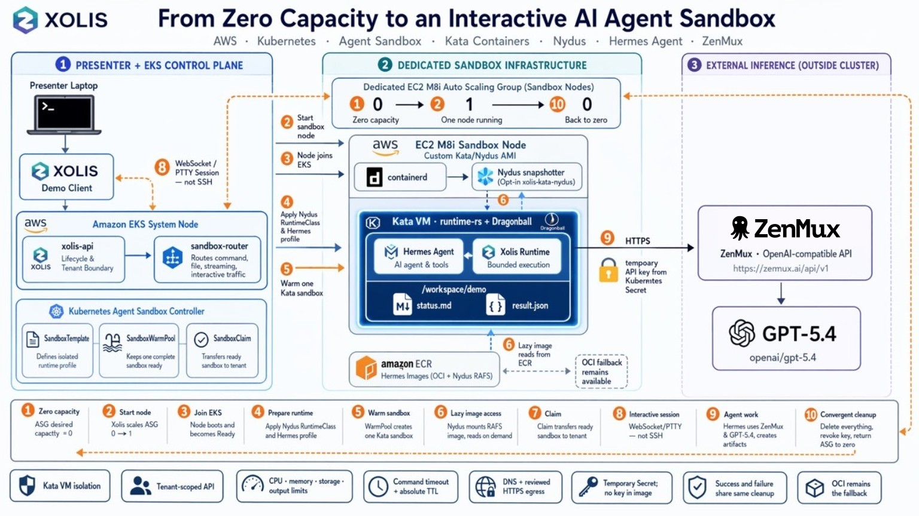
Demo: Run an Agent in the Sandbox

Slide 14
The MVP works; now measure it
VALIDATED NOW
Agent Sandbox v0.5.3 service
Kata + Dragonball on EKS M8i
Acceptance and cleanup automation
Ready: 25.5 s cold; 1.4 s warm (n=1)
NEXT, IN ORDER
20–30 runs; report p50 / p95 / p99
Compare Nydus with stable OCI
Add OIDC, quotas, audit, and ingress
Stream output; then automate capacity
Notes:
Timing: 1:30
Talk track:
State the implementation boundary plainly. The repository contains the architecture, AWS deployment design, orchestration tool, dry-run behavior, and offline tests. It does not yet contain the full EKS modules, custom AMI pipeline, version-pinned runtime manifests, a real checkpoint implementation, or benchmark results. Invite the audience to judge the design by reproducible evidence as those pieces land.
[Sources]
- Docs/Project-Status-and-Roadmap.md, status and roadmap as of 2026-07-27.
- tools/README.md and Docs/AWS-Lab-Tooling.md, command syntax.
[/Sources]

Slide 15
A decade of upstream work converges here
CRI
Kata · 2017
IMAGE
PATH
PVM
Xolis
Container runtime
contract
VM isolation,
container workflow
Dragonfly distribution
+ Nydus lazy loading
Virtualization where
nested VT is constrained
Compose, validate,
contribute upstream
The contribution is integration discipline—not another private runtime stack.
Notes:
Timing: 2:00
Talk track:
Use this slide to establish continuity, not nostalgia. Your teams worked on the original CRI implementation, announced Kata Containers with Intel and the OpenInfra Foundation in 2017, contributed Nydus and PVM, and maintain Dragonfly. The new problem is to compose those upstream capabilities around the agent sandbox lifecycle. Xolis is the integration and validation layer.
[Sources]
- Speaker-provided biography and project history, July 2026.
- https://katacontainers.io/
- https://d7y.io/
- https://nydus.dev/
- https://lpc.events/event/18/contributions/1766/
[/Sources]

Slide 16
Build upstream first; measure every boundary
DESIGN PRINCIPLES
Upstream projects before private forks
Replaceable layers with standard contracts
Dedicated runtime pools with explicit policy
Cleanup is part of correctness
CONTRIBUTE THE MISSING PROOF
Run repeated cold and warm baselines
Measure reliability, density, and cost
Publish results and fixes upstream
Notes:
Timing: 1:30
Talk track:
Close the design section with contribution criteria. Prefer upstream contracts, keep layers replaceable, isolate special runtime capacity, and treat cleanup as correctness. The highest-value contributions now are deployable modules, version-pinned manifests, runtime qualification, and measurements that compare startup, density, reliability, and total cost.
[Sources]
- Docs/Project-Status-and-Roadmap.md, status and roadmap as of 2026-07-27.
- tools/README.md and Docs/AWS-Lab-Tooling.md, command syntax.
[/Sources]

Slide 17
Secure agents by composing proven cloud native boundaries
github.com/gnawux/xolis · Q&A
Notes:
Timing: 1:45
Talk track:
Resolve the opening: agentic applications need stronger execution boundaries, but the cloud-native ecosystem already contains most of the required primitives. The work is to compose, validate, measure, and upstream the missing integration. Invite questions and contributors at the repository URL.
Partner cue: Optionally give a short Japanese recap and invite Japanese-language questions.
[Sources]
- https://github.com/gnawux/xolis
- README.md
[/Sources]

