Slide 1
mushroom classification program
Instructor:pinsky
Xiaoyang wang
gnayoaix@bu.edu

Slide 2
index
1. summary of project
2. description of dataset
3. description of approaches
4. How to run
5. result
6. conclusion

Slide 3
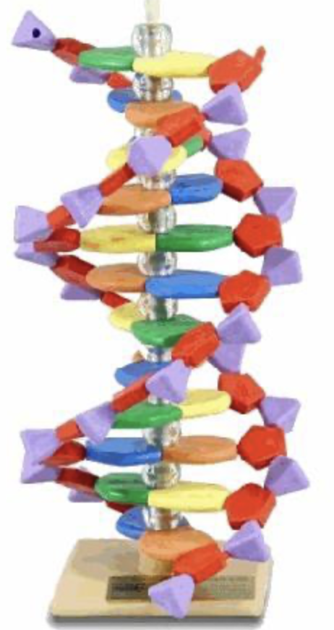
summary
My project is mushroom classification. In my project , there are about 2 categories (edible or poisonous) and 8124 records (52% edible and 48% poisonous).
For my project, I have tried three machine learning models:
SVM , Random forest and logistic regression.
All three models have good performances:
Compare recall, precision, f1-score for both class
F1_score > 95%
Accuracy > 95%

Slide 4
Description of dataset
This dataset includes descriptions of hypothetical samples corresponding to 23 species of gilled mushrooms in the Agaricus and Lepiota Family Mushroom drawn from The Audubon Society Field Guide to North American Mushrooms (1981).
Each species is identified as definitely edible, definitely poisonous, or of unknown edibility and not recommended. This latter class was combined with the poisonous one. The Guide clearly states that there is no simple rule for determining the edibility of a mushroom; no rule like "leaflets three, let it be'' for Poisonous Oak and Ivy.

Slide 5
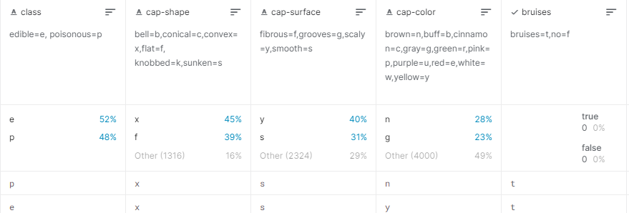
Description of dataset
Attribute Information: (classes: edible=e, poisonous=p)
cap-shape: bell=b,conical=c,convex=x,flat=f, knobbed=k,sunken=s
cap-surface: fibrous=f,grooves=g,scaly=y,smooth=s
cap-color: brown=n,buff=b,cinnamon=c,gray=g,green=r,pink=p,purple=u,red=e,white=w,yellow=y
bruises: bruises=t,no=f
odor: almond=a,anise=l,creosote=c,fishy=y,foul=f,musty=m,none=n,pungent=p,spicy=s
gill-attachment: attached=a,descending=d,free=f,notched=n
gill-spacing: close=c,crowded=w,distant=d
gill-size: broad=b,narrow=n

Slide 6
Description of dataset
gill-color: black=k,brown=n,buff=b,chocolate=h,gray=g, green=r,orange=o,pink=p,purple=u,red=e,white=w,yellow=y
stalk-shape: enlarging=e,tapering=t
stalk-root: bulbous=b,club=c,cup=u,equal=e,rhizomorphs=z,rooted=r,missing=?
stalk-surface-above-ring: fibrous=f,scaly=y,silky=k,smooth=s
stalk-surface-below-ring: fibrous=f,scaly=y,silky=k,smooth=s
stalk-color-above-ring: brown=n,buff=b,cinnamon=c,gray=g,orange=o,pink=p,red=e,white=w,yellow=y
stalk-color-below-ring: brown=n,buff=b,cinnamon=c,gray=g,orange=o,pink=p,red=e,white=w,yellow=y
veil-type: partial=p,universal=u
veil-color: brown=n,orange=o,white=w,yellow=y
ring-number: none=n,one=o,two=t
ring-type: cobwebby=c,evanescent=e,flaring=f,large=l,none=n,pendant=p,sheathing=s,zone=z
spore-print-color: black=k,brown=n,buff=b,chocolate=h,green=r,orange=o,purple=u,white=w,yellow=y
population: abundant=a,clustered=c,numerous=n,scattered=s,several=v,solitary=y
habitat: grasses=g,leaves=l,meadows=m,paths=p,urban=u,waste=w,woods=d

Slide 7
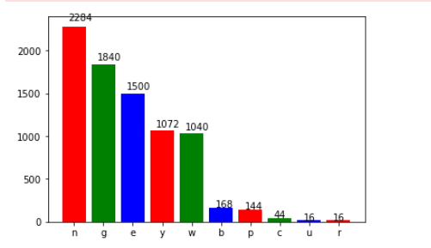
Description of dataset
Attributes :
cap-color: brown=n,buff=b,cinnamon=c,gray=g,green=r,pink=p,purple=u,red=e,white=w,yellow=y

Slide 8
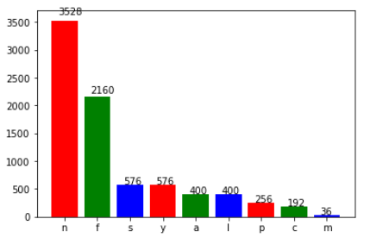
Description of dataset
Attributes :
Odor:
almond=a,anise=l,creosote=c,fishy=y,foul=f,musty=m,none=n,pungent=p,spicy=s

Slide 9
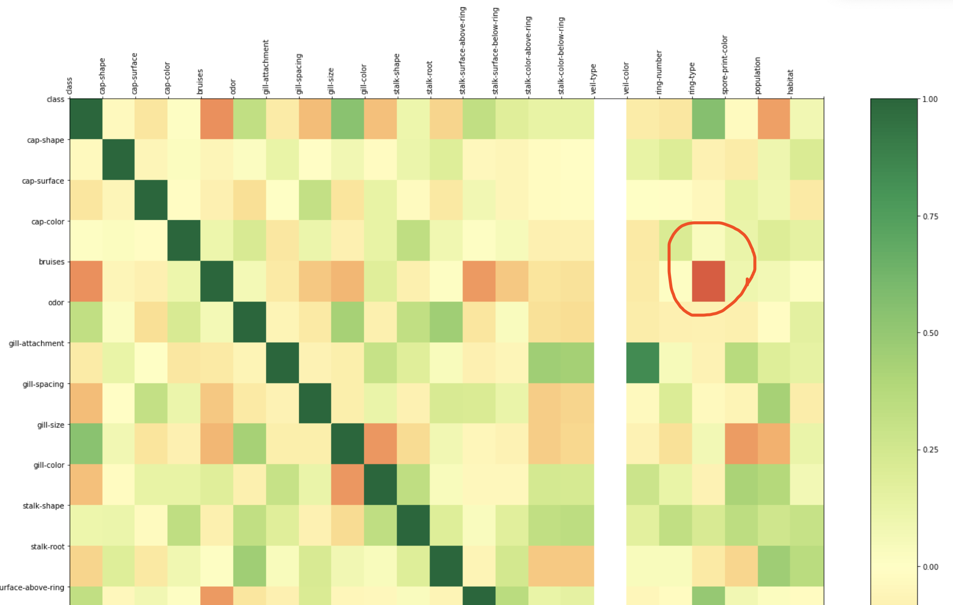
Description of dataset
Correlation metrix:
Bruises and ring-number
Remove bruises

Slide 10
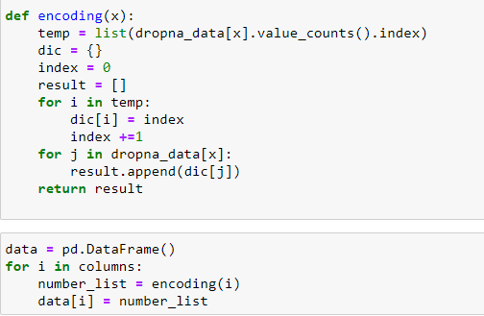
approaches
Data pre-processing :
drop Nan values:
Encoding features :

Slide 11

approaches
Data pre-processing : drop Nan values ; encoding features .
Text transform : from raw features to label – data :

Slide 12
approaches
Data pre-processing : drop Nan values ; encoding features .
Text transform : from raw features to label – data :
PCA: reduce dimensions, as some features are useless

Slide 13
approaches
Data pre-processing : drop Nan values ; encoding features .
Text transform : from raw features to label – data :
PCA: reduce dimensions, as some features are useless
Implement three models: SVM, Random forest and logistic regression:

Slide 14
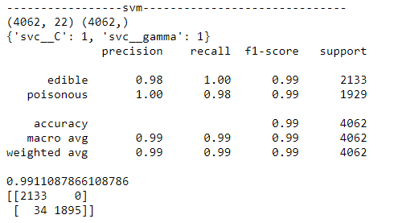
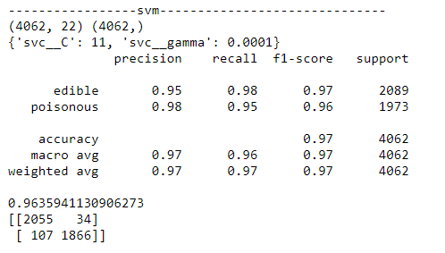
results
1.SVM:

Slide 15
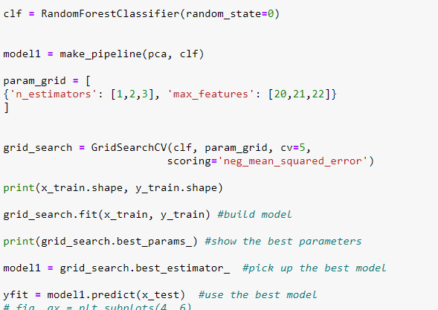
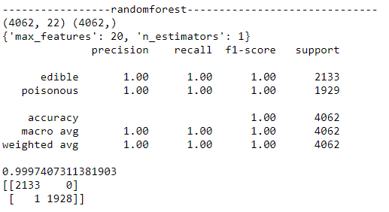
results
2. Random forest:

Slide 16
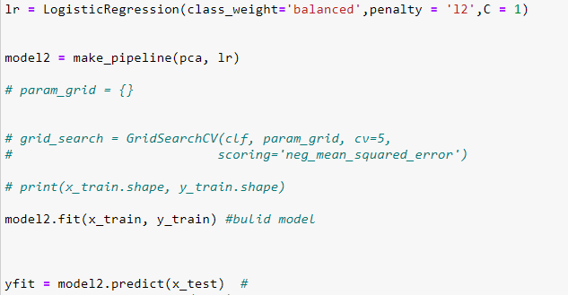
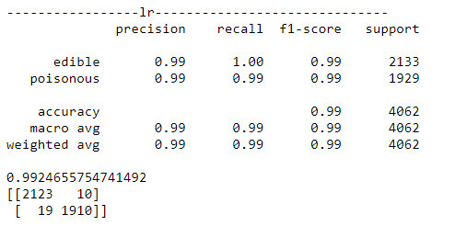
results
3. Logistic regression:

Slide 17
conclusion
Random forest has the best performance above three models.it shows in binary classification, with many features like 20,30,the best choice is Random forest:
It can handle thousands of input variables without variable deletion
It gives estimates of what variables are important in the classification
It generates an internal unbiased estimate of the generalization error as the forest building progresses
….

Slide 18
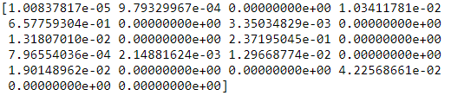
conclusion
Random forest gets the importance of features:
So the 5th, 11th ,20th are the most important ,which are gill-attachment , stalk-surface-above-ring and population

Slide 19
conclusion
Random forest has the best performance above three models.it shows in binary classification, with many features like 20,30,the best choice is Random forest.
In case of balanced and better performance, it is better to keep balanced ratios in each categories when using data to train model.
class_weight :dict or ‘balanced’, default=NoneSet the parameter C of class i to class_weight[i]*C for SVC. If not given, all classes are supposed to have weight one. The “balanced” mode uses the values of y to automatically adjust weights inversely proportional to class frequencies in the input data as n_samples / (n_classes * np.bincount(y))

Slide 20
conclusion
Random forest has the best performance above three models.it shows in binary classification, with many features like 20,30,the best choice is Random forest.
In case of balanced and better performance, it is better to keep balanced ratios in each categories when using data to train model.
Parameters have great contributions to F1-score and accuracy , epically in SVM

Slide 21

conclusion
For example :
When setting:
I get results:

Slide 22

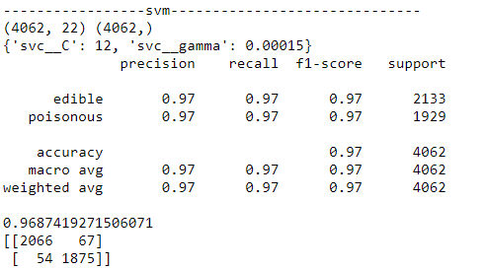
conclusion
However :
When setting:
I get results:

