Slide 1

The DriverPass System
Noelle Bishop – CS-255 – Final Project PPT
Notes:
Today I’ll be talking through the main points in our software development plan for DriverPass. This will give you a chance to see how we’ve turned your vision into a design and give us some feedback.

Slide 2
System Requirements
Functional
Student: Book packages, see driver comments, take course, take quiz
Driver: Input comments
Secretary: Manage student accounts and appointments
IT officer: Reset student passwords
Owner: Download data report, perform any other actions
Nonfunctional
Web-based
Uses cloud services
Tracks record changes by edits and users
Notifies admin of appointments, DMV updates, and security issues
Differs access for user roles (admin, student)
Notes:
First, we have the requirements, or what the software needs to accomplish. Functional requirements refer to what the software will do for its users. You can see each type of user is listed with the actions they take. The student can book a package, see comments from their driver, and so on. The owner can download data reports and perform any other action, since they have full access to the software. Below, in green, you see “nonfunctional” requirements. This means qualities the software needs to be successful aside from handling users. We know the software is a website, so it has to be web-based with all the steps necessary to make that work. It will also use cloud services, which will cover a lot of other ground, like handling large numbers of users at once. As requested, it will track changes made to data by who changed it and what they edited, notify the owner, IT officer, and secretary with updates like DMV changes or a password reset request, and manage access to the software by using different roles. The owner will have a full clearance role, meaning they can do anything anyone else can do, while the student will have a role based on the package they purchase, only allowing them to access the course and practice test if they purchased Package 3.

Slide 3
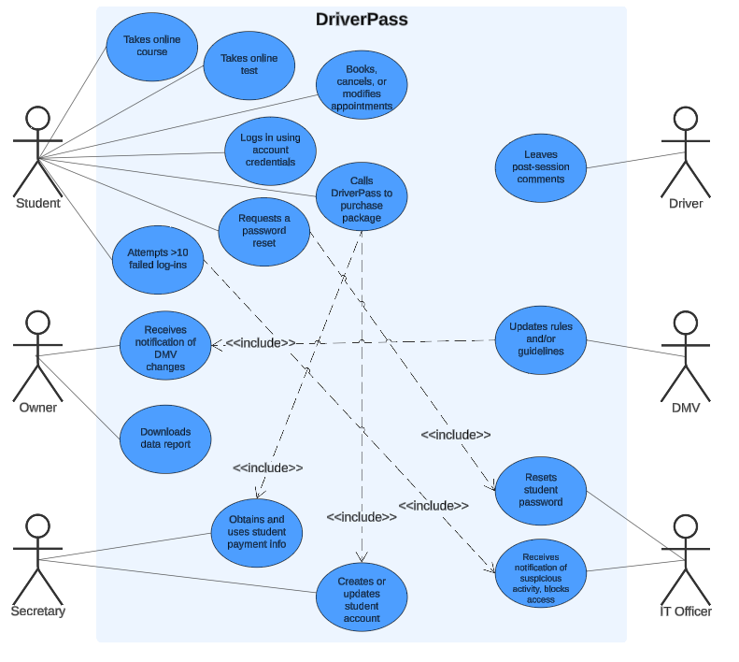
Use Case Diagram
Notes:
Here we have a “use case” diagram. The light blue rectangle labeled DriverPass represents the system, while the stick figures around it are the “actors” or entities interacting with DriverPass. Each blue circle is a use case or an action that each entity can perform when using the software. We can see that the Student stick figure has the most blue bubbles of text—this means the student performs the most actions with the system, like taking the online course, logging in, or modifying appointments.. You’ll notice some actions have a dotted arrow that says “include” as it points to something else. This implies that the action it points to can’t really be completed without the first one. Take a look at the student’s action, “Requests a password reset”. It points to the IT Officer’s action, “Resets student password”. Since there’s no need for the IT officer to reset a password without a request, this action is dependent on the request. Some people or entities, like the driver and DMV, don’t interact with the system much, but they’re still key players. Since it’s so important for the owner to be updated of any DMV guideline changes, the DMV is an entity that interacts with the software. The owner receives notice only if the related DMV pages update, shown here as one of the owner’s tasks.

Slide 4
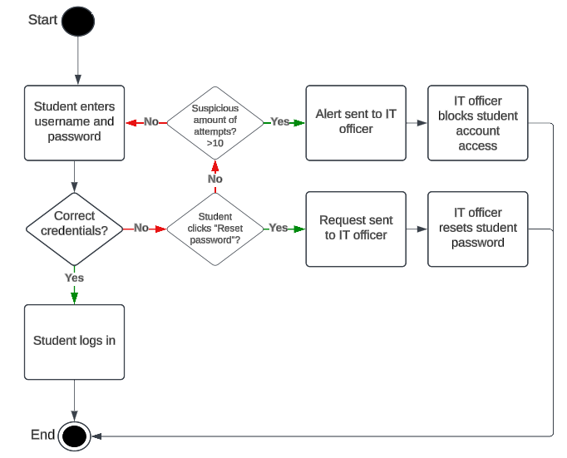
Activity Diagram: Password Alerts
Notes:
Next, we have another kind of diagram to depict an aspect the system visually. This “activity” diagram shows one of the use cases we just looked at in action: the student’s password reset request. This kind of diagram flows in an easy-to-follow way, beginning at the circle labeled “Start” and following the arrows all the way to “End”. Each rectangle represents a process, and each diamond is a decision point. Depending on the outcome of a decision, only one arrow is followed. This diagram begins with the student entering their login information and reaches the first decision point: did the student enter their correct credentials? If so, they log in, and the process ends. If not, then the next decision point asks, did the student request a password reset? If so, the request alert is sent to the IT officer, who resets the student’s password, and the process ends. Conversely, if the student did not request a password reset and simply mis-typed their login information, they can try re-entering their username and password. If they go through this loop entering the wrong password more than 10 times, a suspicious activity alert is sent to the IT officer who then temporarily blocks the student’s account access, and the process ends. While this diagram doesn’t cover all the ins and outs of making this happen, it touches on the main steps each person takes.

Slide 5
Security
Username/password log-in for all users
Role-based access control (RBAC)
HTTPS for encryption
Ability to block access for compromised accounts
Automatic detection of suspicious behavior
Notes:
Security is foundational to any software, and it’s especially important to consider for a web-based platform with different types of users. To start, each person’s account will be secured with a username and password, and the website will prompt users to make reasonably long passwords with a mix of letters, numbers, and special characters—this makes them harder to crack. Next, something called role-based access control will be used to manage user privileges, and it’s exactly like it sounds. The student will have a role related to the package they select—only if they select package three will they be able to view the course and practice test. The secretary, IT officer, and owner will have admin roles that allow them to manage students’ account information and perform other behind-the-scenes actions. Next, HTTPS will be used to secure the website. This is a staple for any web-based system, and it works by encrypting data flow, making it harder for that data to be compromised. If you’ve ever noticed a little padlock symbol to the left of your web browser’s address bar, that means the site is secured by HTTPS. Next, the IT Officer will have the ability to block access to potentially compromised accounts upon receiving suspicious activity alerts. Suspicious activity might be a student attempting to log in over 10 times or large amounts of data being removed or edited at once. By the way, since the software uses cloud services, data will be backed up, so even if something like that happens, it can be fixed.

Slide 6
System Limitations
Requirements may change
Unclear budget
Desktop and mobile development by deadline
Admin must be automatically notified of DMV updates
Notes:
Any project has its limitations. We’ve narrowed down four key ones to go over. First, the requirements may change. In our interview, there were some additional features you were hoping for that we said wouldn’t be feasible in the time frame or without long term maintenance. You may decide you need these features after all, or, after this presentation, you may have some feedback for how some requirements could be tweaked. Either way, this means a re-planning of some of the system’s features, which can impact the speed and expenses of the project. That leads to the next limitation: an unclear budget. If your budget is open to whatever the project needs, then this isn’t really a limitation, but if you do have a budget in mind, it’s important that we know as soon as possible. This way, we can figure out how much the project will realistically cost to produce and if that price is acceptable. Next, we discussed the possibility of being able to use the system on desktop and mobile devices. While this isn’t impossible, it may prove to be too much to complete by the deadline, or the mobile version may be a worse version of the desktop version rather than an equal. Since desktop and mobile development come with their own tasks and tools, it may make more sense to complete the desktop version first then schedule another project for mobile development. Lastly, it’s unclear exactly how admin will be updated when the DMV updates its rules and guidelines. The team is considering setting up some kind of web-scraping system for use on relevant DMV pages, but it’s something we’re still researching. This concludes the design plan presentation, so, please, feel free to share your thoughts on what looks good and what might need editing.

