Slide 1


Green Pace
Security Policy Presentation
Developer: Noelle Bishop

Slide 2

OVERVIEW: DEFENSE IN DEPTH

Slide 3
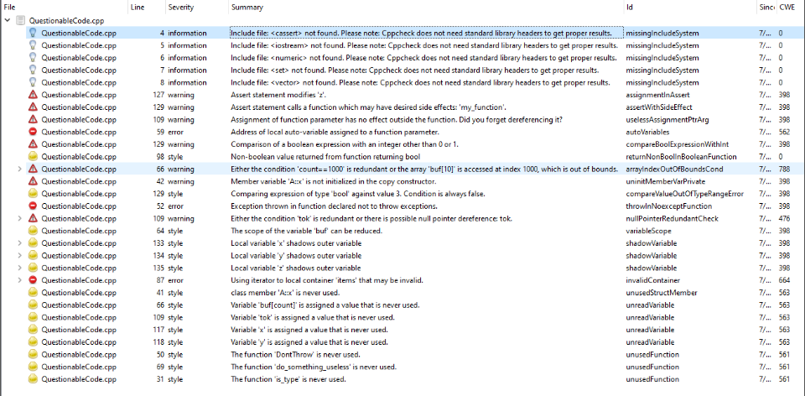
THREATS MATRIX
Likely Data Value String Correctness SQL Injection Memory Protection Exceptions Buffer Overflow Encapsulation Pointers | Priority Data Value String Correctness SQL Injection Memory Protection Exceptions Buffer Overflow Encapsulation Pointers
Low priority Data Type Assertions | Unlikely Data Type Assertions

Slide 4
10 PRINCIPLES
Principles (Seacord & Schiela, 2018) | Associated Coding Standards
1. Adopt a Secure Coding Standard | STD-005-CPP (Memory Protection) STD-007-CPP (Exceptions)
2. Architect and Design for Security Policies | STD-005-CPP (Memory Protection) STD-006-CPP (Assertions) STD-007-CPP (Exceptions)
3. Keep It Simple | STD-001-CPP (Data Type) STD-010-CPP (Pointers)
4. Validate Input Data | STD-003-CPP (String Correctness) STD-004-CPP (SQL Injection)
5. Sanitize Data Sent to Other Systems | STD-003-CPP (String Correctness) STD-004-CPP (SQL Injection)
6. Heed Compiler Warnings | STD-002-CPP (Data Value) STD-008-CPP (Buffer Overflow)
7. Default Deny | STD-009-CPP (Encapsulation)
8. Adhere to the Principle of Least Privilege | STD-004-CPP (SQL Injection) STD-009-CPP (Encapsulation)
9. Use Effective Quality Assurance Techniques | STD-006-CPP (Assertions) STD-008-CPP (Buffer Overflow)
10. Practice Defense in Depth | STD-007-CPP (Exceptions)

Slide 5
CODING STANDARDS
Standards (Priority Ordered) | Vulnerabilities/Risks
1. Buffer Overflow | Memory leak, data loss, undefined behavior
2. SQL Injection | Data breach, system breach
3. Memory Protection | Undefined behavior, memory leak (AdaBeat, n.d.)
4. String Correctness | Injection, subsystem damage, data breach
5. Encapsulation | Data loss
6. Data Value | Buffer underflow, buffer overflow
7. Exceptions | Revealing error messages, system failure
8. Pointers | Undefined behavior (Geeks for Geeks, 2025b)
9. Data Type | Buffer underflow, buffer overflow, data loss
10. Assertions | Errors late in the SDLC, hard-to-find bugs

Slide 6
ENCRYPTION POLICIES
Encryption Type | Policy
At rest | The encryption algorithm AES-256 will be used to encrypt data at rest, such as database records not in use.
In flight | Web and email communications will be protected by HTTPS, which effectively combines the utility of HTTP and the security of TLS to authorize users via certificates.
In use | Homomorphic encryption will be used to obscure plain text as it’s in use by a user and the software.
Information provided by Lupsan (2022).

Slide 7
TRIPLE-A POLICIES
Triple A Component | Policy (Summarized)
Authentication | Careful login information management by users and system Strong passwords without easily identifiable details Multi-factor authentication (MFA) via phone, email, or app
Authorization | Role-based access control with principle of least privilege Logical role designation upon user creation
Accounting | Queries or changes to database will be linked to specific users File access will be linked to specific users
Information provided by Fortinet (2025).

Slide 8
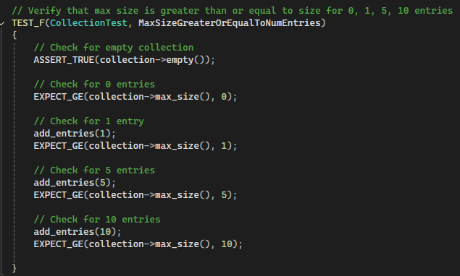
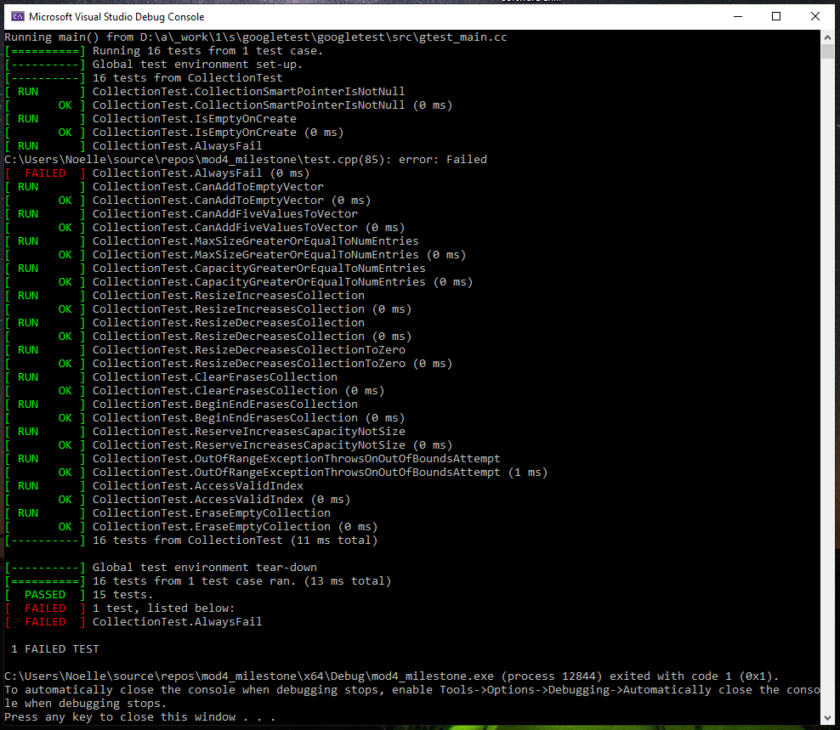
Unit Testing – Is the vector being resized properly?
Vulnerability: Failed vector operations from resizing error, possible overflow
Unit testing framework supplied by GoogleTest (n.d.).

Slide 9
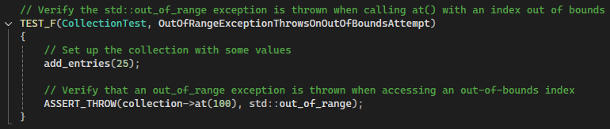
Unit Testing – Does out-of-bounds access throw an exception?
Vulnerability: Buffer overflow from out-of-bounds vector access

Slide 10
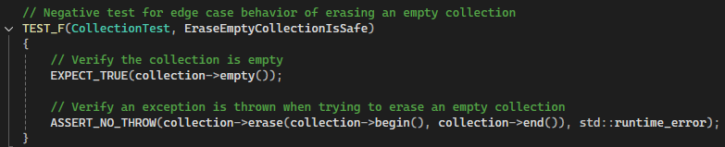
Unit Testing – Is erasing an empty vector safe?
Vulnerability: Undefined behavior from an edge case

Slide 11
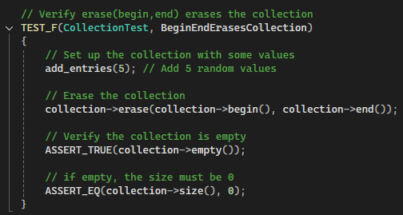
Unit Testing – Does erase() clear the vector and is its size reset?
Vulnerability: Using more memory than intended if erase() fails

Slide 12

AUTOMATION SUMMARY
Information provided by Geeks for Geeks (2025a).

Slide 13
TOOLS
DevSecOps: Continuous integration/Continuous delivery + security (Geeks for Geeks, 2025)
Automation tools are used in pre-production and production
Build
Verify and Test
Transition and health check (deploy)
Maintain and stabilize

Slide 14
RISKS AND BENEFITS
Acting Now vs. Waiting
Preventative measures now = less damage control later
Errors caught sooner in SDLC, easier to fix
Easier to implement tests early and build from there
Steps for Preventative Security:
Adopt DevSecOps model
Familiarize with coding standards
Apply defense in depth
Research past breaches, common vulnerabilities
Test early and often
Employ quality assurance staff and measures
Write human readable comments

Slide 15
RECOMMENDATIONS
Existing security policy is not a catch-all
More non-compliant and compliant code examples
More SEI standards matched to overarching topics
Decide on tools for each standard

Slide 16
CONCLUSIONS
Defense in depth starts with awareness, secure coding culture (Hancock, 2025)
Regular evaluation of policy and risks (Henry, 2022)
Comprehensive automation tools recommended:
CppCheck
Polyspace Bug Finder
Astrée
CodeSonar
Clang
SEI standards to adopt for future vulnerability prevention:
EXPO8-C. Ensure pointer arithmetic is used correctly. (Pointers) (Tucker & Svoboda, 2025)
MSC14-C. Do not introduce unnecessary platform dependencies. (Data Type) (Seacord & Britton, 2025)

Slide 17
REFERENCES
AdaBeat. (n.d.). How memory leaks leave the door open for hackers and how Functional Programming can remedy that. Retrieved August 14, 2025, from https://adabeat.com/insight/how-memory-leaks-leave-the-door-open-for-hackers-and-how-functional-programming-can-remedy-that/
Fortinet. (2025). What is authentication, authorization, and accounting (AAA) security? https://www.fortinet.com/resources/cyberglossary/aaa-security
Geeks for Geeks. (2025a, August 2). DevOps tutorial. https://www.geeksforgeeks.org/devops/devops-tutorial/
Geeks for Geeks. (2025b, January 10). Dangling, void, null, and wild pointers in C. https://www.geeksforgeeks.org/c/dangling-void-null-wild-pointers/
GoogleTest. (n.d.). Testing reference. Retrieved August 14, 2025, from https://google.github.io/googletest/reference/testing.html
Hancock, G. (2025, May 2). How to develop an effective cybersecurity strategy. PurpleSec. https://purplesec.us/learn/cybersecurity-strategy/
Henry, E. (2022, January 6). How to create an effective cybersecurity policy. Cyber Management Alliance. https://www.cm-alliance.com/cybersecurity-blog/how-to-create-an-effective-cybersecurity-policy
Lupsan, S. (2022, August 9). Types of encryption for in motion, in use, at rest data. Cyscale. https://cyscale.com/blog/types-of-encryption/
Seacord, R. & Britton, J. MSC14-C. Do not introduce unnecessary platform dependencies. Software Engineering Institute. https://wiki.sei.cmu.edu/confluence/display/c/MSC14-C.+Do+not+introduce+unnecessary+platform+dependencies
Seacord, R. & Schiela, R. (2018, May 2). Top 10 secure coding practices. Software Engineering Institute. https://wiki.sei.cmu.edu/confluence/display/seccode/Top%2B10%2BSecure%2BCoding%2BPractices
Tucker, B. & Svoboda, D. EXP08-C. Ensure pointer arithmetic is used correctly. Software Engineering Institute. https://wiki.sei.cmu.edu/confluence/display/c/EXP08-C.+Ensure+pointer+arithmetic+is+used+correctly

