Slide 1
Release Management System
High-Level Design, Existing Flow & Functional Explanation
Create
Prepare
Validate
Activate
Assign
Test
A controlled gate from release creation through binary readiness and test preparation

Slide 2
Presentation Objectives
What this design explains
Business / Functional View
Technical / Design View
• What happens when a release is created
• How the release folder is prepared
• How Development Manager is notified
• How DLL availability is checked
• When and why a release becomes Active
• How Test Manager uses the active release
• Release lifecycle and state transitions
• Application and service responsibilities
• File-system / network-share interaction
• Release-to-DLL-to-test traceability
• Role-based responsibilities
• Configuration and environment considerations
2

Slide 3
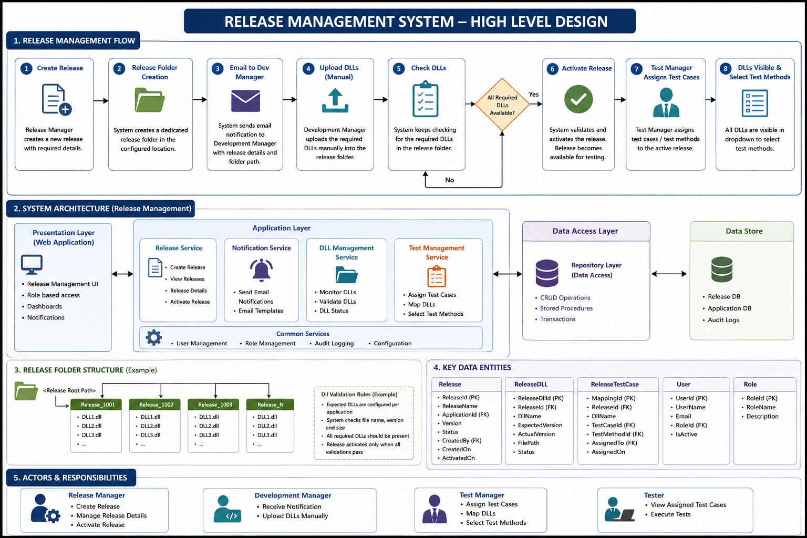
End-to-End Release Management Flow
One view of the complete process
3

Slide 4
Release Lifecycle — Detailed Explanation
The release progresses through controlled gates
1
Create
2
Prepare
3
Notify
4
Upload
Release Manager creates the release with required business and technical details.
System persists release data and creates a dedicated release folder.
System sends an email to the Development Manager with release/folder information.
Development Manager manually uploads required DLLs into the release folder.
5
Validate
6
Activate
7
Assign
8
Execute
System checks the release folder against the expected DLL set.
When validation succeeds, the release is activated and becomes test-ready.
Test Manager assigns test cases and maps DLLs/test methods.
Tester executes the assigned test methods.
Core Gate
• A release should not become available for testing until the required DLL set has been successfully validated.
4

Slide 5
1. Create Release
Release creation establishes the master release context
1
Enter Release Details
2
Save Release
3
Create Folder
Release Manager provides application, version, release information and other configured attributes.
Application persists the release and assigns its initial lifecycle status.
A dedicated physical release location is created for the release.
Release Data
Why the Release Record Matters
• Release identifier / release name
• Application
• Version
• Environment / target configuration
• Description
• Created By / Created On
• Status
• Provides the master key for downstream DLL and test relationships
• Controls lifecycle state
• Supports traceability and audit
• Connects logical release data with the physical release folder
5

Slide 6
2. Release Folder Creation
The logical release is paired with a physical file location
Folder Responsibilities
Example release folder structure
• Create one dedicated location per release
• Keep binaries isolated between releases
• Provide a predictable location for manual DLL upload
• Allow the system to inspect the release contents
• Support release-specific validation
📁 Release Root
📁 Release_1001
• DLL1.dll
• DLL2.dll
• DLL3.dll
📁 Release_1002
• DLL1.dll
• DLL2.dll
6

Slide 7
3. Development Manager Notification & DLL Upload
The hand-off from release preparation to development
1
Release Ready for Upload
2
Email Notification
3
Manual Upload
4
Files Available
System knows the release and folder location.
Development Manager receives release details and required action.
Required DLLs are copied into the release folder.
DLLs are physically present for validation.
Notification Should Communicate
Current Operational Dependency
• Release name / version
• Application
• Release folder path
• Expected action: upload required DLLs
• Any release-specific instructions
• Development Manager performs the physical DLL upload
• The system relies on the configured release folder
• The validation stage determines when the upload is complete
7

Slide 8
4. DLL Validation & Monitoring
The readiness gate before activation
1
Load Expected DLLs
2
Inspect Folder
3
Compare
All required DLLs available?
Determine which DLLs are required for the release/application.
Read the configured release folder.
Check required DLLs against actual files.
When the Answer is NO
When the Answer is YES
• Release remains pending / waiting
• System continues checking according to the configured process
• Release must not be promoted to testing readiness
• Required DLL set is complete
• Release passes the readiness gate
• Release becomes eligible for activation
8

Slide 9
5. Release Activation
Activation is the controlled transition into test readiness
Created
Waiting for DLLs
Validated
Active
Activation Preconditions
Post-Activation Meaning
• Required DLLs are present
• Applicable validation rules pass
• Release is in a state eligible for activation
• Authorized release action is performed
• Release is Active
• Release is available to testing workflow
• Test Manager can select release-specific DLLs
• Lifecycle and audit state can be tracked
9

Slide 10
6. Test Manager — Test Case Assignment
Testing begins with the active release context
1
Open Active Release
2
View DLLs
3
Select Test Case
4
Select Test Method
5
Assign
Select the release that has passed activation.
Only the release's available DLL context is presented.
Choose the required test case(s).
Map the relevant test method to the DLL.
Persist the assignment for execution.
Release
DLL
Test Method
Release_1001 ▼
Application.Core.dll ▼
ValidateApplication() ▼
The important relationship is: Active Release → DLL → Test Case → Test Method → Assigned Tester
10

Slide 11
High-Level System Architecture
Logical view of the Release Management solution
Actors
Release Management Application
External Integrations
• Release Manager
• Development Manager
• Test Manager
• Tester
• Email Server
• File System / Network Share
Release Management
Notification
DLL Management
Test Management
Create / view / activate
Email
Check / validate
Assign / map
Common Services
Data Stores
Security / Roles • Audit • Configuration • Shared utilities
• Release / Application DB
• Audit / operational data
11

Slide 12
Component Responsibilities
What each logical component owns
Release Management
Notification
DLL Management
Test Management
• Create release
• Store release metadata
• View release details
• Manage lifecycle status
• Initiate / perform activation
• Build release notification
• Identify Development Manager
• Send email
• Include release and folder information
• Identify expected DLLs
• Inspect release folder
• Check availability
• Validate status/version where applicable
• Expose DLL state
• Load active release
• Present available DLLs
• Map test cases
• Select test methods
• Assign test work
12

Slide 13
Key Data Relationships
Traceability across the release lifecycle
Application
Environment
Release
Release DLL
Release Test
• ApplicationId
• Name
• Configuration
• EnvironmentId
• Name
• Path / settings
• ReleaseId
• Version
• Status
• DLL Name
• Expected / Actual
• Status
• Test Case
• Test Method
• Assigned To
Traceability Chain
• Application + Environment → Release → Release DLLs → Test Cases / Test Methods → Assignment
13

Slide 14
Environment Management — Design Consideration
Move environment-specific values from hard-coded configuration to managed data
Current Challenge
Recommended High-Level Design
• Environment information may be hard-coded in application configuration
• Changing environment values can require configuration/code changes
• Release folder location can become difficult to maintain consistently
• Multiple environments increase operational complexity
• Introduce an Environment master/table
• Store environment name, active status and release-path/configuration
• Reference Environment from the Release
• Resolve the physical release folder from environment configuration
• Keep environment changes data-driven rather than code-driven
• Audit environment usage and changes
14

Slide 15
Release State Model
Suggested explanation of lifecycle states
Created
Folder Ready
Waiting for DLLs
Validated
Active
Testing
Release record exists
Physical release location created
Required binaries not complete
Required DLL set is complete
Release is ready for testing
Test cases/methods are assigned and executed
State Transition Rules
Control Principle
• Created → Folder Ready after folder creation
• Folder Ready → Waiting for DLLs when binaries are pending
• Waiting → Validated after required DLLs are complete
• Validated → Active after successful activation
• Do not expose an incomplete release to the testing workflow
• Keep status changes auditable
• Make the active state the clear entry point for test assignment
15

Slide 16
Roles & Responsibilities
Clear ownership prevents process gaps
Release Manager
Development Manager
Test Manager
Tester
• Create release
• Maintain release details
• Manage lifecycle / activation
• Receive notification
• Upload DLLs
• Ensure files are placed correctly
• Open active release
• Assign test cases
• Select DLL / test method
• View assigned tests
• Execute test methods
• Record results
16

Slide 17
Current Process vs. Improved Design
Where the design can reduce manual effort and improve control
Area
Current / Existing Pattern
Improved Design Direction
Release configuration
Environment/path values can be hard-coded
Environment master/table drives configuration
DLL readiness
Manual upload + repeated checking
Centralized validation and clear readiness status
Folder management
Release-specific physical folder
Environment-aware, standardized folder resolution
Traceability
Release and test context
Release → DLL → test case → method → user
Visibility
Status spread across workflow
Clear lifecycle state and readiness gate
Auditability
Depends on existing logging
Explicit lifecycle and configuration audit
17

Slide 18
Conclusion
The release is promoted only when it is ready
Create
Prepare
Validate
Activate
Assign
Test
Control
Traceability
Operational Value
• Defined lifecycle
• Readiness gate
• Controlled activation
• Release to DLL
• DLL to test method
• Assignment to user
• Clear ownership
• Better visibility
• Data-driven environment configuration
Create → Prepare → Validate → Activate → Assign → Test
18

