Slide 1
Automation Portal
Modules • Features • Architecture • Roadmap • Screenshots

Slide 2
Product Overview
The Automation Portal is a centralized system for managing, executing, and tracking automated test cases.
Key Highlights:
End-to-end test execution lifecycle automation
Real-time execution panel
Central test data management
Role-based user access
Comprehensive execution analytics dashboard

Slide 3
Modules
Login & Authentication
User Registration
Test Case Assignment
Test Case Execution Panel (Assigned User)
Test Case Execution and Scheduling
Execution Summary Dashboard (Admin and Users)
Test Data Management
User & Role Management
User Settings

Slide 4
Login Page
Overview:
The login page provides secure access to the Automation Portal using email/username and password. It ensures only authorized users can enter the system through JWT-based authentication. The page includes real-time validation, error messages for incorrect credentials, and redirects users based on their assigned roles.

Slide 5
Key Features
Secure JWT-based authentication
Validates username/email and password
Clean and user-friendly UI
Error handling for invalid credentials
Redirects users based on roles (Admin/Test Lead/Tester)
Supports future enhancements like MFA/2FA

Slide 6
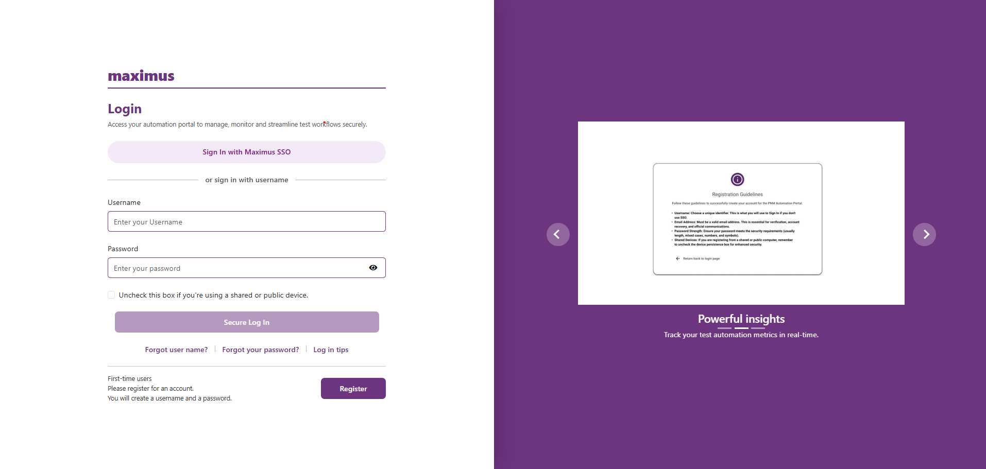

Slide 7
Registration
Overview:
The Registration Page allows new users to sign up for Automation Portal access.
It captures basic user information and sends it for admin approval or direct onboarding depending on configuration.
The page includes validations to ensure correct data entry and prevents duplicate accounts.

Slide 8
Key Features
User self-registration
Validation for unique email
Optional admin approval workflow
Modern and clean UI

Slide 9
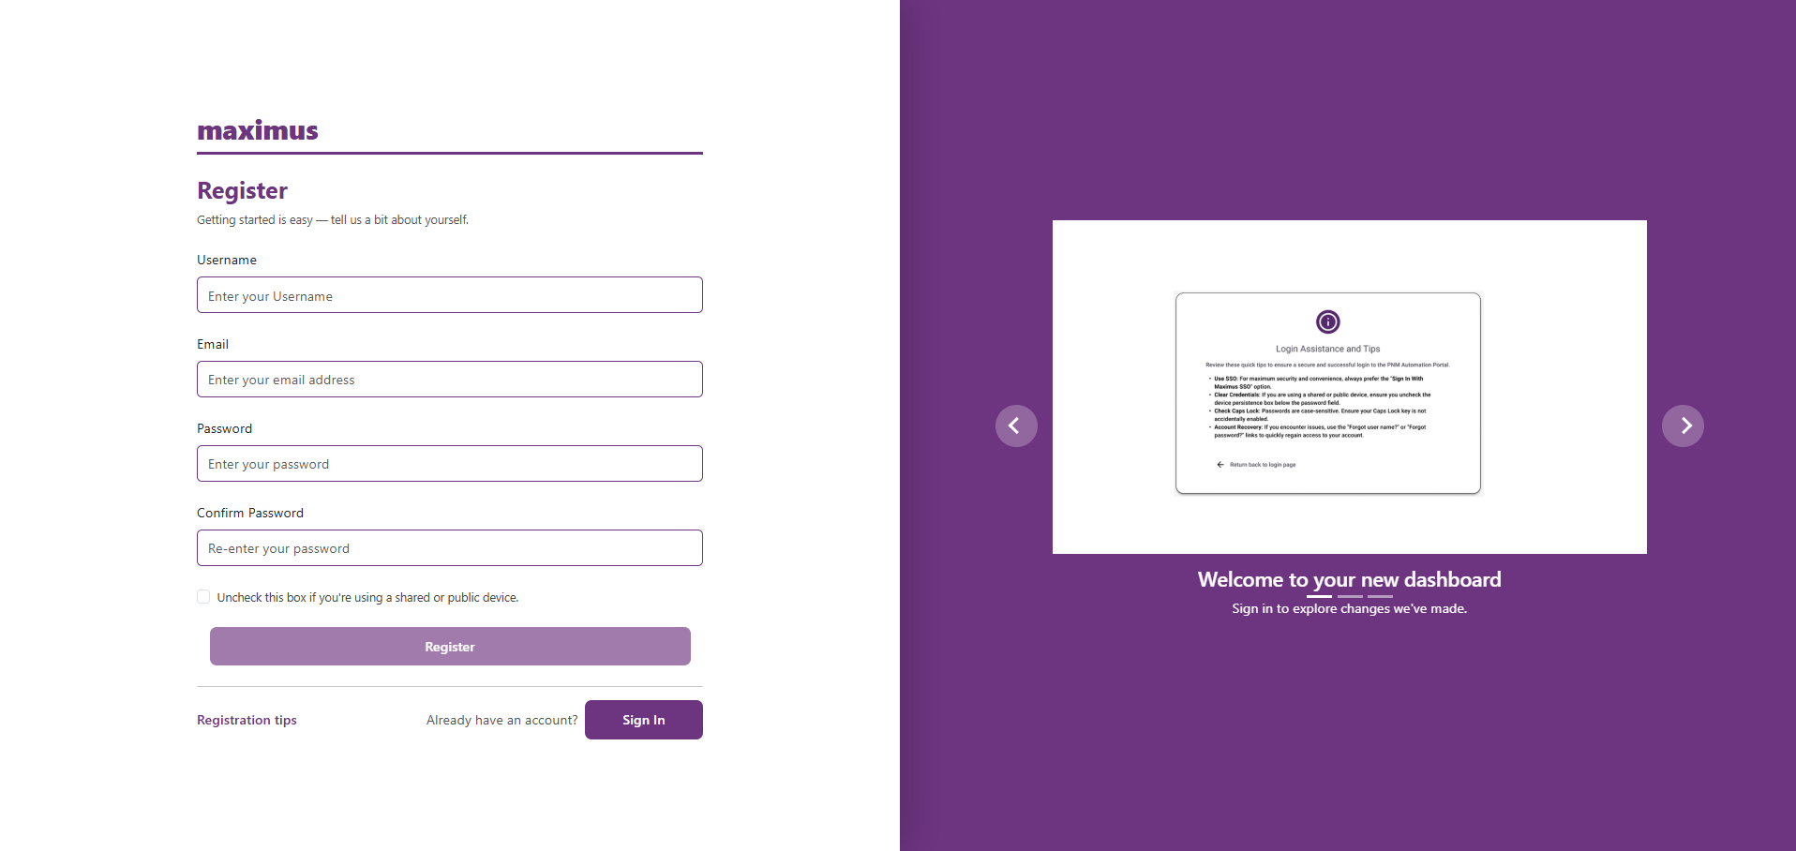

Slide 10
Test Case Assignment
Overview:
The Test Case Assignment module allows administrators and QA leads to assign test suites, libraries, and individual test cases to users. It provides a structured way to manage ownership of automation tasks and ensures every tester knows exactly what they need to execute.
The screen includes filters for library, class, methods, user selection, environment, priority, and execution status. Assigned test cases are tracked centrally, reducing manual coordination and eliminating spreadsheet-based tracking.

Slide 11
Key Features:
Assign test cases to any user
Filter by suite, library, class, method
Supports bulk assignment
Shows execution count & status
Real-time grid with sorting/filtering
Prevents duplicate assignments

Slide 12
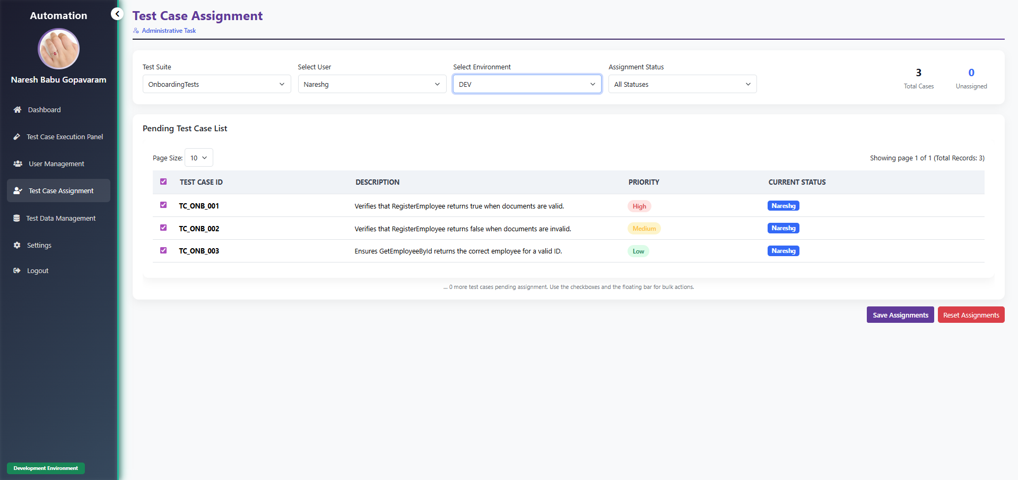

Slide 13
Test Case Execution Panel
Overview:
The Execution Panel is the central place where testers run their assigned automation tasks. It displays each test case with details such as method name, priority, attached data, and current status.
Users can execute tests directly, monitor progress, view logs, and track real-time execution updates. The UI ensures smooth execution flow and minimizes errors.

Slide 14
Key Features:
Assignment-Based Test Case Loading
Auto-Refresh & Live Updates
Execution Summary Metrics
Bulk Execution Actions
One-Click Run Now
Test Case Scheduling Single and Bulk
Screenshot & Logs Access
Real-Time Status Update
Role-Based Access Control
Environment-Based Execution View
Integrated Scheduler & Worker Engine

Slide 15
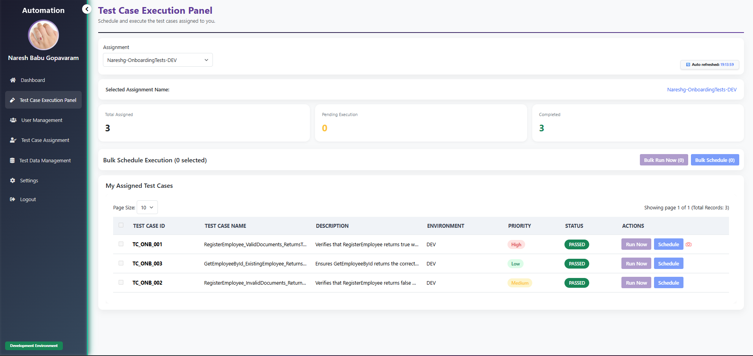

Slide 16
Test Case Execution Summary
Overview:
The Execution Summary module provides a detailed overview of all completed automation runs. It includes charts, filters, timelines, and run-wise execution details for better analysis.
Users can track test coverage, pass/fail ratios, execution duration, and identify failed cases quickly. It is highly useful for reporting and QA governance.

Slide 17
Key Features:
Summary of all runs
Pass/Fail/Skipped statistics
Timeline-based execution tracking
Drilldown into any test method
Retry failed test cases
Export results for reporting

Slide 18
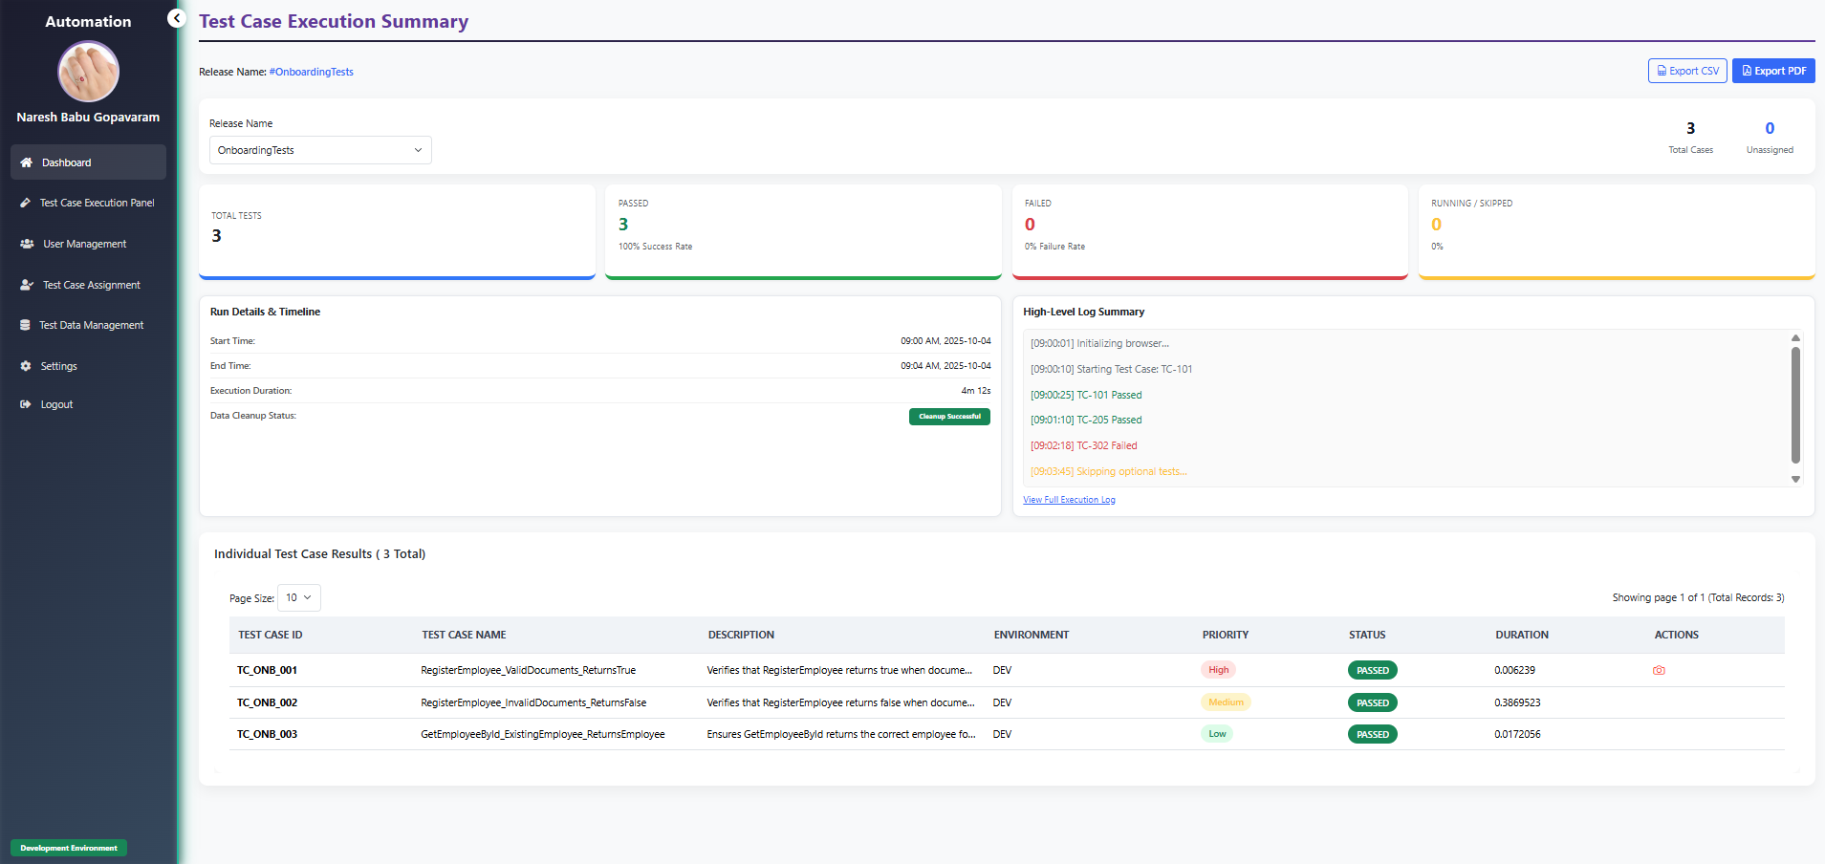

Slide 19
Test Data Management
Overview:
The Test Data Management module allows QA teams to store and maintain all test-related data in one centralized place.
Users can create, edit, update, and delete reusable test datasets that are automatically picked up during automation execution. This reduces data duplication and makes test execution more stable.
Key Features:
Add/edit/delete test data entries
Data linked to libraries & methods
Supports dynamic and parameterized values
Centralized storage for consistent execution
Prevents test failures due to missing data

Slide 20
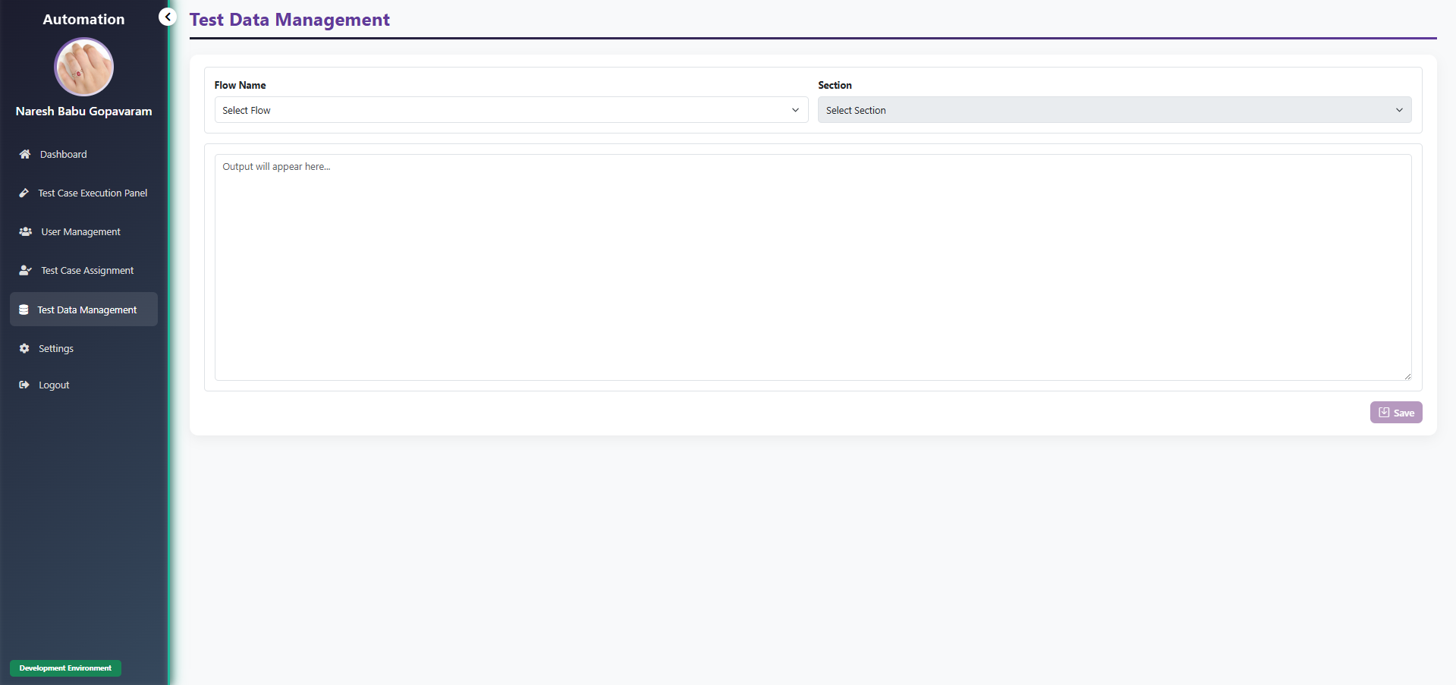

Slide 21
User & Role Management
Overview:
This module enables administrators to manage users, roles, and access levels. It ensures that each user only sees modules they are authorized to use.
The system supports creation of custom roles and mapping users to required privileges.
Key Features:
Add/edit/delete users
Assign roles & permissions
Manage active/inactive status
Secure role-based module access
Audit-friendly user control

Slide 22
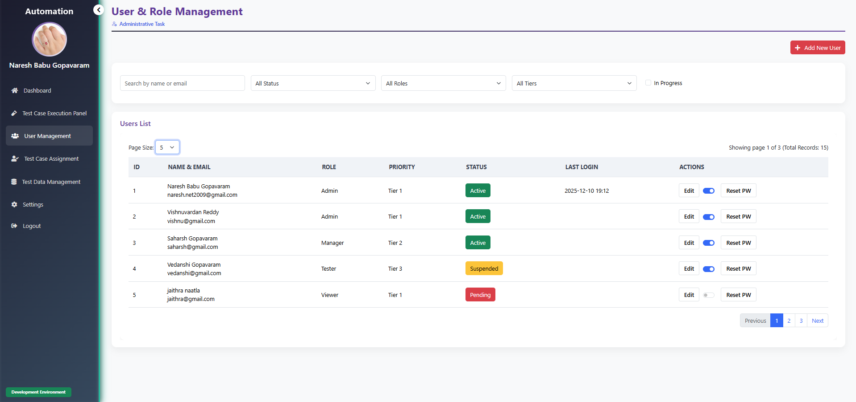

Slide 23
User Settings
Overview:
The User Settings module allows each user to manage their personal preferences.
Users can update profile information, password, display preferences, and notification settings.
Key Features:
Update profile information
Change password
Customize preferences
Manage notification settings

Slide 24
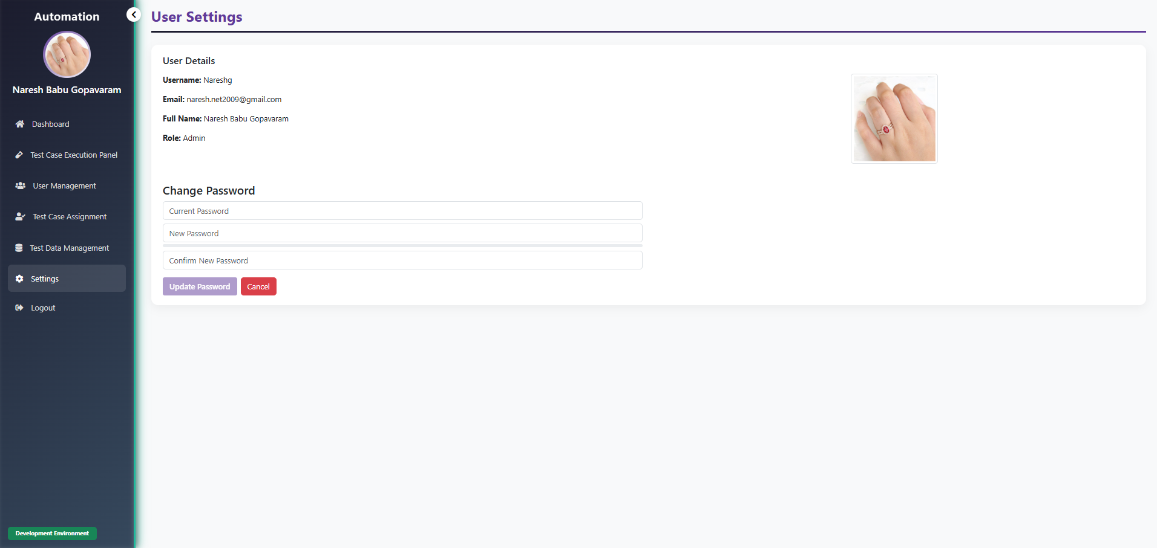

Slide 25
Pain Points Solved
✔ No more Excel‑based test case tracking
✔ Full visibility of execution in real time
✔ Reduced manual coordination
✔ Centralized repository for test data
✔ Better user accountability
✔ Simplified QA governance

Slide 26
Tech Stack
Frontend:
• Angular 19+ (Standalone Components)
• Bootstrap 5
Backend:
• ASP.NET Core Web API
• Micro services Repository pattern
Execution Layer:
• Worker Service
• Selenium/Playwright (optional)
Database:
• SQL Server
• Stored Procedures
Security:
• JWT Authentication
• Role-based Access Control

Slide 27
Future Roadmap
🚀 AI-driven test case recommendations
🚀 Self-healing automation scripts
🚀 Real-time streaming of execution logs
🚀 Advanced reporting & dashboard builder
🚀 Mobile app for approvals & execution status (Proposal)
🚀 Azure DevOps/GitHub Actions CI-CD integration

