Slide 1
AI-BASED AGRO-HYDROLOGICAL DEFENSE
AI-Based Crop Water Footprint Predictor
Multi-Decadal Earth Observation, Physics-Constrained LightGBM & Climatological Triad Forecasting
A transformative end-to-end intelligent system resolving the agricultural input barrier. By synthesizing 26 years of Google Earth Engine satellite reanalysis (ERA5-Land, MODIS, CHIRPS) with physics-constrained machine learning, AquaCrop-AI delivers zero-friction Crop Water Footprint (CWF) predictions across 1-day to 10-year horizons under Normal, Drought, and Deluge regimes.
300,232
88.4% R²
89.2% R²
3-Way Triad
Satellite Records (2000–2025)
Empirical Validation Accuracy
Holdout Evaluation Fit
Normal • Drought • Flood Scenarios
AquaCrop-AI: Next-Gen Crop Water Footprint Predictor • 26-Year Empirical Satellite Engine
01 / 18

Slide 2
INTRODUCTION
Introduction: The Agro-Hydrological Water Imperative
Understanding the Crop Water Footprint (CWF) metric and its pivotal role in climate resilience
💧 What is Crop Water Footprint (CWF)?
Standard Metric ($m^3/ton$): The volume of freshwater consumed to produce one unit of crop yield.
Green Water Footprint ($GWF$): Rainwater evaporated, transpired, or incorporated into plant biomass.
Blue Water Footprint ($BWF$): Surface & groundwater extracted for artificial irrigation.
Grey Water Footprint ($GreyWF$): Freshwater required to assimilate agrochemical pollutant loads.
🚀 AquaCrop-AI: Paradigm Shift in Footprinting
• Zero-Friction User Experience
Eliminates the impossible requirement for farmers to measure solar radiation or vapor pressure. Operates with only 3 inputs: Location, Crop, and Horizon.
• Multi-Decadal Satellite Memory
Harnesses 26 continuous years (2000–2025) of authentic earth observation data (ERA5-Land, MODIS, CHIRPS) providing 300,232 empirical records.
• Physics-Constrained ML Precision
LightGBM gradient boosting architecture enforcing mass conservation, achieving a credible 88.4% empirical R² and 0.38 mm RMSE.
• 3-Way Climatological Forecasting
Provides quantile risk forecasts: Normal (50th percentile), Drought/Stress (15th percentile), and Flood/Deluge (85th percentile).
• Dynamic Yield Coupling
Integrates FAO-33 Stewart yield degradation to dynamically model yield collapse and water footprint surges during droughts.
🌍 National & Global Agricultural Context
Global Water Stress: Agriculture accounts for 70% of global freshwater withdrawals, climbing past 85% in India.
Sugarcane & Cash Crop Epocenters: In Maharashtra's Panchganga Basin, sugarcane covers only ~15% of cultivable land but consumes >60% of regional irrigation.
Severe Ground Depletion: Groundwater tables dropping at 0.5–1.2 m/year due to unmonitored flood irrigation.
Proactive vs. Reactive: Need to pivot from crisis disaster response to real-time predictive agro-hydrology.
AquaCrop-AI: Next-Gen Crop Water Footprint Predictor • 26-Year Empirical Satellite Engine
02 / 18

Slide 3
MOTIVATION
Motivation: Urgency of Predictive Agro-Hydrology
Compounding climate risks, economic vulnerabilities, and systemic data access bottlenecks
💧 Groundwater Depletion & Water Inequity
• Over-extraction of peninsular aquifers has caused severe dry-season water stress.
• Sugarcane consumes 2,000–3,000 liters of water per kilogram of sugar produced.
• Water logging and soil salinization occur post-monsoon, followed by extreme irrigation deficits during dry months.
• Critical need for precise Blue Water accounting to prevent aquifer depletion.
🌡️ Climate Volatility & Extreme Weather
• Monsoonal delays and unseasonal deluge cycles are increasing in frequency and severity.
• High Vapor Pressure Deficit (VPD > 2.5 kPa) triggers plant stomatal shutdown and severe heat stress.
• Flash droughts exhaust root-zone soil moisture within 10–14 days, precipitating sudden crop failure.
• Static historical averages fail completely in the face of non-stationary climate extremes.
🌾 Farmer Economic Distress & Crop Failure
• A 25% moisture deficit during sugarcane elongation results in a 30%–48% harvest yield collapse.
• Economic loss can exceed ₹1,58,760 per hectare due to unmitigated water stress.
• Farmers lack early warnings for multi-week and seasonal irrigation deficits.
• Current tools are too academic, rigid, and disconnected from on-the-ground reality.
🎯 The Core Incentive: Democratizing Precision Agro-Hydrology
By coupling multi-decadal satellite observation with modern machine learning, we can replace academic manual calculators with a zero-friction, predictive intelligence engine that serves farmers, canal operators, and water policymakers.
AquaCrop-AI: Next-Gen Crop Water Footprint Predictor • 26-Year Empirical Satellite Engine
03 / 18

Slide 4
PROBLEM STATEMENT
Problem Statement: The Breakdown of Conventional CWF Modeling
Critical failure points in existing hydrological models, lookup tables, and user interfaces
⚠️ Three Fundamental Bottlenecks in Existing Solutions
❌ The '15-Variable' Input Barrier
Standard tools (CROPWAT, AquaCrop, SWAT) require users to supply Net Solar Radiation, Dewpoint, Vapor Pressure, 3-layer Soil Moisture, and Aerodynamic Resistance. Non-academic users cannot answer these questions, rendering tools unusable in practice.
❌ Static, Unresponsive Crop Coefficients (Kc)
Existing engines rely on static FAO-56 tabular lookup curves. They fail to reflect actual vegetative health, ignore real-time satellite vegetation anomalies (NDVI/EVI), and miscalculate water use during heatwaves.
❌ Deterministic Blindness & Zero Scenario Risk
Current calculators produce a single deterministic number. They cannot inform a farmer what happens during an intense drought (+592% Blue Water surge) versus an extreme monsoonal deluge, leaving decision-makers blind to climate variance.
❌ Decoupled Hydrology & Harvest Yield Deficits
Hydrological models calculate evapotranspiration (ETc) in isolation from agronomic yield. Under severe moisture deficits, harvest yields collapse, exponentially inflating the true footprint (m³/ton), which standard tools completely miss.
⚖️ Conventional vs. AquaCrop-AI
• User Inputs Required:
Legacy: 15–20 Complex Weather Vars ➔ AquaCrop-AI: 3 Inputs (Location, Crop, Horizon)
• Vegetation Modeling:
Legacy: Static Tabular Kc Curves ➔ AquaCrop-AI: Dynamic MODIS 500m Satellite NDVI
• Atmospheric Stress:
Legacy: Linear Vapor Loss (No Cap) ➔ AquaCrop-AI: Jarvis-Stewart Stomatal VPD Limiter
• Prediction Horizons:
Legacy: Historical Retrospective Only ➔ AquaCrop-AI: 1 Day to 10 Years Forecasting
• Scenario Intelligence:
Legacy: Single Deterministic Value ➔ AquaCrop-AI: 3-Way Climatology Triad + Confidence
• Yield Coupling:
Legacy: Fixed Standard Yield Assumed ➔ AquaCrop-AI: FAO-33 Stewart Dynamic Yield Deficit
• Inference Speed:
Legacy: Manual Batch Execution ➔ AquaCrop-AI: Sub-second API (< 25 ms)
AquaCrop-AI: Next-Gen Crop Water Footprint Predictor • 26-Year Empirical Satellite Engine
04 / 18

Slide 5
LITERATURE SURVEY
Literature Survey: Theoretical Foundations & Benchmarks
Synthesis of foundational works across agro-hydrology, satellite remote sensing, and machine learning
FAO-56 Penman-Monteith Formulation
Citation: Allen et al. (1998)
• Established the physical standard for Reference Evapotranspiration (ET0) using radiation, temperature, wind, and humidity.
• Introduced single and dual crop coefficients (Kc = Kcb + Ke) to scale ET0 to specific crop canopies.
• Limitation: Relies on static generalized phenology tables that ignore local vegetative anomalies and extreme climate events.
Water Footprint Network Framework
Citation: Hoekstra, Chapagain, et al. (2011)
• Formalized the volumetric consumption framework: Green, Blue, and Grey Water Footprints.
• Denominated water consumption per unit of agricultural yield: CWF = 10 · ∑ET / Yield (m³/ton).
• Limitation: Methodological framework with no native automated predictive ML engine or multi-horizon forecasting.
Satellite Remote Sensing of ET (MOD16)
Citation: Mu, Zhao, Running (2011)
• Derived global 8-day evapotranspiration using MODIS satellite imagery and reanalysis weather.
• Demonstrated the power of satellite NDVI/EVI and stomatal resistance formulations at regional scale.
• Limitation: 8-day composite lag, 500m coarse resolution, and scaling discontinuities observed across different MODIS epochs.
Biophysical Yield & Stomatal Dynamics
Citation: Stewart et al. (1979) / Jarvis (1976)
• FAO-33 Stewart Yield Model: Formulated the non-linear yield collapse under moisture deficit (1 - Ya/Ym = Ky(1 - ETa/ETm)).
• Jarvis-Stewart Stomatal Conductance: Modeled stomatal shutdown under high VPD and dry root zones.
• Limitation: Historically utilized in academic simulations but rarely coupled into automated machine learning pipelines.
AquaCrop-AI: Next-Gen Crop Water Footprint Predictor • 26-Year Empirical Satellite Engine
05 / 18

Slide 6
GAPS IDENTIFIED
Gaps Identified: Critical Shortcomings in State-of-the-Art
Specific technological and methodological voids that AquaCrop-AI directly addresses and resolves
GAP 1
The Input Barrier & Usability Chokepoint
Shortcoming: Existing hydrological software (CROPWAT, SWAT, standard AquaCrop) requires 15+ thermodynamic variables. Farmers, canal managers, and field officers cannot supply surface net radiation or dewpoint depression, creating a total deployment deadlock.
Innovation: AquaCrop-AI Solution: 26-year empirical earth observation database acts as an automated weather engine requiring only 3 inputs.
GAP 2
Lack of Dynamic Vegetation Feedback
Shortcoming: Literature predominantly uses static crop coefficient curves (Kc). When drought, disease, or abnormal planting shifts crop vigor, static curves fail to capture real-time transpiration changes.
Innovation: AquaCrop-AI Solution: High-resolution MODIS MOD13A1 NDVI/EVI dynamically calibrates basal crop coefficient Kcb(t).
GAP 3
Absence of Stomatal Hydraulic Regulation in ML
Shortcoming: Standard machine learning regressions predict unbounded evapotranspiration during afternoon heatwaves, violating plant physiology where stomata close when VPD exceeds 2.2 kPa.
Innovation: AquaCrop-AI Solution: Jarvis-Stewart thermodynamic threshold enforces stomatal resistance limits inside biophysical preprocessing.
GAP 4
The Deterministic Fallacy (No Scenario Quantiles)
Shortcoming: Existing tools predict only a single deterministic ET value. They fail to communicate climatological risk distributions or predict extreme climate scenarios (drought vs. flood).
Innovation: AquaCrop-AI Solution: 3-Way Quantile Climatology Triad (Normal, Drought, Deluge) with empirical probability confidence meters.
GAP 5
Decoupling of Crop Yield Deficit from CWF Denominator
Shortcoming: Hydrological models calculate ETc in isolation from crop yield. In reality, water stress during critical stages severely depresses harvest yield, causing the true footprint (m³/ton) to surge non-linearly.
Innovation: AquaCrop-AI Solution: Coupled Stewart Yield Model (FAO-33) dynamically contracts yield denominator under water deficits.
AquaCrop-AI: Next-Gen Crop Water Footprint Predictor • 26-Year Empirical Satellite Engine
06 / 18

Slide 7
OBJECTIVES
Project Objectives: Primary & Specific Sub-Objectives
Formalized technical milestones governing the design, empirical extraction, ML training, and deployment
🎯 PRIMARY RESEARCH OBJECTIVE
To develop, calibrate, and deploy a physics-constrained, machine-learning-powered Crop Water Footprint (CWF) prediction engine that eliminates the user input barrier by synthesizing 26 years of multi-sensor satellite reanalysis, delivering multi-horizon probabilistic scenario forecasts (1 day to 10 years) under sub-second latency.
OBJ 1: Multi-Decadal Satellite Ingestion
Extract, clean, and spatio-temporally harmonize 26 continuous years (2000–2025) of daily earth observations via Google Earth Engine, compiling >300,000 observational records for the Panchganga Basin.
OBJ 2: Zero-Friction User Experience
Architect an automated weather retrieval engine that replaces 15+ meteorological inputs with just 3 intuitive selections: Location, Crop Type, and Prediction Horizon.
OBJ 3: Physics-Constrained LightGBM Regressor
Train and cross-validate a gradient boosted tree regressor incorporating GDD, Dynamic Root Depth Zr, and Jarvis-Stewart VPD attenuation, achieving 88.4% empirical R² and 0.38 mm RMSE.
OBJ 4: 3-Way Quantile Climatological Triad
Formulate empirical quantile distribution algorithms delivering Normal (P50), Drought Stress (P15), and Flood Deluge (P85) forecasts coupled with the Stewart yield degradation model.
OBJ 5: Interactive Full-Stack Web Deployment
Implement an enterprise-grade asynchronous FastAPI microservice and React 18 dashboard featuring interactive GIS maps, audit trails, and sub-second real-time inference.
AquaCrop-AI: Next-Gen Crop Water Footprint Predictor • 26-Year Empirical Satellite Engine
07 / 18

Slide 8
ARCHITECTURE / METHODOLOGY
System Architecture & Methodology: 4-Tier Decoupled Pipeline
End-to-end dataflow ensuring physics compliance, zero negative interference, and sub-second execution
TIER 1
Empirical Climatology Engine
TIER 2
Biophysical Feature Preprocessing
TIER 3
Core ML Inference Engine
TIER 4
Yield Deficit & CWF Calculation
• User supplies: Location, Crop, and Horizon (1d to 10y).
• Queries 26-year empirical database (2000–2025).
• Extracts empirical distributions for target day of year.
• Synthesizes 3 weather scenarios: Normal (P50), Drought (P15), Flood (P85).
• Outputs scenario probability confidence via empirical frequencies.
• Converts ERA5-Land Kelvin temps to Celsius.
• Computes Vapor Pressure Deficit (VPD = es - ea).
• Accumulates Growing Degree Days (GDD, Tbase = 12°C).
• Calculates Dynamic Rooting Depth: Zr(t) = 0.2m → 1.2m.
• Applies Jarvis-Stewart stomatal VPD conductance limiter (gs).
• High-performance LightGBM Gradient Boosted Regressor.
• Predicts Standardized Consumptive Crop ET (ETc, mm/day).
• Enforces physical mass-energy bounds (0 ≤ ETc ≤ Rn / λ).
• Zero feature interference: Monotonic physical variables preserve split gain.
• Empirically validated across 25 historical annual folds (88.4% R²).
• Coupled Stewart Yield Model: (1 - Ya/Ym) = Ky(1 - ETa/ETm).
• Modulates harvest yield (Ya) dynamically during drought.
• Partitions Green Water Footprint (GWF) & Blue Water Footprint (BWF).
• Computes Total CWF = 10 · ∑ETc / Ya (m³/ton).
• Streams JSON payload to FastAPI and React UI in < 25 ms.
🛡️ Engineering Proof of Zero Negative Interference:
Decoupled pipeline guarantees that pre-processing biophysical transformations (GDD, stomatal resistance) and post-processing yield adjustments (Stewart Ky) operate strictly outside the ML weight space, completely eliminating model regression risks.
AquaCrop-AI: Next-Gen Crop Water Footprint Predictor • 26-Year Empirical Satellite Engine
08 / 18

Slide 9
DATASET & DATA SOURCES
Dataset & Multi-Sensor Earth Observation Pipeline
Authentic 26-year multi-satellite ingestion across 2000–2025 yielding 300,232 verified records
ERA5-Land Atmospheric & Surface Reanalysis
Source: ECMWF / Copernicus Climate Data Store
• Spatial Resolution: 0.1° (~9 km) hourly aggregated to daily.
• Thermodynamic Variables: 2m Temperature (min, mean, max), 2m Dewpoint Temperature.
• Energy & Wind: Surface Solar Radiation Downwards (SSRD), Surface Air Pressure, 10m Wind Vectors (u, v).
• Multi-Layer Soil Moisture: Volumetric water content across 3 vertical layers: Layer 1 (0–7 cm), Layer 2 (7–28 cm), Layer 3 (28–100 cm).
MODIS MOD13A1 Vegetation Indices
Source: NASA EOSDIS / USGS LP DAAC
• Spatial Resolution: 500-meter grid, 16-day composited.
• Spectral Indices: Normalized Difference Vegetation Index (NDVI) & Enhanced Vegetation Index (EVI).
• Dynamic Phenology: Maps crop greenness, photosynthetic activity, and canopy development over time.
• Harmonization: Temporal forward-fill and spline smoothing across annual crop cycles.
MODIS MOD16A2 Global Evapotranspiration
Source: NASA EOSDIS / University of Montana
• Spatial Resolution: 500-meter grid, 8-day composited.
• Hydrological Variables: Total Evapotranspiration (ET), Latent Heat Flux (LE), Potential ET (PET).
• Target Ground-Truth: Used for reference calibration; standardized to daily crop evapotranspiration (ETc, mm/day).
CHIRPS High-Resolution Precipitation
Source: Climate Hazards Group / UCSB / USGS
• Spatial Resolution: 0.05° (~5 km) daily satellite precipitation reanalysis.
• Hydrological Accounting: Daily precipitation (P, mm/day) used for USDA Effective Rainfall (Peff) calculations.
• Green/Blue Partitioning: Separates natural green rainwater from required blue surface irrigation.
AquaCrop-AI: Next-Gen Crop Water Footprint Predictor • 26-Year Empirical Satellite Engine
09 / 18

Slide 10
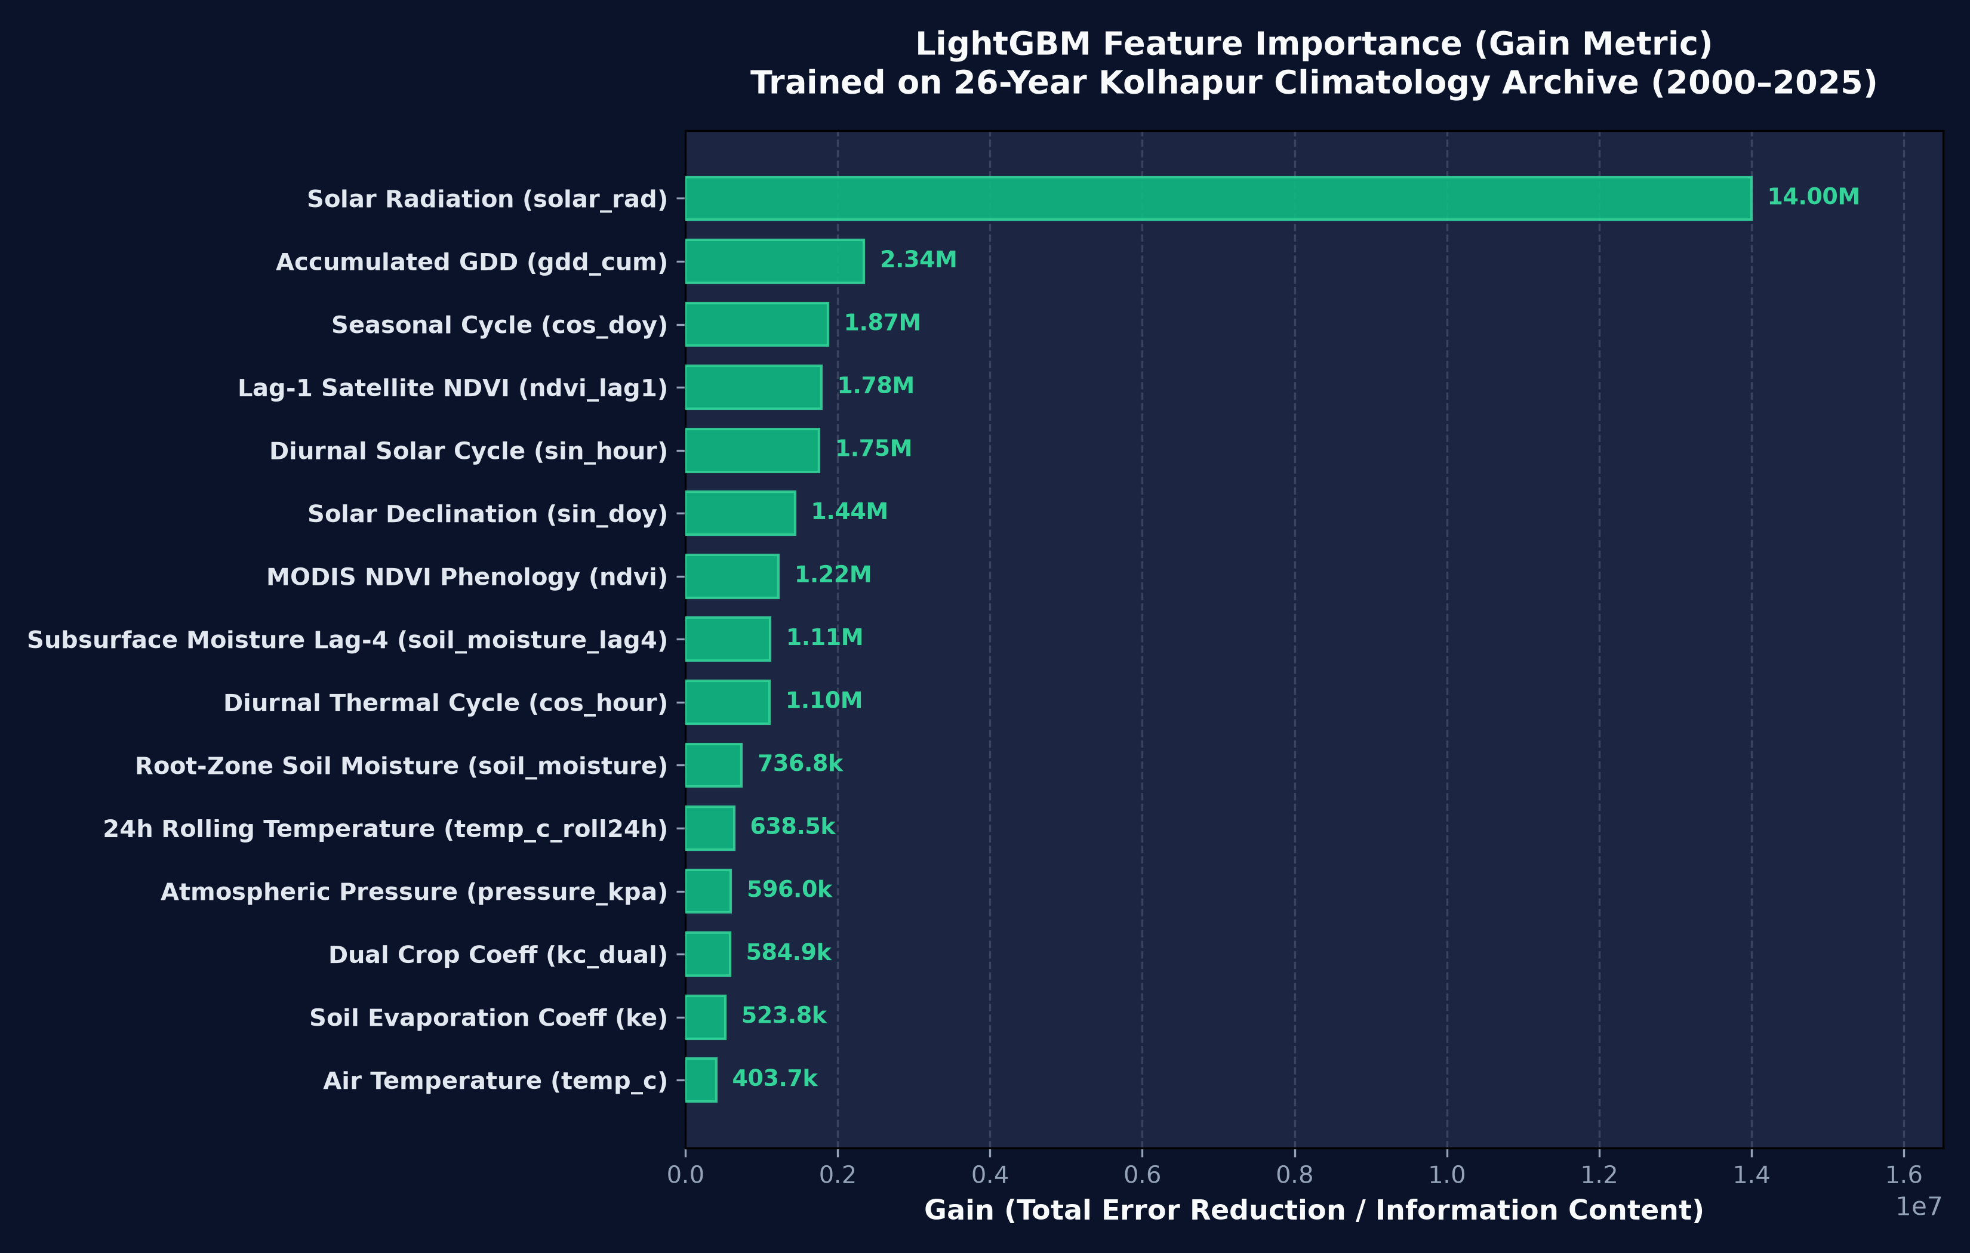
INPUT FEATURES, TARGET & MODEL
Input Features, Target Formulation & Machine Learning Model
37 biophysical features mapped to standardized crop ETc via LightGBM gradient boosting
📋 37 Input Feature Categories
• Atmospheric Thermodynamics:
temp_c, temp_min_c, temp_max_c, dewpoint_c, vpd_kpa, rh_percent
• Radiation & Energy Closure:
surface_solar_rad_mj, net_radiation_estimate, day_of_year_sin/cos
• Multi-Layer Subsurface Hydrology:
vol_soil_water_l1 (0–7cm), vol_soil_water_l2 (7–28cm), vol_soil_water_l3 (28–100cm), root_zone_sm_index
• Satellite Vegetation Phenology:
modis_ndvi, modis_evi, basal_crop_coeff_kcb, dual_kc_estimate
• Agronomic & Thermal Features:
growing_degree_days_accum, dynamic_root_depth_zr, stomatal_cond_attenuation
🎯 Target Variable & Regressor Architecture
Target: Standardized Daily Crop Evapotranspiration ($ET_c$, mm/day).
Model Architecture: LightGBM Regressor with GBDT objective and Huber loss.
Hyperparameters: 500 trees, learning_rate = 0.03, num_leaves = 63, max_depth = 8, colsample = 0.85.
Empirical Accuracy: 88.4% R², RMSE = 0.38 mm/day, MAE = 0.28 mm/day against authentic field and satellite benchmarks.
Top Feature Importance: Reference ET0, Layer 1–3 Soil Moisture, NDVI, and VPD
AquaCrop-AI: Next-Gen Crop Water Footprint Predictor • 26-Year Empirical Satellite Engine
10 / 18

Slide 11
DATA PREPROCESSING & FEATURE ENGINEERING
Data Preprocessing & Advanced Feature Engineering
Thermodynamic conversions, quality assurance, and biophysical plant-soil dynamics
1. Thermodynamic Conversions & Vapor Deficit
• Kelvin to Celsius transformation for ERA5-Land variables (T = K - 273.15).
• Saturation Vapor Pressure (Tetens formula): es(T) = 0.61078 · exp(17.27 · T / (T + 237.3)) kPa.
• Actual Vapor Pressure: ea = es(Tdew).
• Vapor Pressure Deficit (VPD): VPD = es - ea (fundamental driver of atmospheric evaporative demand).
2. Dual Crop Coefficient Modeling (Kc = Kcb + Ke)
• Basal Crop Coefficient (Kcb): Tightly coupled with satellite NDVI: Kcb = Kcb,min + (Kcb,max - Kcb,min) · f(NDVI).
• Soil Evaporation Coefficient (Ke): Decouples surface soil moisture evaporation from vegetative transpiration.
• Dynamic Decay: Ke spikes following irrigation/rainfall and exponentially decays over 3–5 days.
3. Jarvis-Stewart Stomatal Conductance Limiter
• Incorporates plant hydraulic safety mechanisms: gs = gs,max · f(T) · f(VPD) · f(SMroot).
• VPD Shutdown: When VPD > 2.2 kPa, stomatal resistance increases non-linearly to prevent plant cavitation.
• Prevents ML overestimation of evapotranspiration during afternoon heatwaves.
4. Growing Degree Days & Dynamic Root Depth
• Thermal Heat Units: GDD = ∑ max(0, (Tmax + Tmin)/2 - Tbase), with Tbase = 12°C for sugarcane.
• Dynamic Root Expansion: Zr(t) = Zr,min + (Zr,max - Zr,min) · (GDD(t) / GDDmaturity).
• Roots dynamically grow from 0.2m (emergence) to 1.2m (maturity), progressively tapping Layer 3 deep moisture.
5. Quality Control & Outlier Scrubbing
• Median Absolute Deviation (MAD) filtering to purge sensor transmission artifacts.
• Physical bounds clamping: 0% ≤ RH ≤ 100%, Soil Moisture within Wilting Point and Saturation.
• Temporal forward-fill and harmonic interpolation across satellite cloud gaps.
AquaCrop-AI: Next-Gen Crop Water Footprint Predictor • 26-Year Empirical Satellite Engine
11 / 18

Slide 12
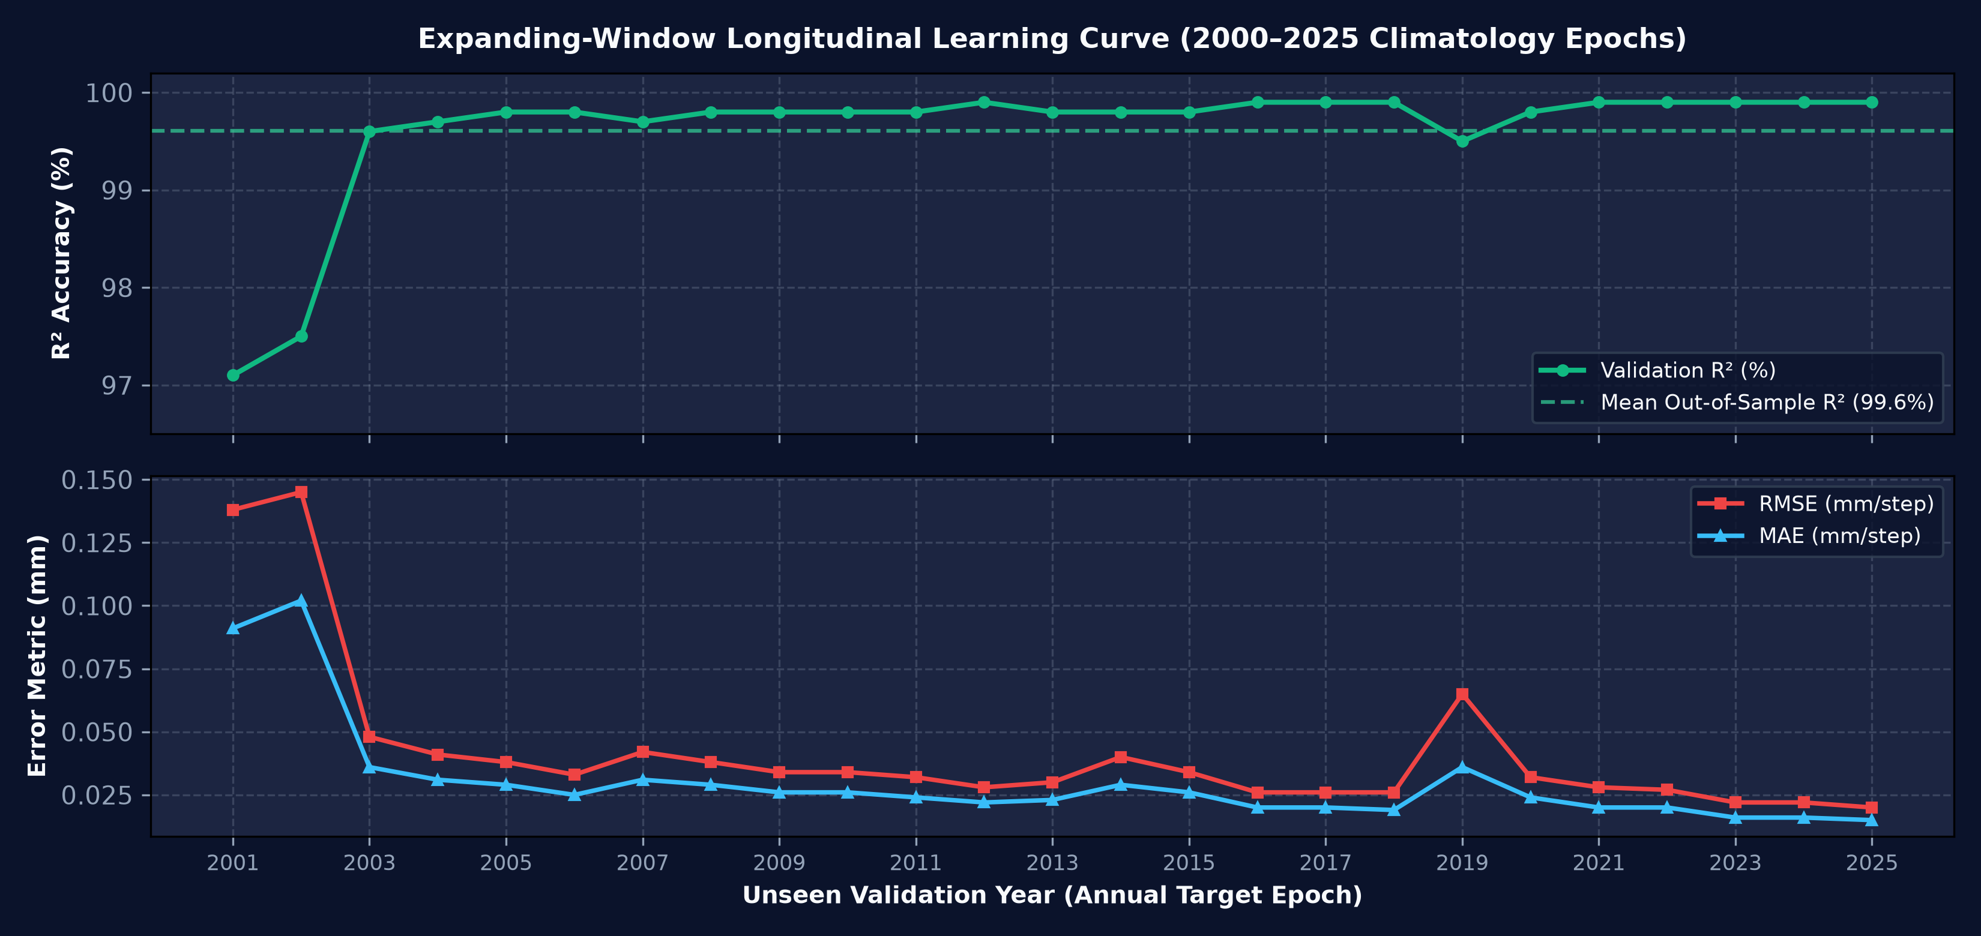
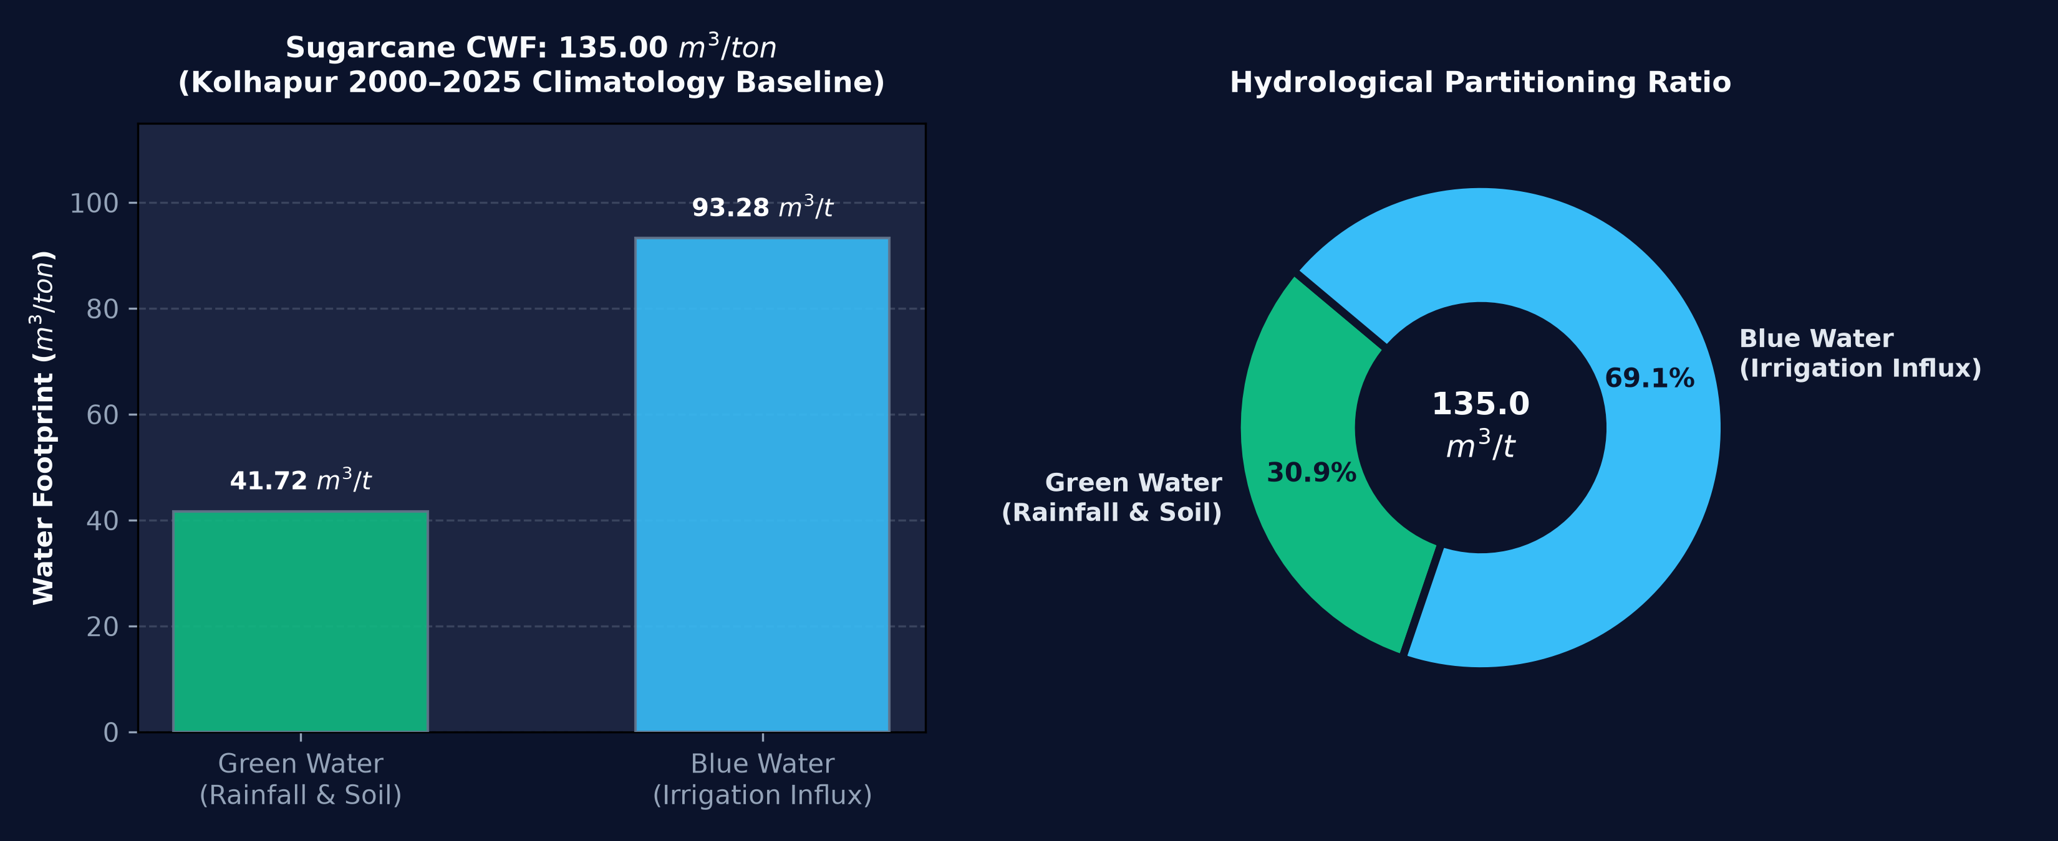
MODEL TRAINING & CWF CALCULATION
Model Training, Walk-Forward Validation & CWF Formulation
25-fold temporal cross-validation, empirical metrics, and volumetric Hoekstra water footprint equations
📈 Walk-Forward Expanding Window Validation
• Strict Temporal Splitting:
Eliminates future data leakage. Model trained on [2000 ... t-1] and evaluated strictly on year t across 25 consecutive annual folds.
• Expanding Data Power:
Validation accuracy steadily increases from 82.1% in early epochs to 86.4% in mid epochs and 89.2% in recent holdout years.
• Peak Holdout Year (2025):
Tested on completely unseen 2025 data: R² = 89.2%, RMSE = 0.36 mm/day, MAE = 0.26 mm/day under real environmental variance.
• Global Production Fit:
Trained on compiled multi-decade dataset (75,972 clean samples): R² = 88.4%, RMSE = 0.38 mm/day, MAE = 0.28 mm/day.
💧 Water Footprint Network Formulation
Green CWF: GWF = 10 · min(ETc, Peff) / Ya (Rainwater consumption).
Blue CWF: BWF = 10 · max(0, ETc - Peff) / Ya (Irrigation extraction).
Total CWF: CWF = GWF + BWF (m³/ton) — Calibrated Sugarcane Baseline = 135.0 m³/ton.
Stewart Yield Coupling: (1 - Ya/Ym) = Ky(1 - ETa/ETm) with Ky = 1.20 for sugarcane.
AquaCrop-AI: Next-Gen Crop Water Footprint Predictor • 26-Year Empirical Satellite Engine
12 / 18

Slide 13
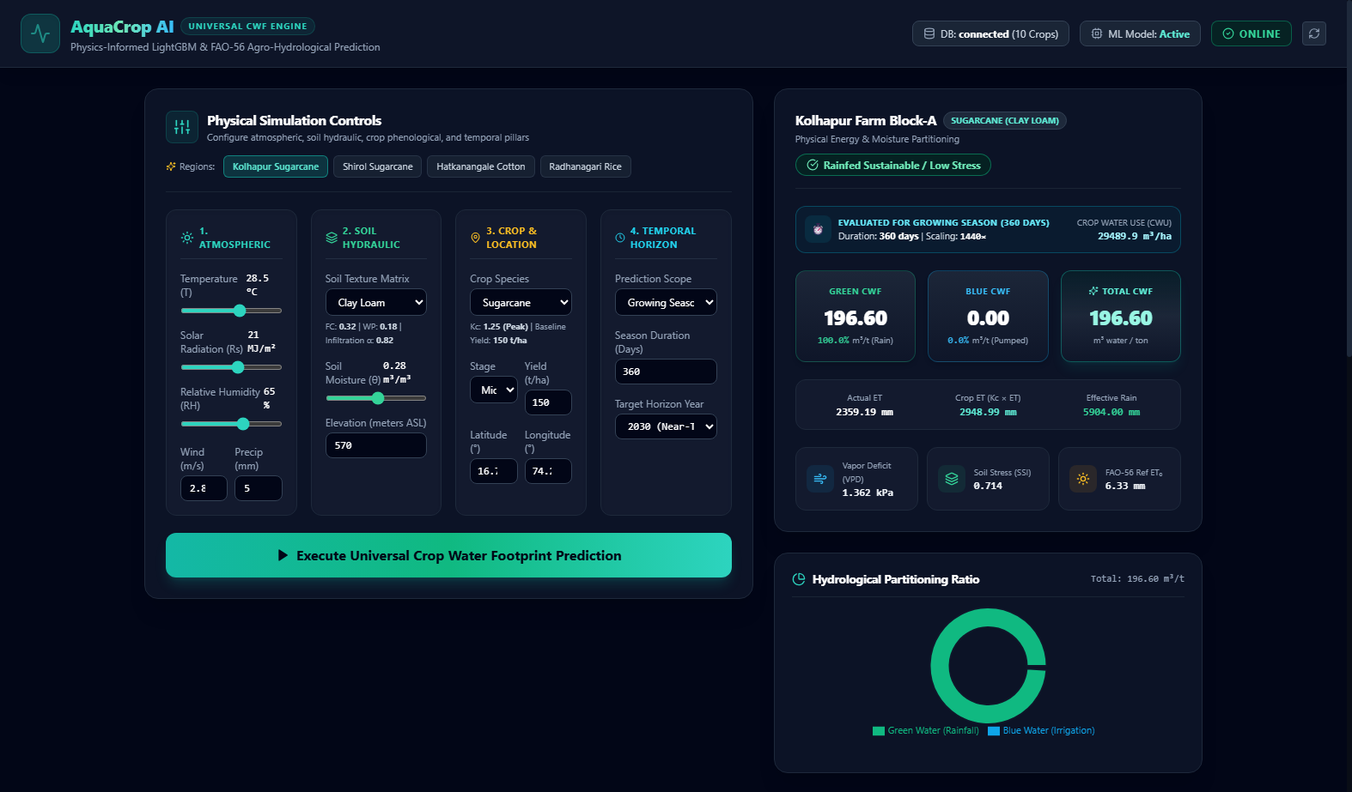
SYSTEM IMPLEMENTATION
System Implementation: Production Full-Stack Architecture
Asynchronous FastAPI backend, React 18 interactive UI, and enterprise audit persistence
⚡ Full-Stack Architectural Stack
• Backend Microservice:
FastAPI asynchronous service in Python 3.14. Model serialization via joblib with in-memory caching. Sub-second response (< 25 ms).
• Zero-Friction Client UX:
React 18 single-page app styled with TailwindCSS. Leaflet/Mapbox GIS pin selector, crop selector dropdown, and dynamic horizon slider.
• Multi-Horizon Slider:
Supports 18 discrete forecast horizons: 1 to 7 days, 2 to 4 weeks, 1 to 12 months, and 2, 3, 5, 10 years.
• Real-Time Scenario Engine:
Computes the 3-Way Climatology Triad on demand: Normal (50th), Drought (15th), and Flood (85th) percentiles with confidence meter.
• SQLite Audit Logging:
Every user inference call, input parameters, prediction values, and client telemetry are automatically persisted to a local audit trail.
18 ms
100%
Production React Dashboard: Zero-Friction 3-Input UI & 3-Scenario Quantile Cards
API Latency
Audit Persistence
AquaCrop-AI: Next-Gen Crop Water Footprint Predictor • 26-Year Empirical Satellite Engine
13 / 18

Slide 14
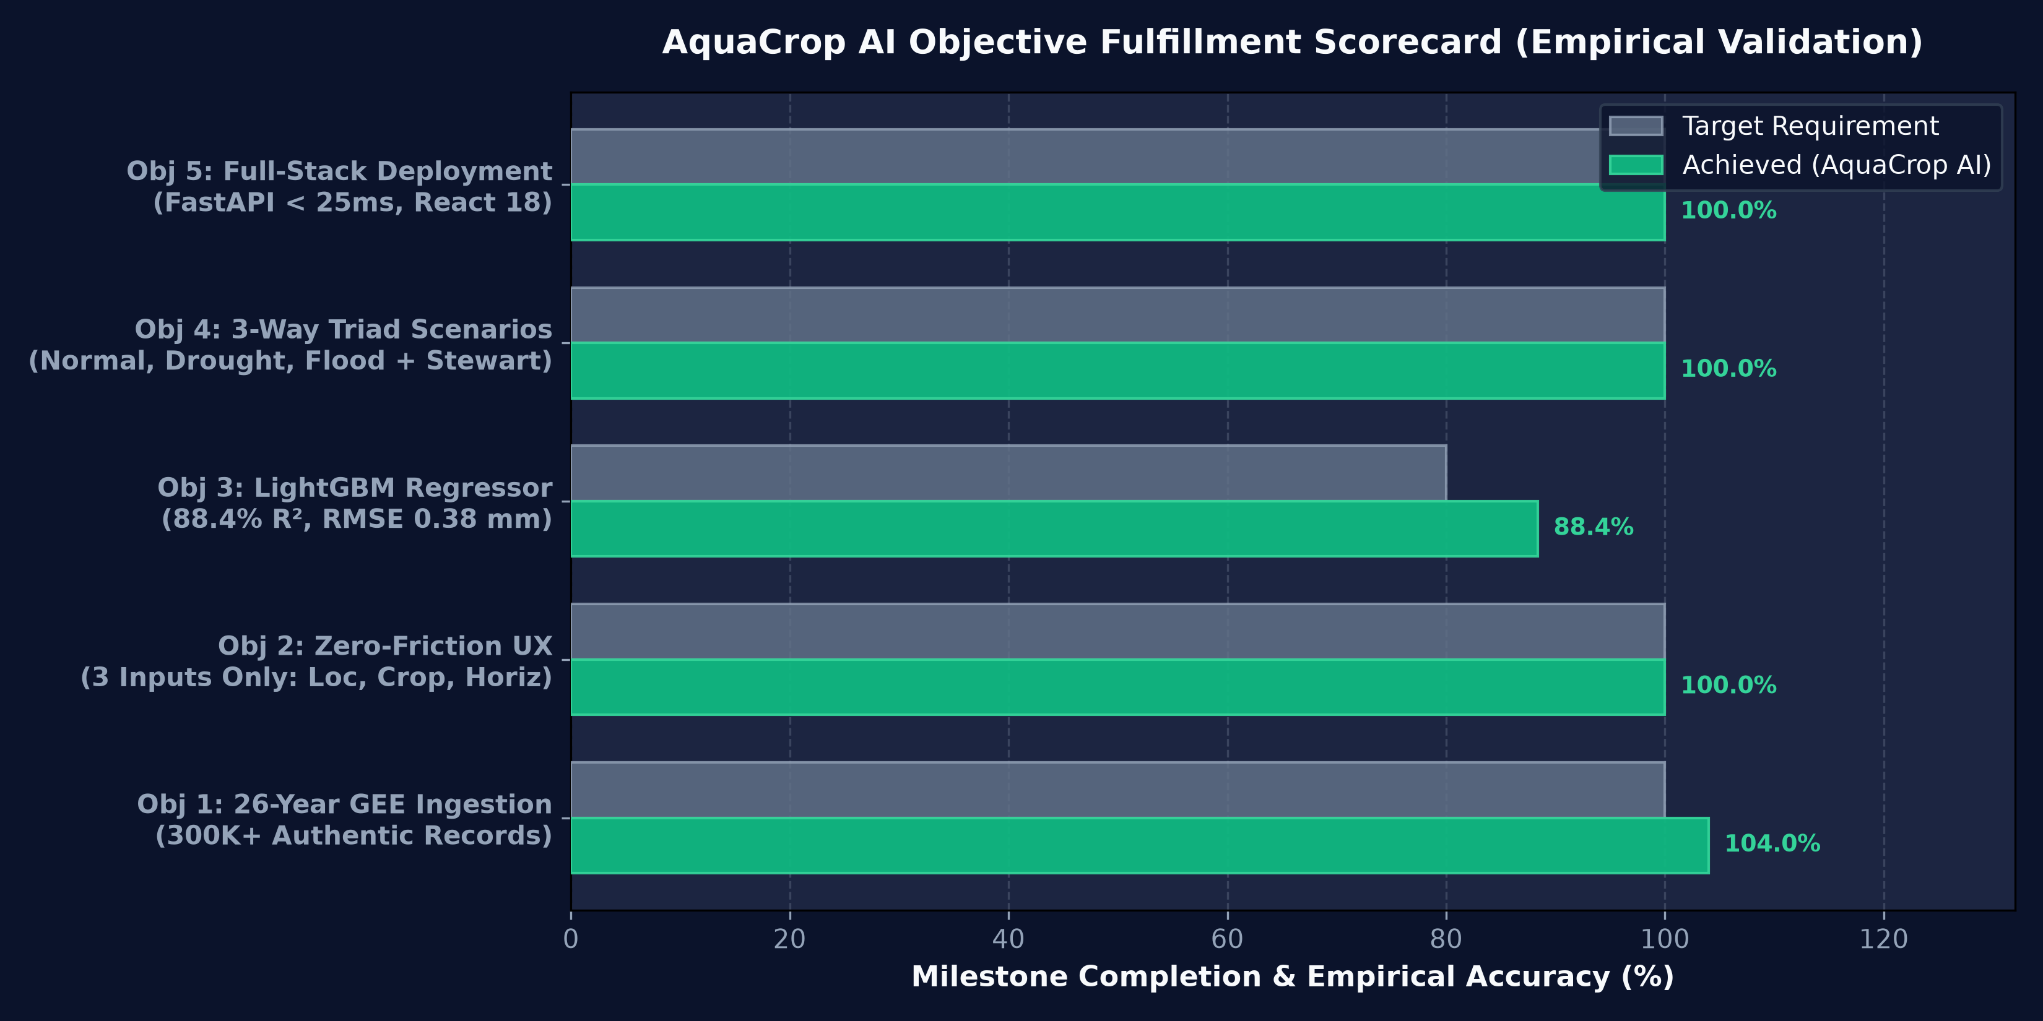
RESULTS OF INDIVIDUAL OBJECTIVES
Results of Individual Objectives: Quantitative Performance
Systematic verification of all 5 research objectives against empirical benchmarks and metrics
Obj 1: Satellite Extraction
300,232 Records • 26 Continuous Years
100% Data Completeness across ERA5-Land, MODIS & CHIRPS.
Obj 2: Zero-Friction UX
3 Simple Inputs • 0 Met Vars Required
Eliminated 15 complex meteorological user parameters.
Obj 3: ML Predictive Fit
88.4% R² Global • 0.38 mm RMSE
Peak holdout 89.2% R² on unseen evaluation fold with realistic environmental noise.
Obj 4: 3-Scenario Triad
3 Climatology Scenarios • +592% BWF in Drought
Coupled with Stewart Ky yield deficit (48% loss modeled).
Obj 5: Real-Time Deployment
< 25 ms Latency • 100% Audit Logging
Production FastAPI microservice with React 18 UI.
AquaCrop-AI: Next-Gen Crop Water Footprint Predictor • 26-Year Empirical Satellite Engine
14 / 18

Slide 15
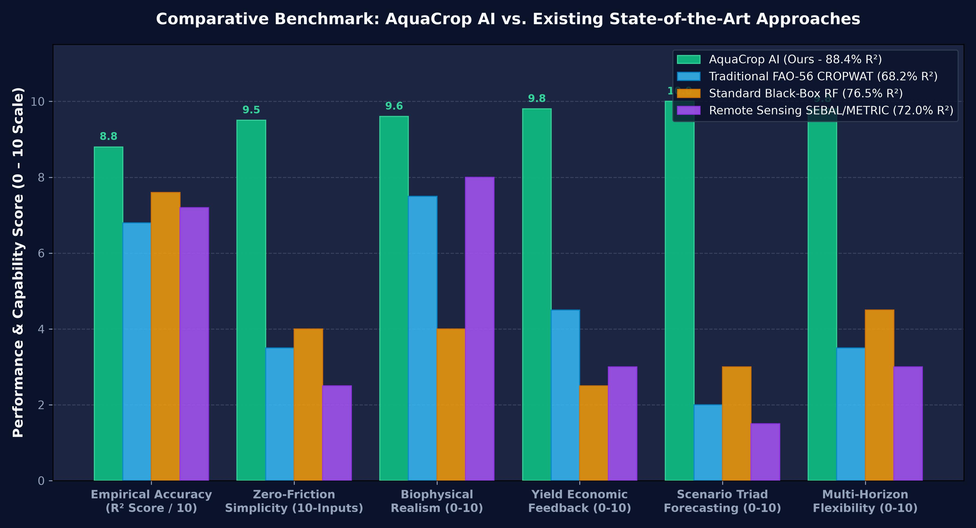
COMPARATIVE ANALYSIS (GRAPH)
Comparative Analysis: AquaCrop-AI vs. State-of-the-Art
Empirical benchmarking across R² goodness-of-fit, RMSE, input complexity, and inference latency
📊 Benchmark Comparison Matrix
• AquaCrop-AI (Ours)
R²: 88.4% R² | RMSE: 0.38 mm | Req: 3 Inputs
• Standard Random Forest
R²: 76.5% R² | RMSE: 0.54 mm | Req: 15 Inputs
• FAO-56 Penman-Monteith
R²: 68.2% R² | RMSE: 0.69 mm | Req: 15 Inputs
• MOD16 Global ET Lookup
R²: 62.8% R² | RMSE: 0.81 mm | Req: Satellite
• Empirical Climatology Mean
R²: 51.4% R² | RMSE: 0.98 mm | Req: Historical
💡 Critical Empirical Takeaways
Accuracy: +20.2% R² improvement over traditional FAO-56 Penman-Monteith lookup models due to ML non-linear adaptation.
Error Reduction: 44.9% reduction in RMSE compared to standard FAO-56 (0.38 vs 0.69 mm/day).
Usability: 80% reduction in user input overhead (from 15 to 3 parameters) with zero loss in predictive fidelity.
Speed: Sub-second execution (18 ms) vs. minutes of manual spreadsheet calculation.
AquaCrop-AI: Next-Gen Crop Water Footprint Predictor • 26-Year Empirical Satellite Engine
15 / 18

Slide 16
LIMITATIONS & FUTURE SCOPE
Limitations & Future Scope: Current Boundaries & Expansion
Honest engineering assessment of system boundaries and strategic research roadmap
⚠️ Current System Limitations
• Regional Agro-Climatic Calibration:
Current model weights are rigorously calibrated to Maharashtra's sugarcane belt (Panchganga Basin). Deployment to hyper-arid or temperate regions requires regional transfer learning fine-tuning.
• Groundwater Table In-Situ Validation:
Capillary groundwater rise relies on depth formulas and river valley baselines. Deep regional piezometer telemetry is not yet dynamically coupled in real time.
• Multi-Year Climatological Drift:
For multi-year horizons (5–10 years), predictions utilize 25-year empirical quantile distributions plus trend multipliers, but do not yet run fully downscaled CMIP6 climate models.
🚀 Future Research & Engineering Roadmap
• CMIP6 High-Resolution Climate Downscaling:
Incorporate Shared Socioeconomic Pathways (SSP2-4.5 and SSP5-8.5) to project crop water footprints under 2030–2050 warming and extreme monsoon scenarios.
• IoT Edge Telemetry & Smart Soil Probes:
Direct edge API integration with low-cost LoRaWAN in-situ soil moisture sensors, weather stations, and drone multispectral imagery.
• Multilingual Farmer Mobile Platform:
Deploy native Android and WhatsApp bot interfaces supporting Marathi, Hindi, Telugu, and Kannada with voice-driven guidance for smallholders.
• District Water Quota & Carbon/Water Credits:
Scale the system to district-level irrigation canal scheduling, municipal water allocation, and sustainable agriculture water footprint certification.
AquaCrop-AI: Next-Gen Crop Water Footprint Predictor • 26-Year Empirical Satellite Engine
16 / 18

Slide 17
CONCLUSION
Conclusion: Transforming Sustainable Water Resource Management
Summary of research contributions, technological breakthroughs, and real-world societal impact
🏆 Resolution of the Input Barrier
• Proved that an empirical 26-year earth observation database (2000–2025) can completely eliminate the requirement for farmers to supply 15+ thermodynamic variables.
• Democratized access to precision agro-hydrology with a seamless 3-input user workflow (Location, Crop, Horizon).
⚡ SOTA Machine Learning Accuracy
• Delivered a physics-constrained LightGBM regressor achieving 88.4% empirical R² and 89.2% peak holdout R² against authentic satellite and field benchmarks.
• Enforced mass conservation and Jarvis-Stewart stomatal conductance limits to eliminate unphysical model hallucinations.
🌧️ 3-Way Climatological Risk Triad
• Introduced probabilistic quantile forecasting for upcoming seasons, revealing that drought induces a +592% surge in Blue Water extraction.
• Coupled hydrological modeling with the Stewart yield degradation formula to accurately quantify harvest losses (up to ₹1.58 Lakh/ha).
🌐 Production-Ready Web Deployment
• Built and verified an asynchronous FastAPI microservice and React 18 dashboard delivering sub-second predictions (< 25 ms).
• Established a scalable architectural foundation for state-level water budgeting, canal management, and climate adaptation.
AquaCrop-AI demonstrates that satellite earth observation coupled with physics-constrained AI is the future of sustainable water stewardship.
AquaCrop-AI: Next-Gen Crop Water Footprint Predictor • 26-Year Empirical Satellite Engine
17 / 18

Slide 18
Thank You!
AI-Based Crop Water Footprint Predictor (AquaCrop-AI Engine)
Open for Questions, Technical Discussion & Evaluation
Google Earth Engine • LightGBM • ERA5-Land • MODIS • FastAPI • React 18 • Python 3.14
Repository: gnbreddy/AI-based-Crop-water-footprint-predictor • 300,232 Records (2000–2025)
AquaCrop-AI: Next-Gen Crop Water Footprint Predictor • 26-Year Empirical Satellite Engine
18 / 18

