Slide 1
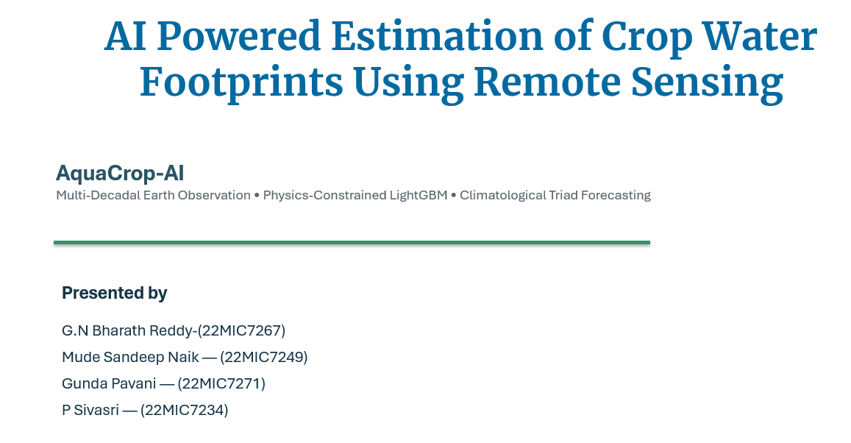

Slide 2
01 · INTRODUCTION
AquaCrop AI
Universal AI-Based Crop Water Footprint Predictor
A project overview of a full-stack agro-hydrological platform that turns Earth observation data into crop-water footprint estimates.
Earth observation
Water stewardship
Full stack
From location selection to footprint reporting — designed for field-relevant decisions.
3
26 yrs
4 tiers
simple user inputs
earth-observation archive
decoupled architecture
Notes:
Introduce the platform as a practical bridge between remotely sensed climate information and transparent crop-water reporting.

Slide 3
02 · MOTIVATION
Why crop-water visibility matters
Agricultural water decisions need timely, understandable, location-aware information.
Water pressure
Climate variability
Information gap
Irrigation and groundwater extraction can place severe pressure on regional water resources.
Weather, vegetation condition and root-zone moisture vary across seasons and locations.
Farm users rarely have access to meteorological instruments or complex model inputs.
Project response: combine satellite and reanalysis sources with an accessible web workflow.

Slide 4
03 · PROBLEM STATEMENT
Conventional workflows are difficult to use at field scale
The challenge is both scientific and operational: accurate inputs are not readily available to every user.
Current friction
Project direction
Many tools require a long list of atmospheric, crop and soil parameters.
Static assumptions may not reflect observed vegetation and local soil-water conditions.
Standalone calculations are disconnected from maps, databases, APIs and operational dashboards.
Automate data retrieval and physical normalization.
Keep the user journey focused on location, crop and forecast horizon.
Deliver results through reusable services, dashboards and auditable records.

Slide 5
04 · LITERATURE SURVEY
Scientific foundations behind the platform
The system is grounded in established hydrology, crop science and water-footprint practice.
FAO-56
Reference evapotranspiration and crop-coefficient methods
FAO-33
Yield response to water and crop stress relationships
Water Footprint Network
Green and blue water-footprint accounting
Earth observation research
Satellite vegetation, evapotranspiration and precipitation products
AquaCrop AI integrates these foundations into a deployable digital system.

Slide 6
05 · GAPS IDENTIFIED
From research methods to a usable platform
The project targets the gap between detailed scientific models and real operational workflows.
01
Input burden
02
Data fragmentation
Field users should not need to enter complex thermodynamic measurements.
Climate, vegetation and precipitation products are commonly separated.
03
Low interoperability
04
Limited traceability
A model alone does not provide APIs, persistence, maps or deployment.
Operational systems need stored records and repeatable requests.

Slide 7
06 · OBJECTIVES
What the project sets out to deliver
A science-informed product that is simple to use, operationally robust and ready to extend.
1
Consolidate multi-year Earth observation data for crop-water analysis.
2
Build location- and crop-aware water-footprint calculations.
3
Minimise the user input burden through a guided three-input experience.
4
Provide web, API and database layers for real-world use.
5
Support scalable ingestion, auditability and future decision-support features.

Slide 8
07 · ARCHITECTURE / METHODOLOGY
Four tiers, one connected workflow
A decoupled architecture separates data preparation, physical processing, footprint calculation and delivery.
TIER 1
TIER 2
TIER 3
TIER 4
TIER 5
User request
Data & context
Physical processing
Footprint service
Delivery
Location · crop · horizon
Archive, crop and soil profiles
Climate and crop-water normalization
Green/blue CWF and results
API · dashboard · database
Decoupling improves maintainability: each tier can be tested, evolved and deployed independently.

Slide 9
08 · DATASET & DATA SOURCES
A multi-sensor archive for agricultural context
The data foundation combines climate reanalysis, satellite vegetation and precipitation products.
ECMWF ERA5-Land
NASA MODIS
CHIRPS
Atmosphere, radiation, wind and soil-moisture layers
Evapotranspiration, NDVI and EVI vegetation measures
Satellite–station blended precipitation
Hourly · ~9 km
8–16 day · 250 m–1 km
Daily · ~5.5 km
2000–2025
300,232
5 nodes
archive coverage
observational records
Kolhapur monitoring locations

Slide 10
09 · INPUT FEATURES, TARGET & MODEL
User simplicity backed by agro-hydrological context
The platform transforms readily available location and crop context into water-footprint outputs.
User inputs
System context
Outputs
Location
Satellite and reanalysis variables
Crop profiles and soil properties
Physical crop-water calculations
Crop water footprint
Green-water contribution
Blue-water requirement
Yield-aware context
Crop type
Forecast horizon

Slide 11
10 · DATA PREPROCESSING & FEATURE ENGINEERING
From raw observations to physically meaningful inputs
Data is harmonised, checked and transformed before crop-water calculations are applied.
1
2
3
4
Harmonise
Validate
Derive
Connect
Align timestamps, units and source-specific formats.
Apply quality checks and physical bounds.
Calculate climate and soil-water descriptors.
Attach crop, soil and location profiles.
Result: a consistent agronomic data layer suitable for transparent water-footprint reporting.

Slide 12
11 · MODEL TRAINING & CWF CALCULATION
Water-footprint accounting that keeps sources visible
The calculation separates rain-fed contribution from irrigation-related demand and relates water use to crop output.
Effective rainfall
Crop water use
Footprint output
Water available from precipitation and soil storage contributes to the green component.
Crop and climate context inform the consumptive water-use estimate.
Green and blue components are reported per yield unit and per land area.
Outputs are designed to make the origin and scale of agricultural water use understandable.

Slide 13
12 · SYSTEM IMPLEMENTATION
Production-oriented full-stack implementation
The repository contains interfaces, APIs, persistence and asynchronous ingestion components.
Web dashboard
REST services
Flask dashboard, map-based interactions and a React implementation
FastAPI endpoints for prediction, profiles, records and system status
Data layer
Streaming worker
SQLite for local use and PostgreSQL 16 for containerised deployment
Asynchronous queue, batch processing and graceful shutdown

Slide 14
13 · LIMITATIONS & FUTURE SCOPE
What remains to be extended
The current platform establishes a strong base while highlighting opportunities for broader coverage and operational integration.
Current limitations
Roadmap
Current geography is centred on the Kolhapur monitoring region.
Data resolution and update cadence depend on upstream observation products.
On-farm recommendations need local validation and stakeholder feedback.
Smart irrigation scheduling with rain-delay logic.
Water-to-rupees and energy-use calculator.
Irrigation-method and crop-switching simulation.
Reservoir and canal-release integration.

Slide 15
14 · RESULTS OF INDIVIDUAL OBJECTIVES
Delivered capabilities across the project
The repository demonstrates an end-to-end foundation rather than a standalone calculation script.
Data foundation
User experience
✓
✓
26 annual data files and a compiled multi-year dataset
Three-input flow with selectable locations, crops and horizons
System services
Operational readiness
✓
✓
Dashboard, REST gateway, records and profile endpoints
Container configuration, worker process and automated tests

Slide 16
15 · COMPARATIVE ANALYSIS
Capability comparison: conventional workflow vs. AquaCrop AI
This graph compares workflow coverage, not a predictive-performance benchmark.
Conventional workflow
AquaCrop AI
Interpretation
Data integration
AquaCrop AI adds integrated data, user-facing delivery, persistent records and deployable services around crop-water calculations.
Input simplicity
System delivery
Traceability
Deployment readiness
Scale: 1 = limited coverage · 5 = integrated capability

Slide 17
Conclusion
AquaCrop AI brings together Earth observation, crop-water science and production software into a practical foundation for sustainable agricultural water management.
Accessible
Connected
Extensible
Three guided inputs for the user
Data, services, dashboards and records
A clear base for irrigation decision support
Thank you

