Slide 1

Student Processing Flowchart
2026/07/12
Reporter: Group 4.9

Slide 2

Contents
catalog
Flowchart Structure
01

Slide 3

Flowchart Structure
01

Slide 4



Initial Setup and Input
Display Title and Course Information
The process begins by displaying a title and inputting course details, date, and the number of students.
Initialize Counters
Before processing students, necessary counters are initialized to track various metrics.

Slide 5


Student Data Processing Loop
Input Student Details
Validate Student Status
For each student, their specific details are input into the system.
The system checks if the input student's status is valid.
Handle Invalid Status
Handle Valid Status
If the student's status is invalid, an error message is displayed, and the process loops back for re-input.
If the student's status is valid, relevant counters are updated.

Slide 6
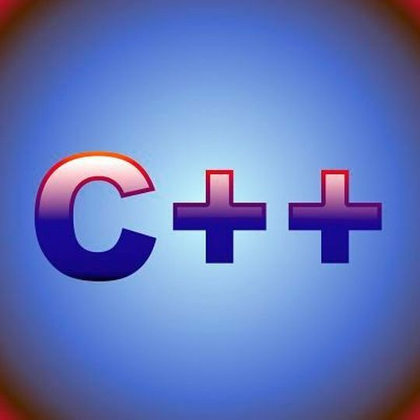

Finalization and Reporting
Calculate Percentage
Display Summary
Save Report to File
End Process
After processing all students, percentages are calculated, and students are classified based on their data.
A summary of all processed student data and classifications is displayed.
The complete report is saved to a file for record-keeping.
The entire student processing workflow concludes.

Slide 7

Thanks
THE END

