Slide 1
SHORING DEWATERING
Presented To-
Prof. Yuvraj Singh

Slide 2
HERE THE PRESENTATION BEGIN…
CONTENT
SHORING
DEWATERING
EQUIPMENTS
Definition
Purpose for Dewatering
Side effects of Dewatering
Methods of Dewatering Excavations at Construction Site
Definition
Requirements of Shoring
It’s Types

Slide 3
SHORING
01
Definition
Requirements of Shoring
It’s Types

Slide 4
Kshitiz 2014044
Definition
Introduction
Requirements of Shoring
It’s Types

Slide 5
Introduction
Shoring is the construction of a temporary structure to support temporarily an unsafe structure. It can be utilized when walls bulge out when walls crack due to unequal settlement of foundation and repairs must be carried out to the cracked wall.
Requirement of Shoring:-
If the wall shows signs of bulging out due to bad workmanship.
To repair a crack on the wall due to unequal settlement of the foundation.
When an adjacent structure is to be dismantled.
If openings are to be made or enlarged in the wall.
To give support to walls that are dangerous or are likely to become unstable because of subsidence, bulging, or leaning.
For avoiding failure of sound walls caused by the removal of underlying support
During demolition works to give support to an adjacent building or structure.

Slide 6
Types of Shoring
1. Raking Shoring
2. Flying Shoring
3. Dead Shoring

Slide 7
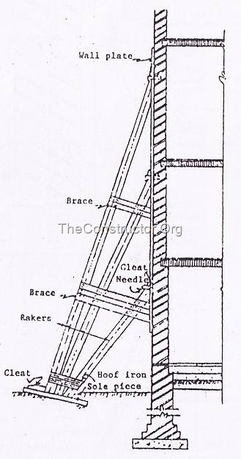
In this method, inclined members known as rakers are used to give lateral supports to walls.
A raking shore consists of the following components:-
Rakers or inclined member
Wall plate
Needles
Cleats
Bracing
Sole plate
Raking Shoring

Slide 8
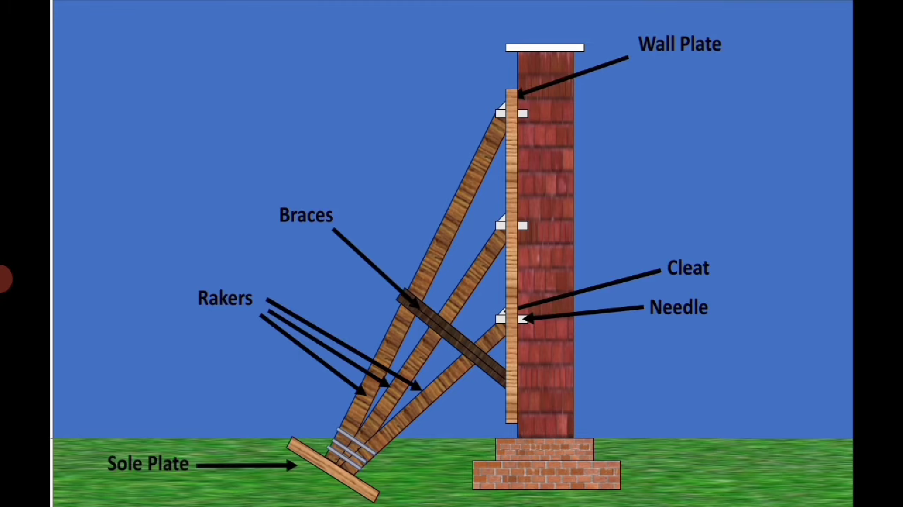
Points to consider for Raking Shoring
Rakers are to be inclined in the ground at 45⁰. However the angle may be between 45⁰ and 75⁰.
Rakers should be properly braced at intervals.
The center line of a raker and the wall should meet at floor level.
Shoring may be spaced at 3 to 4.5m spacing to cover longer length of the bar.
The sole plate should be properly embedded into the ground on an inclination and should be of proper section and size.

Slide 9
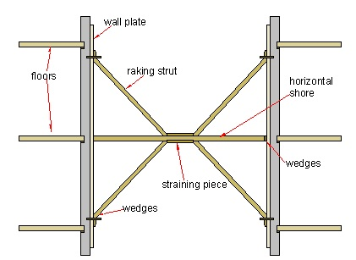
Flying shoring is a support system that provides horizontal support to two parallel party walls when removal or collapse of the intermediate building takes place. These are most often used for supporting temporarily the parallel walls of two adjacent buildings where an intermediate building has to be demolished or rebuilt.
A raking shore consists of the following components:-
Raking Strut
Wall plate
Straining Pieces
Wedges
Floors
Horizontal Shore
Flying Shoring

Slide 10
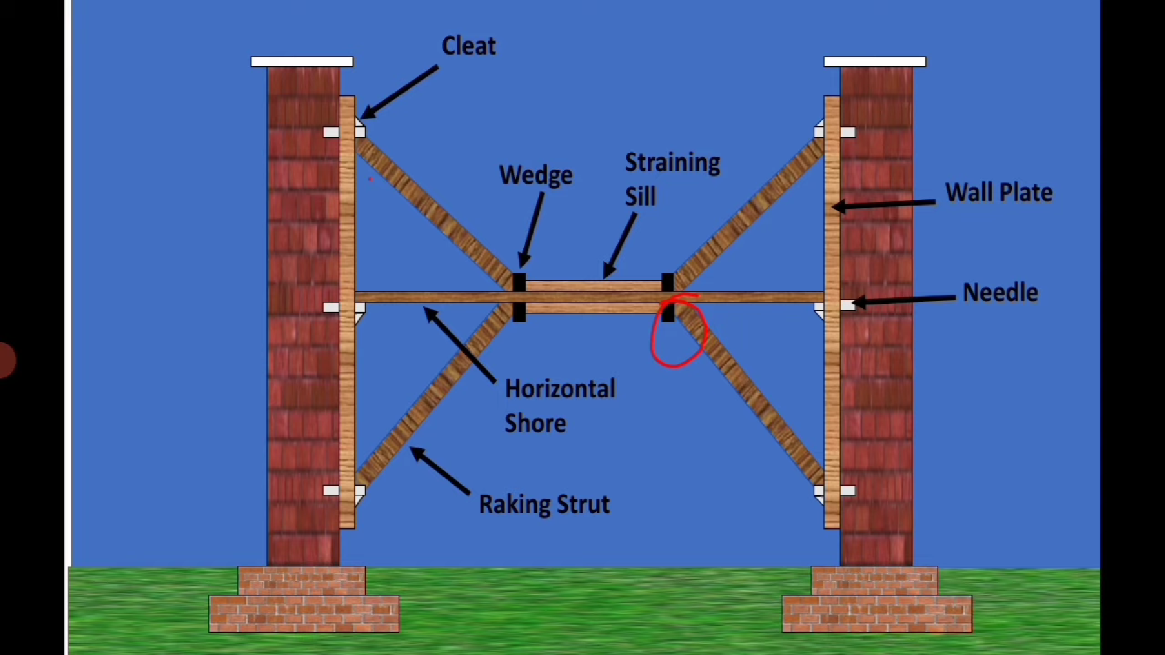
Points to consider for flying shoring
1.
2.
3.
4.
The center lines of flying shore and struts and those of the walls should meet at floor levels of the two buildings.
The struts should preferably be inclined at 45°.
Single shores should be used only up to 9 m distance between walls.
Should be spaced at 3 to 4.5 m centers, along the two walls; and horizontal braces.

Slide 11
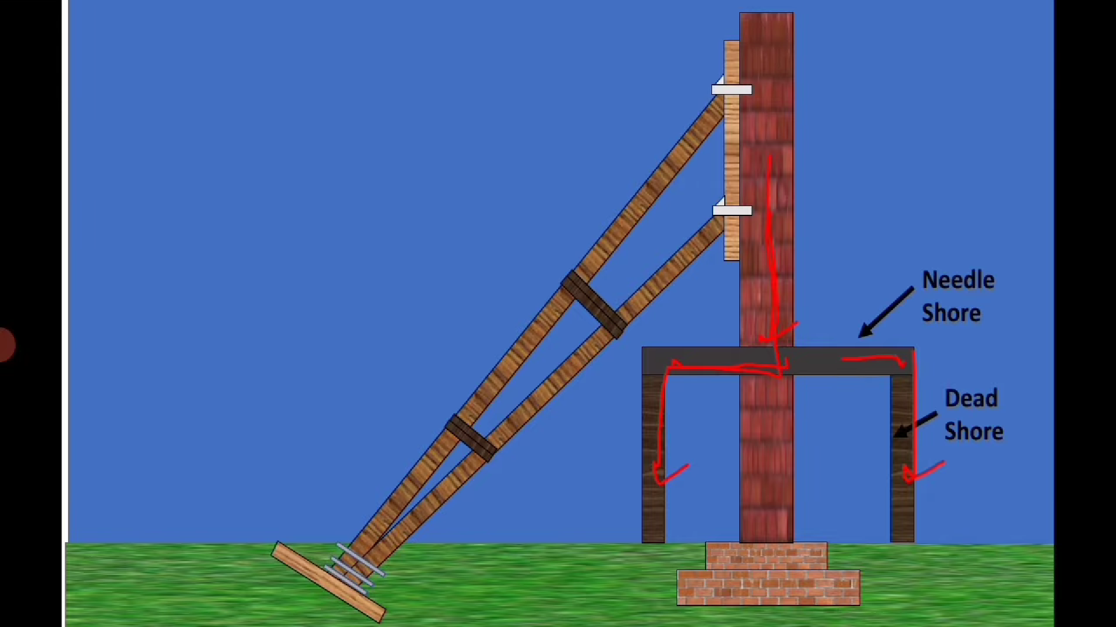
Dead Shoring
Dead shoring is used to temporarily support the walls, roofs, floors, etc., by providing horizontal members known as needles. This type of shoring is used to support dead loads that act vertically downwards. The loads are transferred by the needle to the shore legs and hence down to a solid bearing surface.
Purpose of Dead Shoring:-
To rebuild the defective lower part of the wall.
To rebuild or deepen the existing foundation.
To make large opening in the existing wall at lower level for underpinning and such type of work.

Slide 12
Factors to consider for Dead shoring
5.
6.
1.
2.
3.
4.
The needles are spaced at 1 to 2 meters.
Needles should be suitably braced.
The floors should be suitably supported from inside.
Strut all window openings within the vicinity of the shores.
Cut holes through ceilings and floors for the shore legs.
Leave the shoring in position for at least seven days before starting new work.

Slide 13
02
DEWATERING
Definition
Purpose for Dewatering
Side effects of Dewatering
Methods of Dewatering Excavations at Construction Site
Kshitiz
2014044

Slide 14
Introduction
01
Dewatering is the term for the control of groundwater by pumping.
On construction sites it may be known as ‘construction dewatering’.
The process of dewatering can be defined as – pumping from wells or sumps to temporarily lower groundwater levels, to allow excavations to be made in dry and stable conditions below natural groundwater level.

Slide 15
PURPOSE FOR DEWATERING
1.
2.
3.
4.
5.
Provide a dry excavation and permit construction to proceed efficiently.
Reduce lateral loads on sheeting and bracing in excavations.
Improve supporting characteristics of foundation materials.
Increase stability of excavation slopes and side-hill fills.
Cut off capillary rise and prevent piping and frost heaving in pavements.

Slide 16
Side effects of Dewatering
Settlement of adjacent area.
1.
2.
Temporary reduction in yield of water supply wells in adjacent area.
3.
4.
Long-term damage to water supply aquifer due to salt water infiltration.
Lower water table harms vegetation

Slide 17
Methods of Dewatering Excavations at Construction Site
01
1.
WELLPOINT
02
4.
2.
DEEP WELLPOINT METHOD
EDUCTOR WELLS
3.
04
OPEN SUMP PUMPING
03

Slide 18
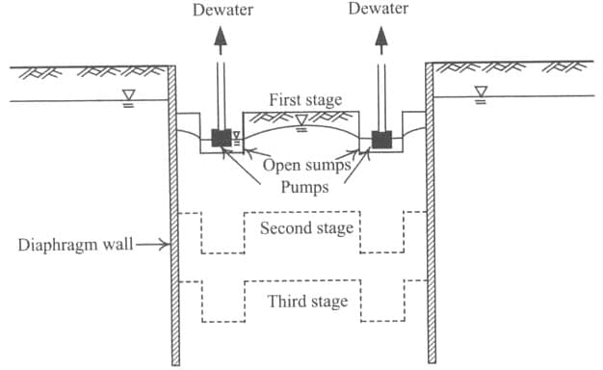
OPEN SUMP PUMPING
01
It’s a reliable choice in a wide range of situations, and it’s also referred to as the simplest, cheapest, and most effective dewatering method. A sump is a hole or an area in the ground (deeper than the basement floor) where water is collected and then pumped away for disposal.

Slide 19
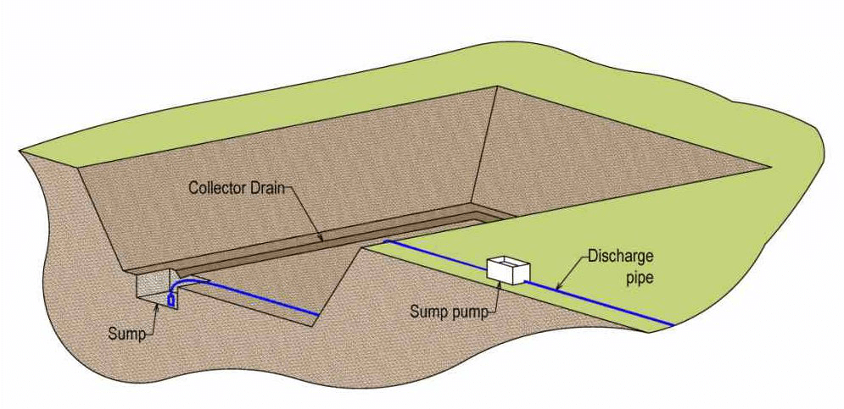
How it works
Drains and sumps are constructed at one or more sides or corners of the foundation pit. The drains collect the groundwater and convey it into the sump. From the sump, the water is continuously evacuated (either manually or mechanically).
This method works well for most soil and rock conditions. Since the bottom of the sump is situated at a level lower than that of the excavation bottom, it will abridge the seepage way along which groundwater from outside seeps into the excavation zone and as a result the exit gradient of the sump bottom will be larger than that on the excavation surface.

Slide 20
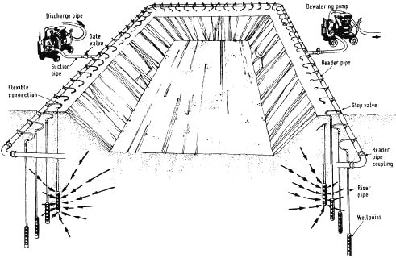
Wellpoint Method
02
In Wellpoint, wells are drilled around the excavation area with submersible pumps installed in the well shaft. These pumps are connected to a header pipe allowing the groundwater to be drawn up by the pumps into the Wellpoints and then discharged.
This method features easy installation, and it’s relatively cheap and flexible, being practical and effective under most soil and hydrologic conditions.

Slide 21
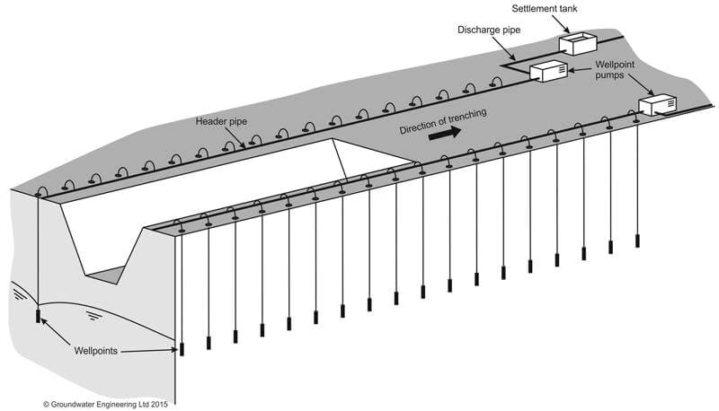
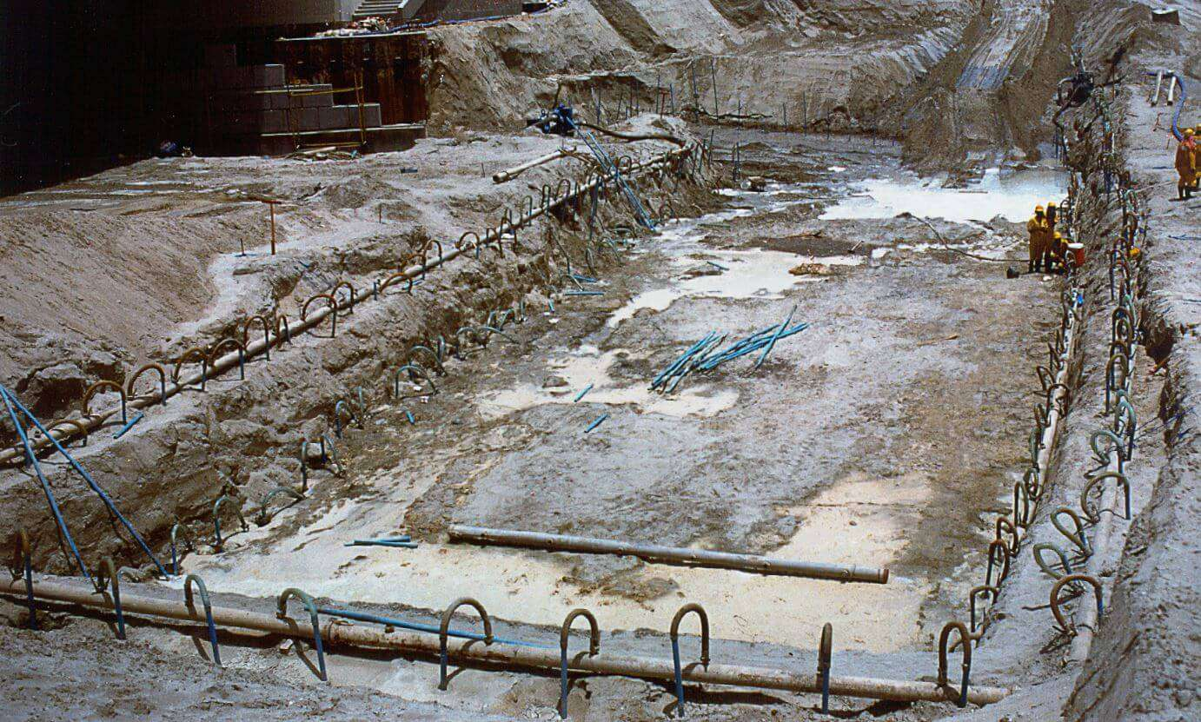
HOW IT WORKS!
Wellpoint systems consist of a series of small-diameter wells, connected by a header pipe to a centrally located suction pump. Groundwater is abstracted via the wellpoints from a vacuum generated by the pump. The perforated pipe has a ball valve to regulate the flow of water (the ball valve also prevents the mud from entering into the pipe). Groundwater can be lowered about six metres by this method.
This method is ideal for buildings with deep basements and is effective in sands and sandy gravels.

Slide 22
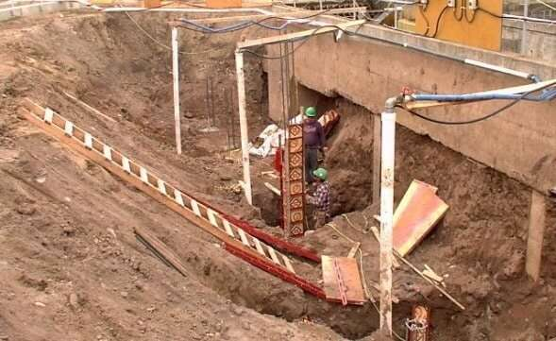
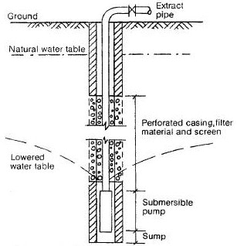
03
In Deepwell, one or several individual wells are drilled, and submersible pumps are placed in each shaft. The Deepwell technique is best suited for deep excavations where large water volumes need to be discharged. The diameter of wells, in this case, varies between 150-200mm. According to the type and arrangement of pumps, the depths of the wells could reach up to 30m. This method is generally adopted when a heavy amount of water from the ground has to be drawn out. In cases when wellpoints and deep wells are not suitable methods for dewatering, the use of eductors can be considered.
DEEPWELLS

Slide 23

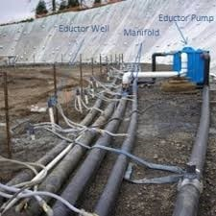
EDUCTOR WELLS

Slide 24
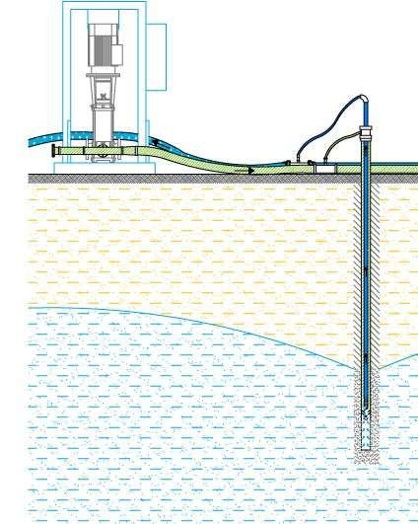
Eductor wells
04
The eductor system (also known as the ejector system) is a specialist technique used in low permeability soils such as very silty sands, silts, or clays. Eductors are typically used to help stabilise the side slopes and soil in the excavation area.
A high-pressure supply main feeds water through a venturi-tube just above the well-screen, creating a reduction in pressure which draws water through the riser pipe.
The biggest advantage of using the eductor system is, the water table can be lowered from depths of 10-45 m if multiple pumps are operated from a single pump station.

Slide 25


