Slide 1
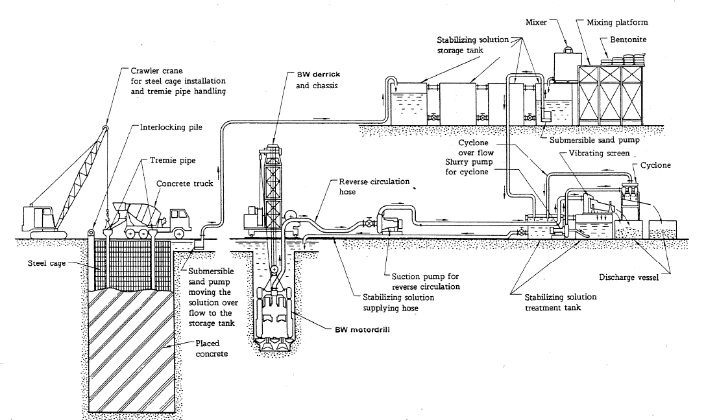
Driving Diaphragm walls
NAME - ISHAAN SACHDEVA
CRN -2014032
URN -2014032

Slide 2
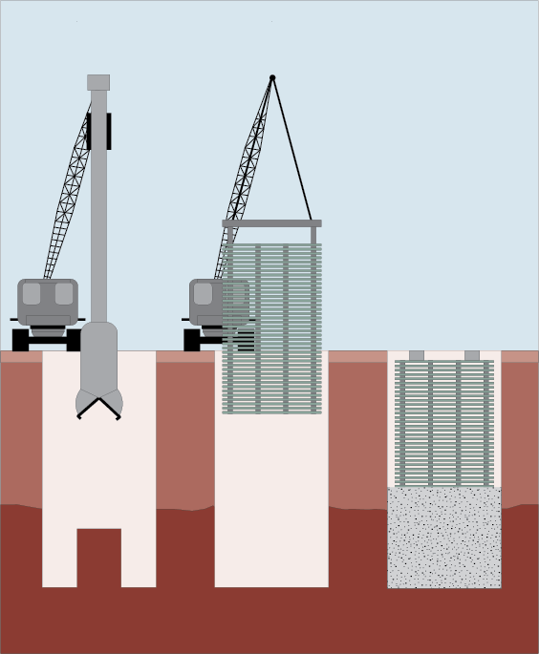
What are Driving Diaphragm Walls?
Diaphragm walls are underground structural elements used in construction to support large vertical loads or to act as retaining walls. They are constructed by excavating a trench and then filling it with concrete, which is reinforced with steel bars or cages.
The process of constructing diaphragm walls is known as "driving" or "installing" diaphragm walls. This involves using heavy equipment to excavate the trench and then placing and compacting the concrete. The process can be quite complex and requires specialized knowledge and skills.

Slide 3
The equipment and materials needed for the process driving diaphragm walls
Diaphragm wall grabs: These are large mechanical grabs that are used to excavate the soil and form the trench for the diaphragm wall.
Tremie pipes: These are long, flexible pipes that are used to pour concrete into the trench.
Bentonite slurry: This is a mixture of water and bentonite clay that is used to support the excavation and prevent the trench from collapsing. The slurry also helps to lubricate the trench walls, making it easier to install the steel reinforcement cages.
Steel reinforcement cages: These are large, heavy cages made of steel bars that are installed in the trench and used to reinforce the concrete.

Slide 4
The equipment and materials needed for the process driving diaphragm walls
Concrete: This is used to fill the trench and form the diaphragm wall.
Cranes: These are used to lift and position the diaphragm wall grabs and other equipment.
Pumps: These are used to transport the bentonite slurry and concrete from the mixing and storage tanks to the excavation site.
Mixing and storage tanks: These are used to mix and store the bentonite slurry and concrete.

Slide 5
The equipment and materials needed for the process driving diaphragm walls
Surveying equipment: This is used to ensure that the diaphragm wall is constructed according to the design specifications and is of the correct size, shape, and depth.
Safety equipment: This includes personal protective equipment such as hard hats, safety glasses, gloves, and safety harnesses, as well as safety barriers, warning signs, and other safety measures to protect workers and the public during the construction process

Slide 6
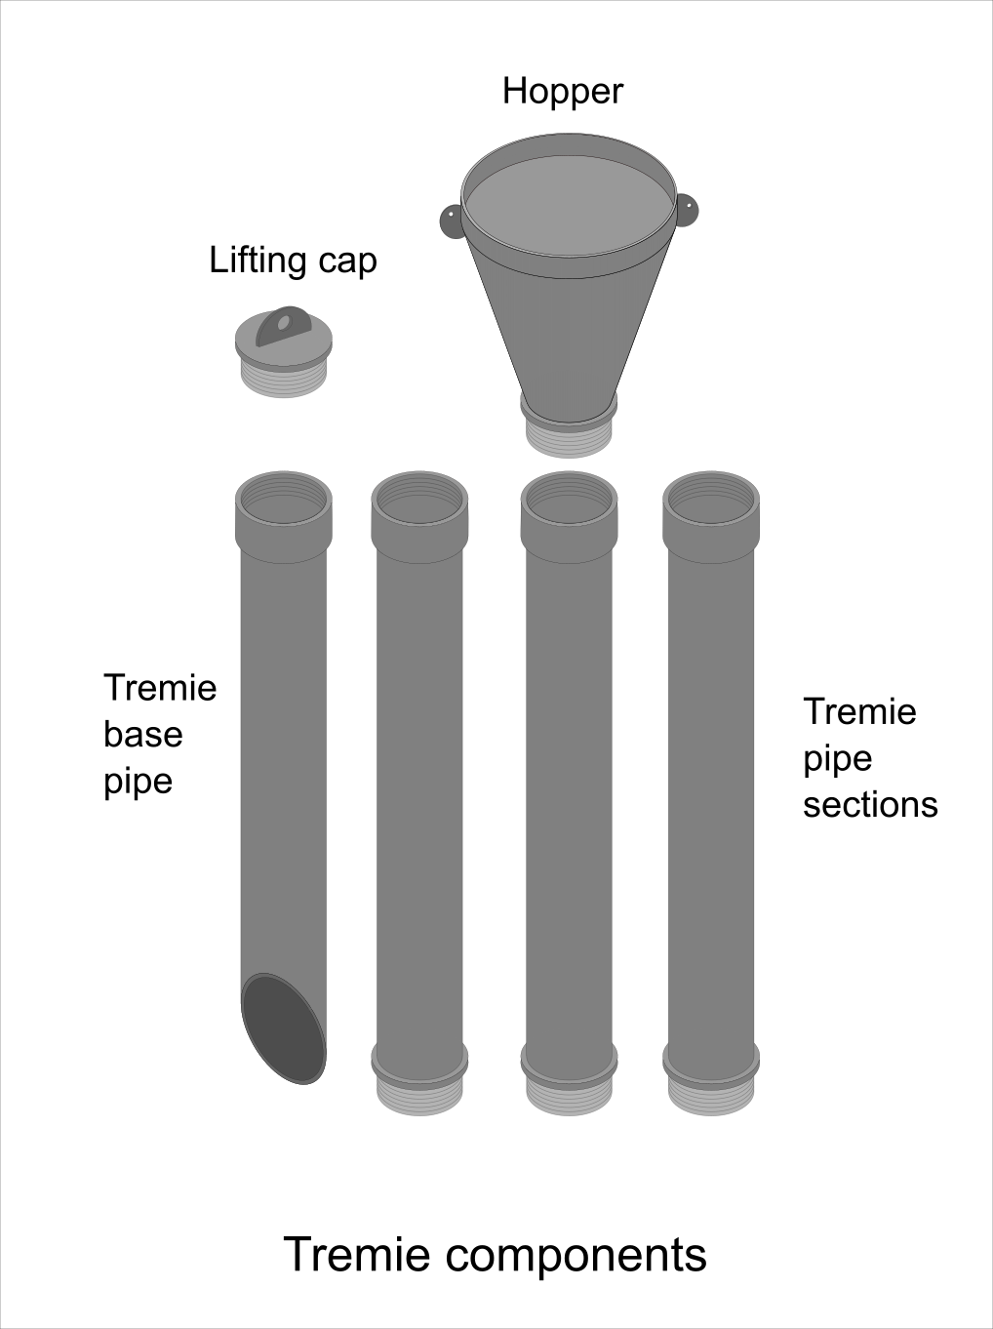
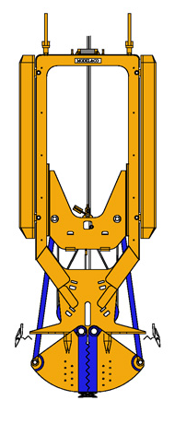
The equipment and materials needed for the process driving diaphragm walls
Diaphragm wall grabs

Slide 7
Diaphragm wall construction procedure
Excavation: The first step in the construction of a diaphragm wall is to excavate a trench along the perimeter of the structure. The trench is typically excavated to a depth that is slightly deeper than the final depth of the wall.
Reinforcement: Once the trench has been excavated, a steel reinforcement cage is lowered into the trench. The reinforcement cage is typically comprised of several layers of steel bars that are tied together using wire. The reinforcement cage is designed to provide the necessary strength and stiffness to the wall.
Formwork: After the reinforcement cage has been installed, formwork is erected along the perimeter of the trench. The formwork is typically made of steel or wood and is designed to hold the concrete in place until it sets.

Slide 8
Diaphragm wall construction procedure
Concrete placement: Once the formwork has been installed, concrete is poured into the trench. The concrete is typically placed using a tremie pipe, which is a large, flexible tube that is lowered into the trench. The concrete is poured through the tremie pipe and displaces the water in the trench, ensuring that the concrete is placed evenly.
Excavation of next panel: After the concrete has set, the formwork is removed, and the excavation of the next panel begins. The process is repeated until the entire diaphragm wall has been constructed.
Post-construction activities: Once the diaphragm wall has been constructed, any necessary post-construction activities, such as grouting or waterproofing, can be carried out to ensure the longevity of the structure.

Slide 9
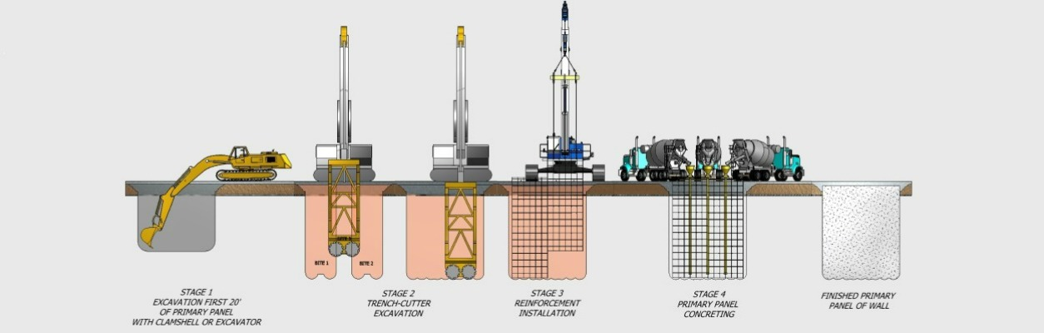
Different techniques used to install diaphragm walls
Slurry trench method: This is the most common technique used for installing diaphragm walls. It involves excavating a narrow trench using a special digging tool called a diaphragm wall grab. As the trench is excavated, a bentonite slurry is pumped into the trench to support the walls and prevent collapse. After the trench is excavated to the required depth, the reinforcement cages are inserted, and concrete is poured into the trench from the bottom using a tremie pipe. The slurry is then displaced by the concrete.

Slide 10
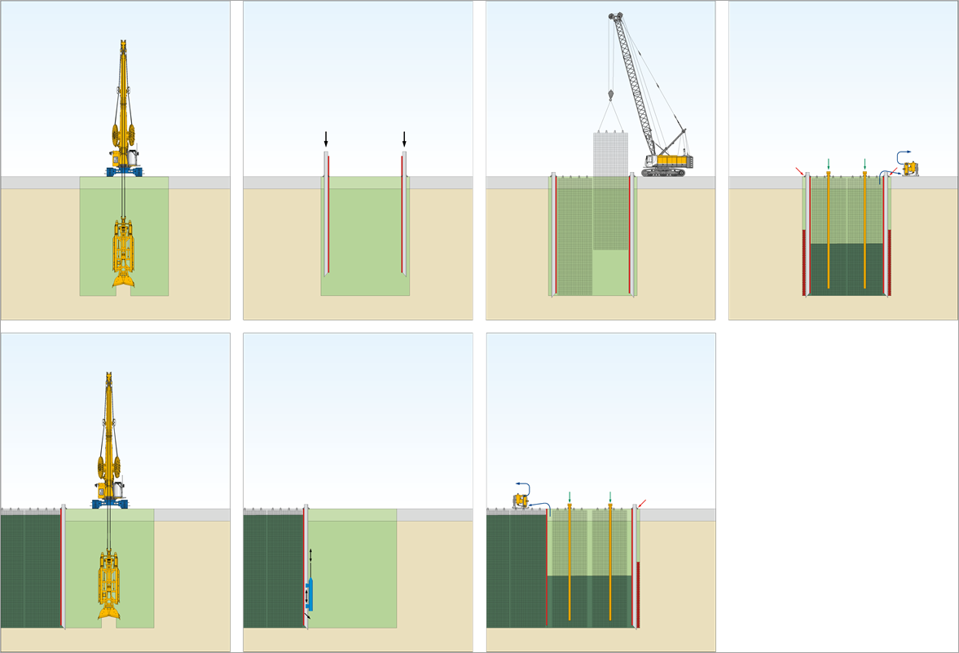
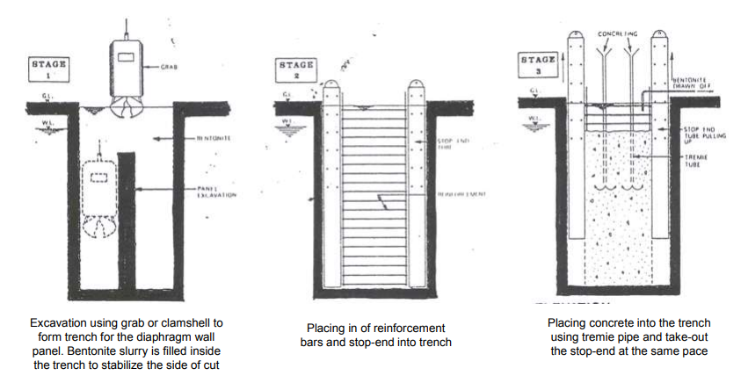
Different techniques used to install diaphragm walls
Grab and drop method: This technique involves excavating the trench in stages using a diaphragm wall grab. The grab is lowered into the soil and then lifted out, carrying a load of soil. The soil is dropped onto a conveyor belt, which transports it away from the excavation area. The process is repeated until the trench is excavated to the required depth. The reinforcement cages are then inserted, and the trench is filled with concrete using a tremie pipe.

Slide 11
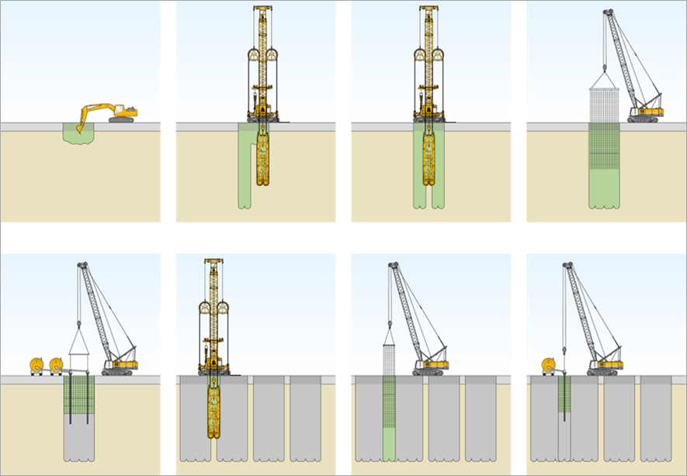
Different techniques used to install diaphragm walls
Cutter soil mix method: This method involves excavating the soil using a rotating cutter head that mixes the soil with a cement slurry to create a soil-cement mix. This creates a support structure that is stronger than a bentonite slurry and can be used in difficult soil conditions. The reinforcement cages are then inserted, and the trench is filled with concrete.

Slide 12

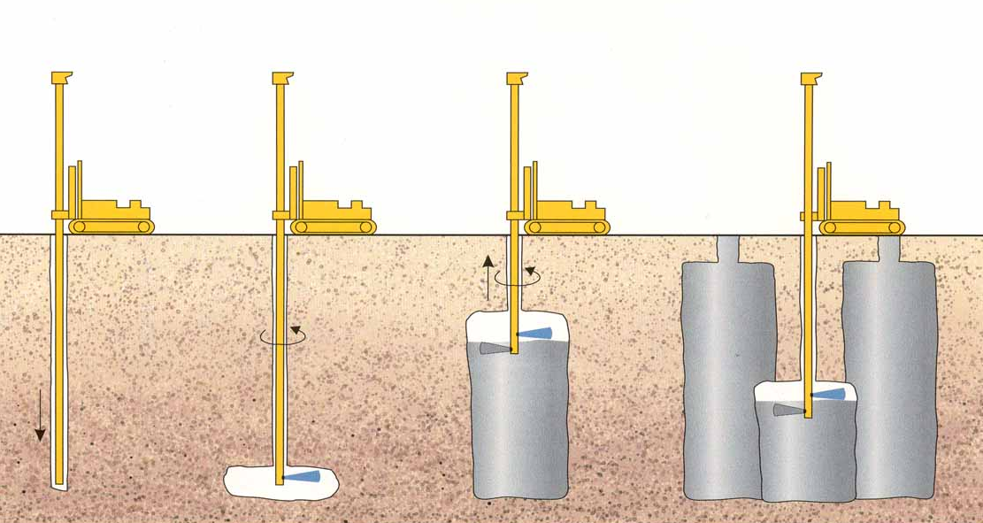
Different techniques used to install diaphragm walls
Jet grouting method: This technique involves injecting high-pressure jets of cement grout into the soil to create a soil-cement mix. The mixture is then allowed to harden, forming a solid wall. The process is repeated to create the full-depth diaphragm wall. Reinforcement cages are then inserted, and the trench is filled with concrete

Slide 13
The safety precautions that must be taken in installing diaphragm walls
Installing diaphragm walls can be a complex and hazardous construction process that involves large machinery, heavy materials, and deep excavations. As a result, it is crucial to follow proper safety precautions to minimize the risk of accidents and injuries. Here are some of the key safety precautions that must be taken during the installation of diaphragm walls:
Personal protective equipment: All workers involved in the construction process must wear appropriate personal protective equipment (PPE) such as hard hats, safety glasses, steel-toed boots, and high-visibility vests.

Slide 14
The safety precautions that must be taken in installing diaphragm walls
Traffic control: Construction sites must be properly marked and cordoned off to prevent unauthorized access, and traffic control measures must be put in place to protect workers and pedestrians.
Excavation safety: Adequate shoring, bracing, or sloping must be used to prevent soil collapse and cave-ins. Workers should also stay clear of excavated areas, and heavy equipment should not operate close to excavation edges.
Machinery and equipment safety: All equipment used in the construction process must be properly maintained and inspected regularly to ensure they are in good working condition. Only trained and authorized workers should operate the machinery and equipment

Slide 15
The safety precautions that must be taken in installing diaphragm walls
Material handling safety: Proper lifting and rigging techniques should be used to lift and transport heavy materials such as steel reinforcement cages and concrete. Material handling equipment such as cranes should be properly rated for the weight of the load and operated by trained personnel.
Electrical safety: Electrical hazards must be identified, and appropriate measures taken to prevent electrocution, such as de-energizing or grounding electrical circuits.
Emergency response: Adequate emergency response plans and procedures should be in place, including evacuation plans, first aid procedures, and rescue equipment.

Slide 16
The benefits of using diaphragm walls in construction projects.
Structural strength: Diaphragm walls provide high structural strength and can withstand significant loads, making them ideal for use in deep excavations and foundation works.
Water-tightness: Diaphragm walls can be designed to provide water-tightness, making them suitable for use in projects that require the retention of groundwater or the prevention of water ingress.
Durability: Diaphragm walls can provide long-term durability and stability, reducing the need for maintenance or replacement.

Slide 17
The benefits of using diaphragm walls in construction projects.
Versatility: Diaphragm walls can be constructed to suit various geometries, making them adaptable to a wide range of projects, such as basements, underground structures, and tunnels.
Environmental benefits: The use of diaphragm walls can help reduce the environmental impact of construction projects by minimizing excavation volumes and reducing noise and vibration levels.

Slide 18
The limitations of using diaphragm walls in construction projects
Cost: Diaphragm walls can be expensive to install, requiring specialized equipment and skilled labor.
Site conditions: The suitability of diaphragm walls for a project depends on the site conditions, such as soil type and groundwater level. Unsuitable site conditions can increase the complexity and cost of the construction process.
Limited access: The size and depth of diaphragm walls can limit access to the construction site, making it difficult to transport materials and equipment.

Slide 19
The limitations of using diaphragm walls in construction projects
Limited flexibility: Once constructed, diaphragm walls are relatively inflexible and cannot be easily modified or adjusted.
Environmental impact: While diaphragm walls can reduce the environmental impact of construction projects, the construction process can still generate noise, dust, and emissions, which can affect nearby communities and the environment.

Slide 20

THANK YOU

