Slide 1
SHEET PILES
PRESENT BY:-
JATIN GARG 2014036
JITENDRA SHAH 2014037

Slide 2
Table of contents
01
02
03
Introduction
Selection
Types
04
06
Applications
Advantages & Disadvantages
05
Procedure

Slide 3
01.
Introduction

Slide 4
Introduction
It is the type of pile that is made of concrete, steel or wood
The thickness of the pile is very less when compared to the length and width of the pile
To prevent the entry water in construction the sheet piles are used, this is also used to separate the vertical member of the building
The piles are inserted by some machine the depth of the piles can be increased by proper joints in successive installment
Provided when large area is to be excavated for a depth grater than 10m
Used when the soil is soft or loose
Provided when the width of the trench is large
It is also provided when the subsoil water is present

Slide 5
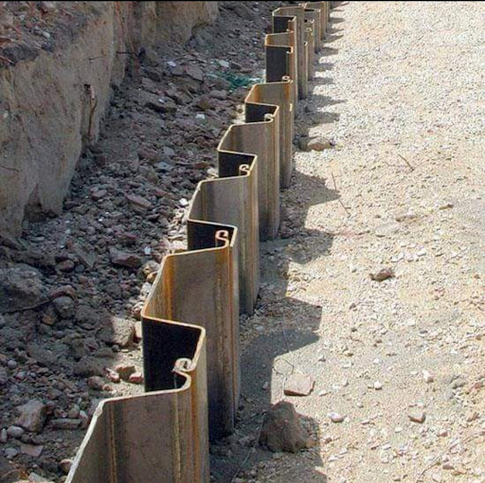

Slide 6
Selection of Sheet Pile
02

Slide 7
The Selection of sheet piling is dependent on factors, such as
01
02
03
04
05
06
The type of work,
For ex. Whether it is permanent or temporary
Site conditions
The required depth of piles.
The bending moments involved.
The nature of the structure.
The type of protection required.

Slide 8
03
Types of Sheet Pile

Slide 9
Types of Sheet Piles
04
03`
Vinyl sheet piles
02
Steel sheet piles
01
Reinforced concrete sheet piles
Timber sheet piles

Slide 10
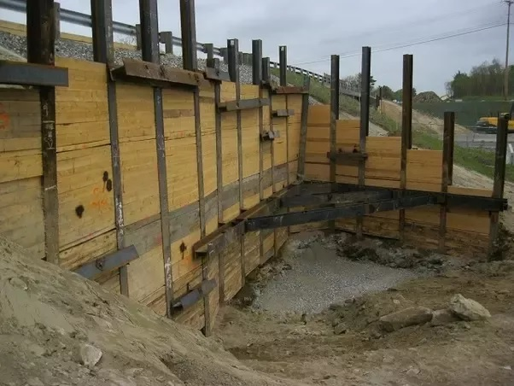
01-Timber sheet piles
Timber sheet piles are generally used for short spans in temporary structures, and to resist light lateral loads. They are typically connected together by groove joints. The disadvantage of timber piles is that they require preservative treatments.

Slide 11
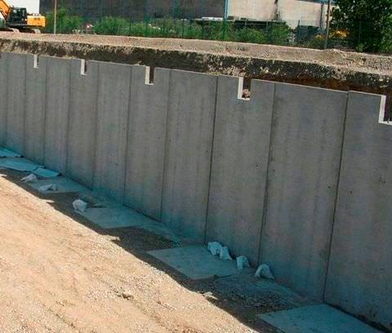
02-Reinforced concrete sheet piles
Reinforced concrete sheet piles are formed using precast concrete members, usually connected together by groove joints. They are commonly used in permanent river embankments, canals and other marine structures. The toe of the sheet piles are usually cut with an oblique face to facilitate easy driving and interlocking, while the heads are finished off by casting a capping beam.

Slide 12
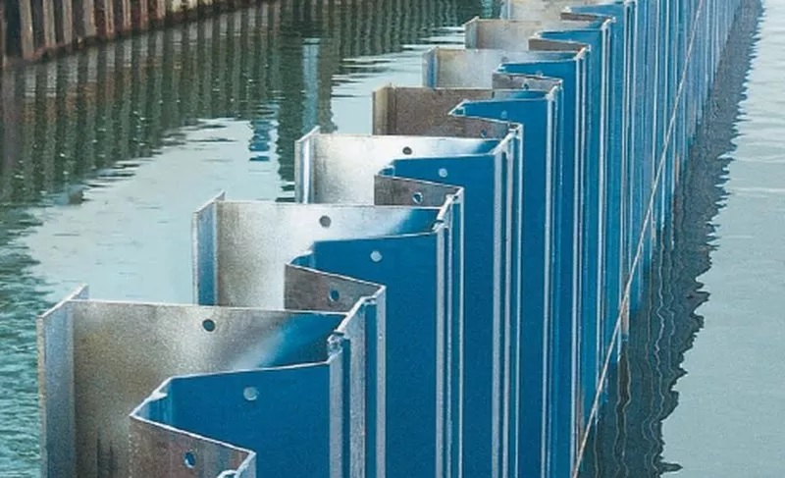
03-Steel sheet piles
Steel is the most common form of sheet piles as it has good resistance to high driving stresses, excellent water tightness, and can be increased in length either by welding or bolting. They are connected by interlocking.

Slide 13
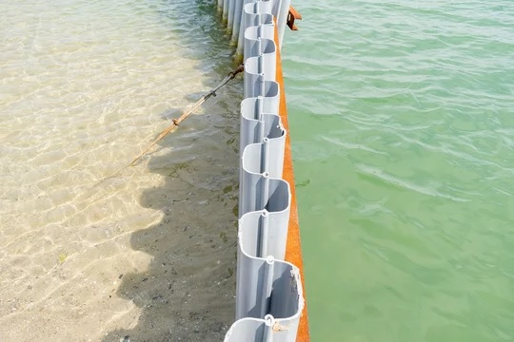
04-Vinyl sheet piles
An effective alternative to steel sheet piling for bulkheads, seawalls and cutoff walls. They are also superior to alternative materials like concrete and wood. The main advantage of vinyl sheet piles is the superior corrosion resistance when exposed to seawater, where no oxidation occurs.

Slide 14
04
PROCEDURE

Slide 15
Procedure
Lift the pile by using mobile crane
Place and align the pile to interlock
Remove the lifting cable attached on the pile
Hook and lift vibro-hammer
Interconnect the vibro-hammer into the pile
Activate the vibro-hammer and drive into the required depth
Weld and fix the wale assembly

Slide 16
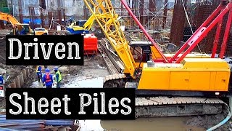
https://www.youtube.com/watch?v=mnYccK9G1u8

Slide 17
05
APPLICATIONS

Slide 18
Applications
Used in constructions of seawell and bulkhead.
Used as the barriers to the groundwater flow
Used for retaining the loose soil around the foundation trenches

Slide 19
06
Advanatges & Disadvanatges

Slide 20
Advantages
Provides high resistance for driving stresses.
Light weight.
Can be reused on several projects.
Long service life above or below water with modest protection.
Easy to adopt the pile length by either welding or bolting.
Joints are less apt to deform during driving.
Availabe in wide range of shape and sizes.
Installed in verry less time
Requirement of less maintaince.

Slide 21
Disadvantges
Sections can rarely be used as part of the permanent structure.
Installation of sheet piles is difficult in soils with boulders or cobbers. In such cases, the desired wall depth may not be reached.
Excavations shape are dedicated by the sheet pile section and interlocking elements.
Sheet pile driving may cause neighbourhood distrubance.
Settlements in adjacent properties may take place due to installation vibrations.

Slide 22
QUESTIONS
Q1:- WHAT IS SHEET PILING?
Q2:- WHAT ARE ADVANTAGES OF SHEET PILES?
Q3:- HOW THICK ARE SHEET PILES?
Q4:- NAME THE TYPES OF SHEET PILES?

Slide 23
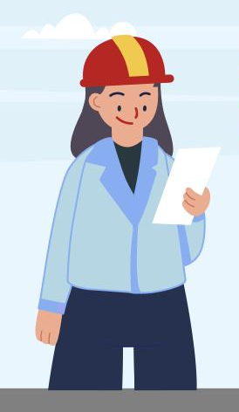
Thanks!

