Slide 1
DJAVAC: Automated Load Distribution Engine for Java
Yaşar University
Computer Engineering Department
Fulya Ertay Yaren Gündüz Halil Bülent Orhon Berke Sayan

Slide 2

OUTLINE
Problem Introduction
What is the DJAVAC?
Implementation of DJAVAC
Functionalities of DJAVAC
Evolutions
Conclusion & Suggestion

Slide 3


1.Problem Introduction
Writing same codes many times on Java.
Consuming a lot of time for programmers.
Creating a compiler engine over network is the great deal to create.

Slide 4
2.What is the DJAVAC?
The aim is providing to enable the Java programmer to write higher quality codes by spending less time.
DJAVAC is an automated loaded engine for java methods compilation over the network.
This engine is used when “distributed” denoted word on a selected method.
It is collected workload on the selected method and then distributed over TCP/IP network.
It can run on local network and internet.
DJAVAC creates an opportunity to load the code and executes between server and clients for programmers.

Slide 5
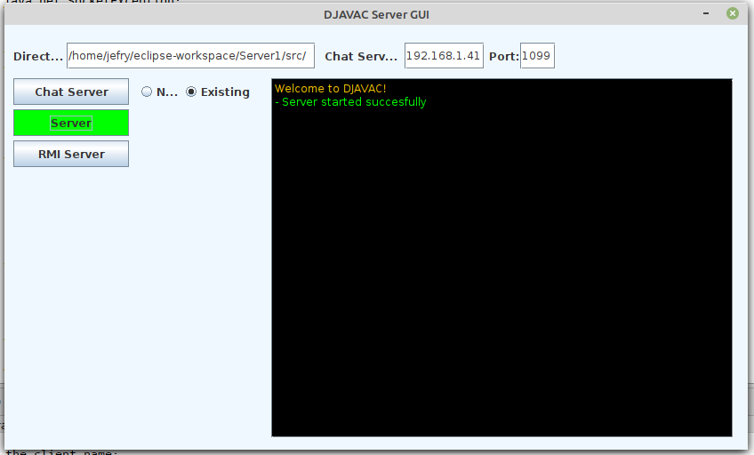
DJAVAC SERVER GUI

Slide 6
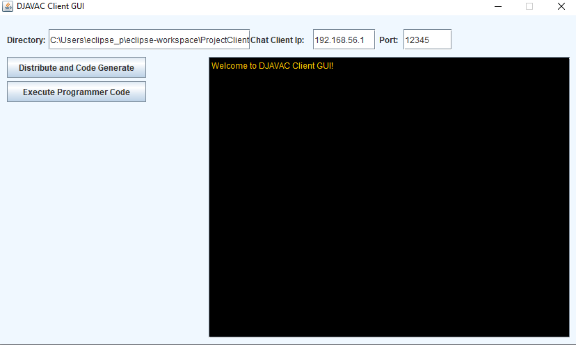
DJAVAC CLIENT GUI

Slide 7
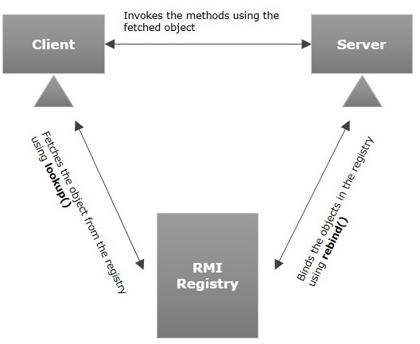
3.Implementation of DJAVAC
Remote Method Invocation (RMI) is an API which allows an object to invoke a method on an object that exists in another address space, which could be on the same machine or on a remote machine.
RMI interface is used invoking remote methodology. Stub object (on client side) and Skeleton object (on server side).
First step for the project is implementing Server-Client interaction codes over the network.
In this case, client writes code or invoke a method, then server executes this method and returns code result to client.
Source:https://www.tutorialspoint.com/java_rmi/java_rmi_introduction.htm

Slide 8
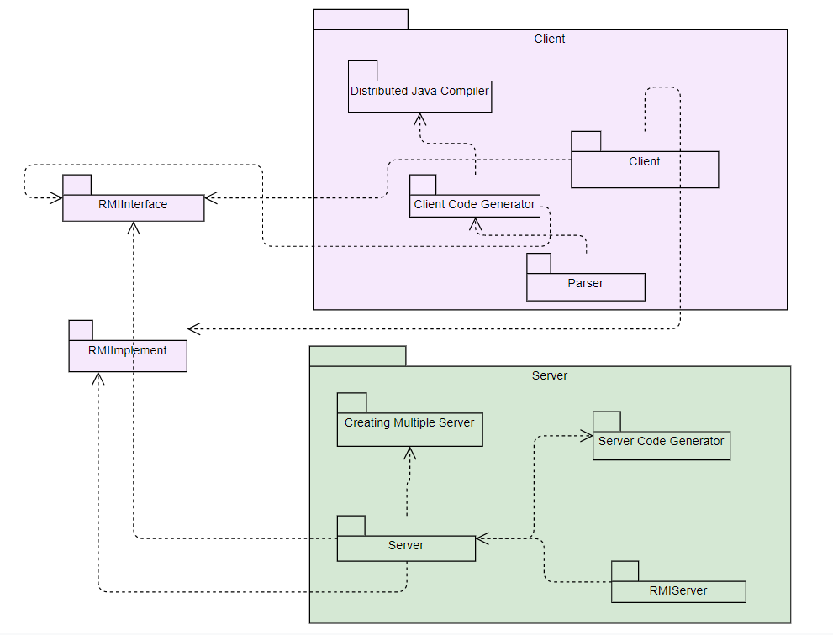
3.Implementation of DJAVAC(Cont.)
DJAVAC includes some important parts that are following;
Central Server-Server-RMI Server
Programmer Own Code-(Copy of this java files)
Parser- Distributed Java Compiler-Code Generator-Server Code Generator
Key class and methods that are used for execute the java files and start-stop the rmiregistry in Windows 10 and Ubuntu OPSIS.
Multiple Server-Multiple Client methodology

Slide 9
4.Functionalities of DJAVAC
Detecting the «distributed» keyword that is declared before the desired method which is written by a Java programmer.
Detecting regular functions without «distributed» keyword.
Providing Server-Client mechanism anywhere.
Executing Client’s codes with written «distributed» keyword over Server.
Supporting multiple Client/Server architecture.
Sending IP address of available server over network.
Collecting workload on the selected method and then distributing over TCP/IP network.

Slide 10
5.Evolutions
When Client’s code is distributed over TCP/IP network, Server runs its code and returns back to the Client.
Client/Server communication is provided successfully.
Clients can write more quality Java codes without spending a lot of time.
The code generators and parser allows for detecting the annotation to receive from the client.
Executing time for Client’s codes over Server depends on the long and complex function written.
Sending IP address of available RMI Server to client without any problem.

Slide 11
6.Conclusion & Suggestion
DJAVAC has multiple Client/Server mechanism.
Java RMI will be used for the connections between client and servers to invoke a method which is called as ‘distributed’ pragma before.
Function with ‘distributed’ pragma can be transferred to the server or the other computers which act as a server.
Server compiles the transferred code and ready to serve these codes over JAVA RMI.
If Java programmers want to write more quality Java codes without spending a lot of time, they should use the DJAVAC.

Slide 12
Thank you for your attention!
Questions?
Yaren Gündüz | Fulya Ertay | Halil Bülent Orhon | Berke Sayan
15070001019@stu.yasar.edu.tr | 16070001182@stu.yasar.edu.tr | 18070001065@stu.yasar.edu.tr | 15070001028@stu.yasar.edu.tr

