Slide 1
Seasonal Vehicle Data Analysis

Slide 2
Objective
To come up with a tool to support Ashok Leyland’s sales and Marketing team to identify possible opportunities for sale.
To identify nascent market opportunities for perishable and seasonal goods like Grapes, Mangoes and Onions and to analyze the vehicle types typically used to transport these products.

Slide 3
Objective
The idea is to make sure Customer's vehicles face a minimum down time, in case of components failures, especially when transporting seasonal perishable goods.

Slide 4
Dataset Description
2 datasets were used for the analysis:Seasonal and vehicle dataset.
Seasonal Dataset contains data about the seasons(lean , off , peak) for the identified products in a given state(district-wise) for each month
Vehicle dataset contains vehicle data (from January 2021 to August 2021)

Slide 5
Dataset Description
Seasonal Dataset :
S.No | Features | Summary
1. | State
2. | Product | Product being analyzed (Grape , Mango, Onion)
3. | District
4. | Month | Month of the year
5. | Season | Season of the particular product in a particular state at a particular month of the year(off , lean, peak)

Slide 6
Dataset Description
S.NO | Features | Summary
1. | Month Of Date | In datetime64 format (01-02-2021/ Date-month-year)
2. | State
3. | Districts
4. | Subsegment | The subsegment the particular vehicle belongs to
5. | Is Bs6 | (0/1)1 to indicate that the vehicle is of bs6 type and 0 to indicate that the vehicle is not
6. | Latitude
7. | Longitude
8. | Vehicle Density | Count of vehicles in a particular district(in an around a particular lat long value)
Vehicle Dataset:

Slide 7
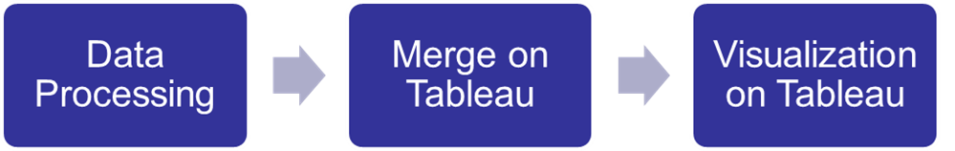
Steps Involved

Slide 8
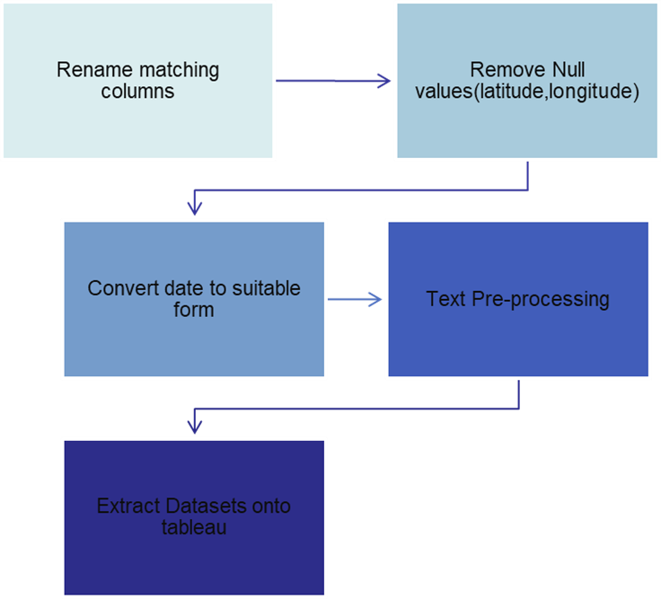
Data Processing

Slide 9
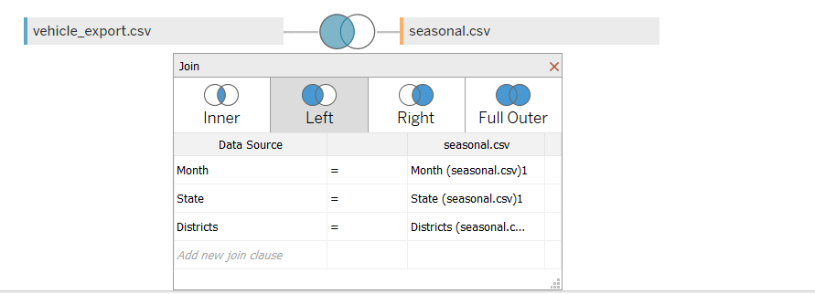
Merge on Tableau
The two datasets were merged on Tableau
A Left join was done on the common fields –Month,State,District.

Slide 10
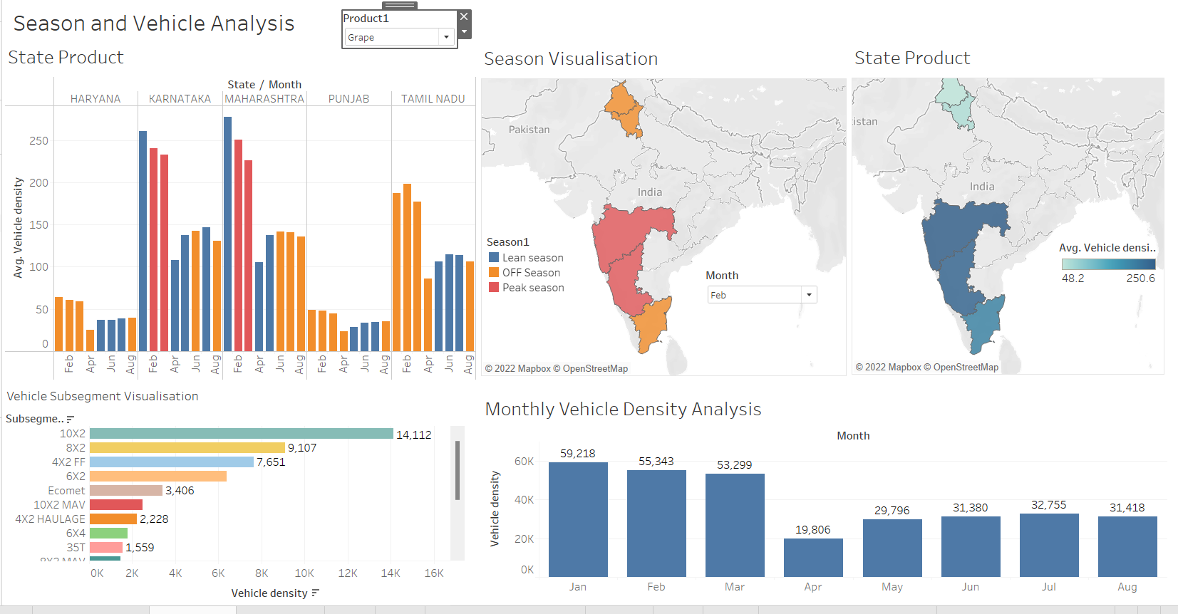
Visualisation(Dashboard1)

Slide 11
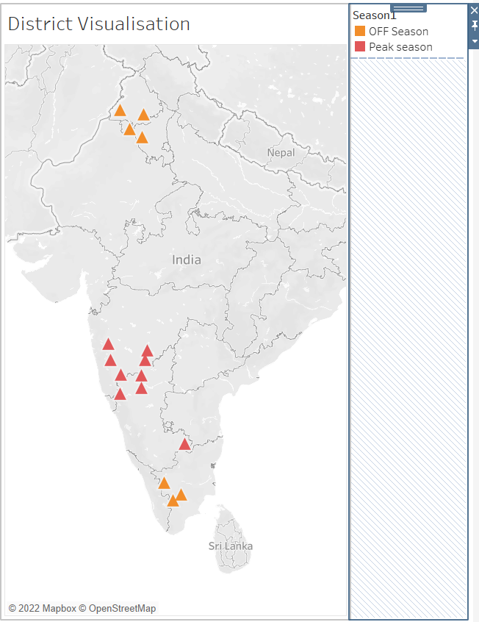
Visualisation(Dashboard2)

Slide 12
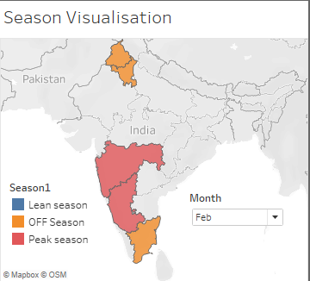
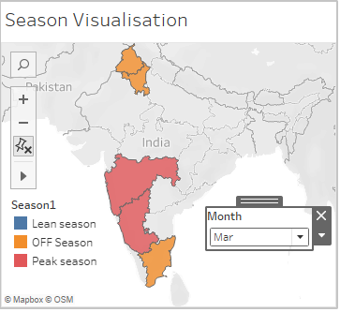
Outcomes-Grape
It is seen from the visualisation below that there is a peak season for Grape in the month of Feb and March in the states of Maharashtra and Karnataka

Slide 13
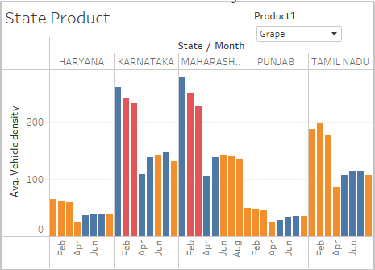
Outcomes-Grape
When there is a peak season for grape we observe that the vehicle density is also high (in the corresponding states)

Slide 14
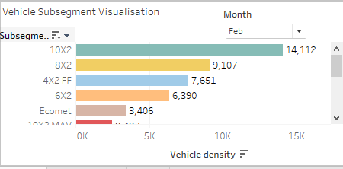
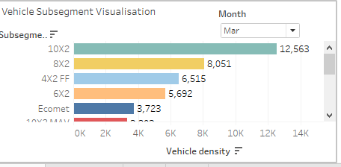
Outcomes-Grape
It is observed that the subsegments 10X2 and 8X2 have operated the most in the months of Feb and March.

Slide 15
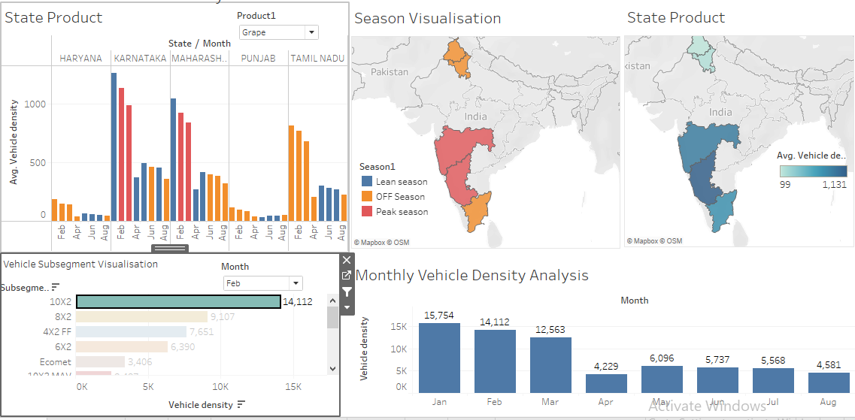
Outcomes-Grape
Considering the 10X2 sub segment for the month of Feb we observe that the density of 10X2 in the states where grape is peak is high.

Slide 16
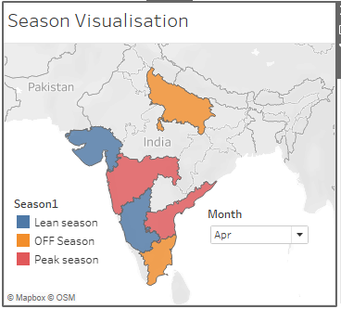
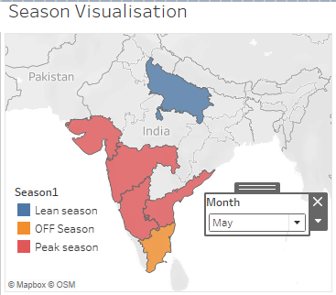
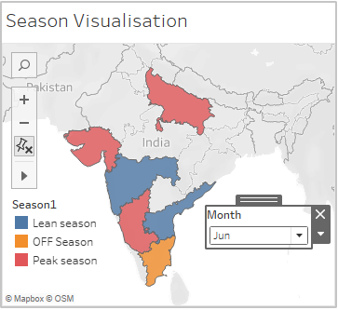
Outcomes-Mango
It is visualised that mango has a peak season from April-June.

Slide 17
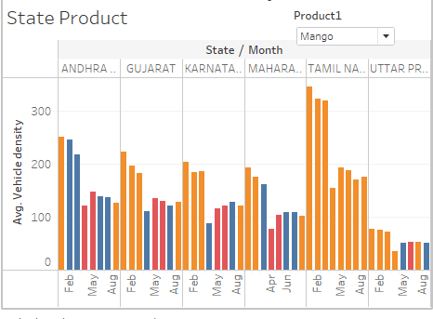
Outcomes-Mango
Visualisation of vehicle density over different seasons in different states:
It is seen that Vehicle Density is not that high for mango in the peak season

Slide 18
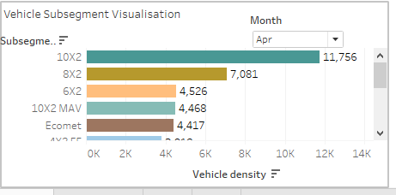
Outcomes-Mango
It is observed that the sub segments 10X2 and 8X2 are predominantly used in the months of April and May and the sub segments 10X2,10X2 MAV, Ecomet,8X2 and 4X2 Haulage are predominantly used in the month of June.

Slide 19
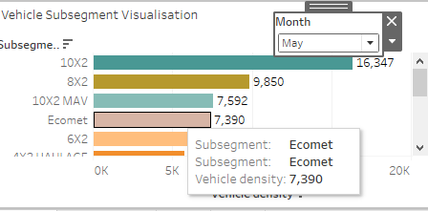
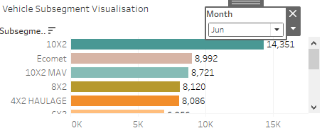
Outcomes-Mango

Slide 20
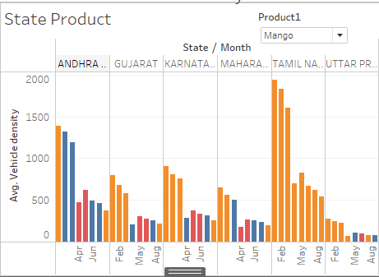
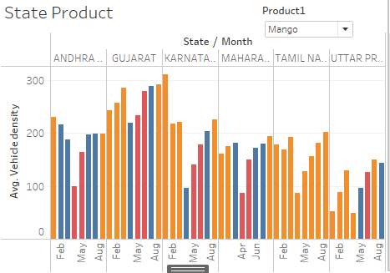
Outcomes-Mango
Consider the month of June where there are 5 sub segments that are predominant-10X2,8X2,Ecomet,10X2 Mav,4X2 Haulage.
10X2: Eco met:

Slide 21
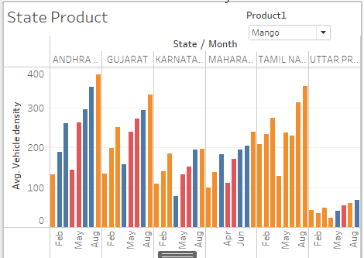
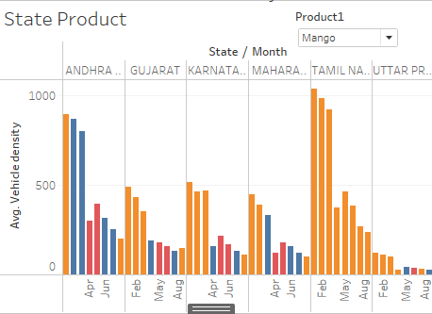
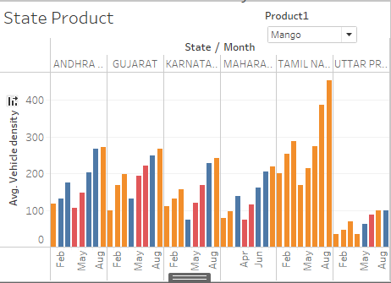
Outcomes-Mango
10X2 Mav 8X2
4X2 Haulage

Slide 22
Outcomes-Mango
From the visualisations for Mango for the month of June we observe that the Ecomet and the 10X2 Mav are predominantly used for mango Transport.
A low vehicle density is observed for the months of April and May due to government restrictions(lockdown).

Slide 23
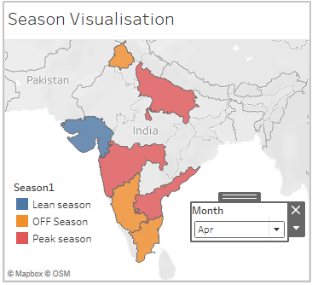
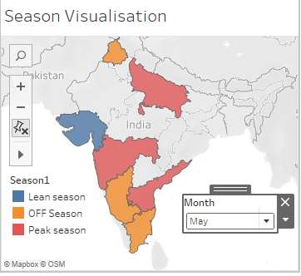
Outcomes-Onion
It is observed that Onion has a peak season in April and May in the states visualised below.

Slide 24
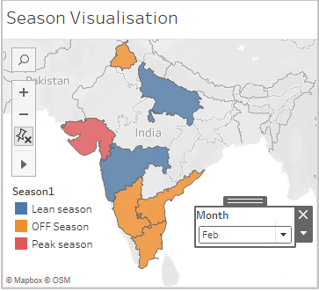
Outcomes-Onion
Onion production peaks in Feb in Gujarat .

Slide 25
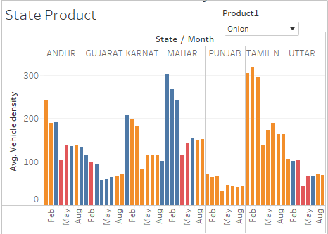
Outcomes-Onion
Visualisation of vehicle density over different seasons in different states:

Slide 26
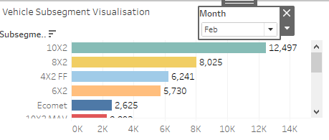
Outcomes-Onion
It is visualised that the sub segments 10X2,8X2 are predominantly used in the month period Feb-April and the sub segments 10X2,8X2,10X2 Mav, Ecomet are predominantly used in the month of June

Slide 27
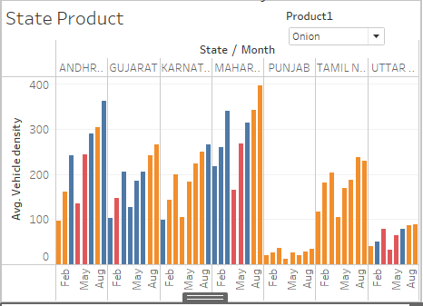
Outcomes-Onion
It is visualised that the 10X2 and 8X2 are used predominantly in Gujarat when Onion peaks.
The 10X2 Mav is used the most in Maharashtra and Andhra Pradesh when there is a peak of Onion production.

Slide 28
Insights
Sales team will have a clear idea about which models can be sold in a particular area and they can give a prior schedule to manufacturing plants so that they can be prepared even before the season starts
Service team can stock up the identified parts so that the down-time of the vehicle is minimized.

Slide 29
Skills Learnt
Data cleaning and processing using python
Working with modules like pandas for pre-processing, matplotlib for plotting in python , numpy library
Connected vehicles and Big data
Data Analysis
Merging datasets on tableau
Clustering (DBSCAN)
Visualisation in tableau(Geographic visualisation, filters, calculated fields etc)

