Slide 1
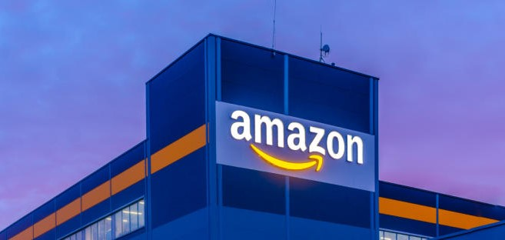
amazon marketing success

Slide 2
01
Introduction
02
Gaurav’s Profile
03
Statistics
04
Timeline
Contents
05
Charts
06
Clustering
07
Competitors
08
Models
09
Strategies
10
References

Slide 3
Introduction
Amazon is a big player in the e-commerce sector, particularly in the Indian market. Generally, I love to work on ecommerce website so it’s enjoyable to work on Amazon Dataset. I am now working on a dataset that includes Indian women's summer dresses and information about their sales. On July 5, 1994, Jeff Bezos launched Amazon from his garage in Bellevue, Washington but Amazon launched an e-commerce website in India in 2013. They started with only selling books. The primary reason for selecting this business is to examine client behaviour and their interactions with this website. Given the diversity of India, Amazon faces several rivals, including Flipkart, Myntra, Snapdeal, and many others, who could have an impact on its sales.
Mission
Learning valuable insights and best practices from data that may apply to for upcoming marketing initiatives.

Slide 4
About me
I am Gaurav Negi, and I am a student. I have 2 years of experience in digital marketing. After that, I switched my career to Data Analyst. I am proficient in tools like Python, Tableau, SQL, Power BI, Excel, PowerPoint, Word, and Google Analytics. Currently, I am brushing up my skills on my capstone project, marketing analysis project and project management project for the betterment of my future.
Gaurav Negi
Data Analyst

Slide 5

Statistics
2T+ INR
9
Women’s Fashion Industry
PRODUCTS
As per Statista, it has been estimated that the women’s fashion industry in India is worth more than 25 billion dollars.
I am just focusing on specific segments of the fashion sector based on our dataset. I collected 9 products, and the data spans from 27 March 2022 to 26 June 2022.
75m+ INR
8000+
TOTAL SALES
Cities
As per our dataset, the total sales in the span of 3 months crossed 75 million. As per an average, we are capturing only 20 percent market approx.
According to the dataset, there are around 8000 cities and 36 states included. Maharashtra state made the largest goods purchases in a given span of time.

Slide 6
Timeline
Investigating a dataset related to Amazon to obtain insightful knowledge and presenting the significant insights and highlights that came from the data research. As per Insights, maximum number of sales generated by M, L and XL sizes.
MAHARASHTRA
TOTAL SALES
Total Sales – 4.7M+
This month's bestselling sizes were L, M, and XL. Approximately 2.2 million were made by these three categories.
BENGALURU
KURTA
As previously defined, data is from 27 March, so the total amount spent by customers within 4-5 days was 98 thousands.
Bengaluru is in Karnataka State. This city has produced almost 2.2 million sales. L, M, and XL contributed one million in sales.
More than 13,000 units were sold this month. Tamil Nadu, Telangana, Karnataka, and Maharashtra contributed more than half of the sales in that.
March
April
May
June

Slide 7
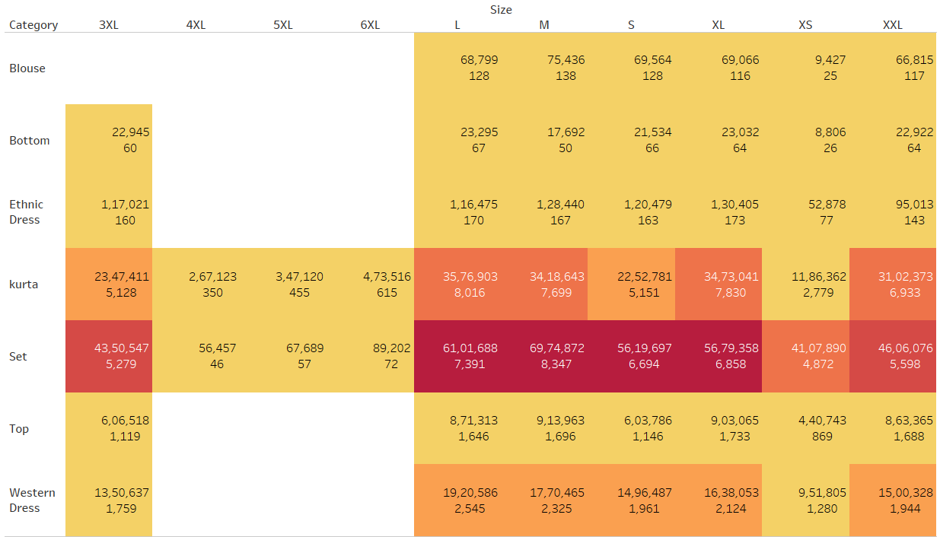
Analyzing Sales Performance: Unveiling Size Trends Across Categories
Sales of sizes L, M, and XL are higher. This suggests that the most customers are teenagers. Set, Kurta and Western Dress has significant sales. Moreover, sales of 3XL, 4XL, 5XL, 6XL, XS, and XXL show that there may be a demand for these sizes as well.
Set, Kurta category has consistent sales across all sizes, promotions, and targeted advertising would boost the sales more.
To boost awareness and sales of less popular sizes (3XL to 6XL and XS, XXL), take seriously specific promotions or advertising.
Create more designs for L, M and XL and do social media marketing to enhance more sales.

Slide 8
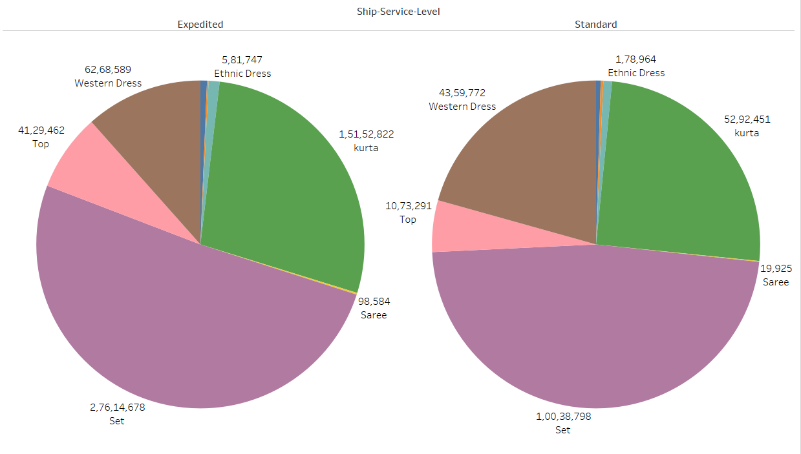
Unveiling Shipping Patterns: Order Distribution Across Categories
Set category in both shipping, indicating high demand. Moreover, Kurta and Western Dress dominate in both shipping categories, showing that customers like them. However, Ethnic Dress is less popular compared to others.
Customer feedback is most important to knowing why certain products are less popular, so we can utilize customer feedback to enhance product offers.
As the SET category is in very high demand, we need to optimize inventory management and delivery time to ensure that stock is enough to meet the demand.
To maximize sales of Kurta and Western Dress, we need to use multi-faceted marketing approach such as digital marketing, influencer partnerships, webpage optimization and promotions.

Slide 9
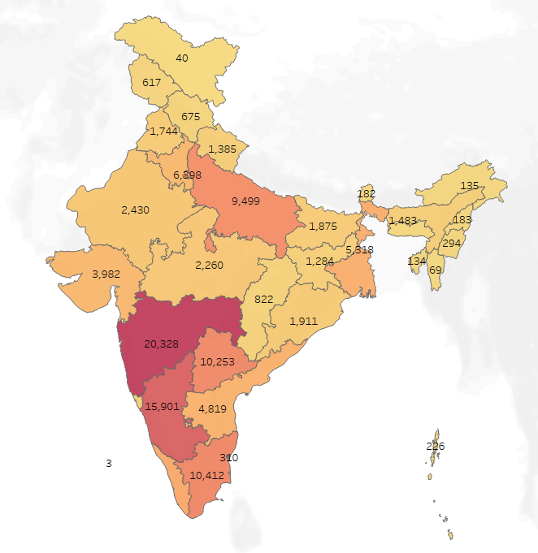
Geographic Sales Analysis: Quantity Sold Across Different States
The information reveals significant geographical variations throughout India. Higher figures (20,328 and 15,901 respectively) are seen in the southern states, especially in Maharashtra and Karnataka, indicating a greater market or demand. Moreover, the moderate prices in the northern and central regions of India indicate possible markets that may be explored and developed.
Targeted marketing would be recommended for southern states as per data, we can clearly see that in southern region the market demand is higher.
To develop northern and central regions we could focus on Market Development Strategies such as special promotions, partnership with local business would help to expand business.

Slide 10
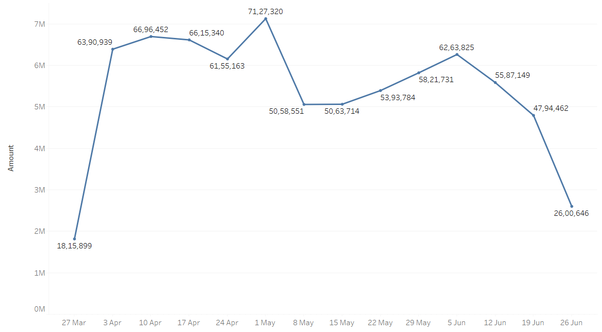
Weekly Sales Snapshot: A Comprehensive Overview of Total Revenue
The graph shows a decline in the Revenue over time. Moreover, the most revenue was generated in the month of April, indicating that there might be a successful campaign or seasonal trend that led to increased sales during that period.
In my opinion, first analyze the cause of decline whether it is done by changes in marketing strategies, market demand, or competition. If the decline in the revenue is due to a change in marketing strategies, then consider past marketing campaigns that were done in April and modify the marketing strategies according to that. This might include special offers and a more targeted audience.

Slide 11
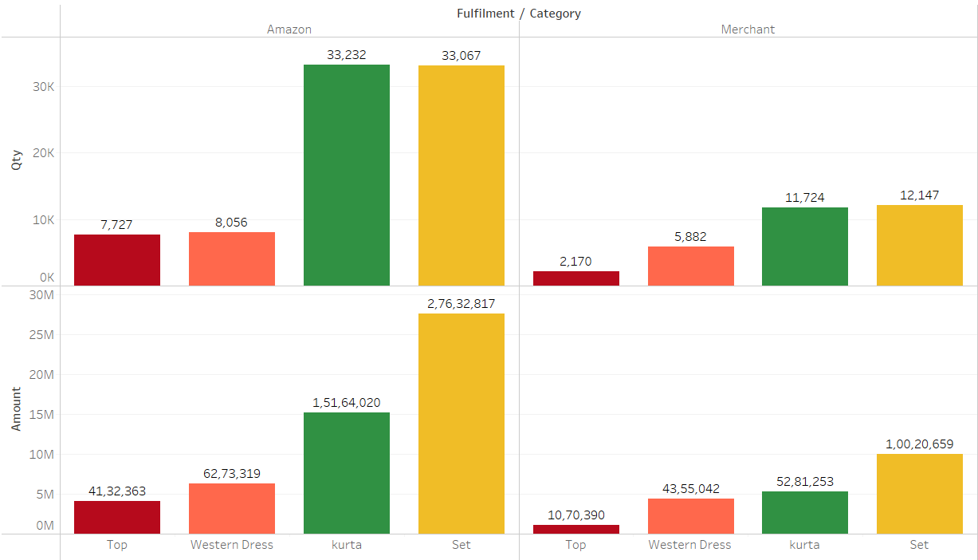
Strategic Fulfilment Choices: Amazon vs. Merchant Fulfilment by Category
For both Amazon and Merchant, the “Kurta" and "Set" categories have significantly higher amounts than the other categories. This suggests that buyers like these products. Moreover, when comparing sales numbers, Amazon outweighs Merchant. This can be the result of increased visibility, a wider consumer base, or additional factors. Also, the quantity sold of kurtas is more than set and sales generated by the SET category is doubled than kurta.
Focus on the SET category should be more as it is generating more revenue and needs to boost sales through special offers and digital marketing strategies. Moreover, improve the products of Top and Western Dress categories by customer feedback to enhance the sales of those products.

Slide 12
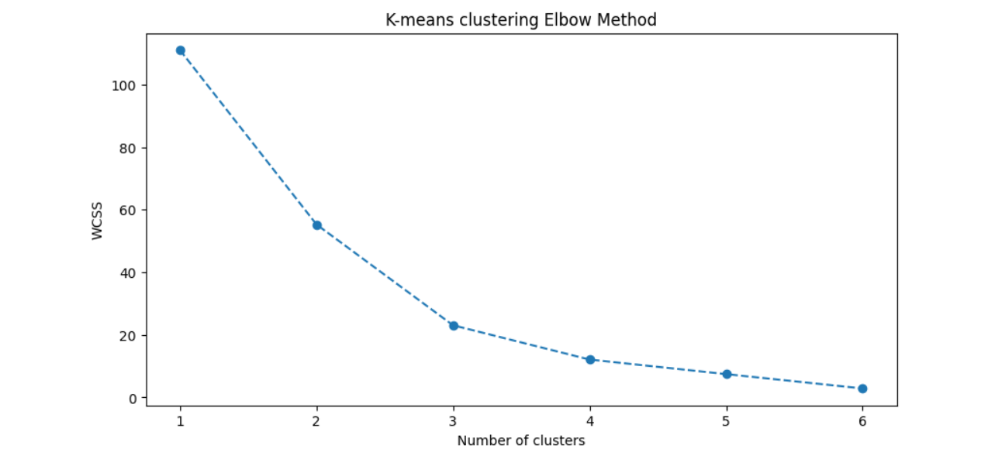
K-means clustering Elbow Method
The graph displays an "elbow" point at cluster 2, meaning that the Within-Cluster-Sum-of-Squares (WCSS) does not significantly drop as the number of clusters is increased beyond this point. This indicates that the ideal number of clusters for your dataset is two.

Slide 13
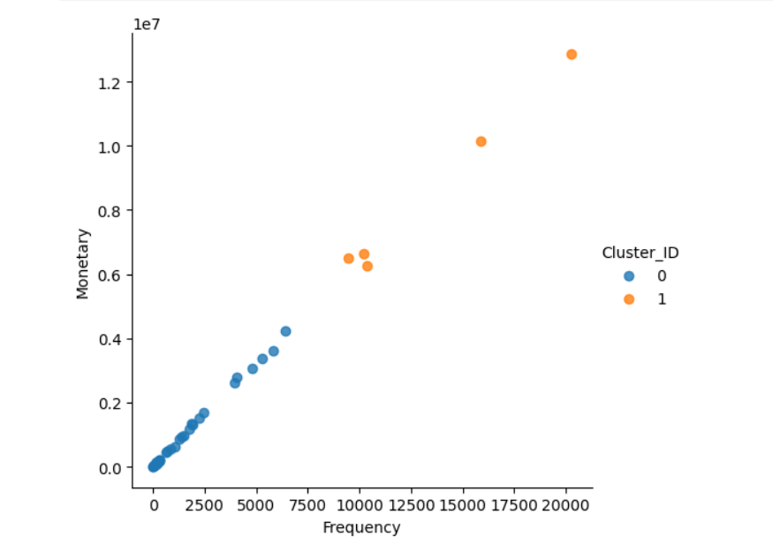
Optimizing Cluster Analysis: Unveiling Patterns with the K-Means Elbow Method
As per K-means clustering, we got to know that Karnataka, Maharashtra, Tamil Nadu, Telangana, and Uttar Pradesh are the ones who spent huge amounts of money and visited Amazon websites more frequently. Whereas the rest of the states spend a decent amount of money and visit less frequently. We can classify Cluster 1 as high valuable customers and Cluster 0 as less valuable customers.

Slide 14


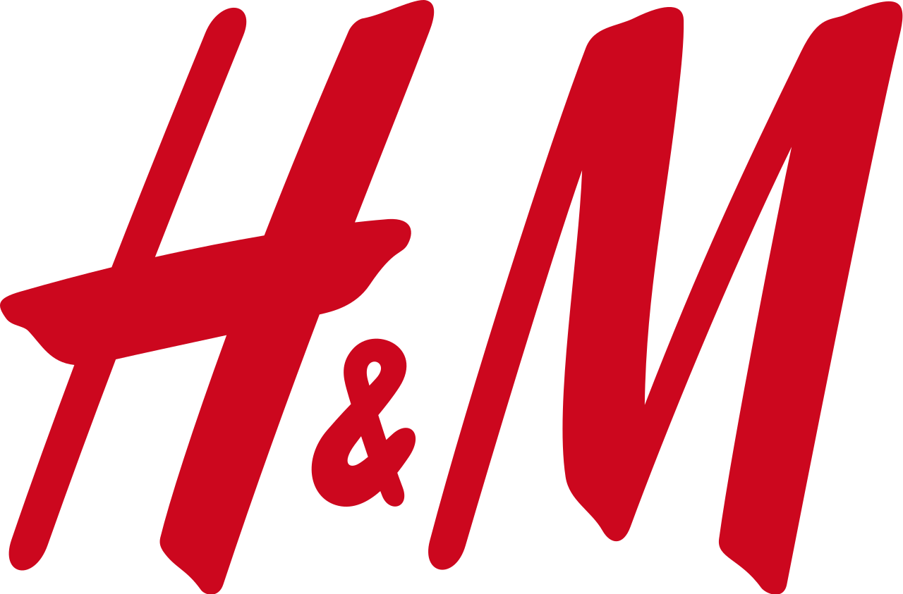

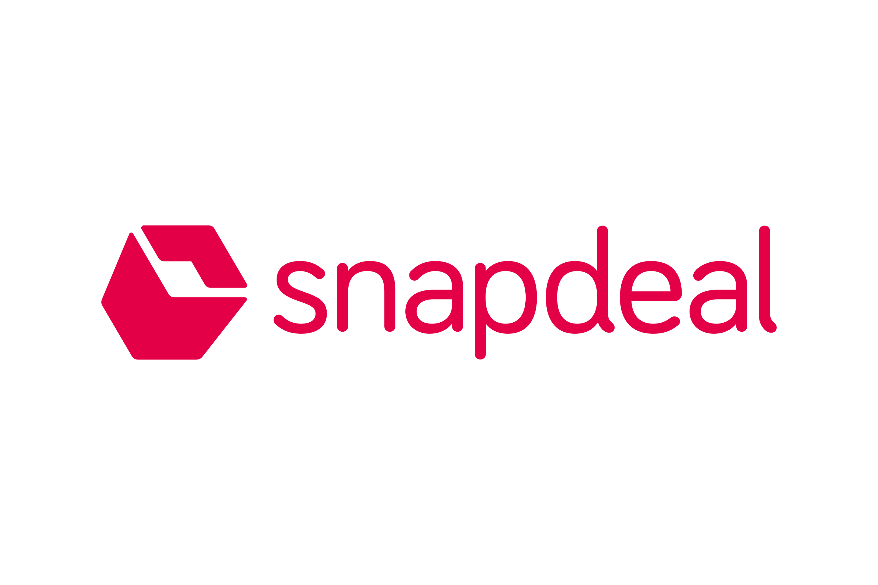
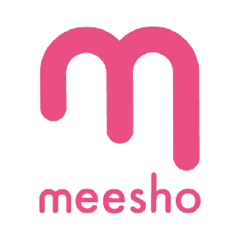
Competitors
As per SEMrush data, In Women fashion industry, amazon has various competitors such as Flipkart, Ajio, H&M, Snapdeal, Meesho and Myntra.
Amazon provides various collection ranging from budget-friendly options to high end designer clothes. Also, they uses AI model to utilize honest customer reviews and ratings to make confident purchase decision. Let's compare Amazon with their competitors.
Flipkart is a major player in India however Amazon has global reach.
Ajio has limited products whereas Amazon has wide variety of products with budget-friendly.
H&M is more intend to physical store and very less online presence, but Amazon has global presence.
Snapdeal has lower brand recognition as compared to Amazon.
Meesho focus on social commence which limits the selection of product whereas Amazon has vast variety of products.
Myntra does not have offer diversity of brands as compared to Amazon.

Slide 15
Competitors
Flipkart is the most dominant player in India. Amazon is growing globally. If we talk about only India, Flipkart is way ahead of Amazon. Let’s see the numbers of both.
AMAZON INDIA
SOCIAL MEDIA
TOTAL REVENUE
AMAZON PRIME
LAUNCH YEAR
Facebook – 146K+
Instagram– 2M+
YouTube – 1.5M+
INR 42000+ Crores
10+ Million Subscribers
2013 (in India)
FLIPKART
SOCIAL MEDIA
TOTAL REVENUE
FLIPKART PLUS
Facebook – 10M+
Instagram– 4.2M+
YouTube – 718K+
INR 56000+ Crores
20+ Million Subscribers
LAUNCH DATE
2007 (in India)

Slide 16
Customer Segmentation Model
DEMOGRAPHICS
Age
Gender
GEOGRAPHICAL
State
BEHAVIOURAL
What product they want
Cities
Customer Lifestyle
Status

Slide 17

Amazon Marketing Strategies
As per research, Amazon is using multiple marketing strategies to increase visibility and boost its sales. I am listing some of them which I observed from the website and other resources.
Optimize Product Listings: Amazon is using high-quality images and 3d images which helps customers to view the products from every angle. This strategy can enhance the mobile shopping experience by allowing customers to interact with the product virtually and help in more sales.
Offers and Discounts: Amazon is giving discounts on selected products and using time-limited discounts, creating a sense of excitement. Moreover, Amazon is giving daily offers named Deal of the Day, which helps boost sales.
Influencer Marketing: Amazon is collaborating with different and top fashion influencers to promote their products which helps in brand awareness and visibility.
Advertising: Amazon is utilizing sponsor products and brands to increase its visibility. Creating a targeted campaign of top search keywords for related products.
Reviews and Ratings: Amazon encourages satisfied customer to rate the product and give positive reviews which increase visibility, and this strategy can gain the trust of other customers. Addressing the customer's concerns to maintain a positive reputation.
Affiliate Marketing: Amazon uses affiliate marketing which helps to gain new audiences from different platforms through amazon affiliates.

Slide 18

Future Marketing Strategies
In my view, I would like to suggest some marketing strategies to use to enhance sales, beat other competitors, and always be on the top in the industry.
Offers and Discounts: I made two clusters highly valuable customers and low valuable customers. So, make offers and discounts according to those. For example, for low valuable customers, I would like to give more offers and discounts to gain their trust.
Acquire Small Competitors: Amazon should acquire its small competitors and try to improve logistics and gain the trust of customers. Low Competitor means High Demand.
Advertising Free Subscriptions: Amazon has Amazon Prime which helps customers to get free delivery and many other free services. I would give 6 months of free subscription services to all customers and advertise it on competitor's keyword searches.
Subscription Expansion: Advertising and growing membership programs like Amazon Prime and offering extra features like early access to all deals such as limited-offers and deals of the day.
Virtual Products: Amazon uses 3D images and virtual products, but all products don’t have this feature. So, will implement this feature on all products for a better shopping experience for customers.

Slide 19
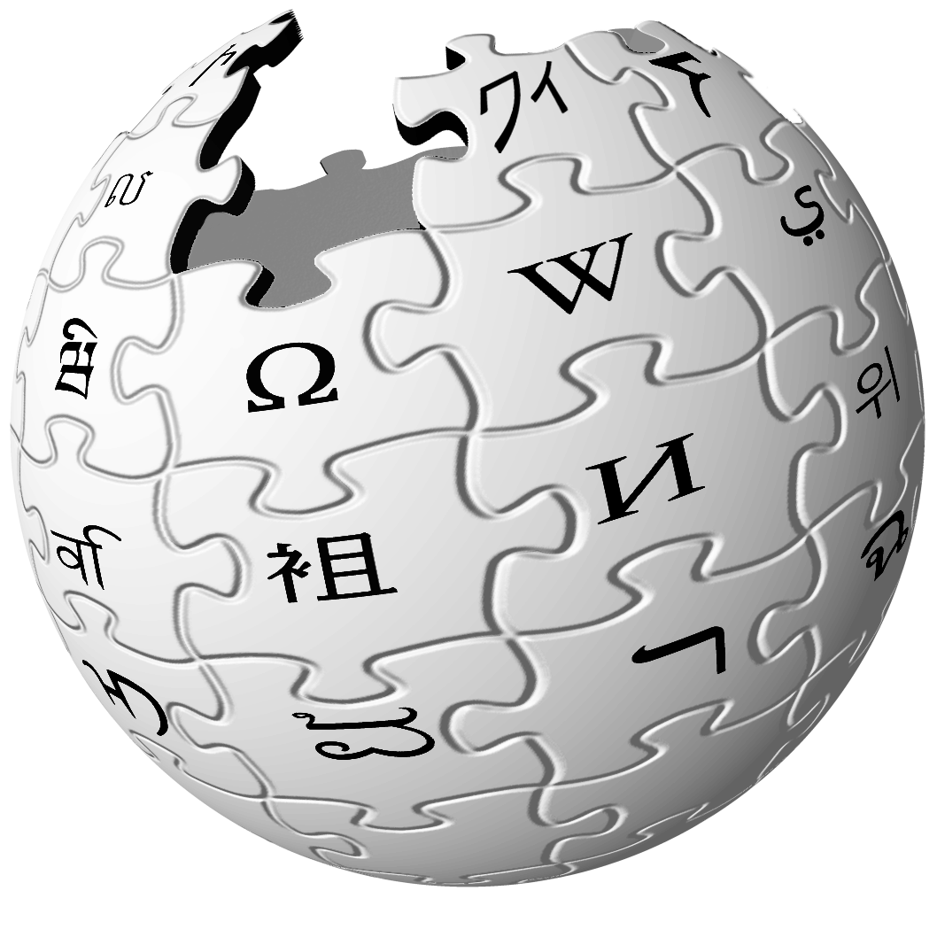




References
https://en.wikipedia.org/wiki/Amazon_(company)
E-Commerce Sales Dataset (kaggle.com)
https://www.semrush.com/website/top/india/fashion/
https://www.statista.com/outlook/cmo/apparel/women-s-apparel/india
Amazon India's YouTube Stats (Summary Profile) - Social Blade Stats

Slide 20
thanks!

