Slide 1
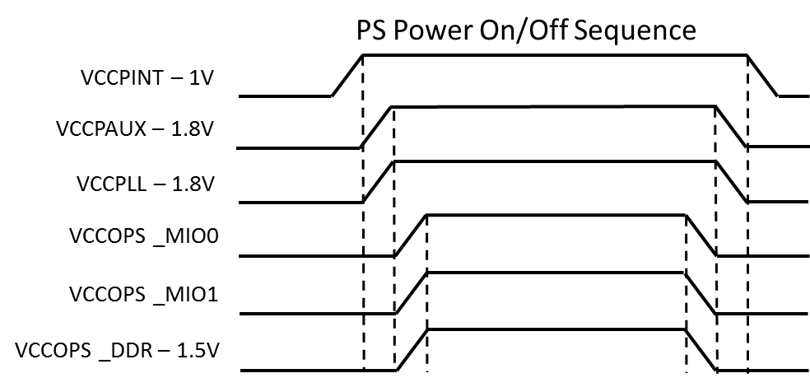
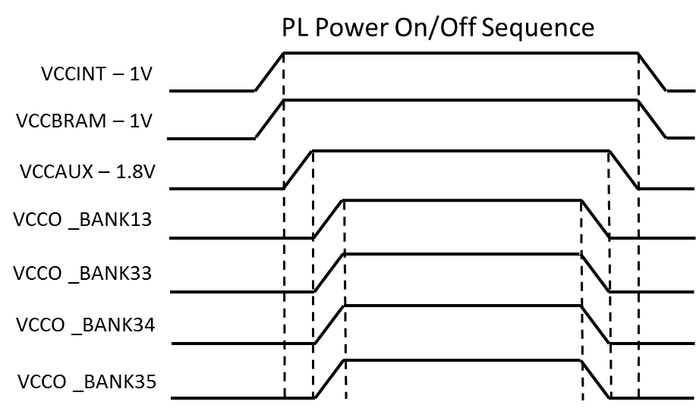
Xilinx DS187 Power On/Off Sequencing
Note: If VCCPAUX, VCCPLL and VCCOPS have same voltage levels they can be combined to same supply. VCCPLL should be filtered.
Note: PS and PL supplies can be combined
Note: VCCINT and VCCBRAM can be powered from same supply.
Note If VCCAUX and VCCO have the same voltage level they can be combined to same supply
Referenced from DS187 Page 8

Slide 2
Japanese Power Supply Architecture
Assume Vin = 12V
+12VA
+V
+12V
Switching Regulator
BD9E303EFJ-LB
3A max
5V
5V
5V
LT1790
1.25V -> PL
VREFP (XADC)
82K
VCC
OUT1
1
VIN
3A max
1.0VA -> PL
VCCINT
EN
OUT2
2
1
EN1
V1
VCCBRAM
12K
1uF
TPS65251
2A max
1.0V -> PS
OUT3
3
EN2
V2
VCCPINT
LM3880
2
EN3
V3
2A max
1.8V -> PS & PL
VCCAUX
VCCPAUX
VCCPLL
VCCADC
t=0.0104
18ms for EN = 1.25V
PGOOD
PG1
Switching Regulator
VCCO_BANK0
VCCO_BANK13
VCCO_BANK33
VCCO_BANK34
VCCOPS_MIO0
VIN
3A max
3.3V
3
EN1
V1
3.3V -> PS & PL
TPS65251
2A max
2.5V -> PL
VCCO_BANK35
VCCOPS_MIO1
3.3V
EN2
V2
EN3
V3
2A max
1.5V -> PS
VCCPS_DDR
PG2
PG2
PGOOD
PG2
PG2
ALL_PGOOD -> PS_POR_RST for Zynq
Switching Regulator
TPS7A7100
1A max
1.2V -> GigE
PG2
PGOOD
PG4
TPS51200
3A max
0.75V -> DDR Term
PGOOD
PG3

Slide 3
Japanese Power Supply Architecture
Power On Sequence
VIN
5V
1.25V
28ms
1
1.0VA - PL
1
1.0V - PS
10ms
2
1.8V – PS & PL
10ms
3
3.3V – PS & PL
3
2.5V - PL
3
1.5V – PS/DDR
0.75V – DDR Term
1.2V - GigE

Slide 4
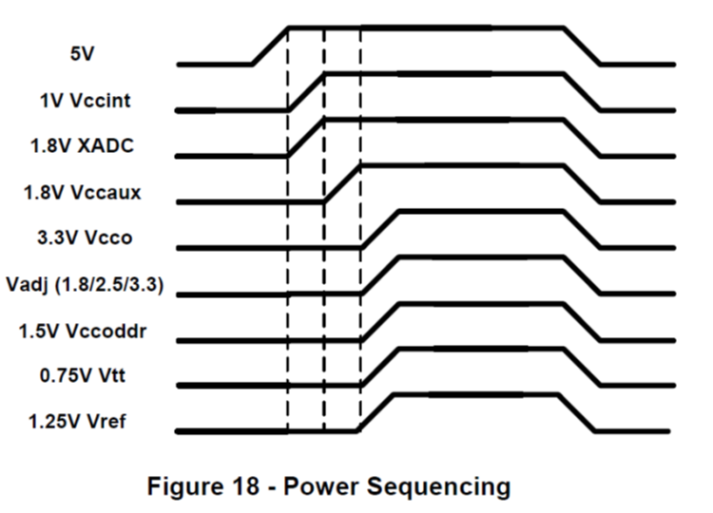
ZedBoard Power Supply Architecture

Slide 5
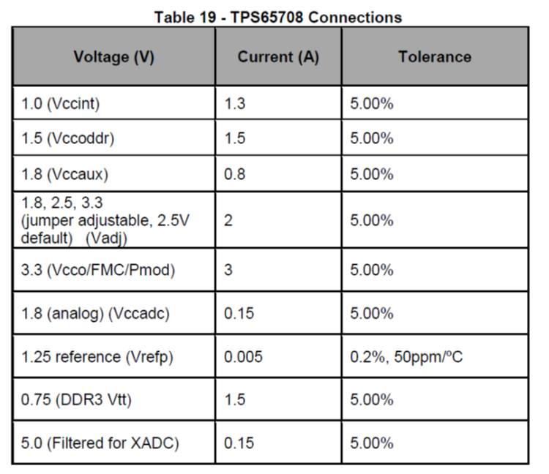
ZedBoard Power Supply Numbers

Slide 6
Microzed Power Supply Architecture

Slide 7
Microzed Power Supply Numbers

Slide 9
Xilinx DS187 Power On/Off Sequencing
PS Power On/Off Sequence
VCCPINT – 1V
Note: PS and PL supplies can be combined
VCCPAUX – 1.8V
VCCPLL – 1.8V
Note: If VCCPAUX, VCCPLL and VCCOPS have same voltage levels they can be combined to same supply. VCCPLL should be filtered.
VCCOPS _MIO0
VCCOPS _MIO1
VCCOPS _DDR – 1.5V
PL Power On/Off Sequence
VCCINT – 1V
Note: VCCINT and VCCBRAM can be powered from same supply.
VCCBRAM – 1V
VCCAUX – 1.8V
VCCO _BANK13
Note If VCCAUX and VCCO have the same voltage level they can be combined to same supply
VCCO _BANK33
VCCO _BANK34
VCCO _BANK35
Info from DS187 Page 8

Slide 10
Japanese Power Supply Architecture
Power On/Off Sequence
VIN
5V
1.25V
28ms
1
1VA - PL
1
1V - PS
10ms
2
1.8V – PS & PL
10ms
3
3.3V – PS & PL
3
2.5V - PL
3
1.5V - DDR
0.75V - DDR
1.2V

