Slide 1
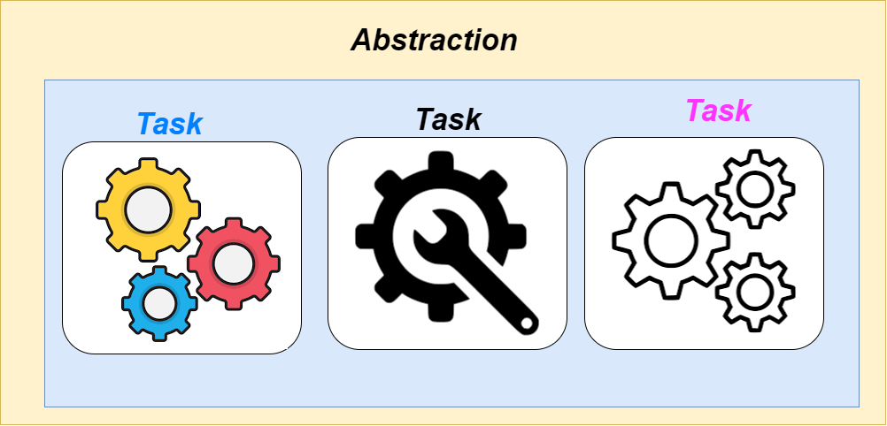
Visualization Analysis & Design
Task Abstraction (Ch 3)
WHY?

Slide 2
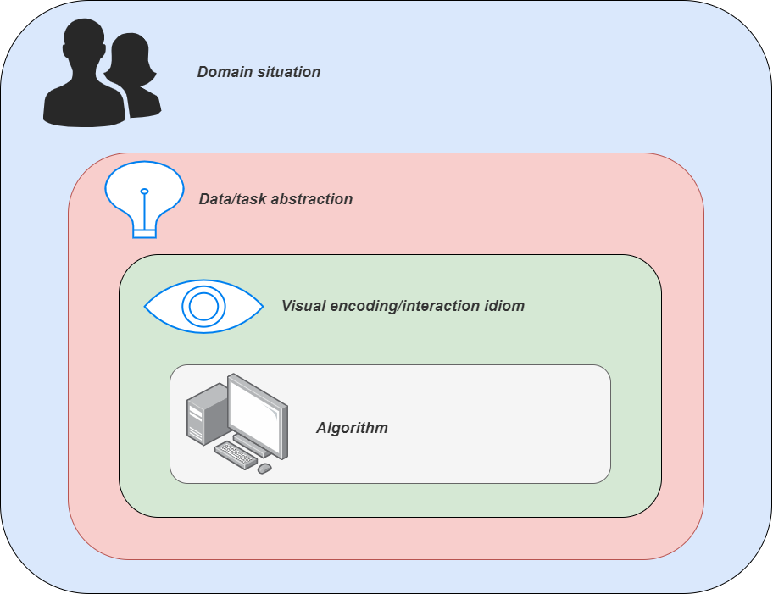
From domain to abstraction
Domain characterization: details of application domain
group of users, target domain, their questions & data
varies wildly by domain
must be specific enough to get traction
domain questions/problems
break down into simpler abstract tasks
Abstraction: data & task
map what and why into generalized terms
identify tasks that users wish to perform, or already do
find data types that will support those tasks
possibly transform /derive if need be
domain
abstraction
2
Notes:
1. Domain Characterization
Domain characterization involves understanding the specific details and nuances of the application domain for which the visualization is being designed. This includes:
A. Group of Users
Identify the Users: Understand who will be interacting with the data. This could include scientists, analysts, decision-makers, or the general public.
User Needs: Determine what users need from the visualization. Different user groups may have varying levels of expertise and different goals.
Example: In a healthcare domain, users might include doctors (looking for patient trends) and researchers (looking for patterns in clinical trials).
B. Target Domain
Context of Use: Identify the specific field or area where the data is applied. This could be anything from climate science to financial markets.
Domain-Specific Knowledge: Understand the specific jargon, practices, and typical workflows within the domain.
Example: In environmental science, the domain might focus on air quality measurements and pollutant levels.
C. User Questions and Data
Common Questions: Determine the types of questions users typically ask about the data.
Data Requirements: Identify what data is needed to answer these questions and how it is structured.
Example: For urban planning, users might ask about traffic patterns or population density, requiring data on vehicle counts and demographic statistics.
D. Domain-Specific Challenges
Variability: Recognize that different domains can have vastly different requirements and challenges.
Specificity: Ensure that the characterization is specific enough to address real issues effectively.
Example: Visualization for stock market analysis will differ significantly from visualization for educational outcomes.
2. Domain Questions/Problems
Breaking Down Domain Problems:
Identify Core Problems: Determine the fundamental problems or questions that need to be addressed within the domain.
Simplify Tasks: Decompose these problems into simpler, more abstract tasks that can be addressed through visualization.
Example: In climate science, a core problem might be understanding how temperature changes over time. A simpler task could be visualizing temperature data across different seasons.
3. Abstraction: Data & Task
Abstraction involves mapping specific needs into generalized terms to guide the design of the visualization. This includes:
A. Mapping What and Why
What: Determine what data is needed and how it should be represented.
Why: Understand the purpose behind using this data and what insights are sought.
Example: For a financial report, “what” could be stock prices and trading volumes, and “why” could be to analyze market trends.
B. Identify User Tasks
Existing Tasks: Identify tasks that users currently perform or wish to perform with the data.
Desired Interactions: Determine how users interact with the data and what types of visualizations or interactions they need.
Example: In social network analysis, users might need to identify influential nodes or community structures.
C. Find Supporting Data Types
Data Types: Identify the types of data that will support the identified tasks.
Transformation/Derivation: Sometimes, data may need to be transformed or derived to fit the task requirements.
Example: For network analysis, raw connection data might need to be transformed into adjacency matrices or graphs.
4. Transform/Derive Data if Necessary
Data Transformation: Sometimes, raw data needs to be processed or transformed to fit the task requirements. This could involve aggregation, normalization, or calculation of derived metrics.
Example: For a time-series analysis, you might need to derive moving averages or trend lines from raw data.
Summary
In summary, effective data visualization design starts with thorough domain characterization to understand the specifics of the application domain, the users, and their needs. This understanding then informs the abstraction process, where you translate specific problems into generalized tasks and identify the data types and transformations needed to support those tasks.
Domain Characterization: Understand users, the target domain, common questions, and domain-specific challenges.
Domain Questions/Problems: Break down complex problems into simpler tasks.
Abstraction: Map specific needs into generalized terms, identify user tasks, find and possibly transform data.
By carefully considering these aspects, you can create visualizations that are both relevant and effective in addressing users' needs within their specific context.
4o mini

Slide 3

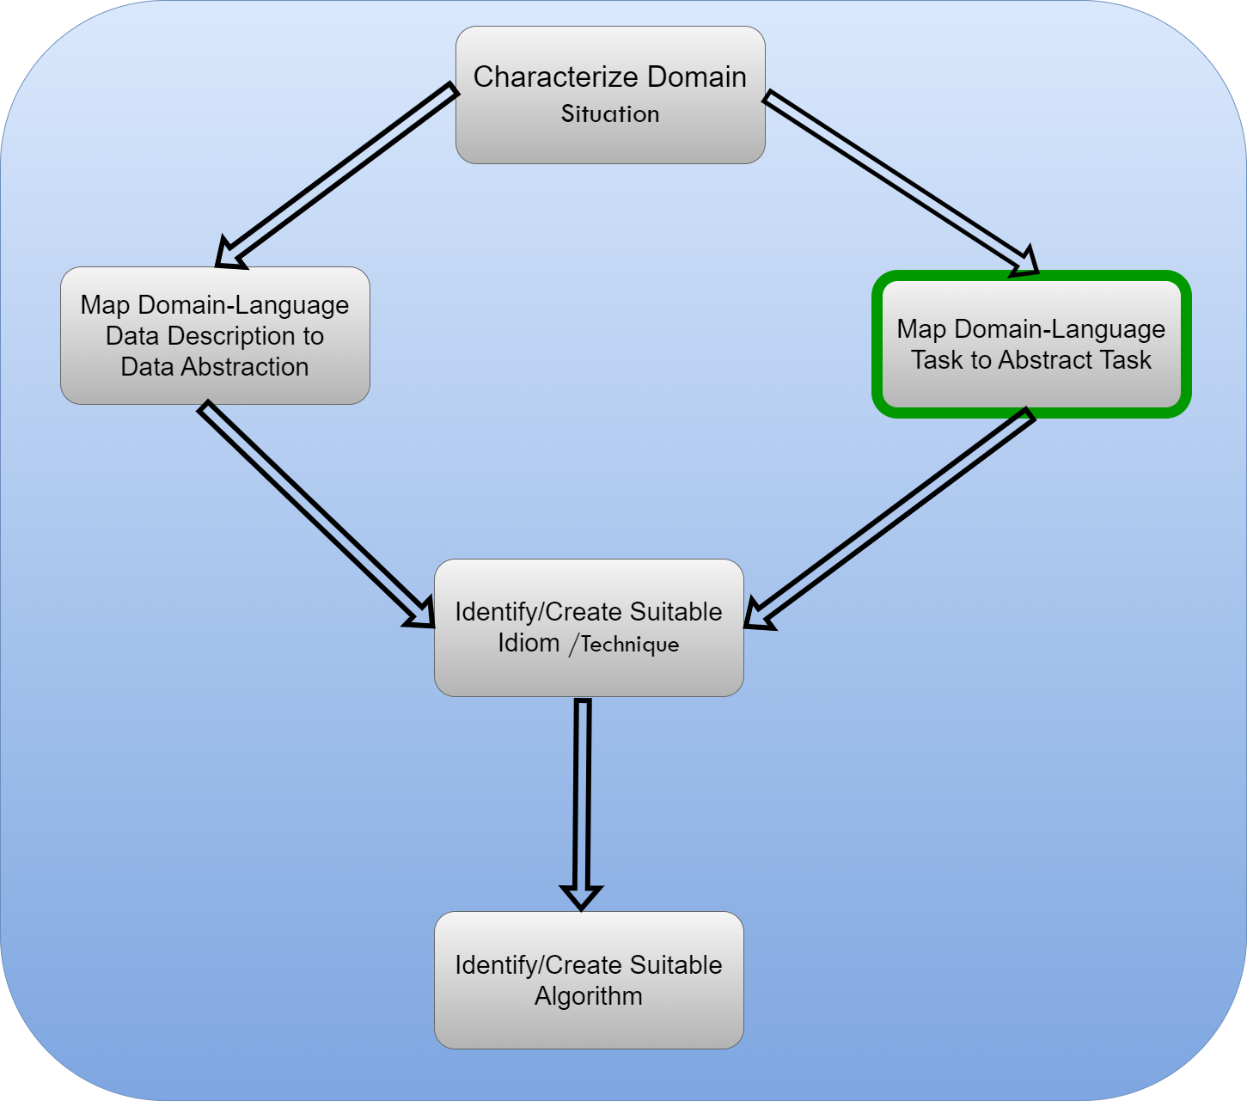
Design process
3
Notes:
This diagram outlines a process for transforming a domain-specific problem into a suitable data visualization approach.
Characterize Domain Situation: This is the starting point where you identify and understand the specific domain or context of the data you are dealing with. For example, in scientific visualization, this could be the study of climate patterns, financial data trends, or molecular structures. Understanding the domain helps in determining the data's nature and the visualization goals.
Map Domain-Language Task to Abstract Task: This step involves translating the specific task or goal within the domain to a more generalized task in data visualization. For example, if the goal in the domain is to identify trends over time, the abstract task might be to design a time-series visualization. This translation helps in focusing on the core objective of the visualization.
Map Domain-Language Data Description to Data Abstraction: Here, the domain-specific data description (such as temperature readings, stock prices, or molecule coordinates) is mapped to a data abstraction that can be easily visualized. For instance, temperature readings could be abstracted into a line graph or a heat map, while molecule structures could be represented using 3D scatter plots.
Identify/Create Suitable Idiom/Technique: After understanding the domain and the abstract tasks, this step involves selecting or designing an appropriate visualization technique (or idiom). For example, if the abstract task is to compare two data sets, a scatter plot might be suitable. This selection is critical for effective communication, as different techniques emphasize different aspects of the data (e.g., distribution, correlation, outliers).
Identify/Create Suitable Algorithm: Finally, to implement the selected visualization technique, suitable algorithms are identified or created. This could involve selecting algorithms for data preprocessing (such as normalization), layout algorithms for graph drawing, or rendering algorithms for 3D visualizations. The choice of algorithm affects the performance and effectiveness of the visualization.
In Summary:
The diagram represents a process flow for developing data visualizations that effectively convey the intended insights from complex, domain-specific data. It emphasizes the importance of understanding the domain context, translating it into abstract tasks, and systematically moving towards the most suitable visualization technique and algorithm to achieve the desired communication goals. This is particularly relevant for graduate-level students who need to design custom visualizations for complex scientific datasets.

Slide 4

Task abstraction: Actions and targets
4

Slide 5
Task abstraction: Actions and targets
Very high-level pattern
Actions
analyze
high-level choices
search
find a known/unknown item
query
find out about characteristics of item
Targets
what is being acted on
{action, target} pairs
discover distribution
compare trends
locate outliers
browse topology
5
Notes:
In the context of scientific data visualization, task abstraction refers to the process of breaking down and simplifying the complex tasks involved in visualizing data into more manageable components. This concept helps in understanding what needs to be achieved in the visualization process and how different aspects of the task can be handled effectively.
Here’s a more detailed look at what task abstraction involves:
Identifying Objectives: Determine what users need to achieve with the visualization. This could involve tasks like identifying trends, comparing data points, or exploring relationships between variables.
Breaking Down Tasks: Decompose these objectives into specific, actionable tasks. For example, if the objective is to identify trends, the tasks might include data aggregation, selecting appropriate visual representations (e.g., line charts, heat maps), and applying appropriate scaling.
Defining Interactions: Specify how users will interact with the visualization. This might involve task abstraction around user actions such as filtering data, zooming in, or highlighting certain elements.
Mapping to Techniques: Match these abstract tasks to visualization techniques and tools. For example, if the task is to compare data points across different categories, techniques like bar charts or scatter plots might be used.
Iterative Refinement: Use feedback to refine the abstraction, ensuring that the visualization effectively supports the intended tasks and goals.
By focusing on task abstraction, you can design visualizations that are not only technically robust but also user-centric, ensuring they meet the needs and expectations of their intended audience.

Slide 6

Actions: Analyze
6

Slide 7
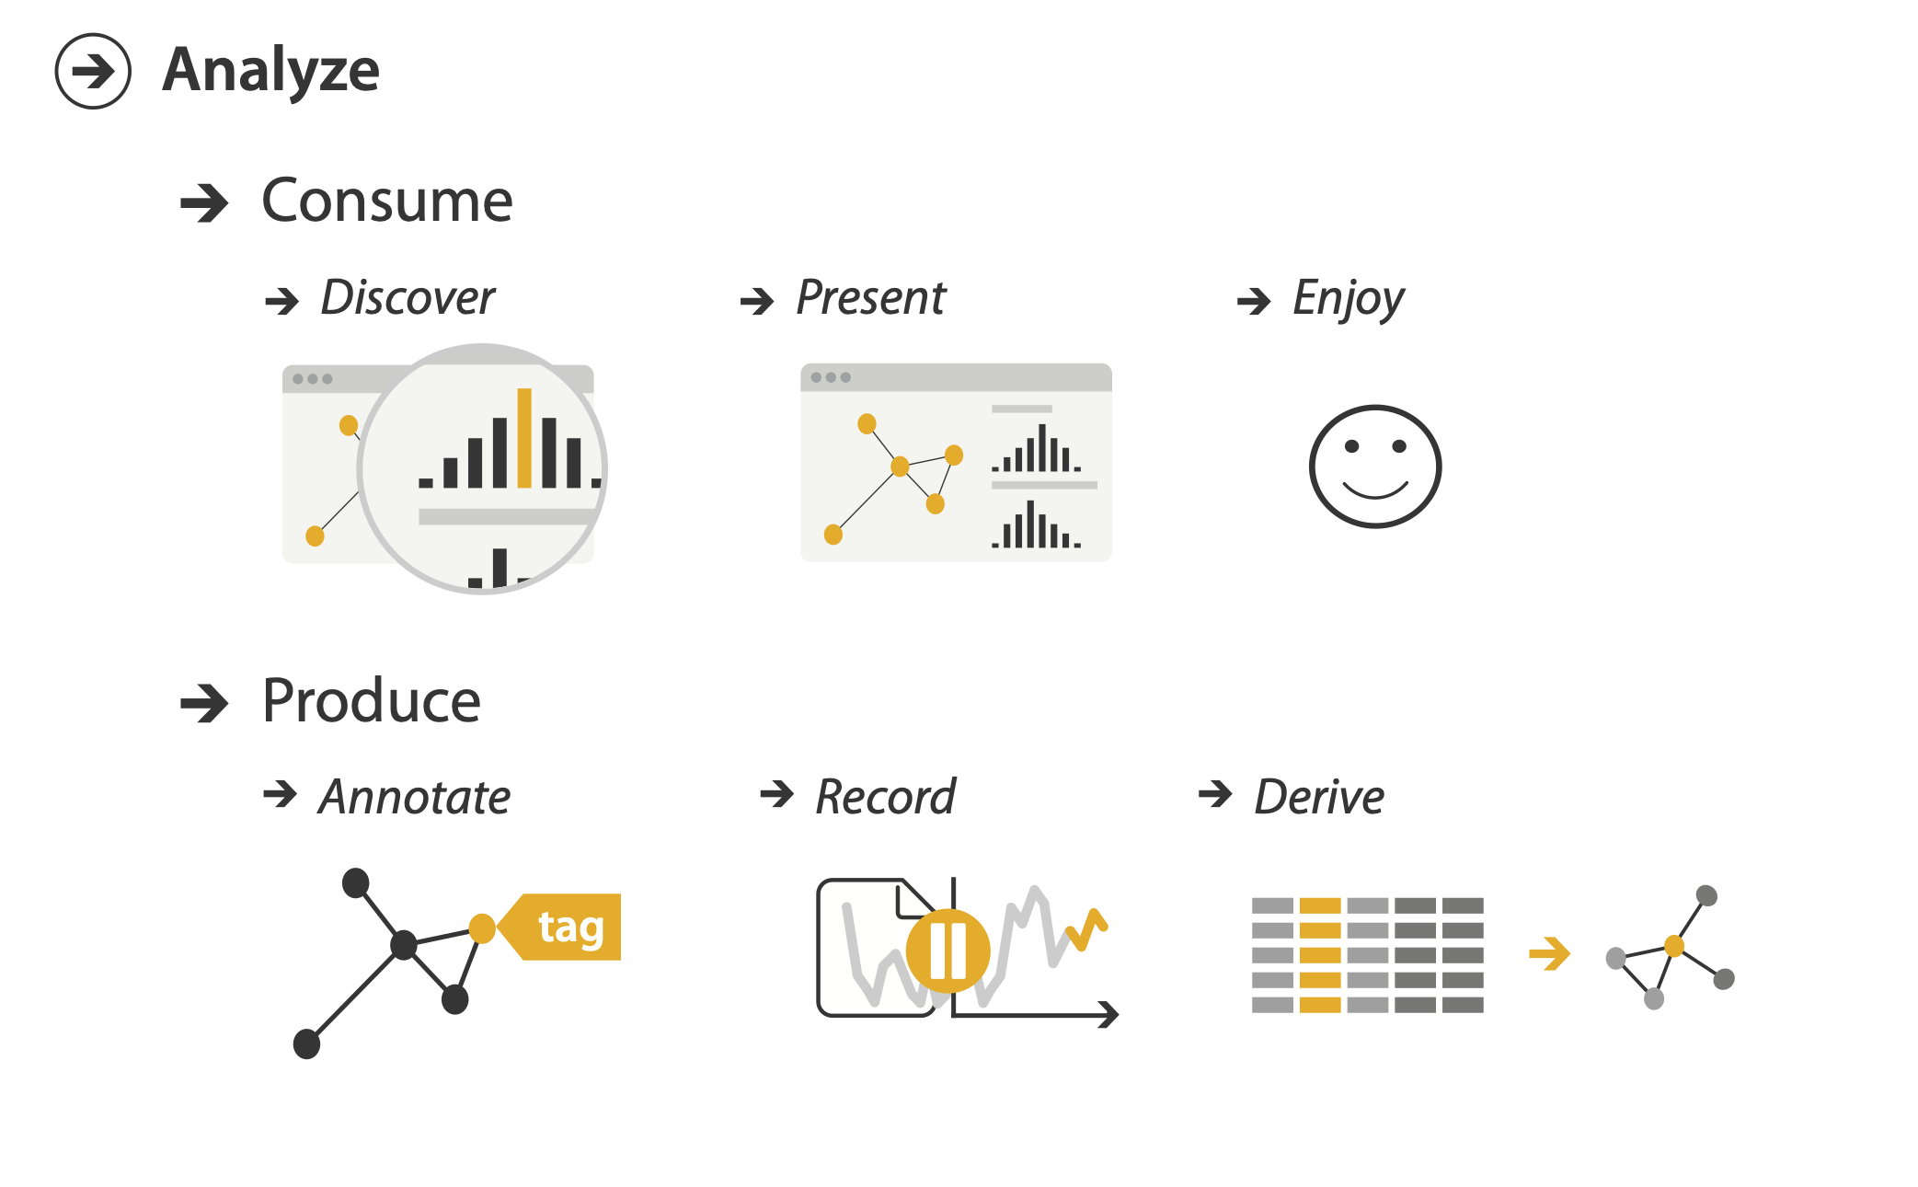
Actions: Analyze
consume
discover vs present
classic split
aka explore vs explain
enjoy
newcomer
aka casual, social
produce
annotate, record
derive
crucial design choice
7
Notes:
1. Consume
Discover vs. Present:
Discover: This involves exploring and uncovering insights from the data. Users are trying to identify patterns, trends, or anomalies.
Present: This involves showcasing data to others, often with the goal of communicating specific findings or supporting a particular argument.
Classic Split (Explore vs. Explain):
Explore: Similar to “Discover,” this refers to the interactive process where users manipulate and interact with data to understand it better.
Explain: This refers to the act of conveying findings or insights in a clear and comprehensible manner, often for a specific audience.
Enjoy: This implies the user experience aspect where visualizations are designed to be engaging and enjoyable. This can be crucial for maintaining user interest and making data interactions more pleasant.
Newcomer (Casual, Social):
Newcomer: This refers to users who are not experts in the field but are engaging with the data. They might need more intuitive and user-friendly visualizations.
Casual, Social: This context often involves visualizations that are designed for informal or social sharing, focusing on accessibility and ease of understanding.
2. Produce
Annotate, Record:
Annotate: Adding notes or comments to a visualization to highlight specific points or provide context.
Record: Documenting data or visualizations for future reference, analysis, or sharing.
Derive: This involves creating new insights or visualizations from existing data. It’s about processing and transforming data to generate meaningful results.
Crucial Design Choice: In designing visualizations, making informed choices about how to present data is critical. Decisions about what type of visualization to use, how to interact with data, and how to convey information can significantly impact the effectiveness of the visualization.
Summary
In summary, these terms and concepts outline the different roles and considerations in scientific data visualization:
Consumption focuses on how users interact with and derive insights from data, whether they are exploring, explaining, or enjoying the experience.
Production deals with the creation of visualizations, including annotating, recording, deriving new insights, and making design choices.
Understanding these aspects helps in tailoring visualizations to meet different needs, from exploratory analysis to effective communication, and from engaging newcomers to supporting detailed analysis.

Slide 8

Actions: Search
8

Slide 9
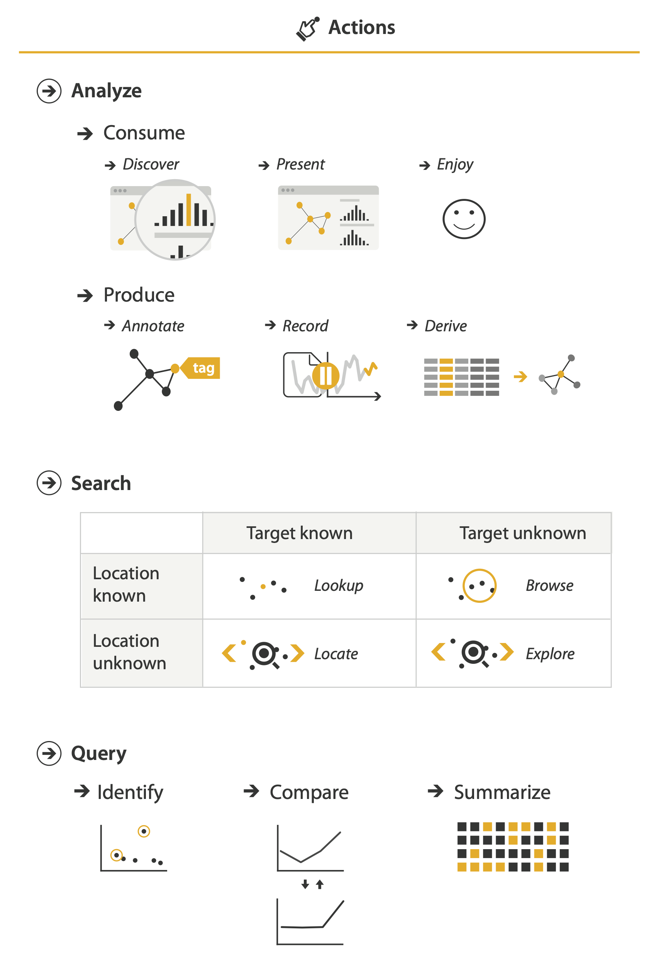
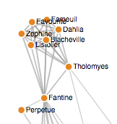
Actions: Search
What does user know
target, location
Lookup
ex: word in dictionary
alphabetical order
Locate
ex: keys in your house
ex: node in network
Browse
ex: books in bookstore
Explore
ex: find cool neighborhood in new city
https://bl.ocks.org/heybignick/3faf257bbbbc7743bb72310d03b86ee8
9
Notes:
These terms refer to different ways users interact with information or data, each requiring different levels of understanding and navigation strategies. Here’s a detailed explanation of each concept:
1. Lookup
Definition: This is a precise and direct method to find specific information when you know exactly what you're looking for.
Example: Looking up a word in a dictionary. You usually have a clear target (the word you need) and you use a systematic method (alphabetical order) to find it.
Characteristics:
Target: You know what you're searching for.
Location: You use a fixed, known method to locate the information (e.g., alphabetical ordering).
2. Locate
Definition: Finding something in a physical or conceptual space where the exact location is not predetermined but is identifiable by context or relative position.
Examples:
Keys in Your House: You may not know exactly where they are, but you have an idea of where they might be (e.g., near the entryway).
Node in a Network: You need to find a specific node within a network, often using navigational aids or knowledge of the network's structure.
Characteristics:
Context-Based: You use contextual or spatial cues to narrow down the search.
Exploration Required: Some exploration or investigation might be needed.
3. Browse
Definition: This is a more casual and less targeted approach where you explore information by scanning or looking through options without a specific goal.
Example: Browsing through books in a bookstore. You might not have a specific book in mind, but you look through different books based on categories, covers, or author names.
Characteristics:
Exploratory: You are open to discovering new or unexpected items.
Varied Approach: Information is accessed in a less systematic, more casual manner.
4. Explore
Definition: This involves a more open-ended approach where you actively seek out new information or experiences, often in a new or unfamiliar context.
Example: Finding a cool neighborhood in a new city. You might walk around, talk to locals, or use a map to discover interesting areas.
Characteristics:
Discovery-Oriented: You’re looking to uncover new or interesting information.
Open-Ended: There may be no fixed destination or goal; the aim is to explore and learn.
Summary
In summary, these terms describe different user approaches to finding and interacting with information:
Lookup: Precise and systematic, with a clear target.
Locate: Contextual and spatial, with an understanding of the general area.
Browse: Casual and exploratory, without a specific goal.
Explore: Open-ended and discovery-driven, often in unfamiliar contexts.
Each approach requires different strategies and tools, and understanding these can help design better user interfaces and experiences for various types of information retrieval and exploration.
4o mini

Slide 10
Actions: Search
How much of the data matters
one: identify
some: compare
all: summarize
10

Slide 11
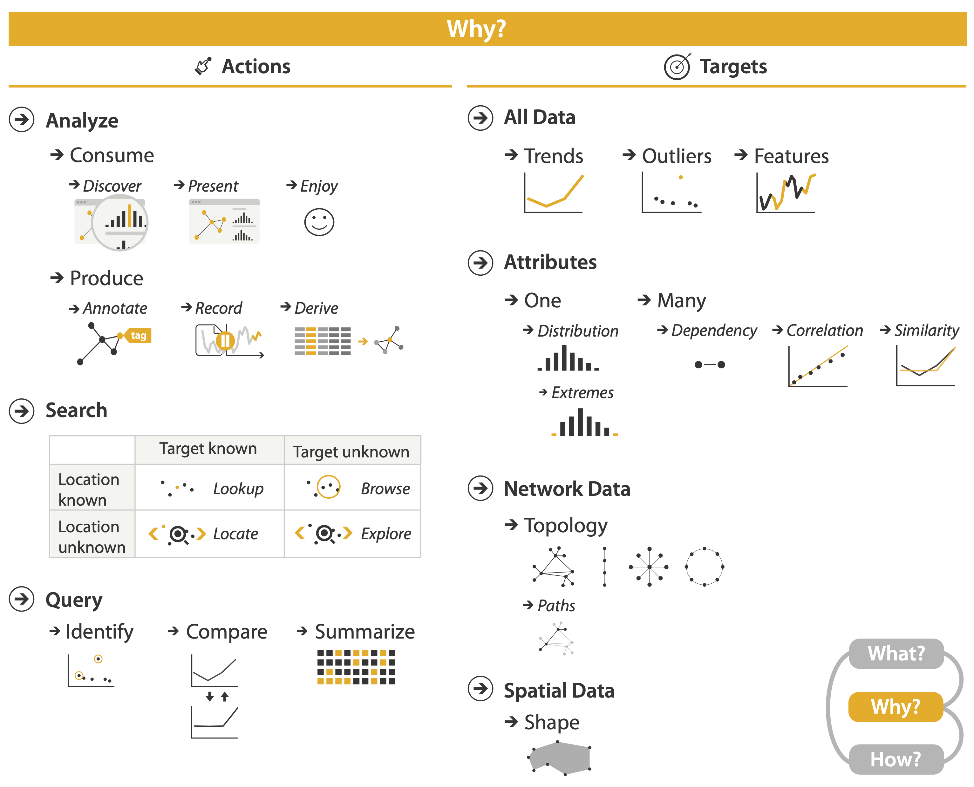
Actions
Independent choices for each of these three levels
analyze, search, query
mix and match
11
Notes:
In the context of data interaction and visualization, analyze, search, and query are different approaches to handling and extracting information from data. Each approach can be used independently or in combination to achieve specific goals. Let’s break down how these can be applied across different levels and how they can be mixed and matched:
1. Analyze
Definition: This involves examining data to understand patterns, trends, or relationships. It’s often more exploratory and involves deeper interaction with the data.
Usage: Typically used when you want to derive insights from data by examining it in various ways. This can include statistical analysis, visual exploration, or identifying trends.
Example: Analyzing sales data to identify trends over time or comparing different regions' performance.
2. Search
Definition: This involves looking for specific pieces of information or data points based on known criteria. It’s usually more targeted and involves finding exact matches or specific data entries.
Usage: Best used when you need to find particular data points or records. It’s often supported by indexing or search algorithms to quickly locate information.
Example: Searching for a specific customer’s order history in a database.
3. Query
Definition: This involves formulating a request for information from a database or dataset using a query language or interface. It’s a structured way to retrieve data based on specific conditions.
Usage: Common in database management and data retrieval systems. Queries can be simple (e.g., retrieving records that match certain criteria) or complex (e.g., joining multiple tables or applying filters).
Example: Writing a SQL query to retrieve all transactions above a certain amount within a specific date range.
Mixing and Matching
Each of these approaches can be combined or used independently depending on the context and goals:
Analyze Only
Scenario: You have a dataset and you want to understand overall trends and patterns without needing to search for specific entries or use a structured query.
Example: Analyzing customer behavior trends over a year using visualizations like heat maps or line charts.
Search Only
Scenario: You are looking for a specific record or data entry in a large dataset.
Example: Searching for a particular product in an e-commerce database to view its details and inventory status.
Query Only
Scenario: You need to extract specific subsets of data based on defined criteria using a database system.
Example: Writing a SQL query to get a list of all users who have made purchases in the last month.
Analyze and Search
Scenario: You perform an initial search to find relevant records and then analyze those records to derive insights.
Example: Searching for all transactions from a particular region and then analyzing those transactions to understand spending patterns.
Analyze and Query
Scenario: You use queries to retrieve specific subsets of data and then analyze that data to uncover deeper insights.
Example: Querying a database for sales data in different regions and then analyzing that data to compare regional performance.
Search and Query
Scenario: You use search techniques to find specific entries and then use queries to further refine or extract detailed information from those entries.
Example: Searching for specific customer records and then using advanced queries to analyze their purchase history.
Analyze, Search, and Query
Scenario: You perform searches to locate specific data points, use queries to structure your data extraction, and then analyze the extracted data to gain insights.
Example: Searching for transactions related to a specific product, querying those transactions for detailed financial metrics, and then analyzing the results to understand sales trends.
Summary
In scientific data visualization and data handling, these methods can be used independently or in combination to achieve different objectives:
Analyze: For deriving insights and understanding data patterns.
Search: For locating specific data points quickly.
Query: For retrieving structured data based on conditions.
By mixing and matching these approaches, you can create flexible and powerful data exploration and analysis workflows tailored to various needs and contexts.

Slide 12


Task abstraction: Targets

Slide 13
Task abstraction: Targets
Notes:
1. Defining the Target
Objective: Identify the specific outcome or goal that the user wants to achieve with the data.
Example: The target might be to identify trends in sales data, locate anomalies, or compare performance metrics across different categories.
2. Types of Targets
Exploratory Targets: Goals related to discovering new insights or patterns in data.
Example: Exploring how sales figures vary across different regions over time.
Analytical Targets: Goals focused on in-depth analysis to understand relationships, causations, or correlations within data.
Example: Analyzing the impact of marketing campaigns on sales performance.
Diagnostic Targets: Goals related to identifying specific issues or anomalies in data.
Example: Diagnosing reasons for a sudden drop in website traffic.
Presentational Targets: Goals related to effectively communicating data insights to an audience.
Example: Creating a visualization to present quarterly performance results to stakeholders.
3. Task Abstraction for Different Targets
Exploration:
Tasks: Interactive filtering, zooming, and data manipulation to discover patterns or anomalies.
Tools: Dynamic dashboards, drill-down capabilities, and interactive charts.
Analysis:
Tasks: Performing statistical analysis, creating comparative visualizations, and deriving metrics.
Tools: Statistical charts, heat maps, and correlation matrices.
Diagnosis:
Tasks: Highlighting outliers, setting thresholds for alerts, and examining data trends.
Tools: Outlier detection tools, alert systems, and anomaly detection graphs.
Presentation:
Tasks: Designing clear, concise visualizations that effectively convey the message.
Tools: Infographics, summary charts, and tailored presentation layouts.
4. Examples of Task Abstraction Based on Target
Explore:
Target: Discover new insights from a large dataset.
Task Abstraction: Use filters, dynamic controls, and exploratory plots to interact with the data. The system should allow users to experiment with different views and aspects of the data.
Analyze:
Target: Understand relationships between variables.
Task Abstraction: Employ statistical analysis tools, create complex visualizations (like scatter plots with regression lines), and perform multi-dimensional analysis.
Diagnose:
Target: Identify issues or irregularities in the data.
Task Abstraction: Implement data validation tools, anomaly detection algorithms, and visual cues to highlight problematic areas.
Present:
Target: Communicate findings to stakeholders.
Task Abstraction: Design polished visualizations, craft clear narratives, and focus on audience-specific needs and preferences.
5. Integrating Targets into Design
Understanding User Needs: Clearly define what users are trying to achieve to tailor the visualization’s features and functionality.
Design Choices: Make informed decisions about which visualization types, interactions, and data representations best support the target.
Feedback and Iteration: Continuously refine the visualization based on user feedback to better meet their goals.
Summary
In task abstraction for data visualization, focusing on the target involves clearly defining the user's goals and breaking them down into specific tasks and interactions that support those goals. By understanding the different types of targets (exploration, analysis, diagnosis, presentation) and the associated tasks, you can design visualizations that are more effective and user-centric. This approach ensures that the visualization not only presents data but also facilitates achieving the desired outcomes efficiently.

Slide 14
Task abstraction: Targets

Slide 15
Task abstraction: Targets

Slide 16
Task abstraction: Targets

Slide 17

Abstraction
These {action, target} pairs are good starting point for vocabulary
But sometimes you'll need more precision!
Rule of thumb
systematically remove all domain jargon
Interplay: task and data abstraction
need to use data abstraction within task abstraction
to specify your targets!
but task abstraction can lead you to transform the data
Iterate back and forth
first pass data, first pass task, second pass data, ...

Slide 18

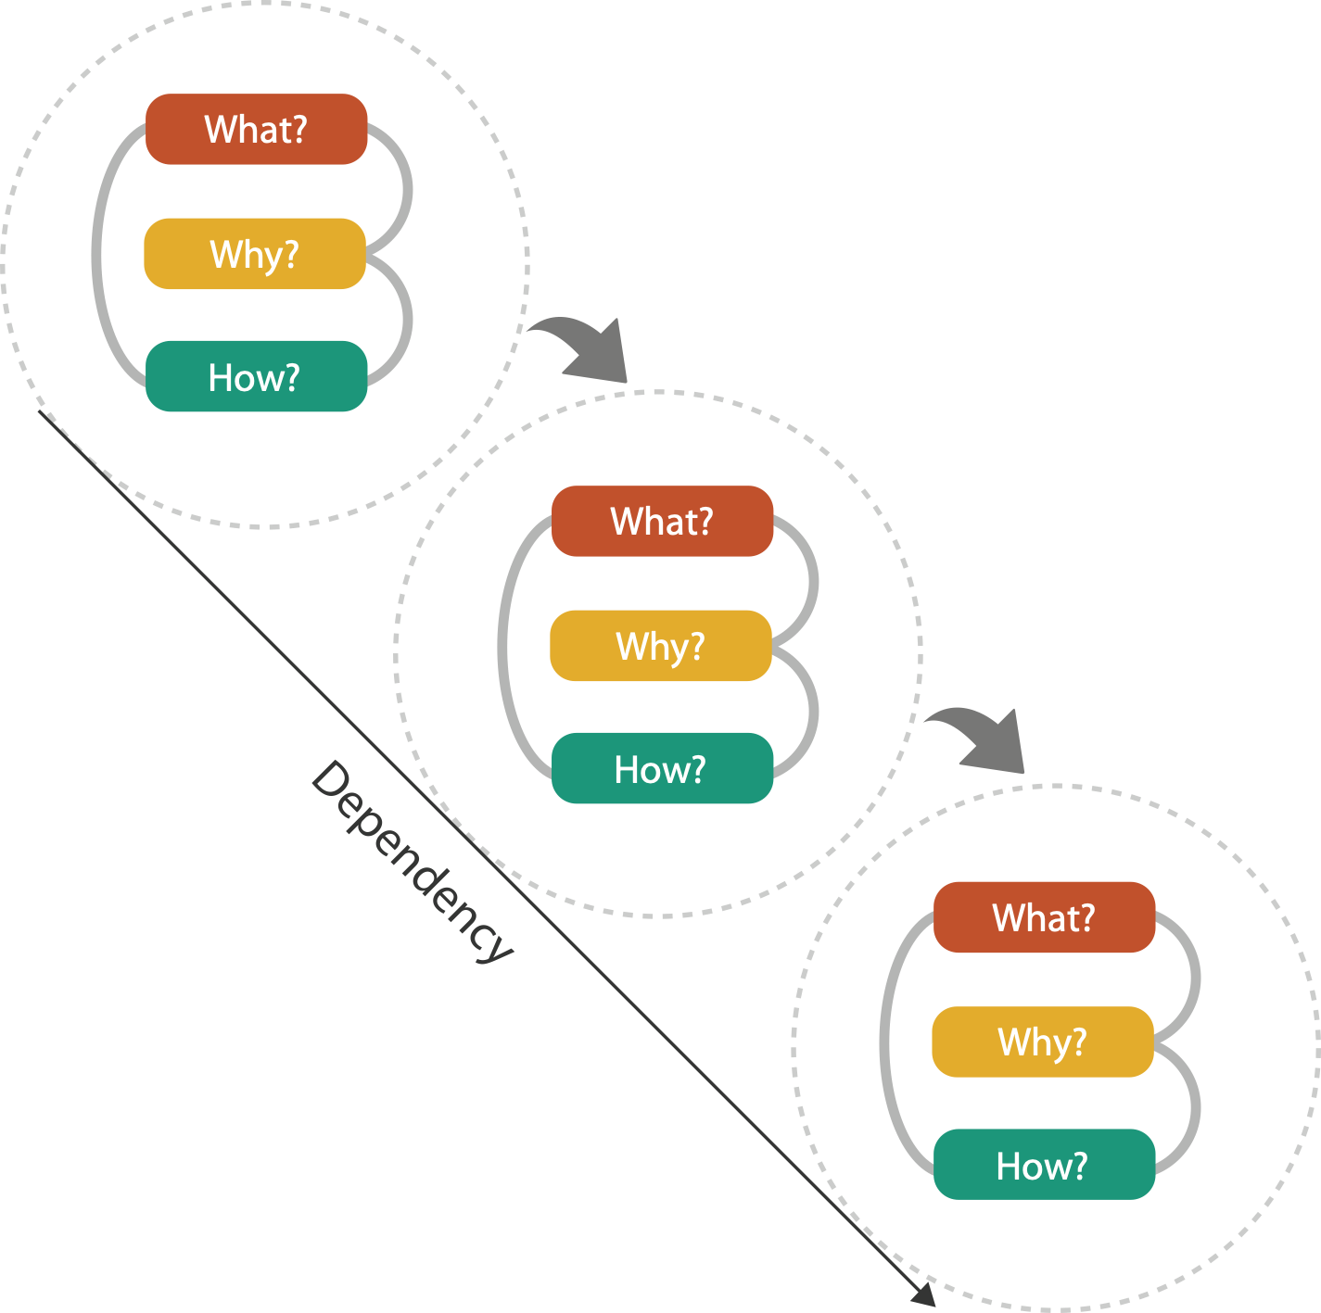
Means and ends

Slide 19
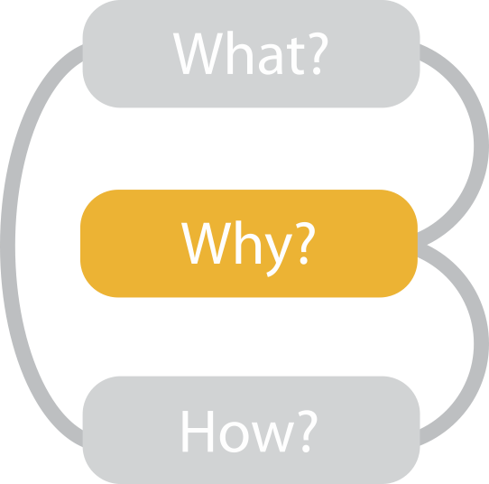
{action, target} pairs
discover distribution
compare trends
locate outliers
browse topology

