Slide 1
ShopEase-Sales Performance Case Study
By: Gaurja Newatia
Gaurja.Newatia.gn@outlook.com

Slide 2
Introduction and Dataset Overview
BUSINESS CONTEXT:
ShopEase, a multi-province retail company, is aiming to accelerate revenue growth and enhance customer retention. To inform strategy, the leadership team requires actionable insights into:
Monthly revenue trends
Top-performing products and regional performance
Customer purchasing behavior and value segmentation
ANALYTICAL OBJECTIVE:
Leverage historical transactional, customer, and product data to:
Identify key drivers of revenue growth
Segment customers based on behavior using a Statistical Solution.
Provide guidance for targeted marketing and operational decisions
DATA OVERVIEW:
Sales Volume: 500 transactions recorded
Time Period Covered: Jan 2024 to April 2025
Customer Base: 100 unique customers
Product Catalog: 20 distinct products across 5 categories
Geographic Reach: Data spans 4 Provinces – Ontario (ON), Quebec (QC), Saskatchewan (SK) and British Columbia (BC)

Slide 3
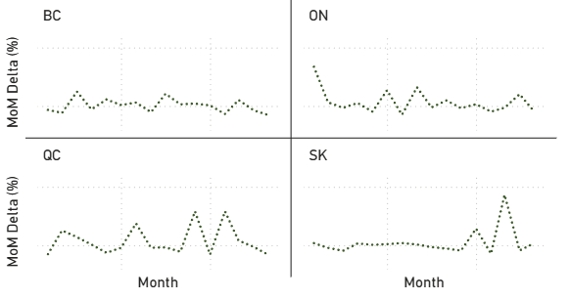
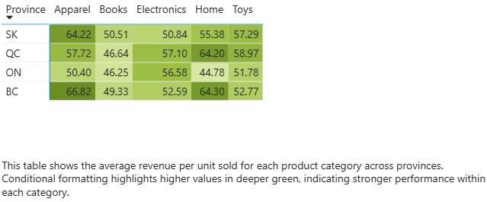
Revenue Trends and Product Performance Analysis
INSIGHTS:
QC and SK show the most volatility with large spikes and dips in monthly revenue growth, indicating seasonal or campaign-driven trends.
ON and BC demonstrate relatively stable growth, but with lower amplitude, suggesting consistent but less aggressive growth strategies.
Peaks in QC and SK may be linked to specific promotions or events, warranting further exploration.
RECOMMENDATIONS:
QC & SK: Deep-dive into months with high spikes to identify drivers (e.g., product launches, campaigns), and consider replicating success during low-performing months.
BC & ON: Introduce seasonal campaigns or limited-time offers to create upward movement in otherwise flat trends.
Figure 1: Month Over Month Growth in Revenue (%) by Province
Revenue Trends
INSIGHTS:
BC leads in unit revenue for Apparel and Home, suggesting a higher willingness to pay.
QC tops Electronics and Toys, possibly due to product mix or regional demand patterns.
ON shows consistently lower unit revenue across most categories, indicating discount-heavy pricing or lower customer spend.
Books have the lowest average revenue per unit across all provinces — a potential pricing concern.
RECOMMENDATIONS:
BC: Maintain or test price increases in strong-performing categories like Apparel and Home.
ON: Conduct a pricing audit or evaluate promotional strategies to understand low unit revenue.
Books: Review pricing, and assess whether margins can be improved via cross-sell or volume deals.
Product Performance Analysis
Figure 2: Average Revenue Per Unit Sold by Province for Each Category

Slide 4
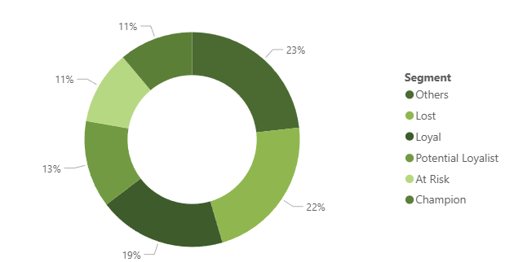
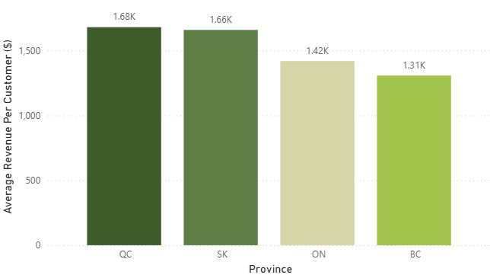
Customer Segmentation and Provincial Performance Analysis
INSIGHTS:
23% of customers fall into the "Others" category—indicating inconsistent or low-value behavior.
A significant 22% are classified as "Lost", suggesting customer churn or inactivity.
19% are "Loyal", followed by 13% "Potential Loyalists", and only 11% are "Champions". Combined, only 30% of the customer base exhibits high-value or frequent behavior.
RECOMMENDATIONS:
Retention Focus: Target the "Lost" and "At Risk" segments with win-back campaigns, OR discounts.
Nurture Growth: Develop loyalty programs or exclusive offers to convert "Potential Loyalists" into "Champions".
Upsell to Loyalists: Use cross-selling and premium offerings to increase the monetary value from the "Loyal" segment.
RFMD (Recency, Frequency, Monitoring and Diversity) Analysis for Customer Segments
Figure 3: Segmentation of Customers Based on RFMD (%)
INSIGHTS:
QC has the highest average revenue per customer at $1.68K , closely followed by SK at $1.66K.ON sits at $1.42K, while BC has the lowest at $1.31K despite leading in unit revenue per product.
This indicates that customers in QC and SK purchase more frequently or in larger baskets, contributing to higher revenue per customer.
RECOMMENDATIONS:
BC: Explore customer engagement strategies such as loyalty programs or cross-selling to boost average customer spend
ON: Consider targeted campaigns or product bundling to increase basket size.
QC & SK: Identify best-performing customer segments and replicate success in lower-performing provinces.
Provincial Performance Analysis
Figure 4: Average Revenue Per Customer by Province

