Slide 1
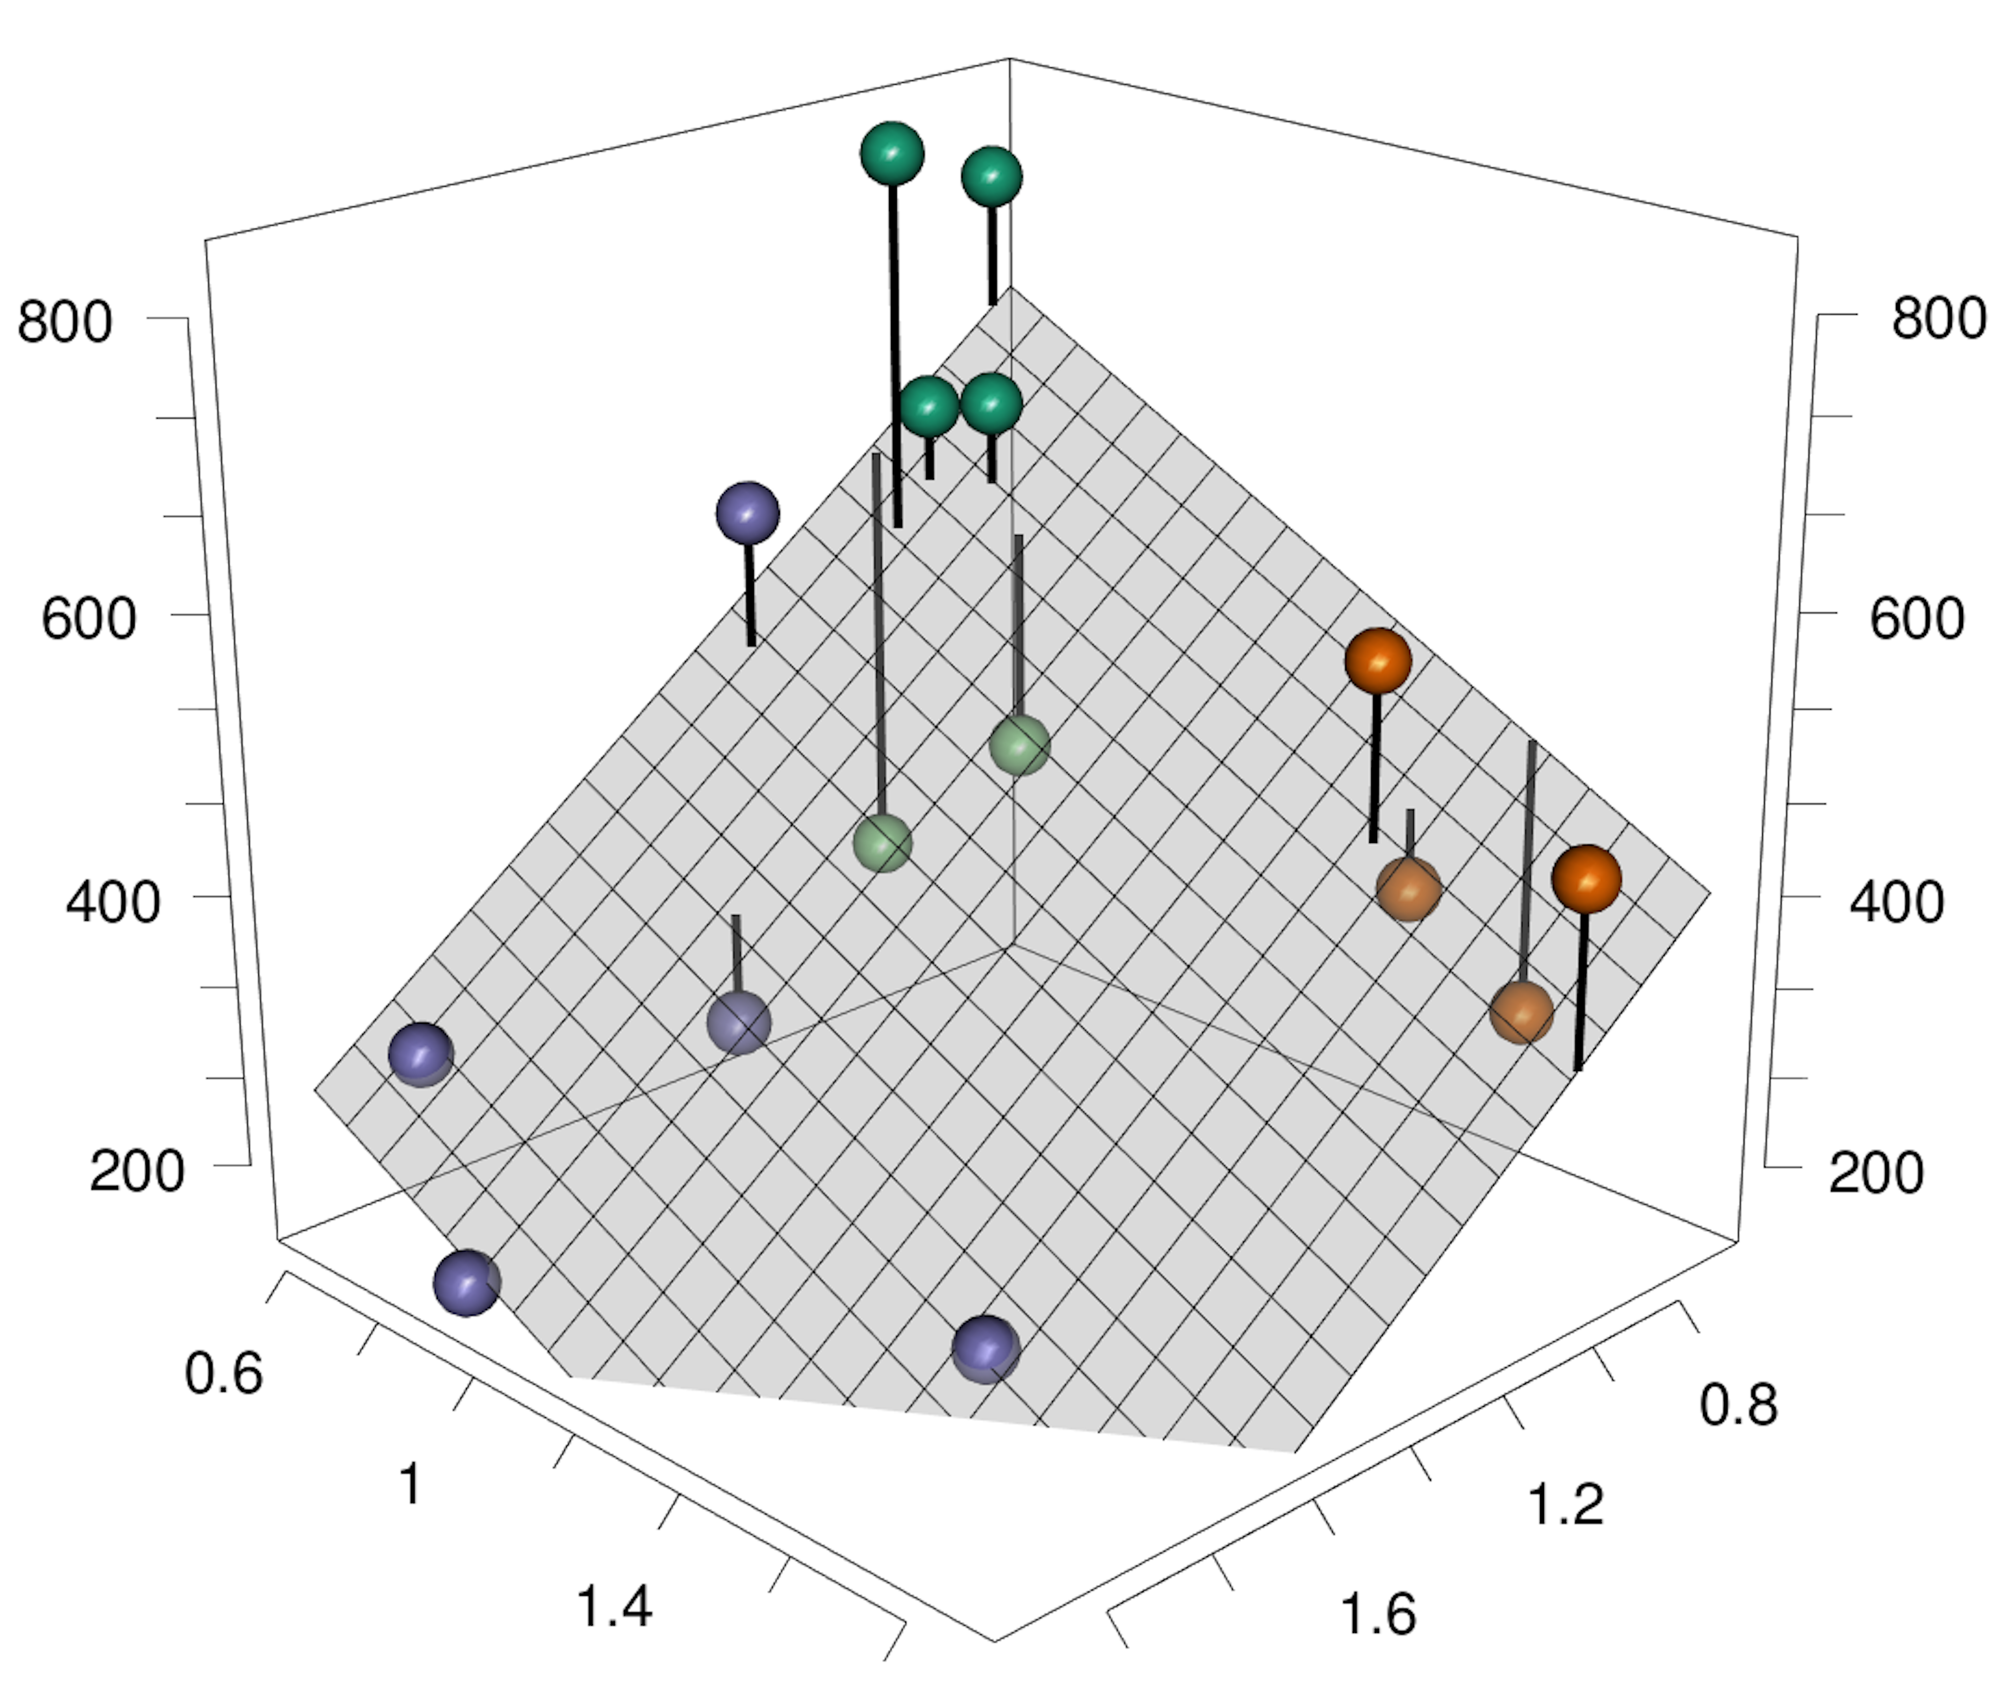
Root Biomass (g m⁻²)
C4 Grass
C3 Grass
Plant K (%)
Legume
Forb
Plant N (%)

