Slide 1


Gender Recognition by Voice
Group 21
Nguyen Anh Thu
Dinh Lam Kieu Phuong
Nguyen Thi Kim Phuong
Nguyen Nguyen Hoang Thi

Slide 2

Motivation
Initial motivation:
Some people are misrecognized as other gender because of their voice.
Support choosing appropriate honorifics (Mr/Mrs/etc)
Enhance security system (combining with facial/iris/finger print recognition)

Slide 3
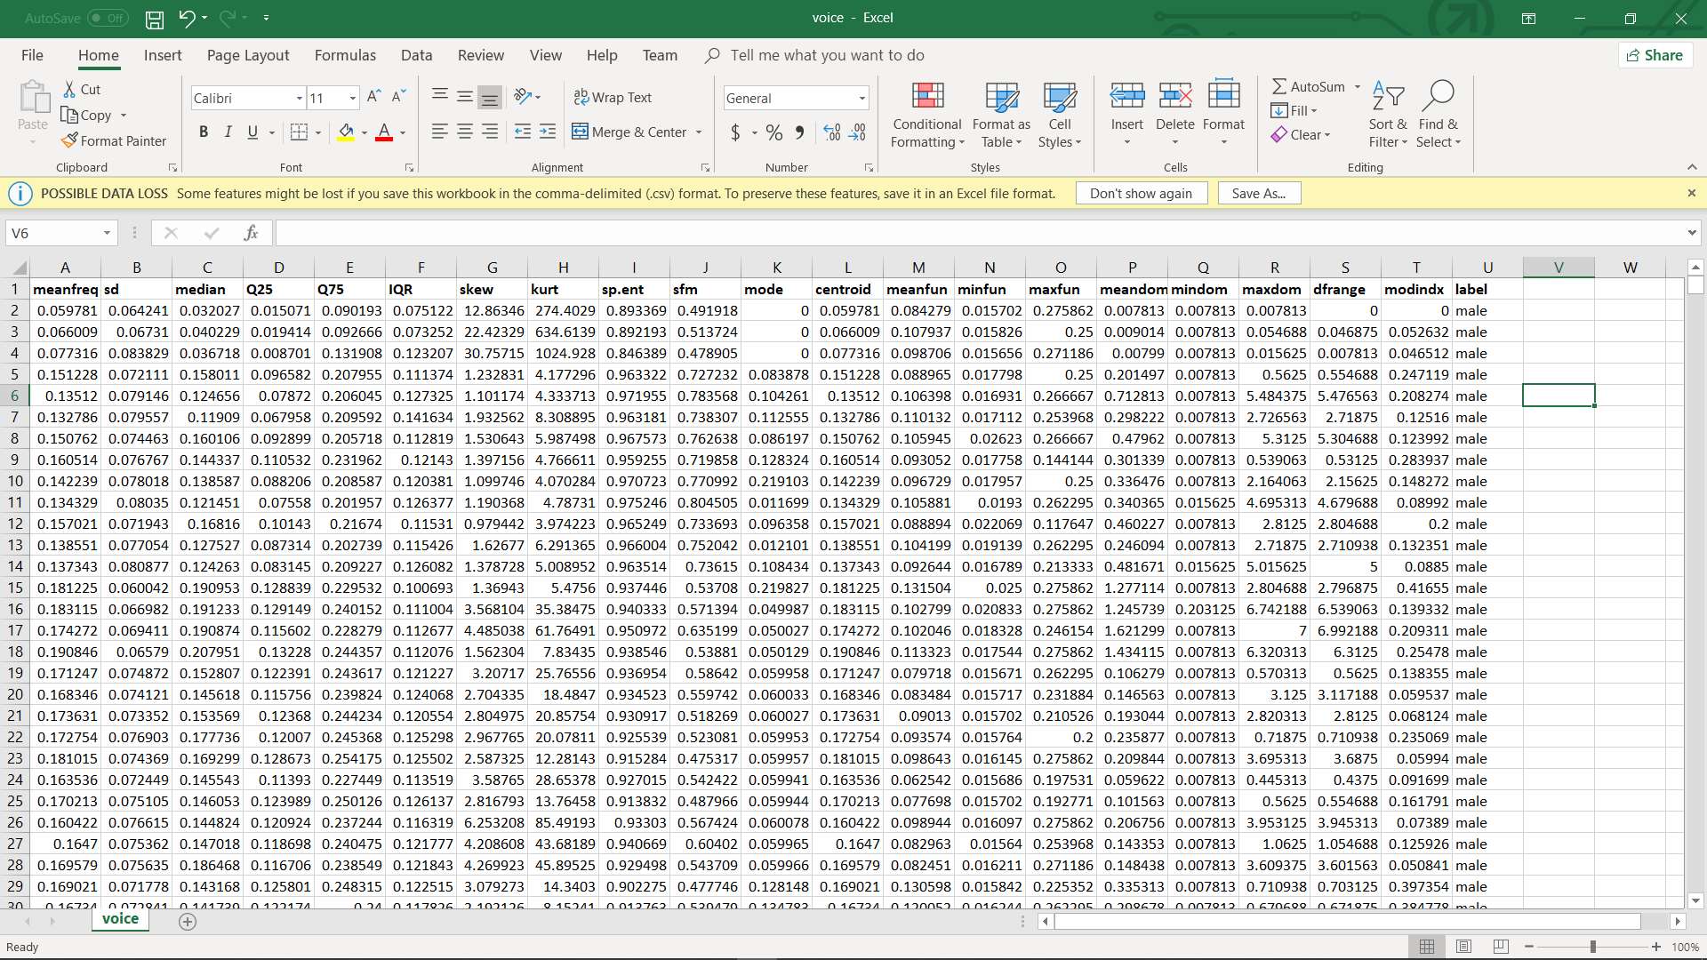
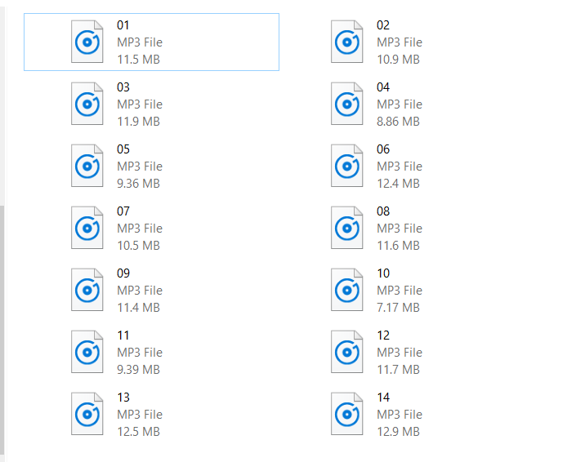
Motivation
Exploit meaningful information from raw voice data.
Knowledge about acoustic characteristics is helpful to process and store data information.
1.041KB
152.08MB
= 155729.92KB

Slide 4
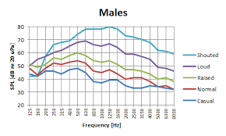
Objectives
Use acoustic characteristics (mean frequency & skewness etc) to determine the gender of a voice.

Slide 5
Objectives
Compare two Classifications
Decision Tree
Gradient Boosting

Slide 6
Dataset
Gender Recognition by Voice
Creator: Kory Becker
Identify a voice as male or female, based upon acoustic properties of the voice and speech
Consists 3,168 recoded voice samples (speech signal format)
Analyzed range of 0Hz – 280Hz (human vocal range)

Slide 7
Dataset
Acoustic properties of each voice are measured in CSV file:
meanfreq: mean frequency (in kHz)
sd: standard deviation of frequency
median: median frequency (in kHz)
etc

Slide 8
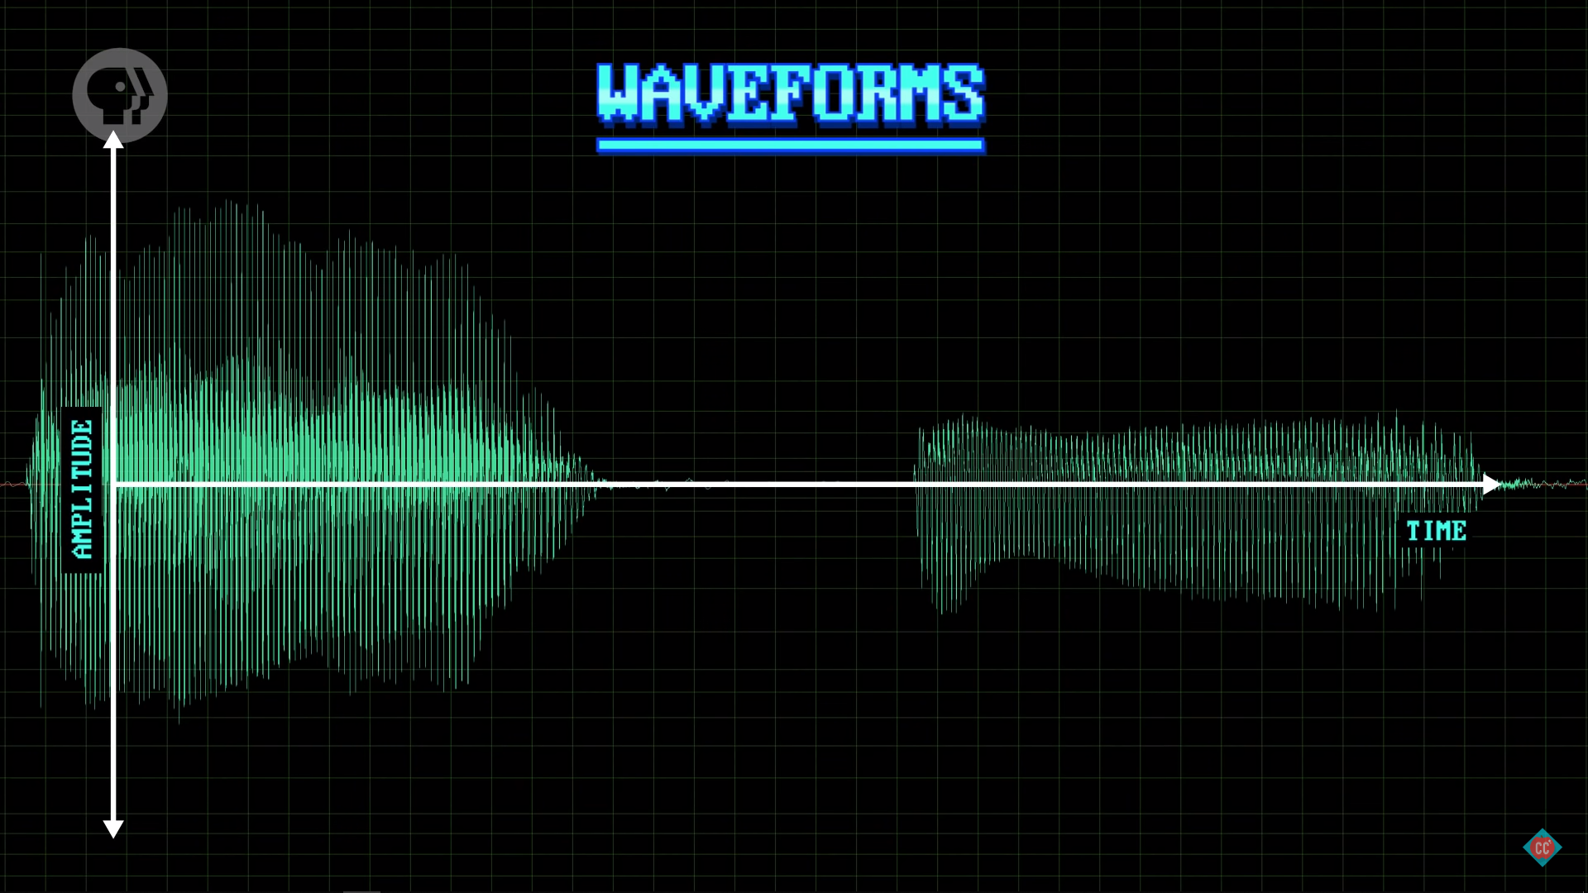
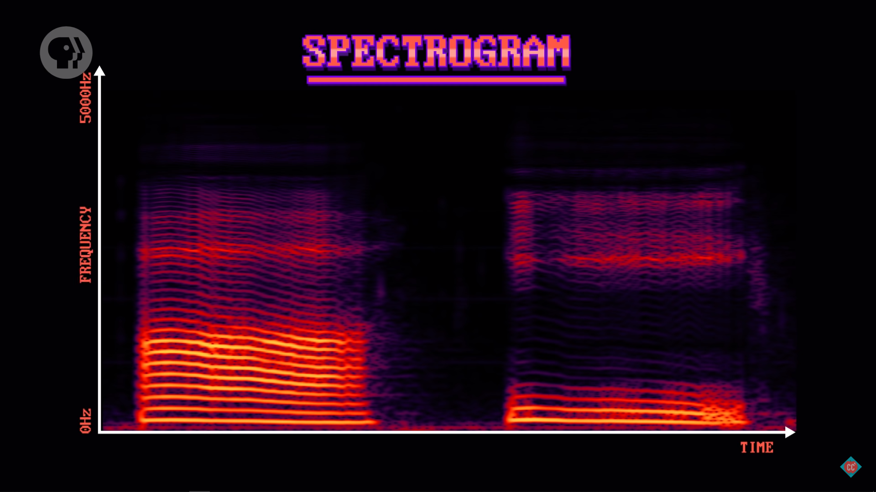
Method
Step 1: Transform to speech signal
Step 2: Training phase (8-2) cross validation (Linear Regression)
Step 3: Testing phase

Slide 9
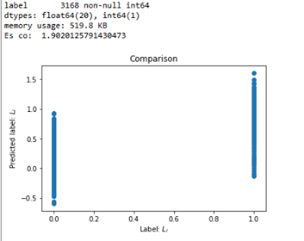
Initial Result

Slide 10
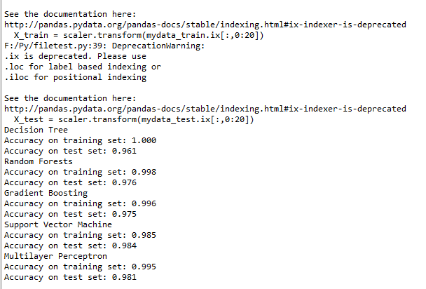
Other Method

Slide 11
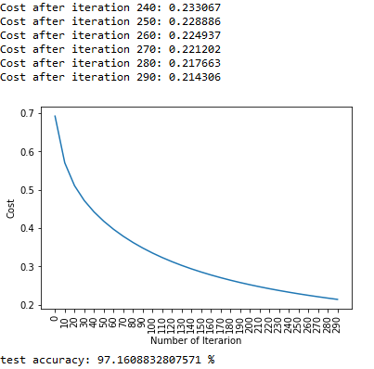
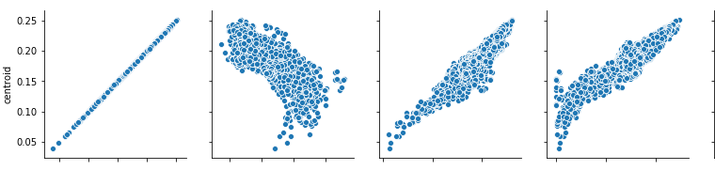
Next step

Slide 12
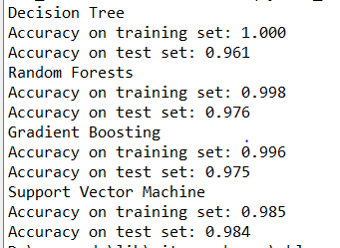
Next Step
Confusion matrix – Evaluate accuracy
Compare two ways of splitting data (train/test): (80/20) and (70/30)
Cross Validation to check overlifting and selection bias (trained set is not randomized)

Slide 13
Next Step
THANK YOU FOR LISTENING!

Slide 14
Motivation
Gender Recognition is a key part of identification.
The result of Gender Recognition can be used in many other fields (Gender Studies, etc).
Knowledge about acoustic characteristics is helpful to process and store data information.

Slide 15

Motivation
The result of Gender Recognition can be used in many other fields (Gender Studies, etc).

Slide 16
Objectives
Use acoustic characteristics (mean frequency & skewness etc) to determine the gender of a person.
Compare different Classification (Random Forest, Neural Network Model).
Feeling prediction (speaker is happy/sad/surprised/etc).

Slide 17

Objectives
Feeling prediction (speaker is happy/sad/surprised/etc).

