Slide 1
Image to recipe
Group 10
Nguyen Phuc Minh 1751081
Nguyen Quoc Binh 1751051
Le Quoc Huy 1751072
Phan Dang Khoa 1751124
1

Slide 2
CONTENT
Motivation
Objective
Dataset
Method
Initial Result
Open problem
Q&A
2

Slide 3
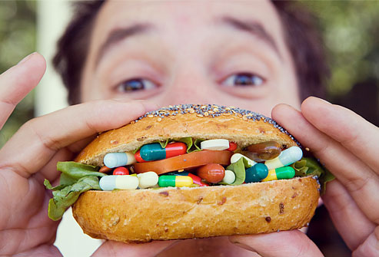
Motivation
Food is intricately linked to our health, our feelings and our culture.
Food also offers new perspectives on topical challenges in computer vision (eg.finding representations that are robust to occlusion and deformation)
3
Notes:
There are few things so fundamental to the human experience as food. Its consumption is intricately linked to our health, our feelings and our culture.
Food also offers new perspectives on topical challenges in computer vision like finding representations that are robust to occlusion and deformation (as occur during ingredient processing).

Slide 4
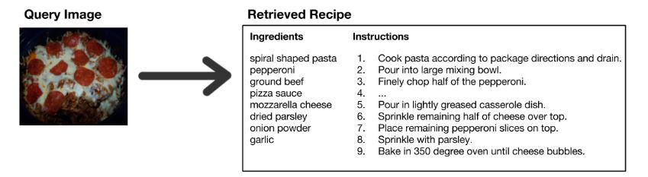
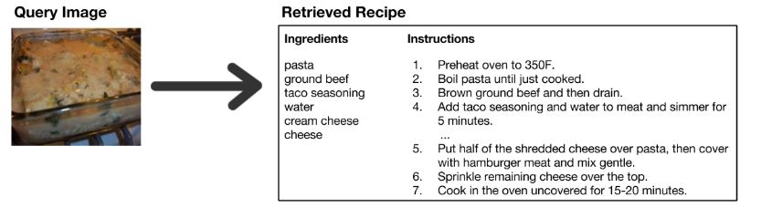
Objective
4
Notes:
Given a food image to retrieve its recipe from a collection of test recipes.

Slide 5
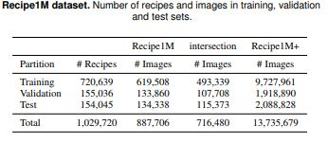
Dataset : Recipe1M
Collection from Recipe Website
Data Extension using Image Search Engine (ISE)
Dataset
5
Notes:
Although the aforementioned datasets constitute a large step towards learning richer recipe representations, they are still limited in either generality or size. As the ability to learn effective representations is largely a function of the quantity (especially when learning features using deep architectures) and quality of the available data, we create and release publicly a new, large-scale corpus of structured recipe data that includes over 1M recipes and 13M images.

Slide 6
Collection from RecWebsite
Scrap the recipes from over 2 dozen popular cooking websites:
Exact relevant text from the raw HTML
Download linked images
Assemble the data to compact JSON schema
Remove duplicates and near-matches (roughly 2% of the original data)
➔ the retained dataset contained over 1M cooking recipes and 800K food images
Conclusion:
The resulting dataset is larger than any other dataset in this particular domain
The total number of images is not the same scale as the largest publicly available datasets such as ImageNet and Places
➔ Aim to extend the initial collection of images by querying for food images through an image search engine.
Dataset
6
Notes:
(remove excessive whitespace, HTML entities, non-ASCII characters)

Slide 7
Data Extension through ISE
Data download:
Collecting 50M image (50 images per recipe) use title of recipe as queries on Google. Store image URL locally. Download images use Aria2
Data consolidation:
Using a pre-trained ResNet18 as a feature extractor and computed pairwise euclidean distances between the collected images to remove duplicates.
Dataset
7
Notes:
Collecting 50M image (50 images per recipe) use title of recipe as queries on Google. Store image URL locally. Download images use Aria2 (a lightweight multi-protocol & multi-source command-line download utility)
Data consolidation:
Tính toán khoảng cách cặp euclide giữa các hình ảnh thu thập được. Trong quá trình xóa này, chúng tôi đã kết hợp bộ hình ảnh ban đầu được thu thập từ các trang web công thức và những hình ảnh được thu thập thông qua tìm kiếm hình ảnh của Google.
Để loại bỏ gần trùng lặp, chúng tôi đã chọn ngưỡng khoảng cách khắc nghiệt giữa các hình ảnh. chúng tôi đã chạy một máy dò tìm khuôn mặt qua các hình ảnh và loại bỏ những người có khuôn mặt với độ tin cậy cao.

Slide 8
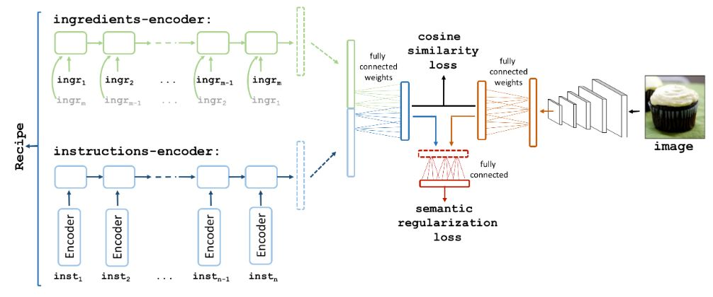
Method
Method
8
Notes:
So sánh 2 vector đặc trực được rút trích từ image và Recipe
Sau đó điều chỉnh và chọn Recipe gần nhất
H1 vs h2 là vector
(h is for compute the cosine similarity loss which will rate how fit is our Recipe and image. )
The outputs of both encoders are concatenated and embedded into a recipe-image joint space.
The goal is to learn transformations to make the embeddings for a given recipe-image pair “close.”
Semantic Regularization
The key idea is that if high-level discriminative weights are shared, then both of the modalities (recipe and image embeddings)
utilize these weights in a similar way which brings another level of alignment based on discrimination.
We optimize this objective together with our joint embedding loss. Essentially the model also learns to classify any image or recipe embedding into one of the food-related semantic categories.

Slide 9

Cosine similarity loss
With :
A is recipe vector
B is image vector
Method
9
Notes:
dùng cái này để train, và khi test thì sẽ encode ảnh, sau đó dùng độ đo này để tìm bộ công thức và ingredients phù hợp nhất

Slide 10
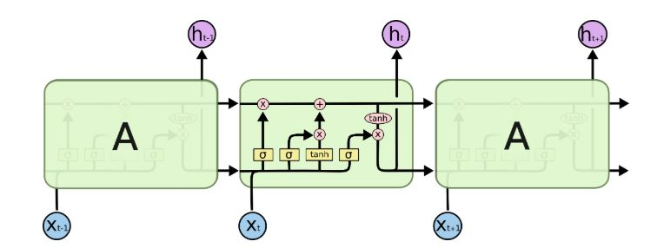
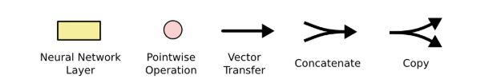
LSTM : Long Short Term Memory networks
Method
11
Notes:
All RNNs have feedback loops in the recurrent layer.
Instead of having a single neural network layer, there are four, interacting in a very special way.
This lets them maintain information in 'memory' over time. But, it can be difficult to train standard RNNs to solve problems that require learning long-term temporal dependencies. This is because the gradient of the loss function decays exponentially with time (called the vanishing gradient problem). LSTM networks are a type of RNN that uses special units in addition to standard units. LSTM units include a 'memory cell' that can maintain information in memory for long periods of time. A set of gates is used to control when information enters the memory, when it's output, and when it's forgotten. This architecture lets them learn longer-term dependencies.

Slide 11
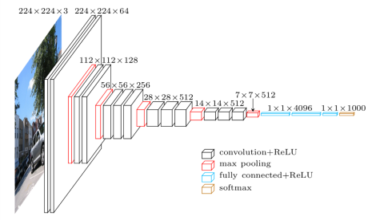
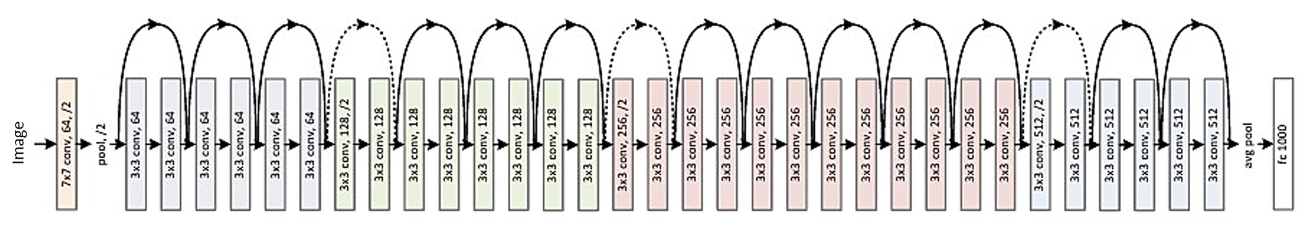
Method: image encoder
VGG16 and Resnet50 models
incorporating by removing the last softmax classification layer and connecting the rest to our joint embedding model.
Method
10
Notes:
What are the VGG cons?
It has so many weight parameters, the models are very heavy, 550 MB + of weight size.
Which also means long inference time
Resnets take lesser memory, faster inference time, and allows deeper networks to be trained. Based on your problem, you can decide how many layers you want for the required accuracy and inference time requirements. Its rather simple to understand too.

Slide 12
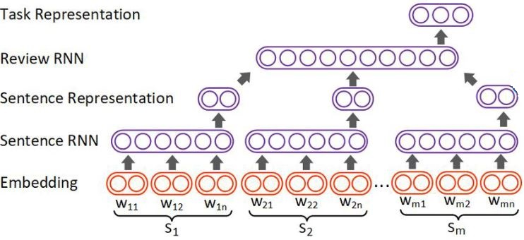
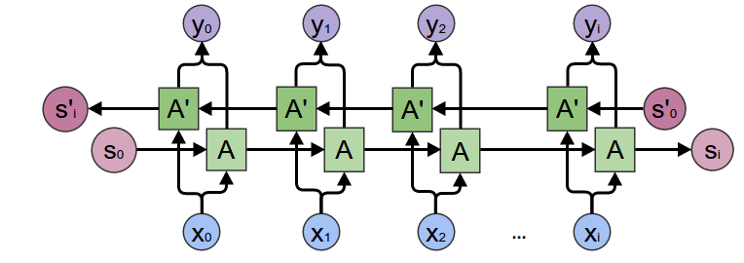
Recipe encoder: ingredients encoder
Hierarchical RNN model architecture
Method
12
Notes:
The ingredients encoder combines the sequence of ingredient word vectors.
Since the ingredient list is an unordered set, we choose to utilize a bidirectional(2 ways) LSTM model, which considers both forward and backward orderings: at each time step it takes two ingredient-word2vec(two-layer neural networks that are trained to reconstruct linguistic contexts of words)
Using bidirectional will run your inputs in two ways, one from past to future and one from future to past and what differs this approach from unidirectional is that in the LSTM that runs backwards you preserve information from the future and using the two hidden states combined you are able in any point in time to preserve information from both past and future.
What they are suited for is a very complicated question but BiLSTMs show very good results as they can understand context better, I will try to explain through an example.

Slide 13
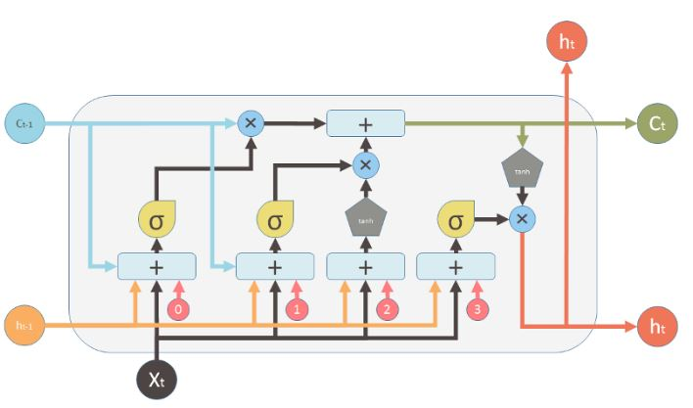
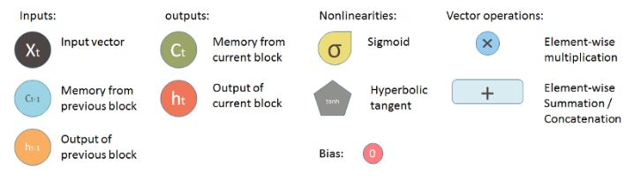
Recipe encoder: instructions encoder
Skip-instructions vector
Method
Notes:
The instructions encoder is implemented as a forward LSTM model over skip-instructions vectors(a technique which predict next recipe instruction). At each time step it receives an instruction representation from the skip-instructions encoder, and finally it produces the fixed-length representation

Slide 14
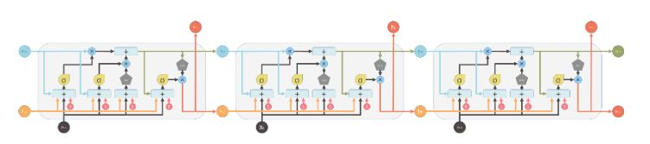
Recipe encoder: instructions encoder
forward LSTM model over skip-instructions vectors
Method
14

Slide 15
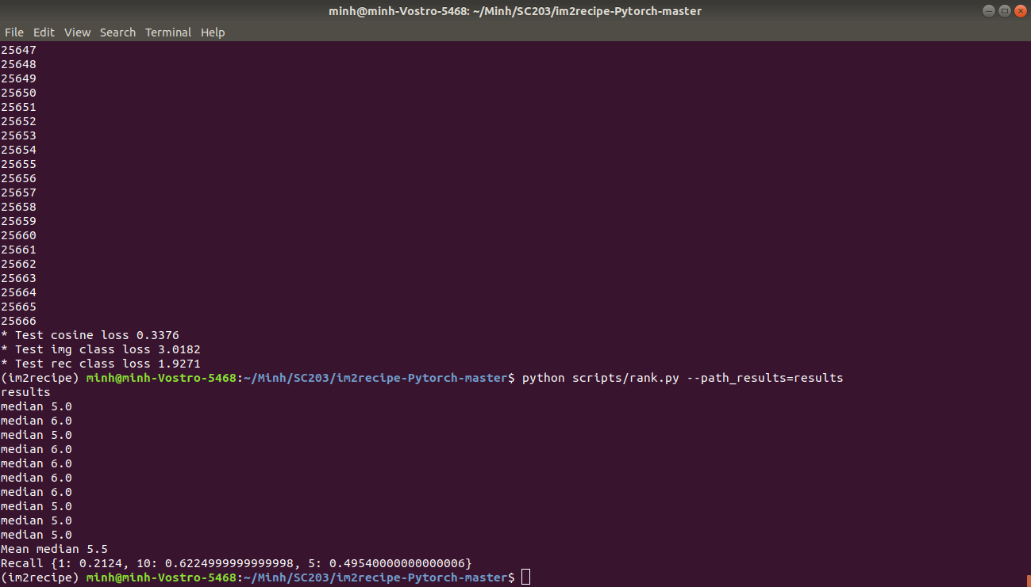
Result
Cosine loss | 0.3376
Mean median | 5.5
R@1 | 0.24
R@5 | 0.49
R@10 | 0.62
Computer configures: Core I7-7200U,GTX 940MX – 2GB GPU,RAM 8GB
Result
15
Notes:
Cosine similarity in the common space for ranking the relevant recipes and perform im2recipe retrieval.
The median rank function is used to estimate the cumulative probability of failure of the of identically stressed samples
( Tính độ mất mát của số thứ I trong hàm lũy thừa). => càng nhỏ càng tốt.
Reporting results on a subset of randomly selected 1,000 recipeimage pairs from the test set. We repeat the experiments 10 times and report the mean results. We report median rank (MedR) which lower is better.
To clarify, R@5 in the im2recipe task represents the percentage of all the image queries where the corresponding recipe is retrieved in the top 5, hence higher is better

Slide 16
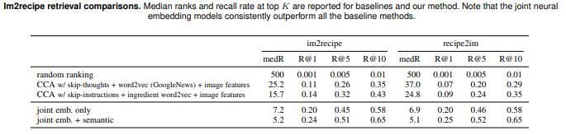
Result : Comparision
Cosine loss | 0.3376
Mean median | 5.5
R@1 | 0.24
R@5 | 0.49
R@10 | 0.62
This models are trained on 4 NVIDIA GTX 1080 with 8GB of memory for two and a half days
Result
16

Slide 17
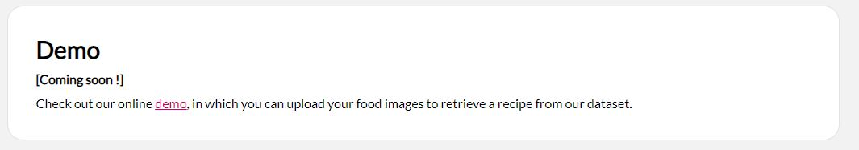
Open problem
How can we demo from this pretrained model
17

Slide 18

18

